Slide 1
E-commerce and retail analytics using machine learning techniques
A8
Akshay s - AM.SC.U4CSE23009
Goutham Krishna - Am.sc.u4cse23031
Pranav s - Am.sc.u4cse23067
Rahul rajan Sebastian - Am.sc.u4cse23069

Slide 2
1. Introduction
Problem Statement: Businesses struggle to utilize complex e-commerce data for decision-making; this project solves this by evaluating machine learning techniques. The challenge is to predict customer behavior (like churn and spending), segment customers effectively, and identify key drivers of engagement using diverse datasets.
Motivation : In the competitive retail landscape, gaining a deep understanding of customer patterns through advanced analytics is crucial for enabling businesses to improve retention strategies and drive sustainable revenue growth.
Objective : Our core objective is to implement and rigorously evaluate a range of machine learning algorithms across four different e-commerce datasets, to compare and contrast results.
Type of ML task : Covers Classification, Regression, Clustering, and Dimensionality reduction.

Slide 3
2. Dataset 1 – Description
Source : Kaggle (https://www.kaggle.com/datasets/uom190346a/e-commerce-customer-behavior-dataset)
Number of (samples : 3941, features : 11 )
Feature descriptions : An individual customer profile, detailing their account history, satisfaction metrics, and whether they have discontinued the service.
Preprocessing steps : numerical {imputation-median, standard scaler}; categorical {imputation-most frequent, one hot encoding}
Train–test split details : 80:20 train test split, random state 42

Slide 4
3. Models Used for Dataset 1
List of Models Applied
K-Nearest Neighbors (KNN)
Logistic Regression
Naive Bayes (GaussianNB)
Reason for Choosing Each Model
KNN: Selected as a simple, non-parametric baseline model.
Logistic Regression: Chosen as a robust linear baseline that offers interpretable coefficients.
Naive Bayes: Used as a probabilistic baseline effectively assuming feature independence.
Hyperparameters
KNN: n_neighbors=5 (Default).
Logistic Regression: max_iter=1000 (to ensure convergence), random_state=42.
Naive Bayes: Default parameters.
Frameworks Used
Python, scikit-learn, pandas, numpy, matplotlib, seaborn

Slide 5
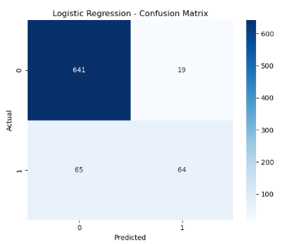
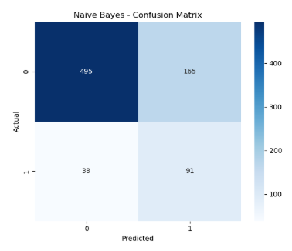
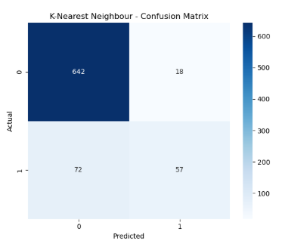
4. Result Analysis – Dataset 1

Slide 6
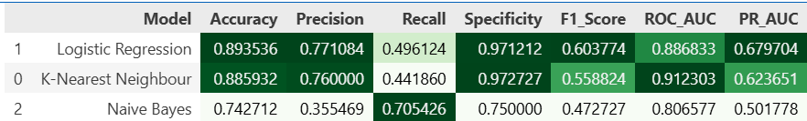
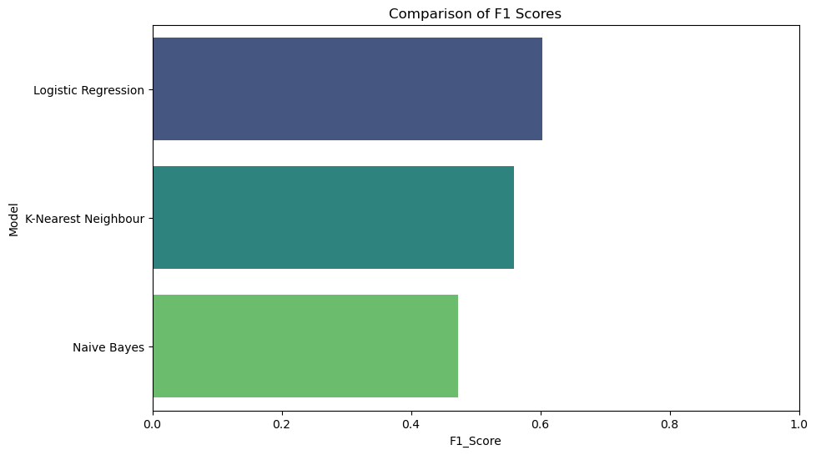
5. Interpretation of Results

Slide 7
6. Dataset 2 – Description
Source : Kaggle (https://www.kaggle.com/datasets/uom190346a/e-commerce-customer-behavior-dataset)
Number of samples (350) ; features (11)
Feature descriptions : A specific consumer, capturing their demographic details, membership status, and overall spending habits.
Preprocessing steps : encoding (binary, ordinal), imputation (median), standard scaler
Train–test split details : 80:20 train test split, random state 42

Slide 8
7. Models Used for Dataset 2
List of models applied
Linear Regression
Ridge Regression
Lasso Regression
Decision Tree Regressor
Reason for choosing each model
Linear Regression as a baseline, Ridge to handle multicollinearity and overfitting, Lasso for feature selection, Decision Tree to capture non-linear relationships
Hyperparameters
Ridge (alpha=1.0), Lasso (alpha=0.1), Decision Tree (max_depth=5, random_state=42), Train-Test Split (test_size=0.2, random_state=42)
Frameworks used
Python, scikit-learn, pandas, numpy, matplotlib, seaborn, scipy

Slide 9
8. Result Analysis – Dataset 2 (if classification)
Confusion Matrix
Accuracy, Precision, Recall, Specificity, F1
ROC-AUC, PR-AUC
ROC, PR Curves

Slide 10
9. Interpretation of Results

Slide 11

10. Dataset 3 – Description
Source : UCI (https://archive.ics.uci.edu/dataset/292/wholesale+customers)
Number of samples and features
Feature descriptions : A business client (such as a restaurant or retailer), characterized by their annual spending across different product categories like fresh food, milk, and grocery.
Preprocessing steps : scaling (standard scaler)
Train–test split details : None (not applicable)

Slide 12
11. Models Used for Dataset 3
List of models applied
K-Means
Agglomerate
DBSCAN
Reason for choosing each model
K-Means: Good for creating spherical, distinct clusters.
Hierarchical: For visualizing relationships, helps determine optimal cluster count.
DBSCAN: Good for arbitrary shapes and outlier detection.
Hyperparameters
K-Means: n_clusters=3, init='k-means++', n_init=10, random_state=42
Hierarchical: Default
DBSCAN: Default
Frameworks used
Python, scikit-learn, pandas, numpy, matplotlib, seaborn, scipy

Slide 13
12. Result Analysis – Dataset 3 (if classification)
Confusion Matrix
Accuracy, Precision, Recall, Specificity, F1
ROC-AUC, PR-AUC
ROC, PR Curves

Slide 14
13. Interpretation of Results

Slide 15
14. Dataset 4 – Description
Source : UCI (https://archive.ics.uci.edu/dataset/468/online+shoppers+purchasing+intention+dataset)
Number of samples and features ; Feature descriptions
Feature descriptions : A single user session on the website, tracking navigation patterns, page views, and whether the visit resulted in a transaction.
Preprocessing steps : data cleaning{removed duplicates}, encoding {label encoder}, normalization {standard scaler}
Train–test split details : 70:30 train test split, random state 42

Slide 16
15. Models Used for Dataset 4
List of Models Applied:
Principal Component Analysis (PCA)
Linear Discriminant Analysis (LDA)
Logistic Regression (wrapped in Sequential Feature Selection)
Reason for Choosing Each Model:
PCA: Unsupervised reduction to minimize features while retaining 95% of data variance.
LDA: Supervised reduction to project data onto a lower-dimensional space that maximizes class separation.
Logistic Regression: Robust baseline classifier used to evaluate and select the most significant features.
Hyperparameters:
PCA: n_components=2 (for 2D visualization).
LDA: n_components=1 (optimal for binary classification).
Logistic Regression: max_iter=1000, random_state=42.
Feature Selection: n_features_to_select=5, direction='forward'.
Frameworks used:
Python, scikit-learn, pandas, matplotlib

Slide 17
16. Result Analysis – Dataset 4 (if classification)
Confusion Matrix
Accuracy, Precision, Recall, Specificity, F1
ROC-AUC, PR-AUC
ROC, PR Curves

Slide 18
17. Interpretation of Results

Slide 19
18. Final Comparative Summary
Comparison of models
Best-performing model
Insights gained
Future improvements

