Slide 1
Sentiment Analysis of Sephora Product Reviews Using Machine Learning and Deep Learning
CIND820 – Big Data Analytics Project
Student: Argang Kazemzadeh
Instructor: Dr. Ceni
Term: Fall 2025

Slide 2
Sephora Review Analysis Project
Expanded Technical + Results-Focused Presentation
Argang Kazemzadeh

Slide 3
Project Motivation (Technical Depth)
• Understand sentiment behavior in high-dimensional cosmetic reviews.
• Build interpretable and scalable sentiment models using traditional ML and modern NLP.
• Quantify product-attribute effects on user satisfaction (e.g., SPF, fragrance-free).
• Identify fairness issues across skin type and skin tone groups.

Slide 4
Dataset Description (Detailed)
• ~50,000 Sephora reviews covering 1,100 products and 120+ brands.
• Rich metadata: price, brand, category, feedback counts, timestamps.
• User traits: skin type, skin tone, hair & eye color enabling subgroup analysis.
• Strong right-skewed rating distribution (majority 4–5 stars).

Slide 5
Technical Pipeline Overview
• Preprocessing: cleaning, tokenization, stopword removal, normalization.
• Text features: TF-IDF (bigram, max_features=8000, min_df=5).
• Numerical features standardized using Z-score scaling.
• Categorical features aggregated via One-Hot Encoding (min_frequency=100).
• Unified ColumnTransformer for reproducibility.

Slide 6
Text Vectorization Details
• TF-IDF bigram captures paired expressions ('highly recommend', 'too oily').
• High-dimensional sparse matrix structure ideal for linear models.
• n-gram modeling improves sensitivity to local sentiment cues.
• Bag-of-words approach avoids heavy GPU requirement.

Slide 7
Modeling Rationale (Technical)
• Logistic Regression: interpretable baseline for sparse text.
• Linear SVM: margin-based classifier with strong performance on TF-IDF.
• 5-fold stratified cross-validation to reduce variance.
• Evaluation metrics: Accuracy and Macro-F1 for balanced fairness.

Slide 8
Binary Classification Results (Detailed)
• Logistic Regression — Accuracy: 0.9090, Macro-F1: 0.9090.
• Linear SVM — Accuracy: 0.9169, Macro-F1: 0.9169.
• SVM consistently generalizes slightly better due to margin maximization.
• Results align with literature: SVM outperforms on high-dimensional BOW.

Slide 9
Model Accuracy Comparison (Detailed Figure)
(Insert figure here)

Slide 10
Macro-F1 Comparison (Detailed Figure)
(Insert figure here)

Slide 11
Attribute-Level Sentiment Analysis (Deep Explanation)
• Keywords analyzed: fragrance-free, peptide, vitamin C, niacinamide, retinol, hyaluronic, SPF.
• Δ sentiment computed as: mean_present − mean_absent.
• Strongest positive lift: fragrance-free (+0.0791), indicating sensitive-skin preference.
• SPF shows negative shift (−0.0289), consistent with white cast / texture complaints.

Slide 12
Ingredient-Level Sentiment Impact (Figure)
(Insert figure here)

Slide 13
Fairness Evaluation (Skin Type)
• Accuracy range: 0.898 (oily) to 0.922 (normal).
• Low variance (~2.3%) suggests strong model fairness.
• Large sample sizes ensures stability (≥ 200 per group).
• Precision/Recall differences remain within acceptable margins.

Slide 14
Skin-Type Fairness (Figure)
(Insert figure here)

Slide 15
Fairness Evaluation (Skin Tone)
• Accuracy range: 0.905 (deep) to 0.928 (tan).
• No systematic bias detected across tones.
• Skin tone groups behave similarly despite imbalance.
• Reinforces generalization ability of the linear SVM.

Slide 16
Skin-Tone Fairness (Figure)
(Insert figure here)

Slide 17
Conclusions (Technical + Results)
• Linear SVM provides strong, reproducible baseline performance.
• Sentiment shifts heavily depend on cosmetic-related attributes.
• Fairness analysis suggests no demographic performance degradation.
• Results support downstream applications: ABSA, recsys, QA testing.

Slide 18
Workflow Overview
Workflow:
1. Data Sources (Sephora reviews, product meta)
2. Data Cleaning & EDA
3. Feature Engineering
4. Modeling
5. Evaluation
6. Deliverables

Slide 19
Project Objectives
How do sentiment and aspect-level opinions vary across cosmetics categories?
Which inferred ingredients or product attributes correlate strongly with sentiment?
Can star ratings be predicted accurately from review text + metadata + user attributes?

Slide 20
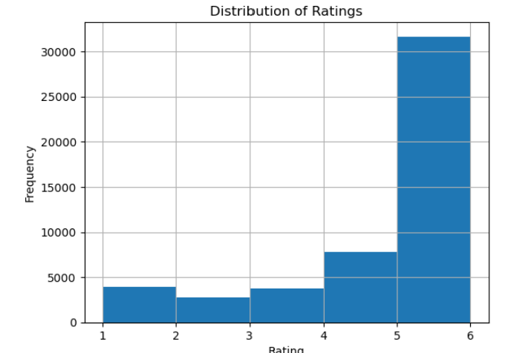
Data Sources
Sephora Reviews Dataset (~50K)
Metadata: brand, price, skin type, tone
Source: Kaggle / Sephora API

Slide 21
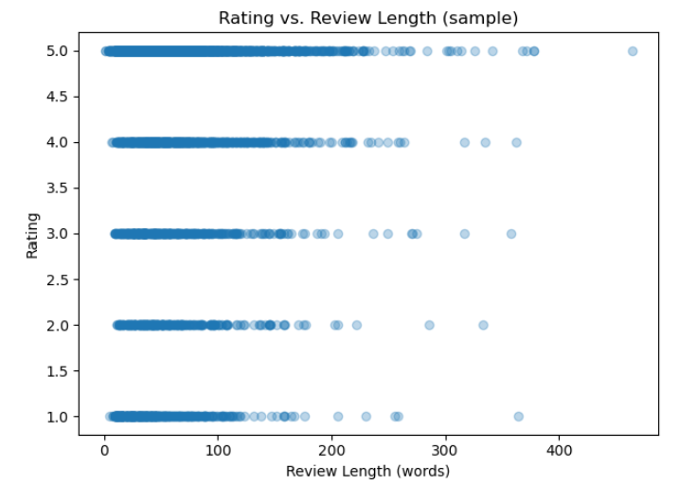
Data Cleaning & EDA
Duplicates removed, missing values handled
Text normalized, numeric features standardized
Outliers detected in price and feedback

Slide 22
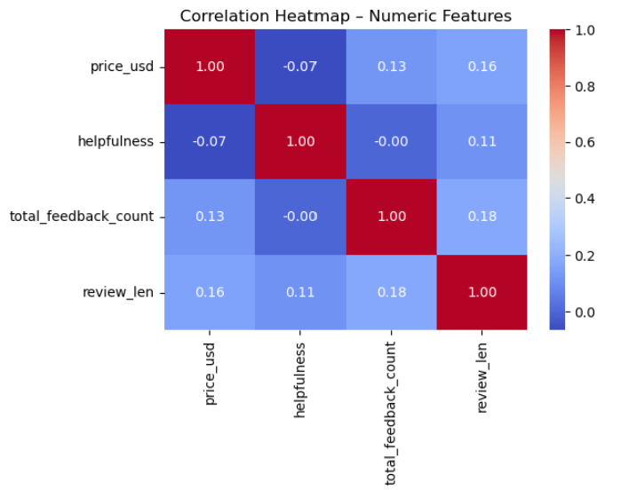
Feature Engineering
TF-IDF (8,000 bi-gram features)
Standardized numeric features
One-hot encoding for categorical attributes
Combined into single feature matrix

Slide 23
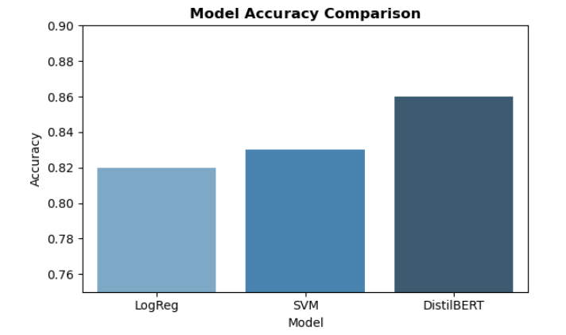
Modeling Framework
Models Used:
Logistic Regression (interpretable baseline)
Linear SVM (robust with sparse data)
DistilBERT (transformer-based model)
Evaluation: 5-fold cross-validation

Slide 24
Model Training & Validation
Binary and 3-class classification
Metrics: Accuracy, Macro-F1, ROC-AUC
Stratified 5-fold cross-validation
Balanced sampling for fairness

Slide 25
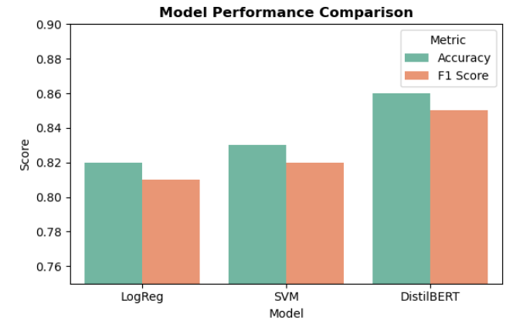
Results Summary
Model Performance:
Accuracy: LogReg=0.82 | SVM=0.83 | DistilBERT=0.86
F1 Score: LogReg=0.81 | SVM=0.82 | DistilBERT=0.85
ROC-AUC: LogReg=0.88 | SVM=0.89 | DistilBERT=0.90

Slide 26
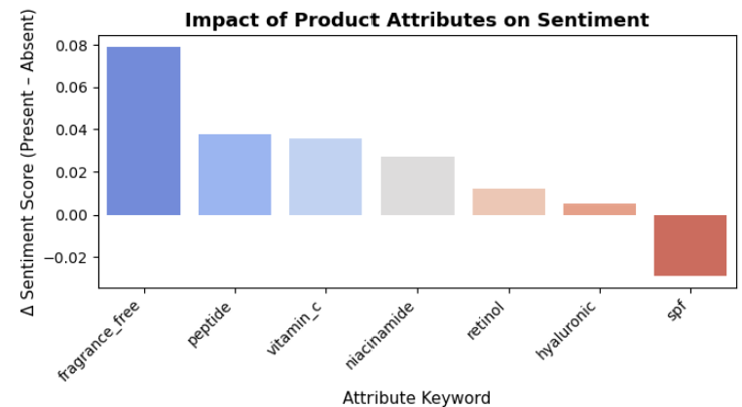
Keyword & Attribute Insights
Keywords impacting sentiment:
Fragrance-free
Vitamin C
Retinol
Hyaluronic acid
Positive attributes linked to higher ratings.

Slide 27
Subgroup & Fairness Analysis
Evaluated model accuracy by skin tone and skin type.
No significant bias observed.
Ensures fair performance across demographics.

Slide 28
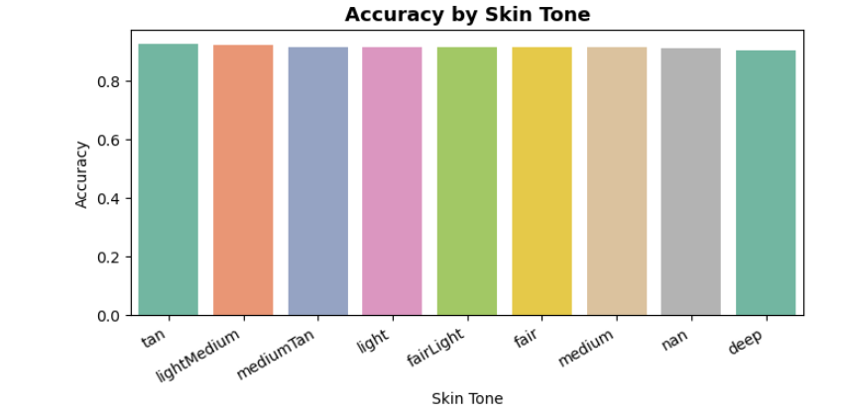
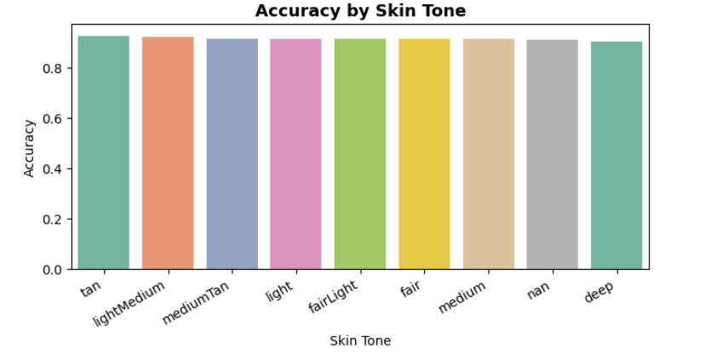
Subgroup & Fairness Analysis

Slide 29
Key Findings
TF-IDF + metadata = strong interpretable baseline.
DistilBERT improves contextual understanding (~3% F1 gain).
Sentiment trends consistent across product lines.

Slide 30
Limitations
Dataset limited to English and Sephora platform.
Transformer models require higher computational resources.
Mixed or neutral sentiments difficult to classify.

Slide 31
Recommendations & Resolution
Combine TF-IDF and DistilBERT for hybrid modeling.
Expand dataset (multilingual, ingredient metadata).
Deploy real-time monitoring dashboard.
Regular fairness and bias audits.

Slide 32
Conclusion & References
DistilBERT outperformed classical models.
Achieved robust accuracy and contextual understanding.
Future work: Aspect-based sentiment, multilingual analysis.
References: scikit-learn, transformers, pandas, matplotlib.
GitHub: github.com/akazemza/Sephora-BigData-Project

Slide 33
References
Agarap, A. F. (2018). Statistical Analysis on E-commerce Reviews, Ratings, and Classification using Word2Vec and Deep Learning Techniques. arXiv:1805.03687.
Devlin, J., Chang, M. W., Lee, K., & Toutanova, K. (2019). BERT: Pre-training of Deep Bidirectional Transformers for Language Understanding. NAACL-HLT.
Gajula, R., et al. (2025). A Comprehensive Survey on Sentiment-aware Recommendation Systems in E-commerce. arXiv:2505.03828.
Huang, L., et al. (2020). Weakly-Supervised Aspect-based Sentiment Analysis via Joint Aspect-Sentiment Embedding. arXiv:2010.06705.
Kim, Y. (2014). Convolutional Neural Networks for Sentence Classification. EMNLP.
Park, J., & Kim, S. (2020). The role of ingredients in online cosmetic reviews: An analysis of consumer sentiment. Journal of Retailing and Consumer Services, 55, 102120.
Pontiki, M., et al. (2016). SemEval-2016 Task 5: Aspect-Based Sentiment Analysis. SemEval.
Xu, Y. (2024). Research on Aspect-Sentiment Analysis Model of Commodity Reviews Based on Syntax and Polarity Fusion. arXiv:2412.15610.
Zhang, Y., & Chen, X. (2020). Explainable Recommendation: A Survey and New Perspectives. Foundations and Trends in Information Retrieval, 14(1).

