Slide 1
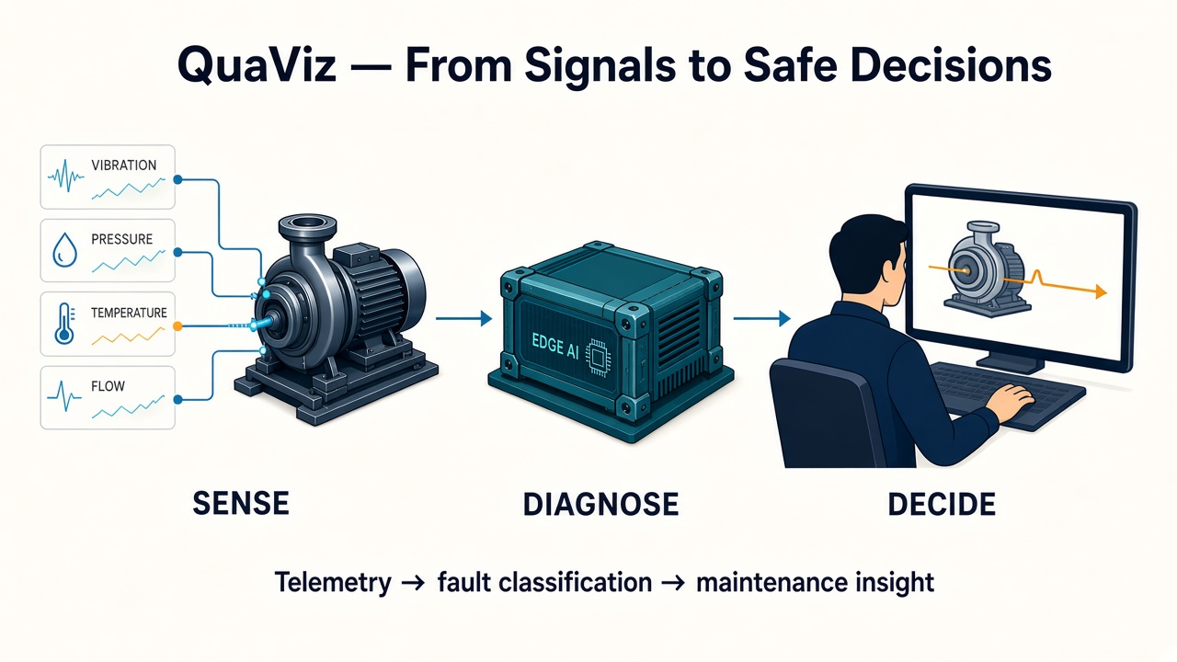
Notes:
Industrial machines already generate valuable data. What they often lack is a way to turn those signals into early warnings and useful maintenance decisions.
Our challenge was to do that for an existing cooling-water pump: detect developing faults, explain the evidence, and recommend what an operator should do next—without controlling the equipment.
We built Retrofit-QuaViz.

Slide 2
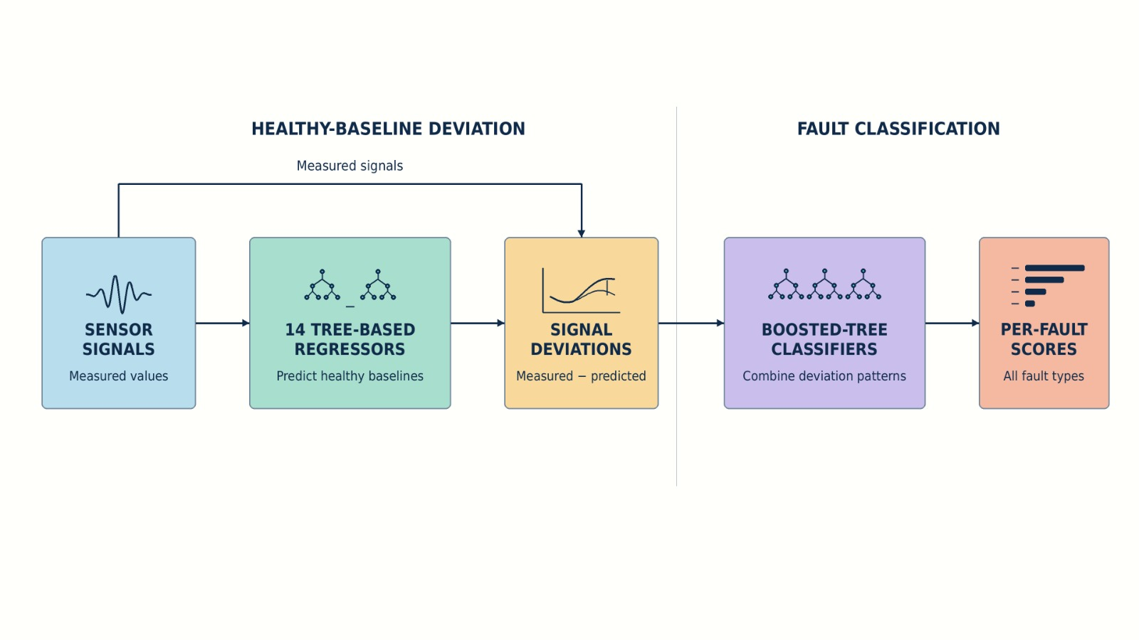
Notes:
The system starts with 14 tree-based regressors that estimate how signals should behave under healthy conditions. We compare those predictions with actual measurements, then pass the deviations to an ensemble of boosted-tree classifiers that score the possible fault types.

Slide 3
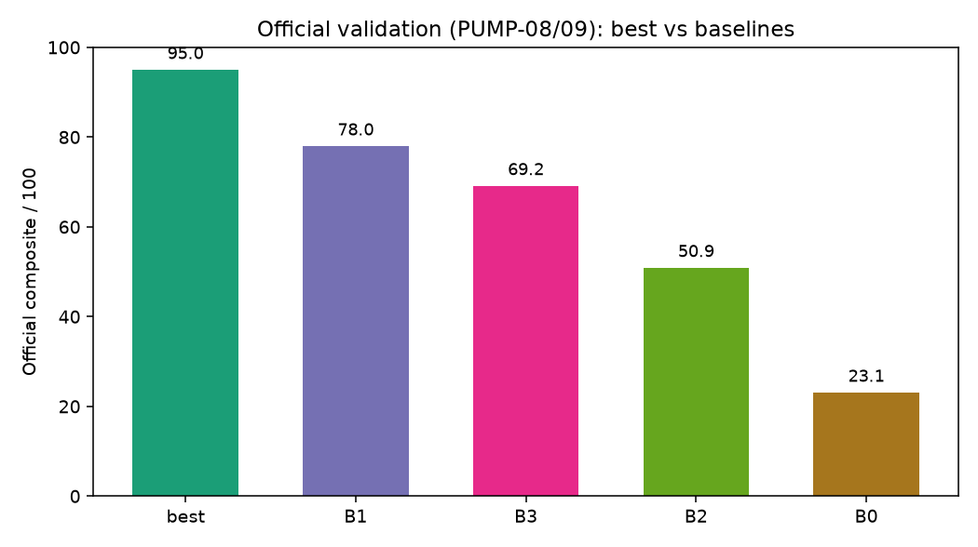
Official Validation Performance
Notes:
In our evaluation, our approach correctly detected three additional fault types that the best provided baseline failed to detect.

Slide 4
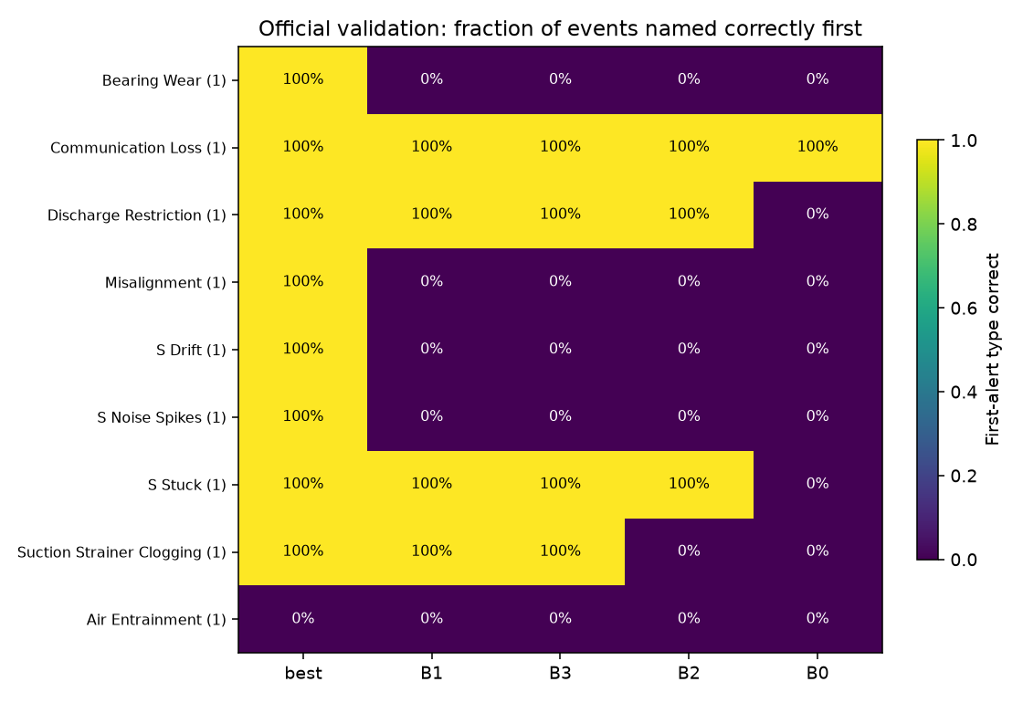
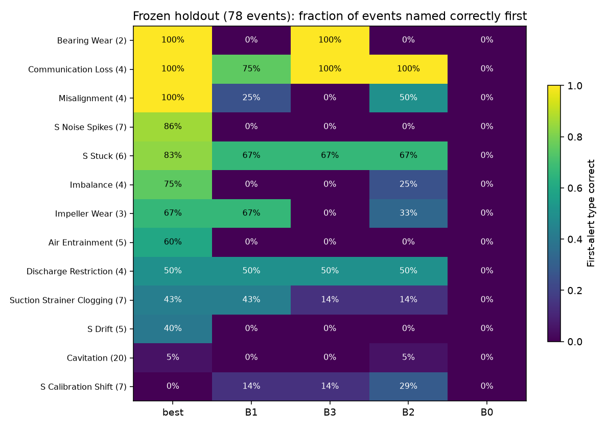
Per-Fault Detection Accuracy
Notes:
QuaViz achieved 100% first-alert detection on Bearing Wear, Misalignment, and Sensor Drift — faults the best baseline missed entirely. Transfer holds across 78 post-freeze holdout events.

Slide 5
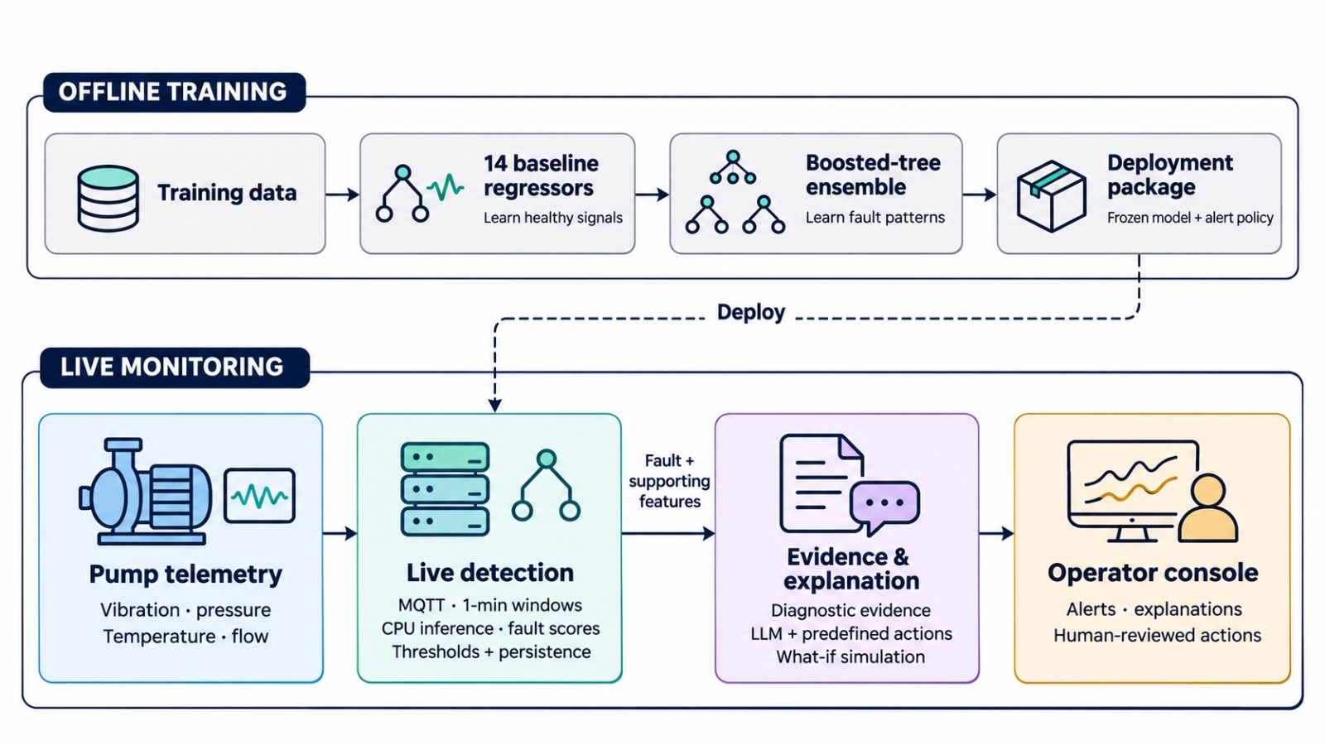
Notes:
We deploy the frozen model on a backend that processes incoming telemetry. Fault-specific thresholds and persistence rules turn continuous scores into actionable alerts while limiting nuisance notifications.
Each alert includes the predicted fault, its confidence score, and the measurements supporting it. An LLM then turns that structured evidence into a concise explanation, drawing recommendations from a predefined action catalog. It cannot change the diagnosis or alert status.
Operators can inspect the evidence, review the recommendation, and use the sandbox to explore the potential effects of an intervention. The decision to act remains with a human; the system sends no commands to plant equipment.

Slide 6
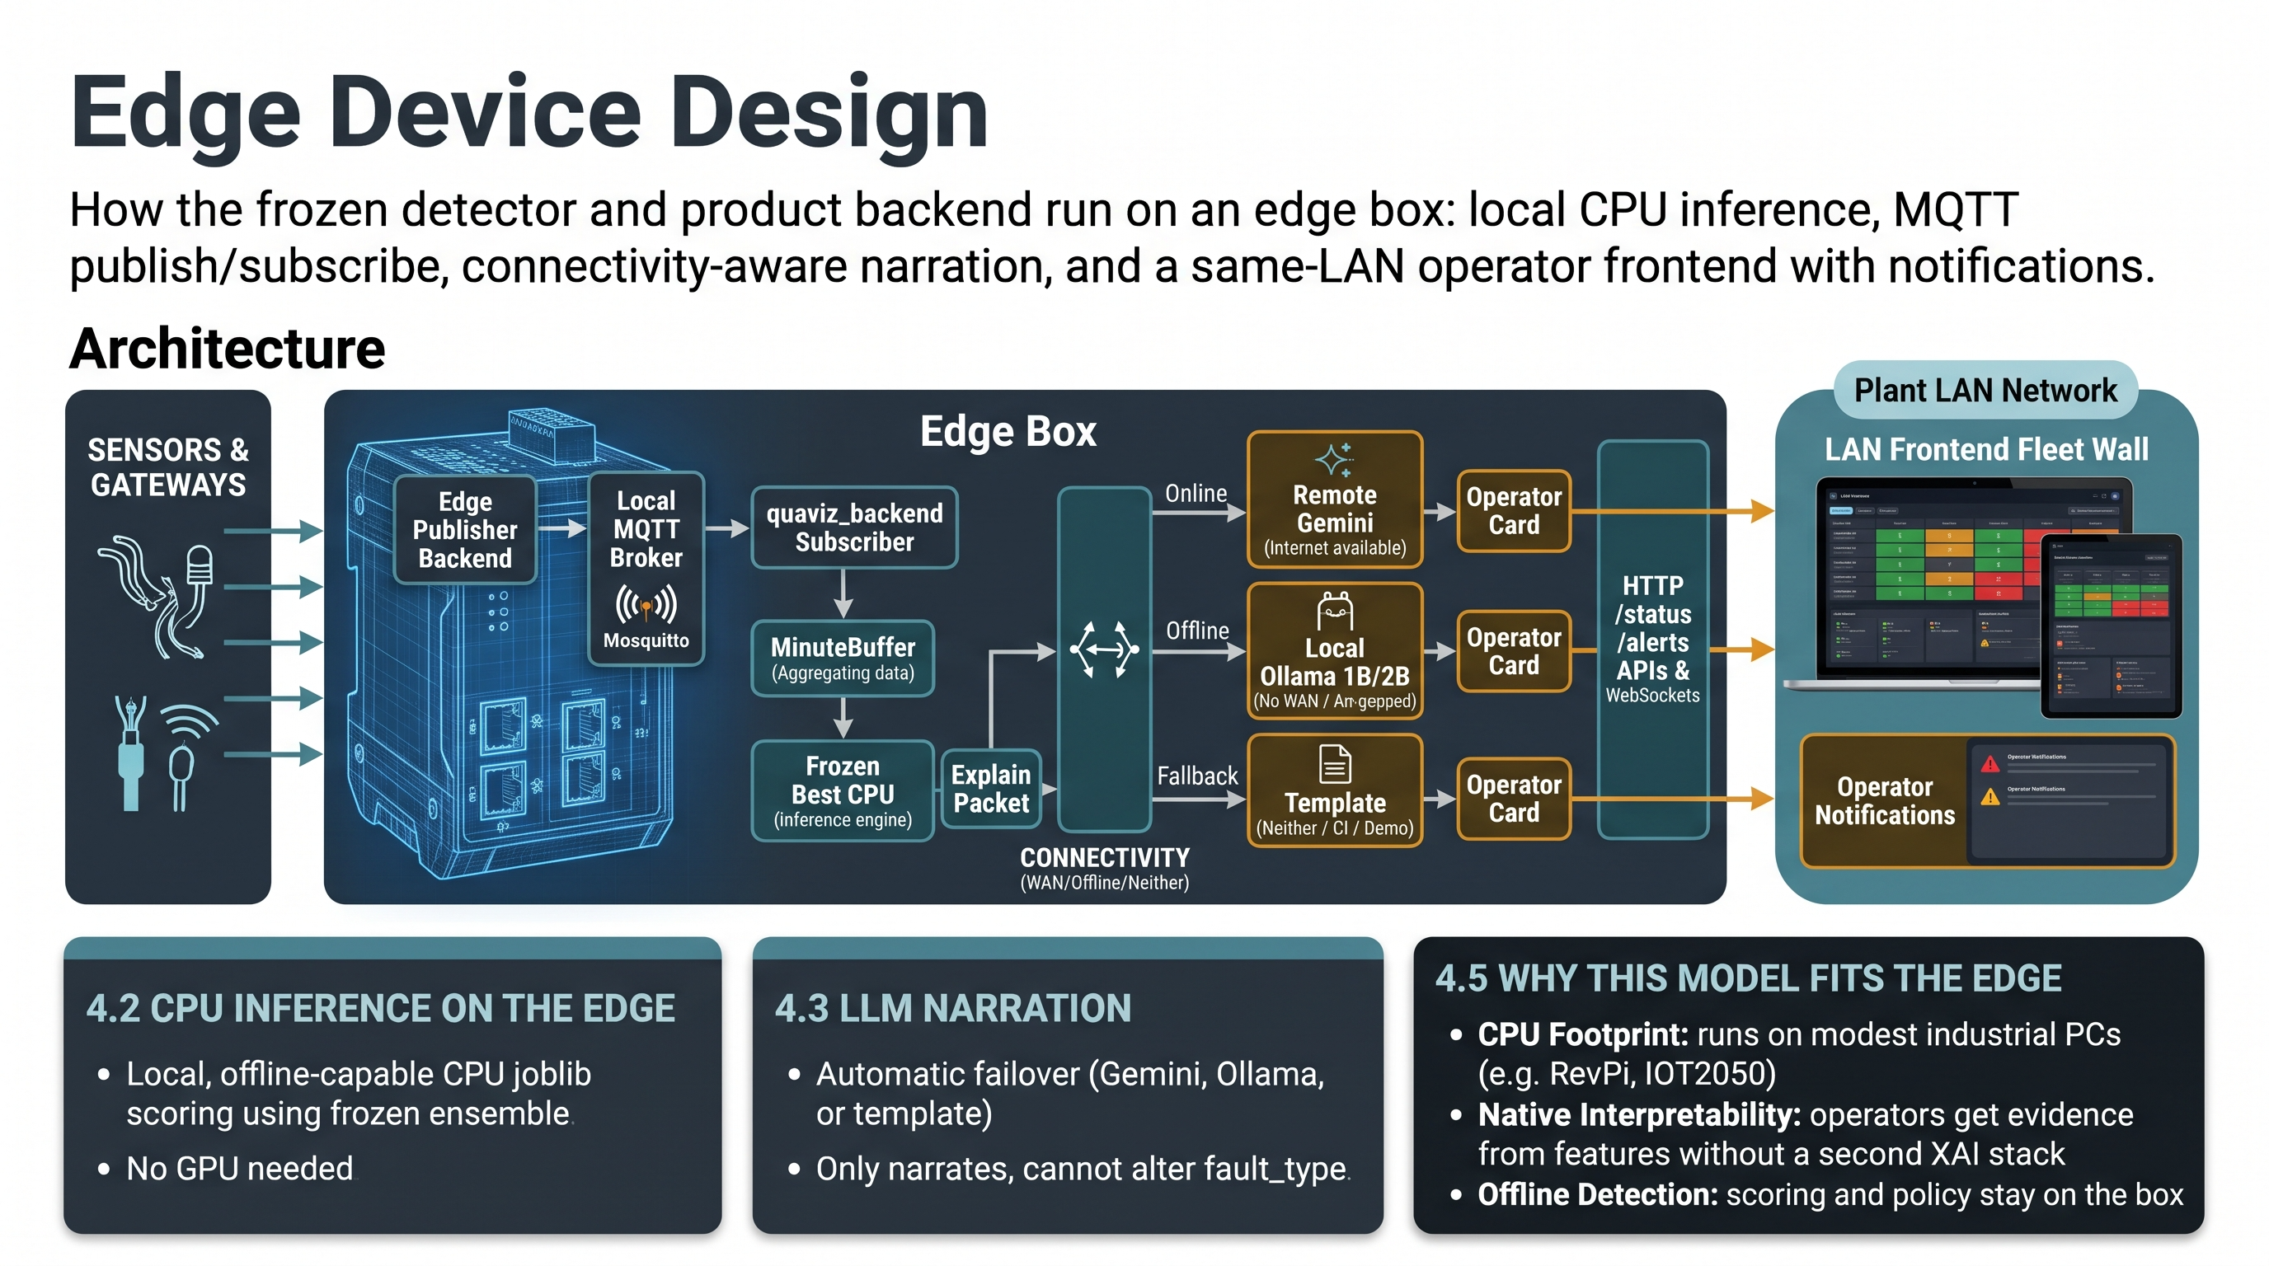
Notes:
The architecture also separates the machinery-specific models from the explanation and interface layers. That gives us a reusable foundation for other equipment, with appropriate retraining, configuration, and validation. Cloud or local explanations allow the system to accommodate different connectivity requirements.

Slide 7
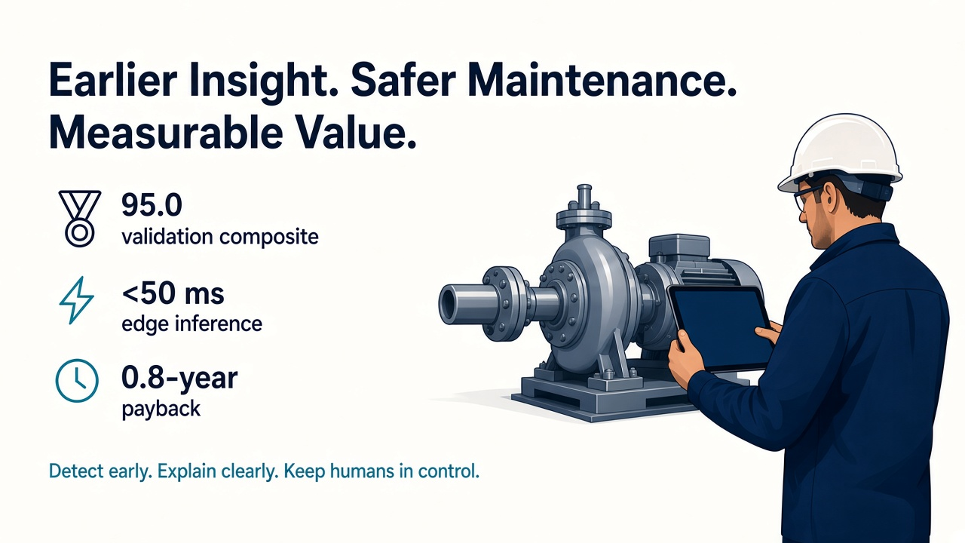
Retrofit-QuaViz in Action
Demo video follows
Notes:
Now, let’s see Retrofit-QuaViz in action.

