Slide 1

React.JS
Introduction to React

Slide 2
Module Learning Objective
Introduction to React
Features of React
Why React?
Angular vs React
Installation and Setup
Introduction to JSX
Why JSX

Slide 3
What is React ?
React is a JavaScript library created by Facebook
React is a User Interface (UI) library
React is a tool for building UI components

Slide 4
About React
JS library for building fast and interactive user interface
Developed by Facebook in 2011
Heart of React application is referred to as “Component”
The most primary component is conventionally named as “App” component representing entire application and containing other child components
Splitting the web application into independent and isolated components.
A component will have a state and render method
React uses a virtual DOM Element, which is cheaper and easier to create
Understanding working of virtual DOM and its benefit over using Real DOM
REACT essentially reacts to the state changes and updates the Real DOM

Slide 5
React Features
The important features of ReactJS are as following.
JSX
Components
One-way Data Binding
Virtual DOM
Simplicity
Performance

Slide 6
Why we need React?
DOM is slow in its real form
As the application grows, manipulation of the DOM and its update starts affecting application performance, making it slow.
React uses virtual DOM, which is significantly faster and more efficient to update.
Creating web-applications where information could be added and changed in real-time without the user having to reload the page.

Slide 7
Why we need React? (Contd.)
Simple and Easy to learn
Use of JavaScript
Component-based library
Well-defined lifecycle of components
Only requirement of having fundamental knowledge of CSS and HTML
Reusability
Each component in an application can be rendered separately with its own logic
Consistency in the application
Code is easier to maintain and application becomes easier to develop
For instance, reusing components in form editor (while building forms) as well as on the actual form (while forms are rendered as HTML using server-side JS)

Slide 8
Why we need React? (Contd.)
Robust re-rendering with virtual DOM
Virtual DOM is significantly faster and more efficient to update.
Creating web-applications where information could be added and changed in real-time without the user having to reload the page.
Native libraries
React comes with native libraries which allows the designer to create native applications for iOS and Android.
The code is different from what’s used in designing web applications; however, the methodology and architecture is same.

Slide 9
Why we need React? (Contd.)
Performances
Modules like Browserify or ES-6 can be used via Babel or ReactJS-di to inject dependencies automatically for high performance.
Easy Testing
Applications written using ReactJS fairly easy to test.
By manipulating the state, we can explore the output as well as the triggered actions and events along with the working of associated functions, etc.

Slide 10



Which one is better?
Angular
VueJS
ReactJS

Slide 11
React vs Angular
Parameters | React | Angular
Type | React is a JavaScript library and is consider much order compare with Angular | Angular is a complete framework
Use of libraries | React can be used with other programming libraries | Angular is a complete solution which provide everything
Data binding | One-way data binding | Two-way data binding
Language | JavaScript XML (JSX) | Typescript
Dependency Injection | Does not entirely support dependency injection | Support dependency injection
DOM | Virtual DOM | Incremental DOM
Learning Curve | Easier to learn | Harder to learn
Performance | Faster Performance | Slower Performance
Notes:
REACT vs. ANGULAR
Both REACT and ANGULAR are similar in their component-based architecture
ANGULAR is a framework or a complete solution, whereas REACT is a library only rendering and responsible for “View” and ensuring that the “View” is in sync with the state because of which REACT has a very small API to understand
REACT requires use of other libraries for Routing, and calling HTTP services etc. Hence, a user can choose the libraries to install depending on his preferences
On the other hand, ANGULAR comes in with fixed libraries bundles inside its application, which might get changed from one version to another

Slide 12
Installation and Setup

Slide 13
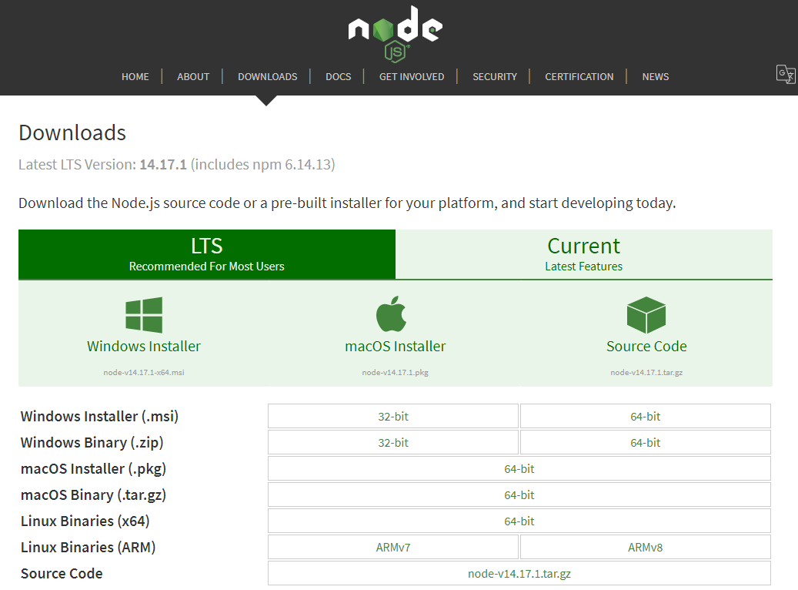
Installation and Setup
First step is to install Node.js
It can be downloaded from https://nodejs.org/en/download/

Slide 14
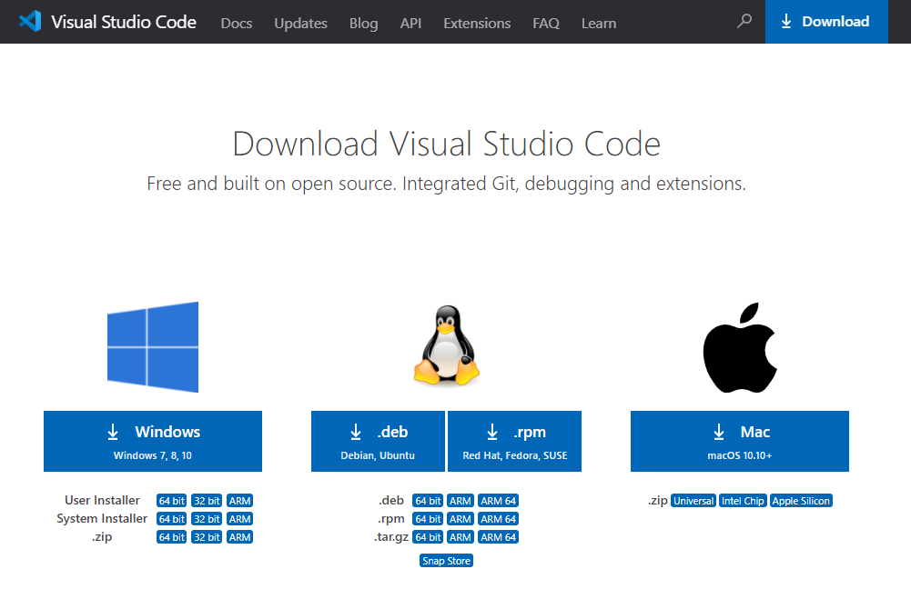
Download Code Editor
Visual Studio Code is recommended but you can use any modern text editor
It can be downloaded from https://code.visualstudio.com/Download

Slide 15
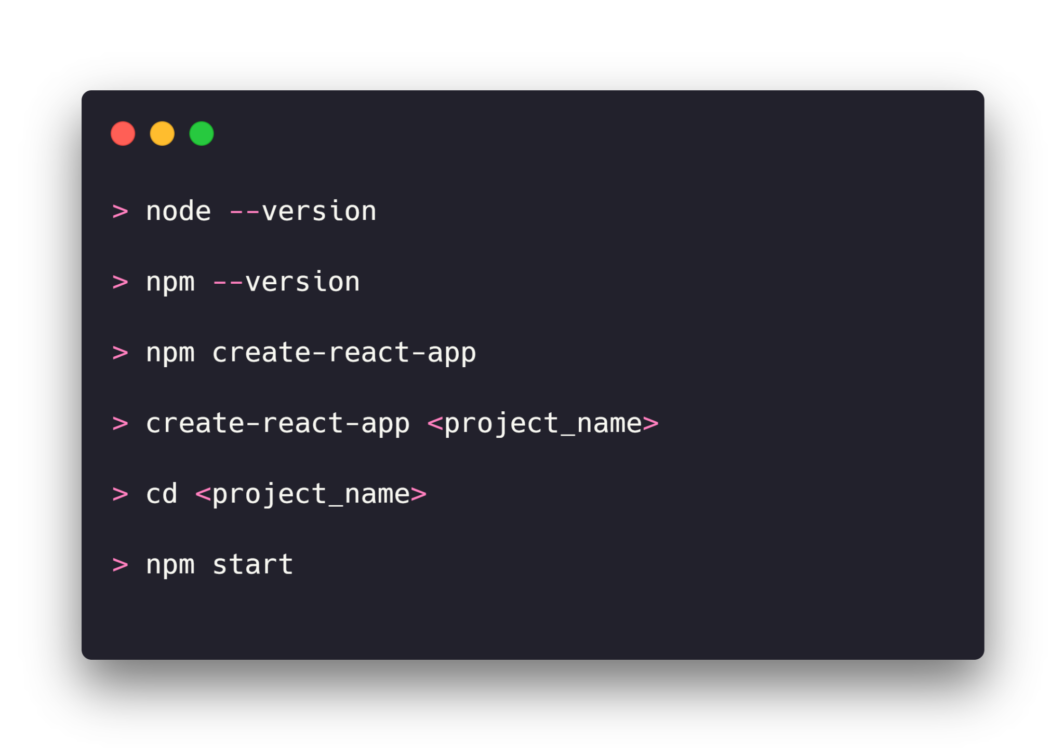
Create your first react app
There are two ways to create new react app
Using npm and installing tool individually
Using create-react-app (recommended)
Create-react-app is an excellent tool which allows you to create and run React project quickly. It is an npm package maintain by facebook and can work on any platform

Slide 16
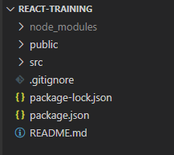
Folder Structure
node_modules: This folder contain the dependencies require for react project
public: This folder contain public assets of the application. It contain index.html where React will mount application root component.
src: It contains the application source code where you mostly create files
.gitignore: this file used by git to ignore file and folder while publishing source code into remote server

Slide 17
Folder Structure
package-lock.json: this is an auto generated and modified file that gets updated whenever npm does an operation related to node_module or package.json
package.json: This is npm configuration file. It includes details about your app along with dependencies.
README.md: It provides the documentation to read

Slide 18
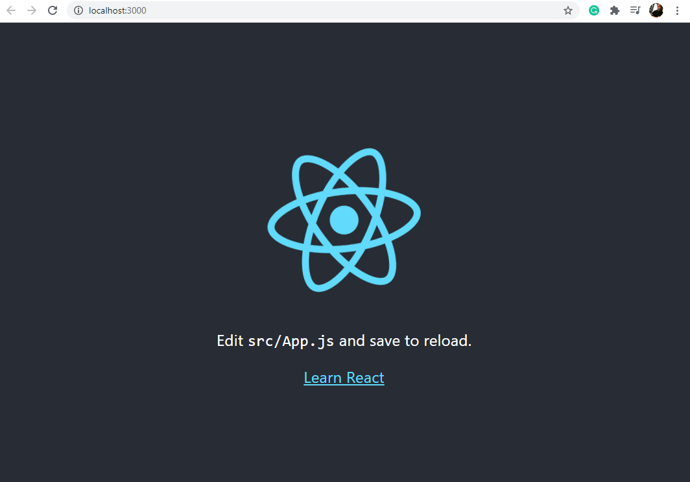
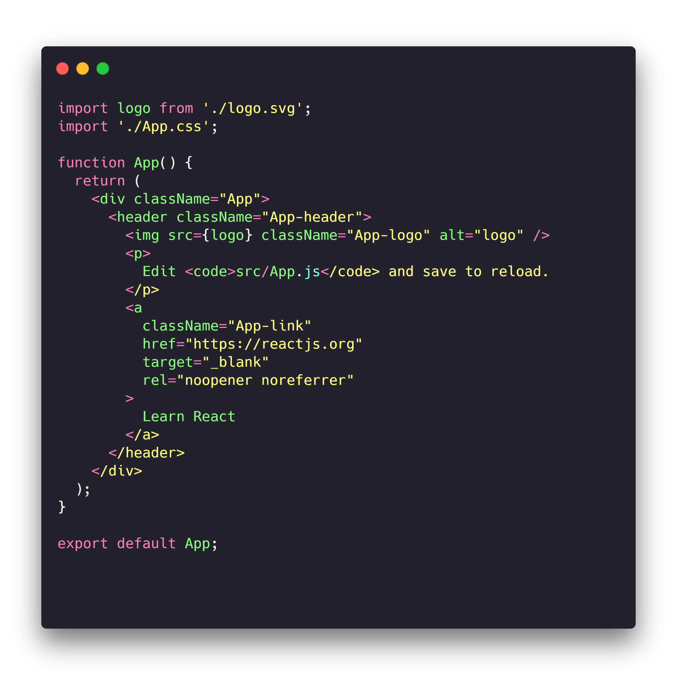
Create React App

Slide 19
Introduction to JSX

Slide 20
Introduction to JSX
JSX can be considered as a syntactical expression of JavaScript syntax, used to create React element.
Rendering these elements to React DOM
For instance
var myElement = <h1>Hello, Everyone</h1>

Slide 21
Why JSX?
Why we need JSX?
Faster than JavaScript in compilation and execution
Ensures optimization during translation of the code to JS
Ensures better optimization as it allows React to highlight useful errors and messages of warning at compile time.
Using JSX, developers find easier to work with components of React having UI inside the JS code.
Notes:
Basic working of React lies in inherently coupling the rendering logic with other interface logic to handle the events and handle state changes over a period of time. Instead of separating markup and logic in distinct files, React performs separation of concerns using “components” that contain both markup and logic.
Using JSX, developers find easier to work with components of React having UI inside the JS code.
Note: Separation of concerns refers to separating a set/piece of computer program, which has a certain impact on the program.
Concern is a certain set of information that affects the code of a computer program.

Slide 22
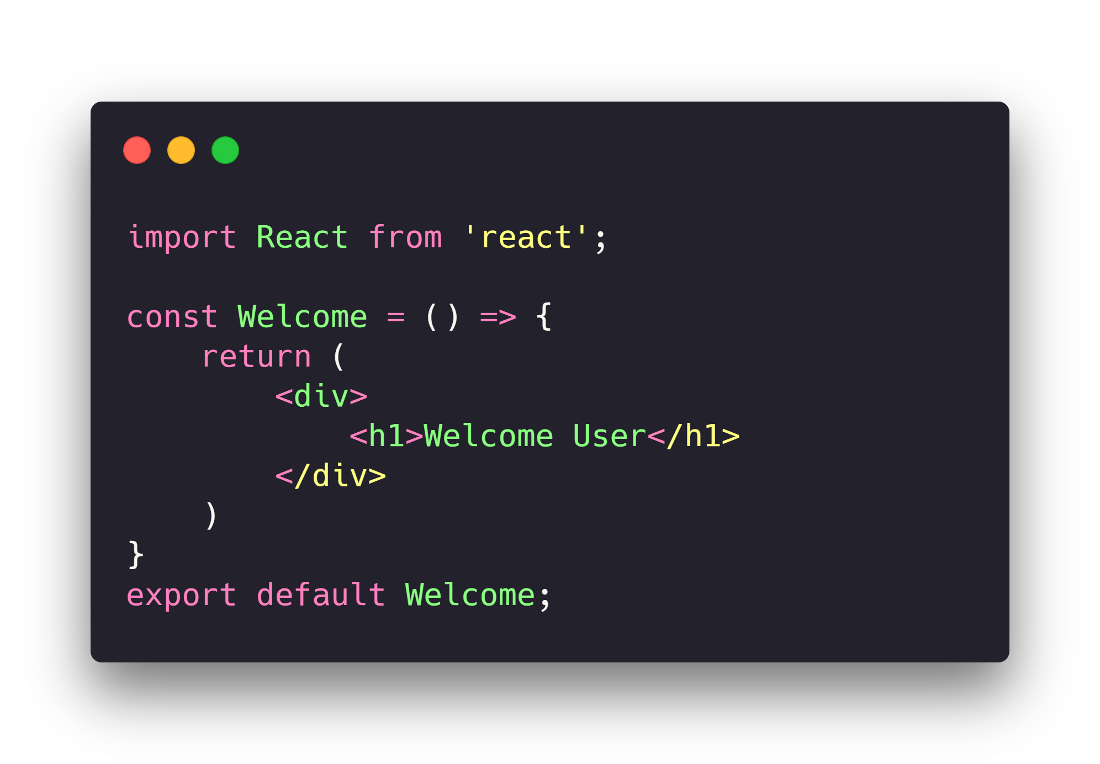
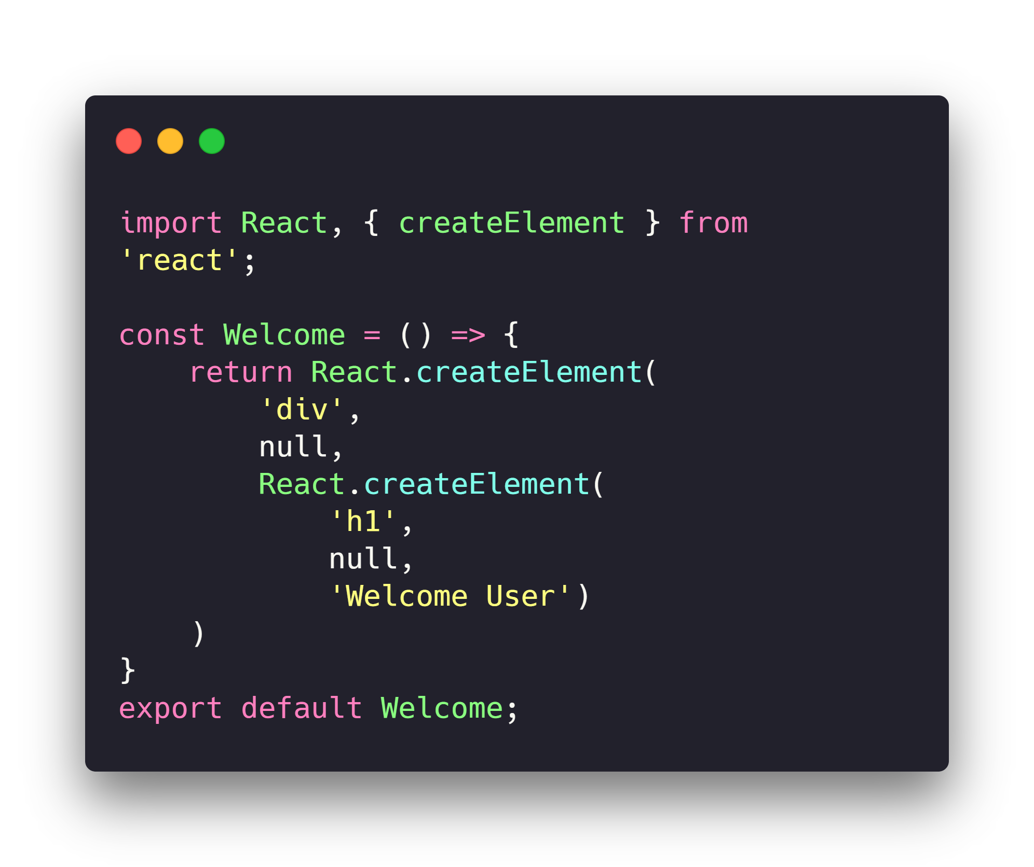
How to write JSX
JSX Code
Without JSX Code

Slide 23
JSX as an expression
Declaring a variable as we do in JavaScript and using it in a JSX code by wrapping the JS expression/variable inside a curly bracket {}
You can insert any valid JS expression inside the curly brackets. For instance, 23 + 22, x.age, or fullName(user)
Notes:
const Greeting = (user) => {
if (user) {
return <h1>Hello, {fullName(user)}!</h1>;
}
return <h1>Hello, Unknown.</h1>;
};

Slide 24
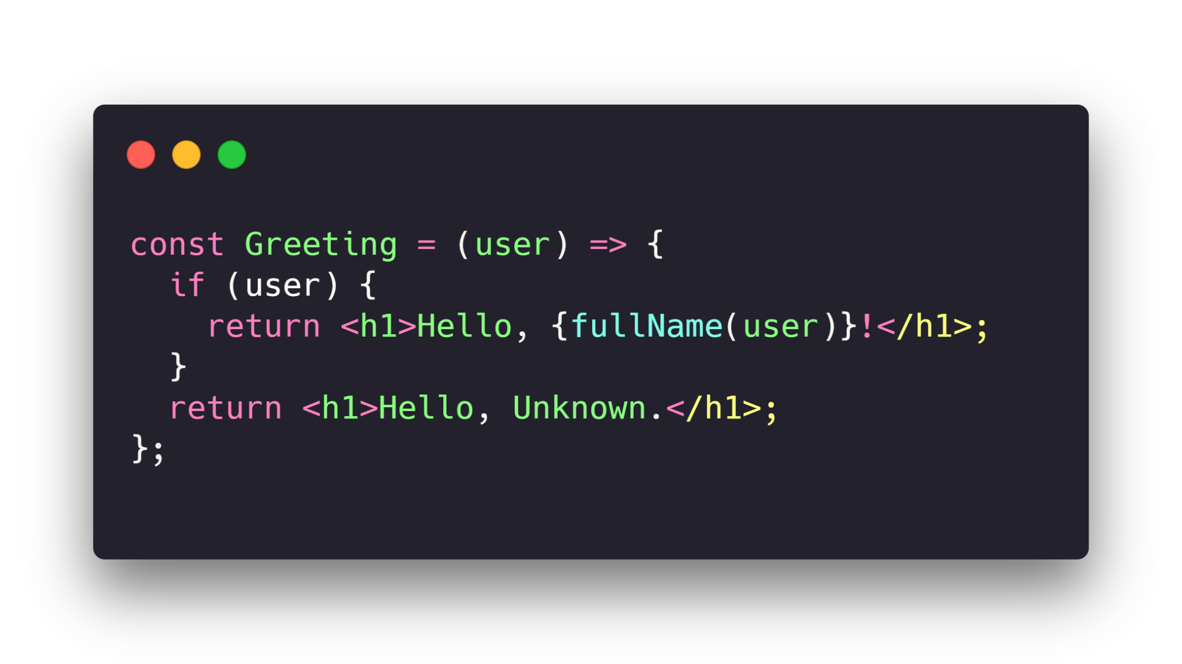
Embedding JavaScript expression in JSX
JSX expression turns into regular JavaScript code after compilation.
Therefore, JSX can be used as an expression inside of if statements or for loops by assigning it a variable, making it accept as argument and having it return from functions
Notes:
const Greeting = (user) => {
if (user) {
return <h1>Hello, {fullName(user)}!</h1>;
}
return <h1>Hello, Unknown.</h1>;
};

Slide 25
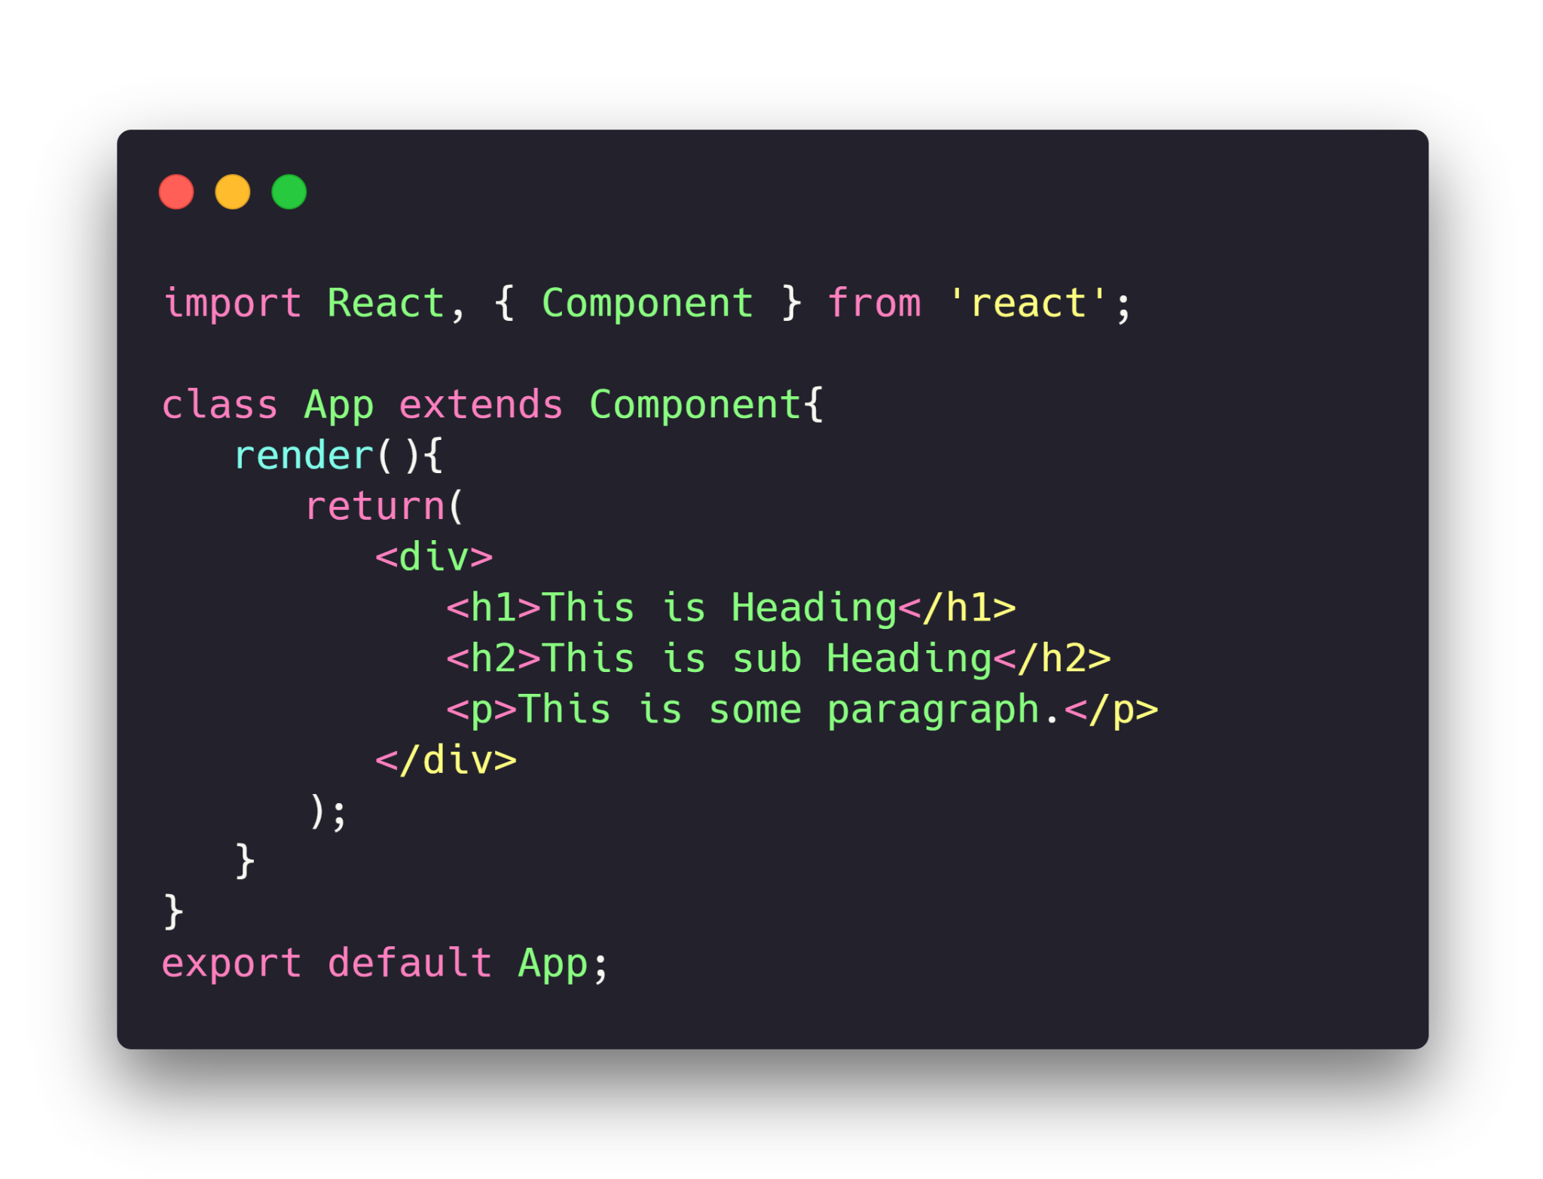
Nested elements in JSX
If you want to have more than one element, you need to warp with one container element.
In this example we are using div as a container element which has three nested elements inside it.
Notes:
import React, { Component } from 'react';
class App extends Component{
render(){
return(
<div>
<h1>This is Heading</h1>
<h2>This is sub Heading</h2>
<p>This is some paragraph.</p>
</div>
);
}
}
export default App;

Slide 26
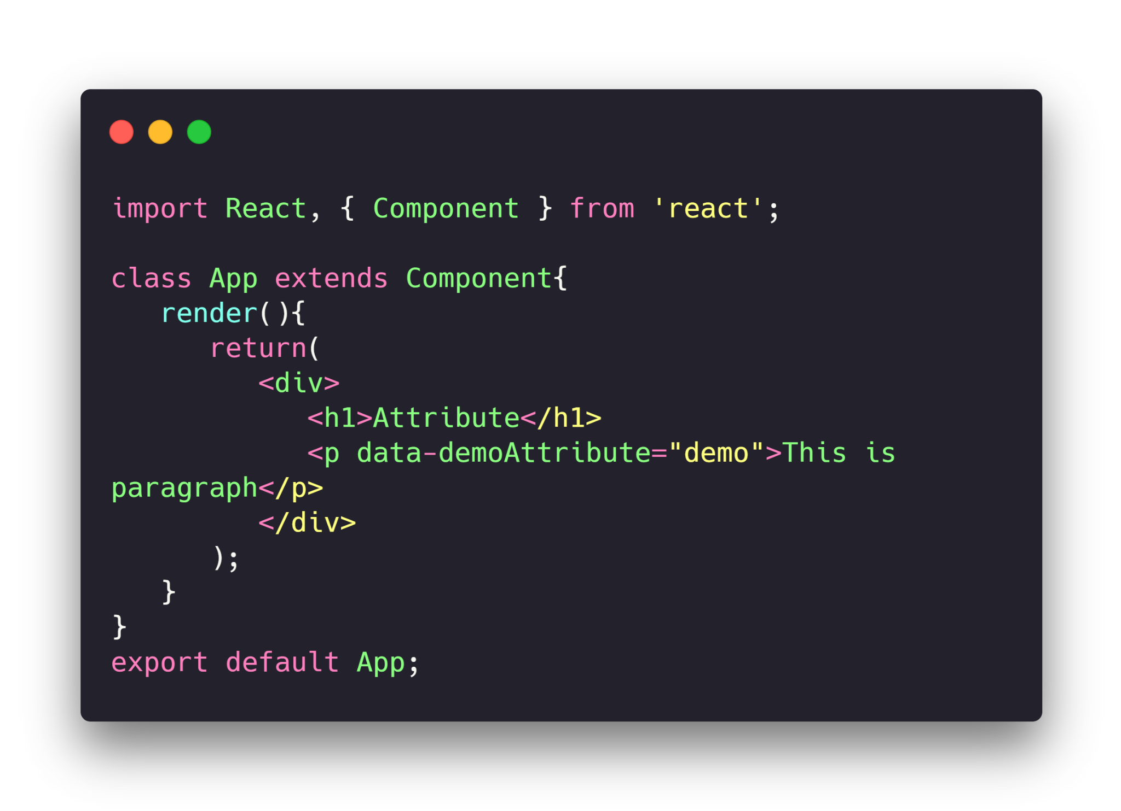
JSX Attributes
JSX use attributes with the HTML elements same as regular HTML.
JSX uses camelcase naming convention for attributes rather than standard naming convention of HTML such as a class in HTML becomes className in JSX because the class is the reserved keyword in JavaScript.
We can also use our own custom attributes in JSX. For custom attributes, we need to use data- prefix.
Notes:
import React, { Component } from 'react';
class App extends Component{
render(){
return(
<div>
<h1>Attribute</h1>
<p data-demoAttribute="demo">This is paragraph</p>
</div>
);
}
}
export default App;

Slide 27
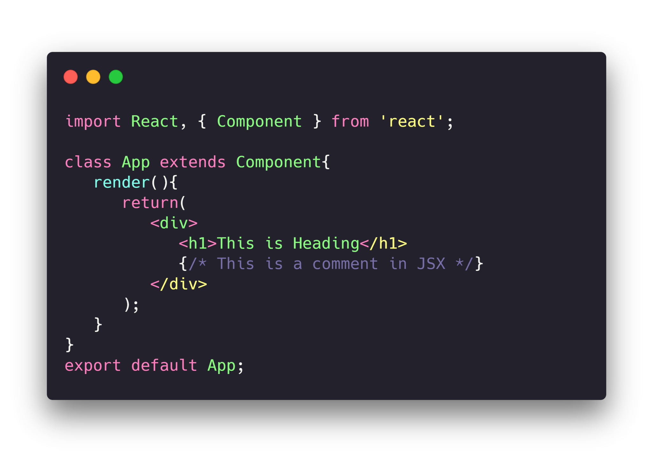
JSX comments
Comments can be used with a similar syntax as used in JS
(beginning with /* and ending with */) and is used in JSX as wrapped inside curly brackets

