Slide 1

Presented to: Professor Mahmoud Alfadel Presented by: Mohammad Kaosain Akbar
Introductory Presentation for phd in computer science

Slide 2
Contents
Introduction
Publication Record
Summary of my previous research
Alignment of My Experience with your research
Research Topic of Interest
Tentative PhD Plan
Tentative Career Plan
Link for the slides: kaosain.com/calgary

Slide 3

Introduction
Name: | Mohammad Kaosain Akbar
Current Role: | Junior Data Scientist at Desjardins
Location: | Montreal, QC, Canada
Place of Birth: | Dhaka, Bangladesh
Research Interests: | Human-Computer Interaction (HCI), Machine Learning,
 | Deep Learning, Data Imputation, System Development,
 | Computational Intelligence

Slide 4
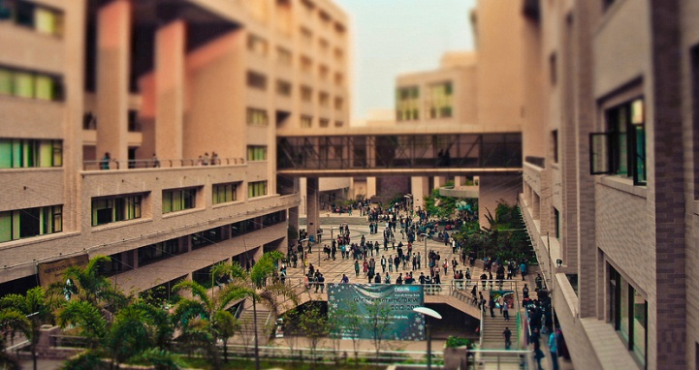
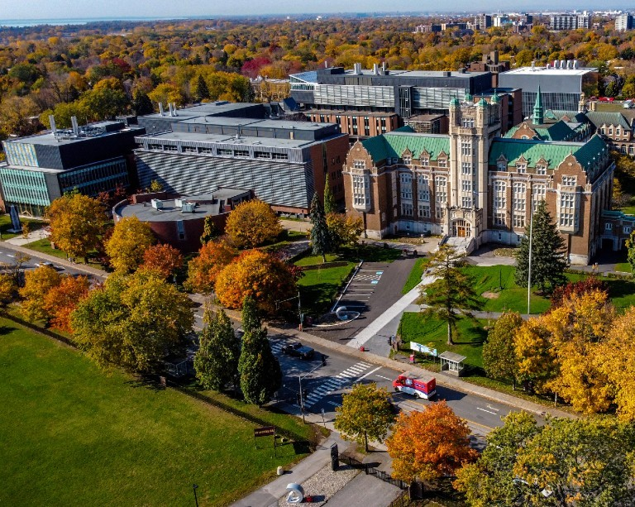
Introduction
Undergraduate Degree: | Bachelor of Science in Computer Science and Engineering
Institution: | North South University, Dhaka, Bangladesh
GPA: | 3.84/4.77 (Summa Cum Laude)
Graduate Degree: | Masters of Applied Science in Systems Engineering
GPA: | 3.77/4.30
Institution: | Concordia University, Montreal, QC, Canada
Thesis: | Non-intrusive Load Monitoring using Machine and Deep Learning Approaches

Slide 5
Introduction
Timeline | Role | Organization
January 2019 to August 2019 | Database Developer (Co-op) | Samsung Electronics Bangladesh
 | Undergraduate Teaching Assistant | North South University
September 2019 to December 2020 | Lecturer | Daffodil International University
May 2021 to December 2023 | Machine Learning Engineer | Applied AI Institute – Concordia University

Slide 6
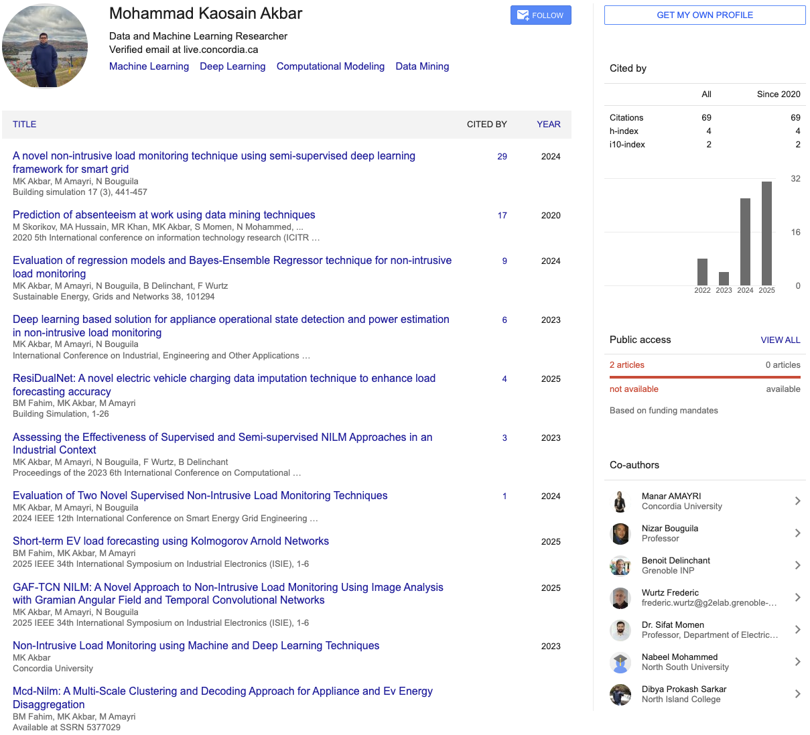
Publication Record

Slide 7
Summary of My Previous Research
Non-Intrusive Load Monitoring (NILM): Developed ML/DL methods to disaggregate energy usage from aggregate signals GAF-TCN NILM.
Energy Forecasting: Proposed advanced regression and imputation methods. Tackled noisy, missing, and privacy-sensitive data in real-world contexts.
Applications: Smart grid optimization, demand-side management, EV charging infrastructure.

Slide 8
Alignment of My Experience with your Research
My MASc research focused on time series modeling, imputation, and anomaly detection.
Developed models robust to noisy and incomplete sequential data.
Published multiple works on EV load forecasting and NILM methods.
These align with your interests in robust ML, sequential data, and applied machine learning for real-world impact

Slide 9
Research Topic of Interest
Robust machine learning for sequential and structured data.
Methods for learning from incomplete, noisy, or distributed data.
Explainability and interpretability in ML models for decision-making.
Exploring new frontiers in healthcare analytics, signal processing, or complex systems under your guidance

Slide 10
Tentative PhD Plan
Year 1–2:
Deep dive into theoretical foundations of robust ML and sequential modeling
Replicate and extend existing work in your group to gain hands-on alignment
Year 2–3:
Propose novel methods for robust learning from noisy and incomplete data
Apply to one or two real-world datasets (healthcare, energy, or social systems)
Year 3–4:
Advance towards publishing in NeurIPS, ICML, ICLR
Build transferable frameworks for sequential data robustness
Complete dissertation integrating theoretical and applied contributions

Slide 11
Tentative Career Plan
Short-term: Contribute to impactful publications and collaborative projects under your supervision
Medium-term: Pursue postdoctoral research to further deepen expertise in robust ML and sequential data
Long-term: Become a professor and lead a research group, focusing on trustworthy AI and human-centered ML

Slide 12
Thank You

