Slide 1

Presented to: Professor Lili Wei, Department of Electrical and Computer Engineering, Mcgill University Presented by: Mohammad Kaosain Akbar
PhD CHAT and Discussion with Professor Lili wei

Slide 2
Contents
Introduction
Publication Record
Summary of my previous research
Why Am I interested to do PhD in this domain
Alignment of My Experience with your research
Tentative Career Plan
Link for the slides: kaosain.com/interview

Slide 3
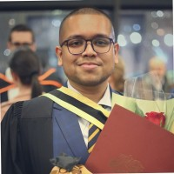
Introduction
Name: | Mohammad Kaosain Akbar
Current Role: | AI Platform Dev at Desjardins
Location: | Montreal, QC, Canada
Place of Birth: | Dhaka, Bangladesh
Research Interests: | Human-Computer Interaction (HCI), Software Engineering,
 | Machine Learning, Deep Learning, System Development,
 | Computational Intelligence

Slide 4
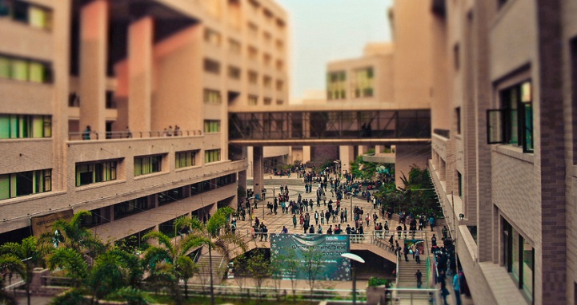
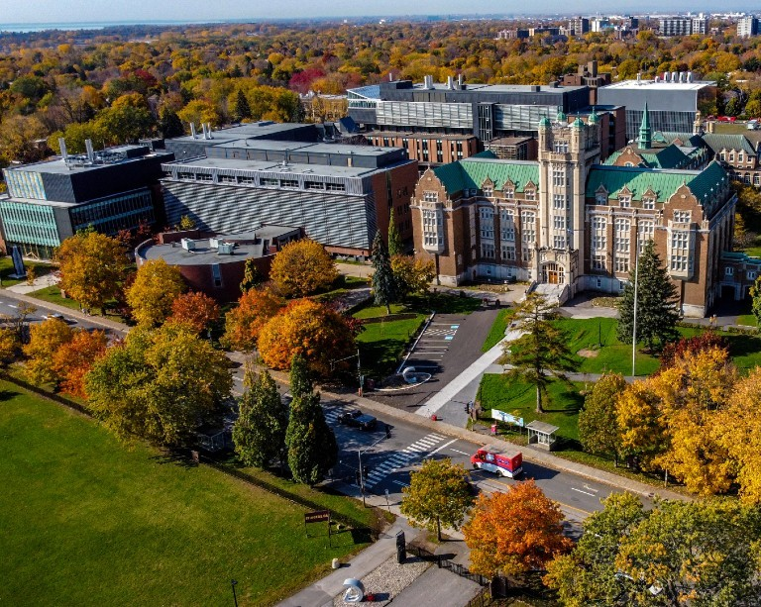
Introduction
Undergraduate Degree: | Bachelor of Science in Computer Science and Engineering
Institution: | North South University, Dhaka, Bangladesh
GPA: | 3.84/4.77 (Summa Cum Laude)
Graduate Degree: | Masters of Applied Science in Systems Engineering
GPA: | 3.77/4.30
Institution: | Concordia University, Montreal, QC, Canada
Thesis: | Non-intrusive Load Monitoring using Machine and Deep Learning Approaches

Slide 5
Introduction
Timeline | Role | Organization
January 2019 to August 2019 | Database Developer (Co-op) | Samsung Electronics Bangladesh
 | Undergraduate Teaching Assistant | North South University
September 2019 to December 2020 | Lecturer | Daffodil International University
May 2021 to May 2023 | Graduate Machine Learning Researcher | Applied AI Institute – Concordia University

Slide 6
Introduction
Hobbies and Interest
Playing console games.
Currently playing Pokemon Legend Z-A (on emulator)
Completed Pokemon Scarlet (unfortunately didn’t complete the whole pokedex)
Detroit Become Human (made poor choices, Alice, Kara, Markus and Hank dies)
Reading books
Currently reading: Ultralearning by Scott Young
Cycling
Fav Area: Lachine Canal, towards the René-Lévesque Park.
Photography
Mostly street and nature photography (Cameras: Canon 6D and DJI Action 4).

Slide 7
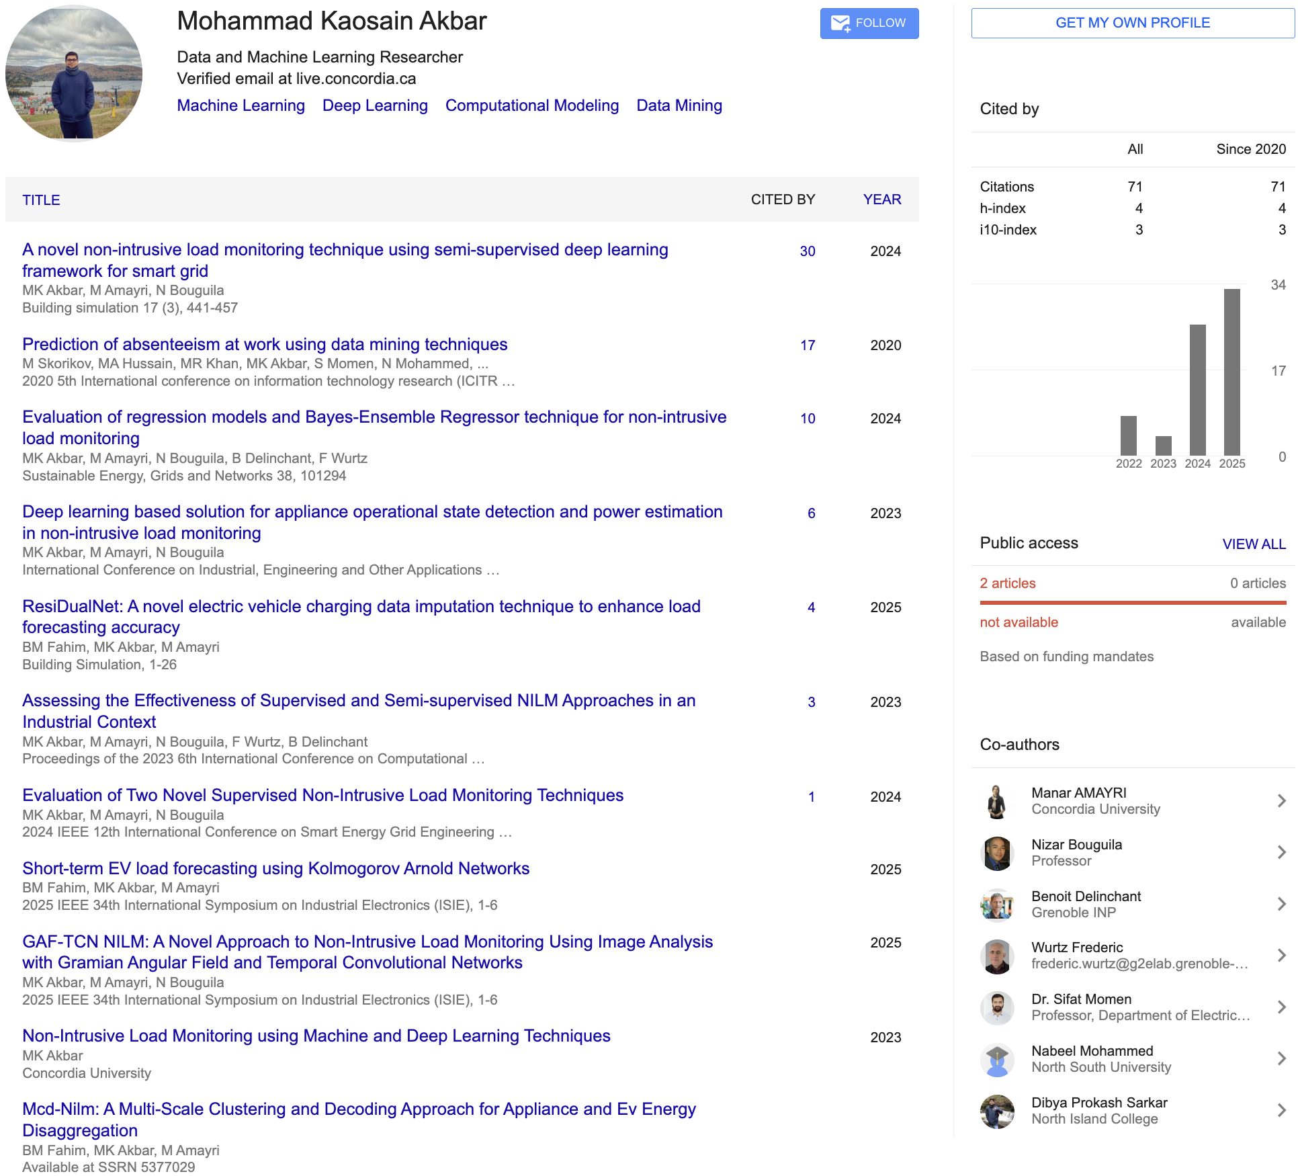
Publication Record

Slide 8
Summary of My Previous Research
Conducted research on Non Intrusive Load Monitoring using deep learning models such as CNN, BiLSTM and TCN for energy disaggregation
Developed ResiDualNet, a residual BiLSTM CNN model for missing data imputation in electric vehicle charging datasets that improved forecasting accuracy
Designed Bayesian Ensemble Regressor and other regression models for appliance level power estimation and anomaly detection
Created GAF TCN based framework that integrates temporal encoding for better state detection and interpretability
Completed undergraduate capstone titled “I Am Here,” a user centered and privacy preserving security service for emergency support

Slide 9
Why I Am Interested to do PhD in this domain
I want to explore how intelligent and data-driven methods can make complex software systems more dependable and easier to maintain.
I enjoy identifying hidden patterns in software behavior and using analytical approaches to improve software performance and reliability.
I am deeply interested in combining empirical research with experimentation, where data and code analysis lead to practical improvements in software quality.
I see the PhD journey as a chance to strengthen my ability to design research frameworks that solve real-world software challenges using both AI and systematic engineering principles.
I am motivated by curiosity and understanding how software evolves, fails, and can be made more robust through automation and learning techniques.

Slide 10
Alignment of My Experience
I have worked extensively on machine learning and deep learning models, which can be applied to analyze and predict software behavior.
My past projects involved data-driven analysis of large time-series and system datasets, which aligns with data mining and software analytics research.
I have hands-on experience in Python, model development, and skills that support research in intelligent software testing and maintenance.
My earlier research focused on improving model performance and interpretability, which connects with the broader goal of enhancing software reliability through analytical methods.
I am used to combining theory with implementation such as designing models to validating them with real-world data. This mindset that fits research-driven software engineering.

Slide 11
Tentative Career Plan
Short-term: Contribute to impactful publications and collaborative projects under your supervision.
Medium-term: Continue as a postdoctoral researcher in Software Engineering, System Development and AI
Long-term: Become a Professor and establish my own research group focused on Software Engineering with enhancement by Data Mining and AI approaches.

Slide 12

Thank You Very Much

