Slide 1

Presented to: PhD hiring team, Faculty of Technology, Art and Design, Department of Computer Science, Oslo Metropolitan University Presented by: Mohammad Kaosain Akbar
PhD interview on Artificial Intelligence in the field of Large Language Models in health research

Slide 2
Contents
Introduction
Publication Record
Summary of my previous research
Why Am I interested to do PhD in this domain
Alignment of My Experience with your research
Tentative Career Plan
Link for the slides: kaosain.com/oslomet

Slide 3
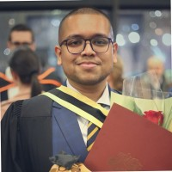
Introduction
Name: | Mohammad Kaosain Akbar
Current Role: | AI Platform Dev at Desjardins
Location: | Montreal, QC, Canada
Place of Birth: | Dhaka, Bangladesh
Research Interests: | Human-Computer Interaction (HCI), Machine Learning,
 | Deep Learning, Data Imputation, System Development,
 | Computational Intelligence

Slide 4
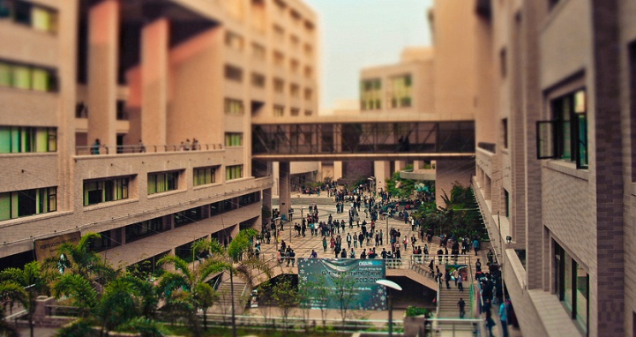
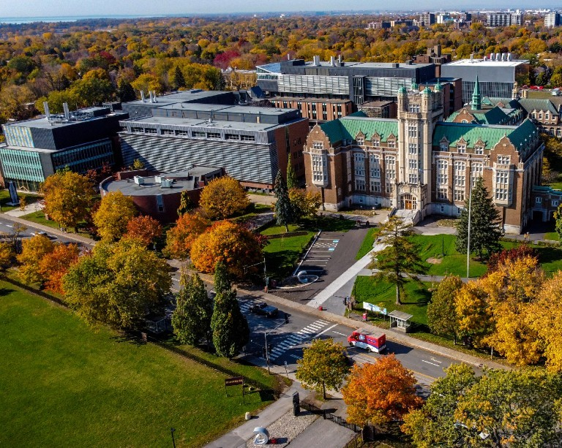
Introduction
Undergraduate Degree: | Bachelor of Science in Computer Science and Engineering
Institution: | North South University, Dhaka, Bangladesh
GPA: | 3.84/4.77 (Summa Cum Laude)
Graduate Degree: | Masters of Applied Science in Systems Engineering
GPA: | 3.77/4.30
Institution: | Concordia University, Montreal, QC, Canada
Thesis: | Non-intrusive Load Monitoring using Machine and Deep Learning Approaches

Slide 5
Introduction
Timeline | Role | Organization
January 2019 to August 2019 | Database Developer (Co-op) | Samsung Electronics Bangladesh
 | Undergraduate Teaching Assistant | North South University
September 2019 to December 2020 | Lecturer | Daffodil International University
May 2021 to May 2023 | Graduate Machine Learning Researcher | Applied AI Institute – Concordia University

Slide 6
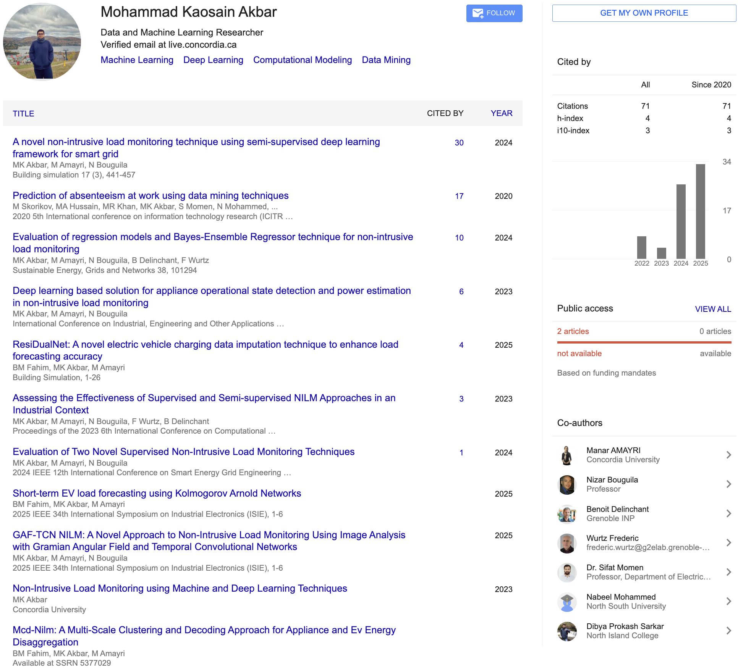
Publication Record

Slide 7
Summary of My Previous Research
Conducted research on Non Intrusive Load Monitoring using deep learning models such as CNN, BiLSTM and TCN for energy disaggregation
Developed ResiDualNet, a residual BiLSTM CNN model for missing data imputation in electric vehicle charging datasets that improved forecasting accuracy
Designed Bayesian Ensemble Regressor and other regression models for appliance level power estimation and anomaly detection
Created GAF TCN based framework that integrates temporal encoding for better state detection and interpretability
Completed undergraduate capstone titled “I Am Here,” a user centered and privacy preserving security service for emergency support

Slide 8
Why I Am Interested to do PhD in this domain
Fascinated by the intersection of Artificial Intelligence and Healthcare, especially how LLMs can assist real-world medical practice.
Strong motivation to work on trustworthy, evidence-based AI systems that can make health recommendations reliable and transparent.
Passionate about AI for societal impact, particularly in improving accessibility to physiotherapy and rehabilitation support.

Slide 9
Alignment of My Experience
Previous experience with machine learning and deep learning models, including model explainability and time-series forecasting.
Academic background in AI-driven data science aligns perfectly with the project’s focus on Retrieval-Augmented Generation (RAG) and knowledge-grounded reasoning.
Excited to apply technical expertise to a multidisciplinary project combining AI, healthcare, and human-centered design.

Slide 10
Tentative Career Plan
Short-term: Contribute to impactful publications and collaborative projects under your supervision.
Medium-term: Continue as a postdoctoral researcher in LLM and AI in Health Care
Long-term: Become a professor and establish my own research group focused on designing ML models and resolving Health Care challenges using AI

Slide 11

Thank You Very Much

