Slide 1


Presented to: - Université Gustave-eiffel - Instituto Universitário De Lisboa Presented by: Mohammad Kaosain Akbar email: Kaosain@hotmail.com address: Montreal, QC, Canada
PhD Interview on “Risk assessment of electric two-wheelers in France using Generative AI approaches”

Slide 2
Contents
Link for the slides: kaosain.com/ue
Introduction
Publication Record
Summary of my previous research
Why I am interested in this PhD opportunity
Alignment of My Previous Research with This PhD
Tentative PhD Plan
Tentative Career Plan

Slide 3
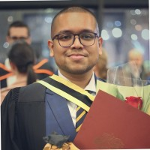
Introduction
Name: | Mohammad Kaosain Akbar
Current Role: | Junior Data Scientist at Desjardins
Location: | Montreal, QC, Canada
Place of Birth: | Dhaka, Bangladesh
Research Interests: | Human-Computer Interaction (HCI), Machine Learning,
 | Deep Learning, Data Imputation, System Development,
 | Computational Intelligence

Slide 4
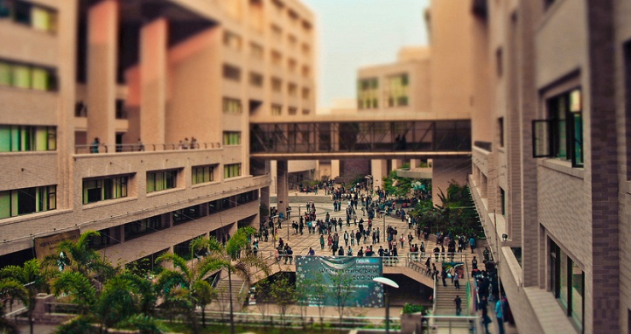
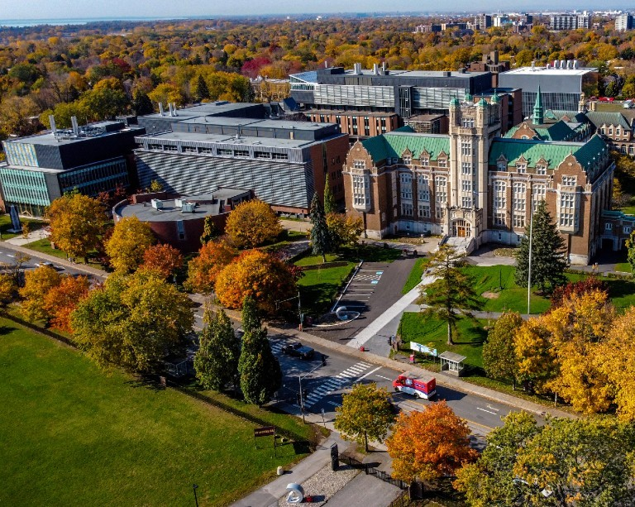
Introduction
Undergraduate Degree: | Bachelor of Science in Computer Science and Engineering
Institution: | North South University, Dhaka, Bangladesh
GPA: | 3.84/4.77 (Summa Cum Laude)
Graduate Degree: | Masters of Applied Science in Systems Engineering
GPA: | 3.77/4.30
Institution: | Concordia University, Montreal, QC, Canada
Thesis: | Non-intrusive Load Monitoring using Machine and Deep Learning Approaches

Slide 5
Introduction
Timeline | Role | Organization
January 2019 to August 2019 | Database Developer (Co-op) | Samsung Electronics Bangladesh
 | Undergraduate Teaching Assistant | North South University
September 2019 to December 2020 | Lecturer | Daffodil International University
May 2021 to December 2023 | Machine Learning Engineer | Applied AI Institute – Concordia University

Slide 6
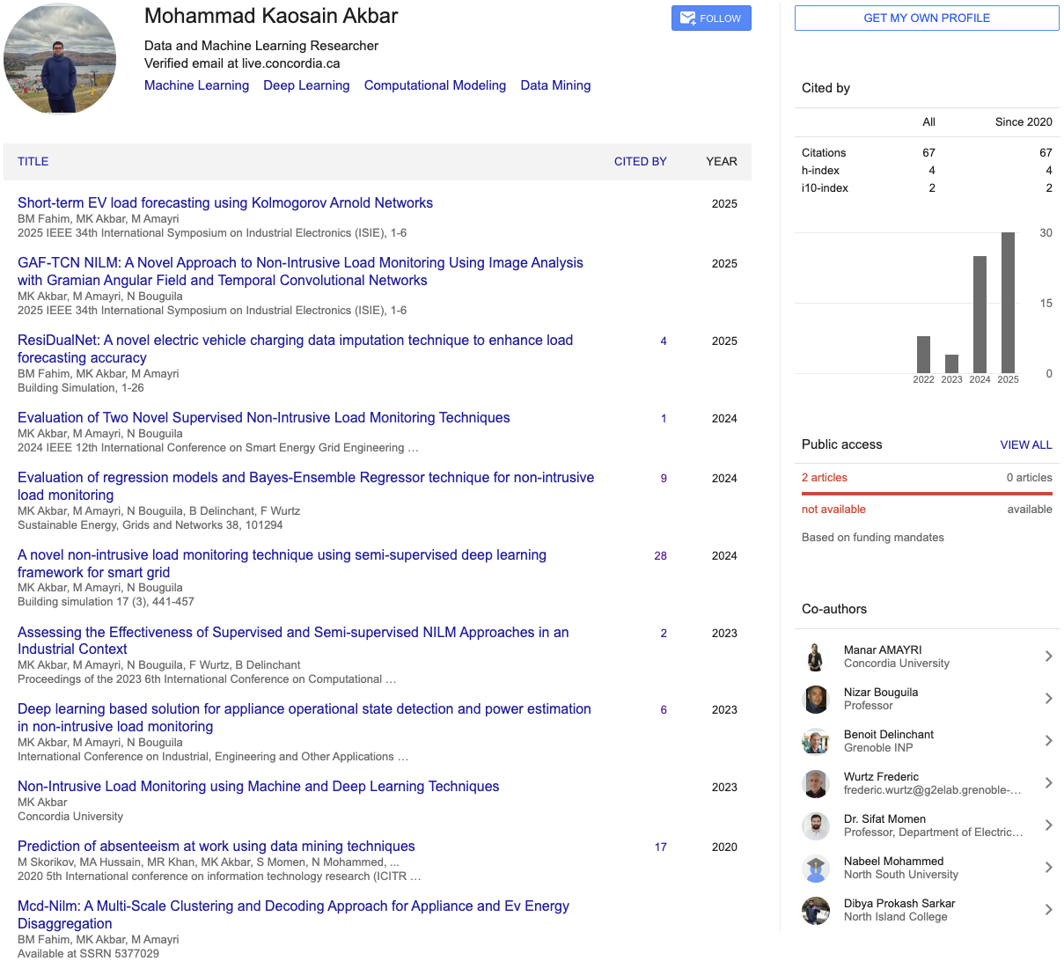
Publication Record

Slide 7
Summary of My Previous Research
Non-Intrusive Load Monitoring (NILM): Developed ML/DL methods to disaggregate energy usage from aggregate signals GAF-TCN NILM.
Energy Forecasting: Proposed advanced regression and imputation methods. Tackled noisy, missing, and privacy-sensitive data in real-world contexts.
Applications: Smart grid optimization, demand-side management, EV charging infrastructure.

Slide 8
Why I Am Interested in This PhD
Societal impact: Improving safety of e-bikes & e-scooters aligns with my broader interest in sustainable mobility.
Interdisciplinary challenge: Combines my expertise in AI for time-series & multimodal data with new directions in Generative AI & vision-language models.
Research motivation: Opportunity to apply AI to human-centered safety problems, directly impacting urban transport policy and public well-being.
Career fit: Builds a bridge from my energy/EV background to e-mobility safety, aligning with my long-term goal of becoming an academic researcher in sustainable AI and mobility.

Slide 9
Alignment of My Research with This PhD
Multimodal Data Handling: My work on energy + contextual signals (NILM, EV load forecasting) parallels the PhD’s use of video + sensor + behavioral data.
Focus on Real-World Noisy Data: Both domains require methods that are robust, interpretable, and scalable for practical deployment.
E-Mobility Connection: Already contributed to EV charging analytics; now extending to safe operation of e-scooters/bikes, broadening my impact in the e-mobility ecosystem.

Slide 10
Tentative PhD Plan
Year 1 – Familiarization with datasets, literature review, baseline models for scene understanding.
Year 2 – Develop generative AI methods to detect and describe critical events; integrate multimodal data.
Year 3 – Validate models against annotated events, refine risk detection framework, publish results, contribute to safety tools for e-mobility.

Slide 11
Tentative Career Plan
Short-Term (Post-PhD): – Continue research in Generative AI & transport safety. – Pursue a postdoctoral fellowship in the same domain. – Expand international collaborations and publish in top venues.
Long-Term: – Become a professor in academia, leading research on AI for mobility & safety. – Supervise PhD students and build an interdisciplinary lab. – Contribute to policy, standards, and safer urban mobility through academic research.

Slide 12
Thank You

