Slide 1

Presented to: Professor KAMI VANIEA Presented by: Mohammad Kaosain Akbar
Introductory Presentation for phd in Electrical and Computer engineering

Slide 2
Contents
Introduction
Publication Record
Summary of my previous research
Why Am I interested to do PhD in this domain
Alignment of My Experience with your research
Tentative Career Plan
Link for the slides: kaosain.com/uw

Slide 3
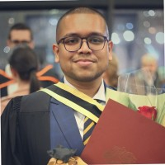
Introduction
Name: | Mohammad Kaosain Akbar
Current Role: | Junior Data Scientist at Desjardins
Location: | Montreal, QC, Canada
Place of Birth: | Dhaka, Bangladesh
Research Interests: | Human-Computer Interaction (HCI), Machine Learning,
 | Deep Learning, Data Imputation, System Development,
 | Computational Intelligence

Slide 4
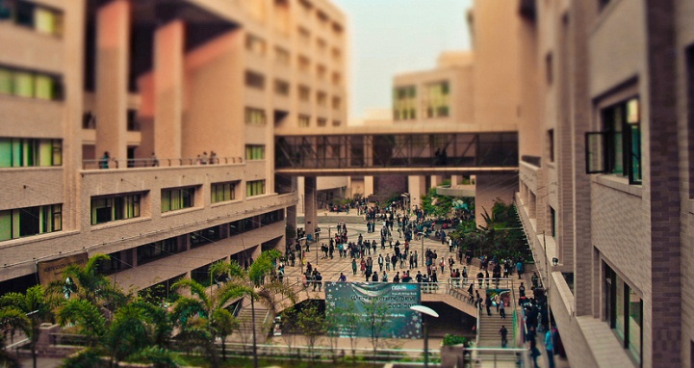
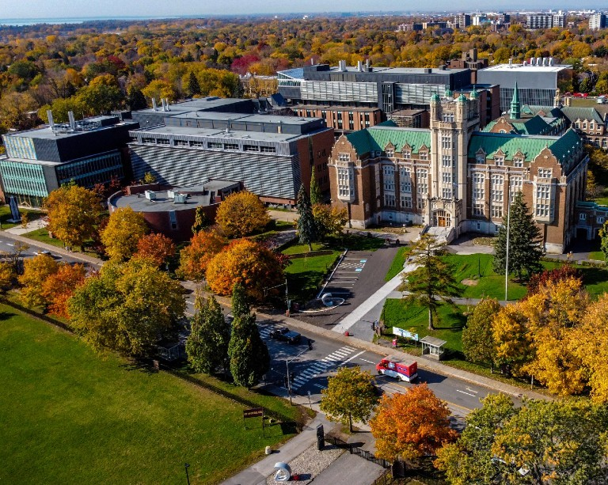
Introduction
Undergraduate Degree: | Bachelor of Science in Computer Science and Engineering
Institution: | North South University, Dhaka, Bangladesh
GPA: | 3.84/4.77 (Summa Cum Laude)
Graduate Degree: | Masters of Applied Science in Systems Engineering
GPA: | 3.77/4.30
Institution: | Concordia University, Montreal, QC, Canada
Thesis: | Non-intrusive Load Monitoring using Machine and Deep Learning Approaches

Slide 5
Introduction
Timeline | Role | Organization
January 2019 to August 2019 | Database Developer (Co-op) | Samsung Electronics Bangladesh
 | Undergraduate Teaching Assistant | North South University
September 2019 to December 2020 | Lecturer | Daffodil International University
May 2021 to December 2023 | Machine Learning Engineer | Applied AI Institute – Concordia University

Slide 6
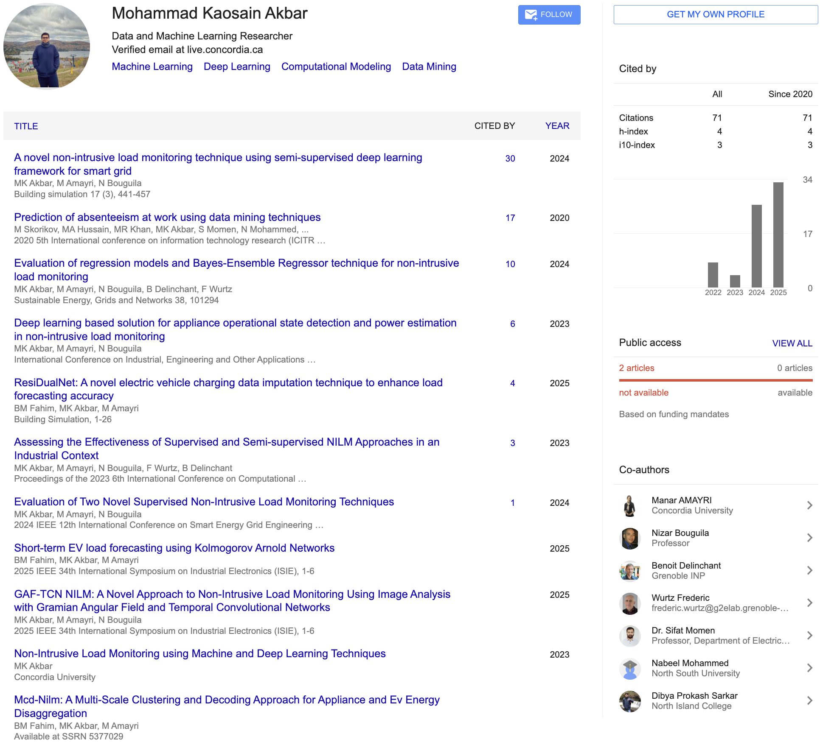
Publication Record

Slide 7
Summary of My Previous Research
Conducted research on Non Intrusive Load Monitoring using deep learning models such as CNN, BiLSTM and TCN for energy disaggregation
Developed ResiDualNet, a residual BiLSTM CNN model for missing data imputation in electric vehicle charging datasets that improved forecasting accuracy
Designed Bayesian Ensemble Regressor and other regression models for appliance level power estimation and anomaly detection
Created GAF TCN based framework that integrates temporal encoding for better state detection and interpretability
Completed undergraduate capstone titled “I Am Here,” a user centered and privacy preserving security service for emergency support

Slide 8
Why I Am Interested to do PhD in this domain
I am fascinated by how people understand and interact with technology, especially in situations that involve security and privacy decisions.
I am interested to explore how artificial intelligence may support, but never replace, human judgment various privacy-based scenarios.
Working in this area would allow me to contribute to building technologies that respect human values, empower users, and strengthen digital trust globally.

Slide 9
Alignment of My Experience
My work on energy data and NILM systems has made me aware of how technical systems can unintentionally affect user privacy and trust.
I value the idea of designing systems that communicate clearly with users instead of hiding decisions behind technical complexity.
My background in AI and system design gives me a foundation to study how advanced technologies can be integrated into everyday life responsibly.

Slide 10
Tentative Career Plan
Short-term: Contribute to impactful publications and collaborative projects under your supervision.
Medium-term: Continue as a postdoctoral researcher or research scientist, leading projects that apply HCI principles to real world security systems.
Long-term: Become a professor and establish my own research group focused on designing usable, trustworthy, and inclusive security technologies.

Slide 11
Thank You

