Slide 1

PhD Interview on “Contextual Filtering and Opportunistic Local Processing of Health Data”
Presented to:
IMT Atlantique – IRISA – EASE team
Presented by:
Mohammad Kaosain Akbar email: kaosain@hotmail.com
address: Montreal, QC, Canada

Slide 2
Contents
Link for the slides: kaosain.com/imt
Introduction
Publication Record
Previous Research Overview
Previous Work aligning with PhD
Motivation for this PhD
Reference Papers Discussion
PhD Plan
Career Plan

Slide 3

Introduction
Name: | Mohammad Kaosain Akbar
Current Role: | Junior Data Scientist at Desjardins
Location: | Montreal, QC, Canada
Place of Birth: | Dhaka, Bangladesh
Research Interests: | Human-Computer Interaction (HCI), Machine Learning,
 | Deep Learning, Data Imputation, System Development,
 | Computational Intelligence

Slide 4
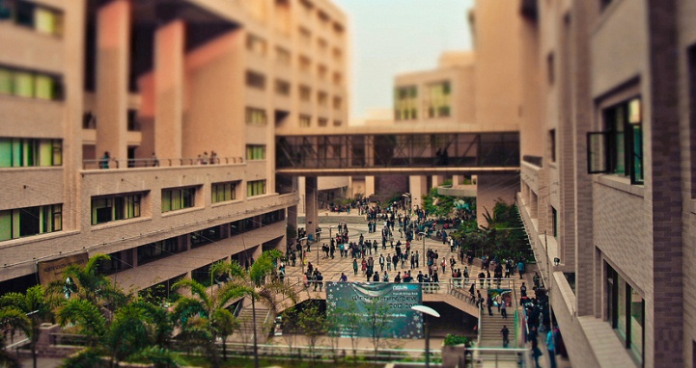
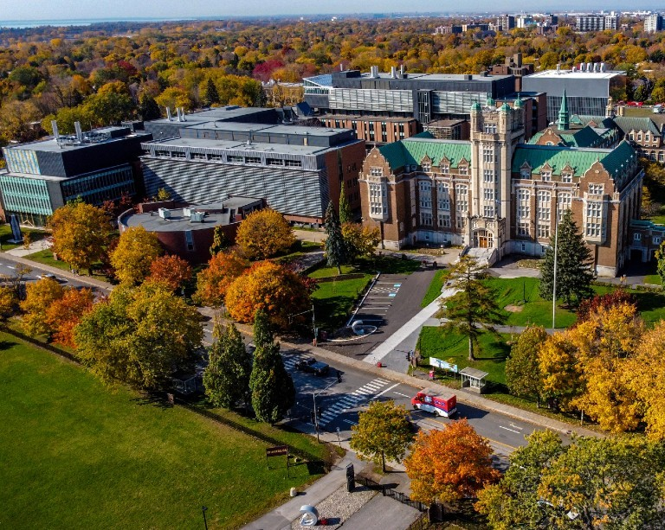
Introduction
Undergraduate Degree: | Bachelor of Science in Computer Science and Engineering
Institution: | North South University, Dhaka, Bangladesh
GPA: | 3.84/4.77 (Summa Cum Laude)
Graduate Degree: | Masters of Applied Science in Systems Engineering
GPA: | 3.77/4.30
Institution: | Concordia University, Montreal, QC, Canada
Thesis: | Non-intrusive Load Monitoring using Machine and Deep Learning Approaches

Slide 5
Introduction
Timeline | Role | Organization
January 2019 to August 2019 | Database Developer (Co-op) | Samsung Electronics Bangladesh
 | Undergraduate Teaching Assistant | North South University
September 2019 to December 2020 | Lecturer | Daffodil International University
May 2021 to December 2023 | Machine Learning Engineer | Applied AI Institute – Concordia University

Slide 6
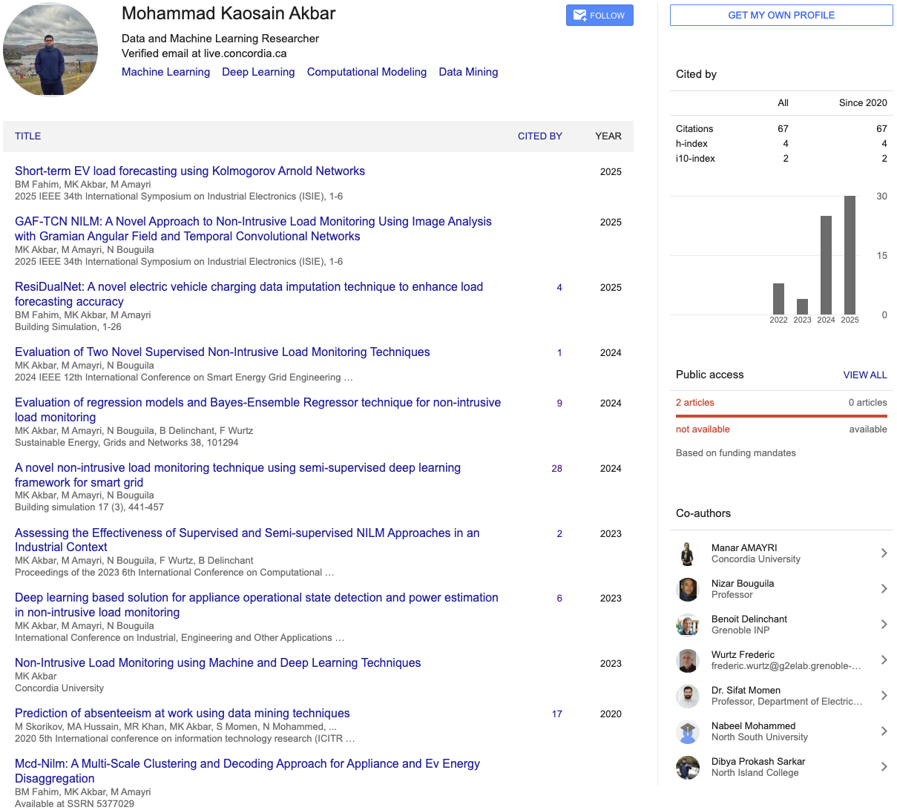
Publication Record

Slide 7
Previous Research Overview
Theme: Energy Data Intelligence – NILM & EV Forecasting
Core Problem: Extract useful insights from aggregate sensor data (building loads, EV charging)
Research Progression:
Supervised NILM (regression & classification)
Semi-supervised deep learning (TCN-LSTM hybrids)
Ensemble regression with Bayesian
Image-based NILM (GAF-TCN)
EV charging forecasting (Kolmogorov–Arnold Networks)
EV charging data imputation (ResiDualNet, BiLSTM-CNN)

Slide 8
Previous Research Overview
NILM Contributions:
Supervised & semi-supervised deep learning → robust to limited labeled data
Bayesian-optimized ensemble models for adaptive NILM
EV Forecasting & Data Imputation Contributions:
ResiDualNet: novel BiLSTM-CNN imputation technique → boosts EV load forecasting accuracy
Introduced Kolmogorov–Arnold Networks for short-term EV load prediction
Overall Contribution:
Advanced methods for handling noisy, incomplete, and real-world time-series data
Solutions for both disaggregation (NILM) and forecasting (EV loads)

Slide 9
Previous Work Alignment towards PhD (BSc)
Capstone Project: “I am Here”
Context & Motivation
Rising harassment, kidnapping, and public insecurity in Bangladesh.
Need for a safety system that provides emergency help while protecting user privacy.
System Design
Mobile App (Android): Core platform for location abstraction, SOS calls, trusted contacts.
Wearable SOS Trigger: Wristband-style button, connected via Bluetooth, to discreetly activate emergency alerts.
Privacy Features:
Location abstraction (exact, area-level, city-level).
Share only with trusted contacts.
Multilingual (English & Bengali).
Evaluation
Survey (n=84) → informed requirements.
Deployment (n=107) → urban & rural users.
Findings:
95% found the system useful.
Strong preference for broad location sharing over exact GPS.

Slide 10
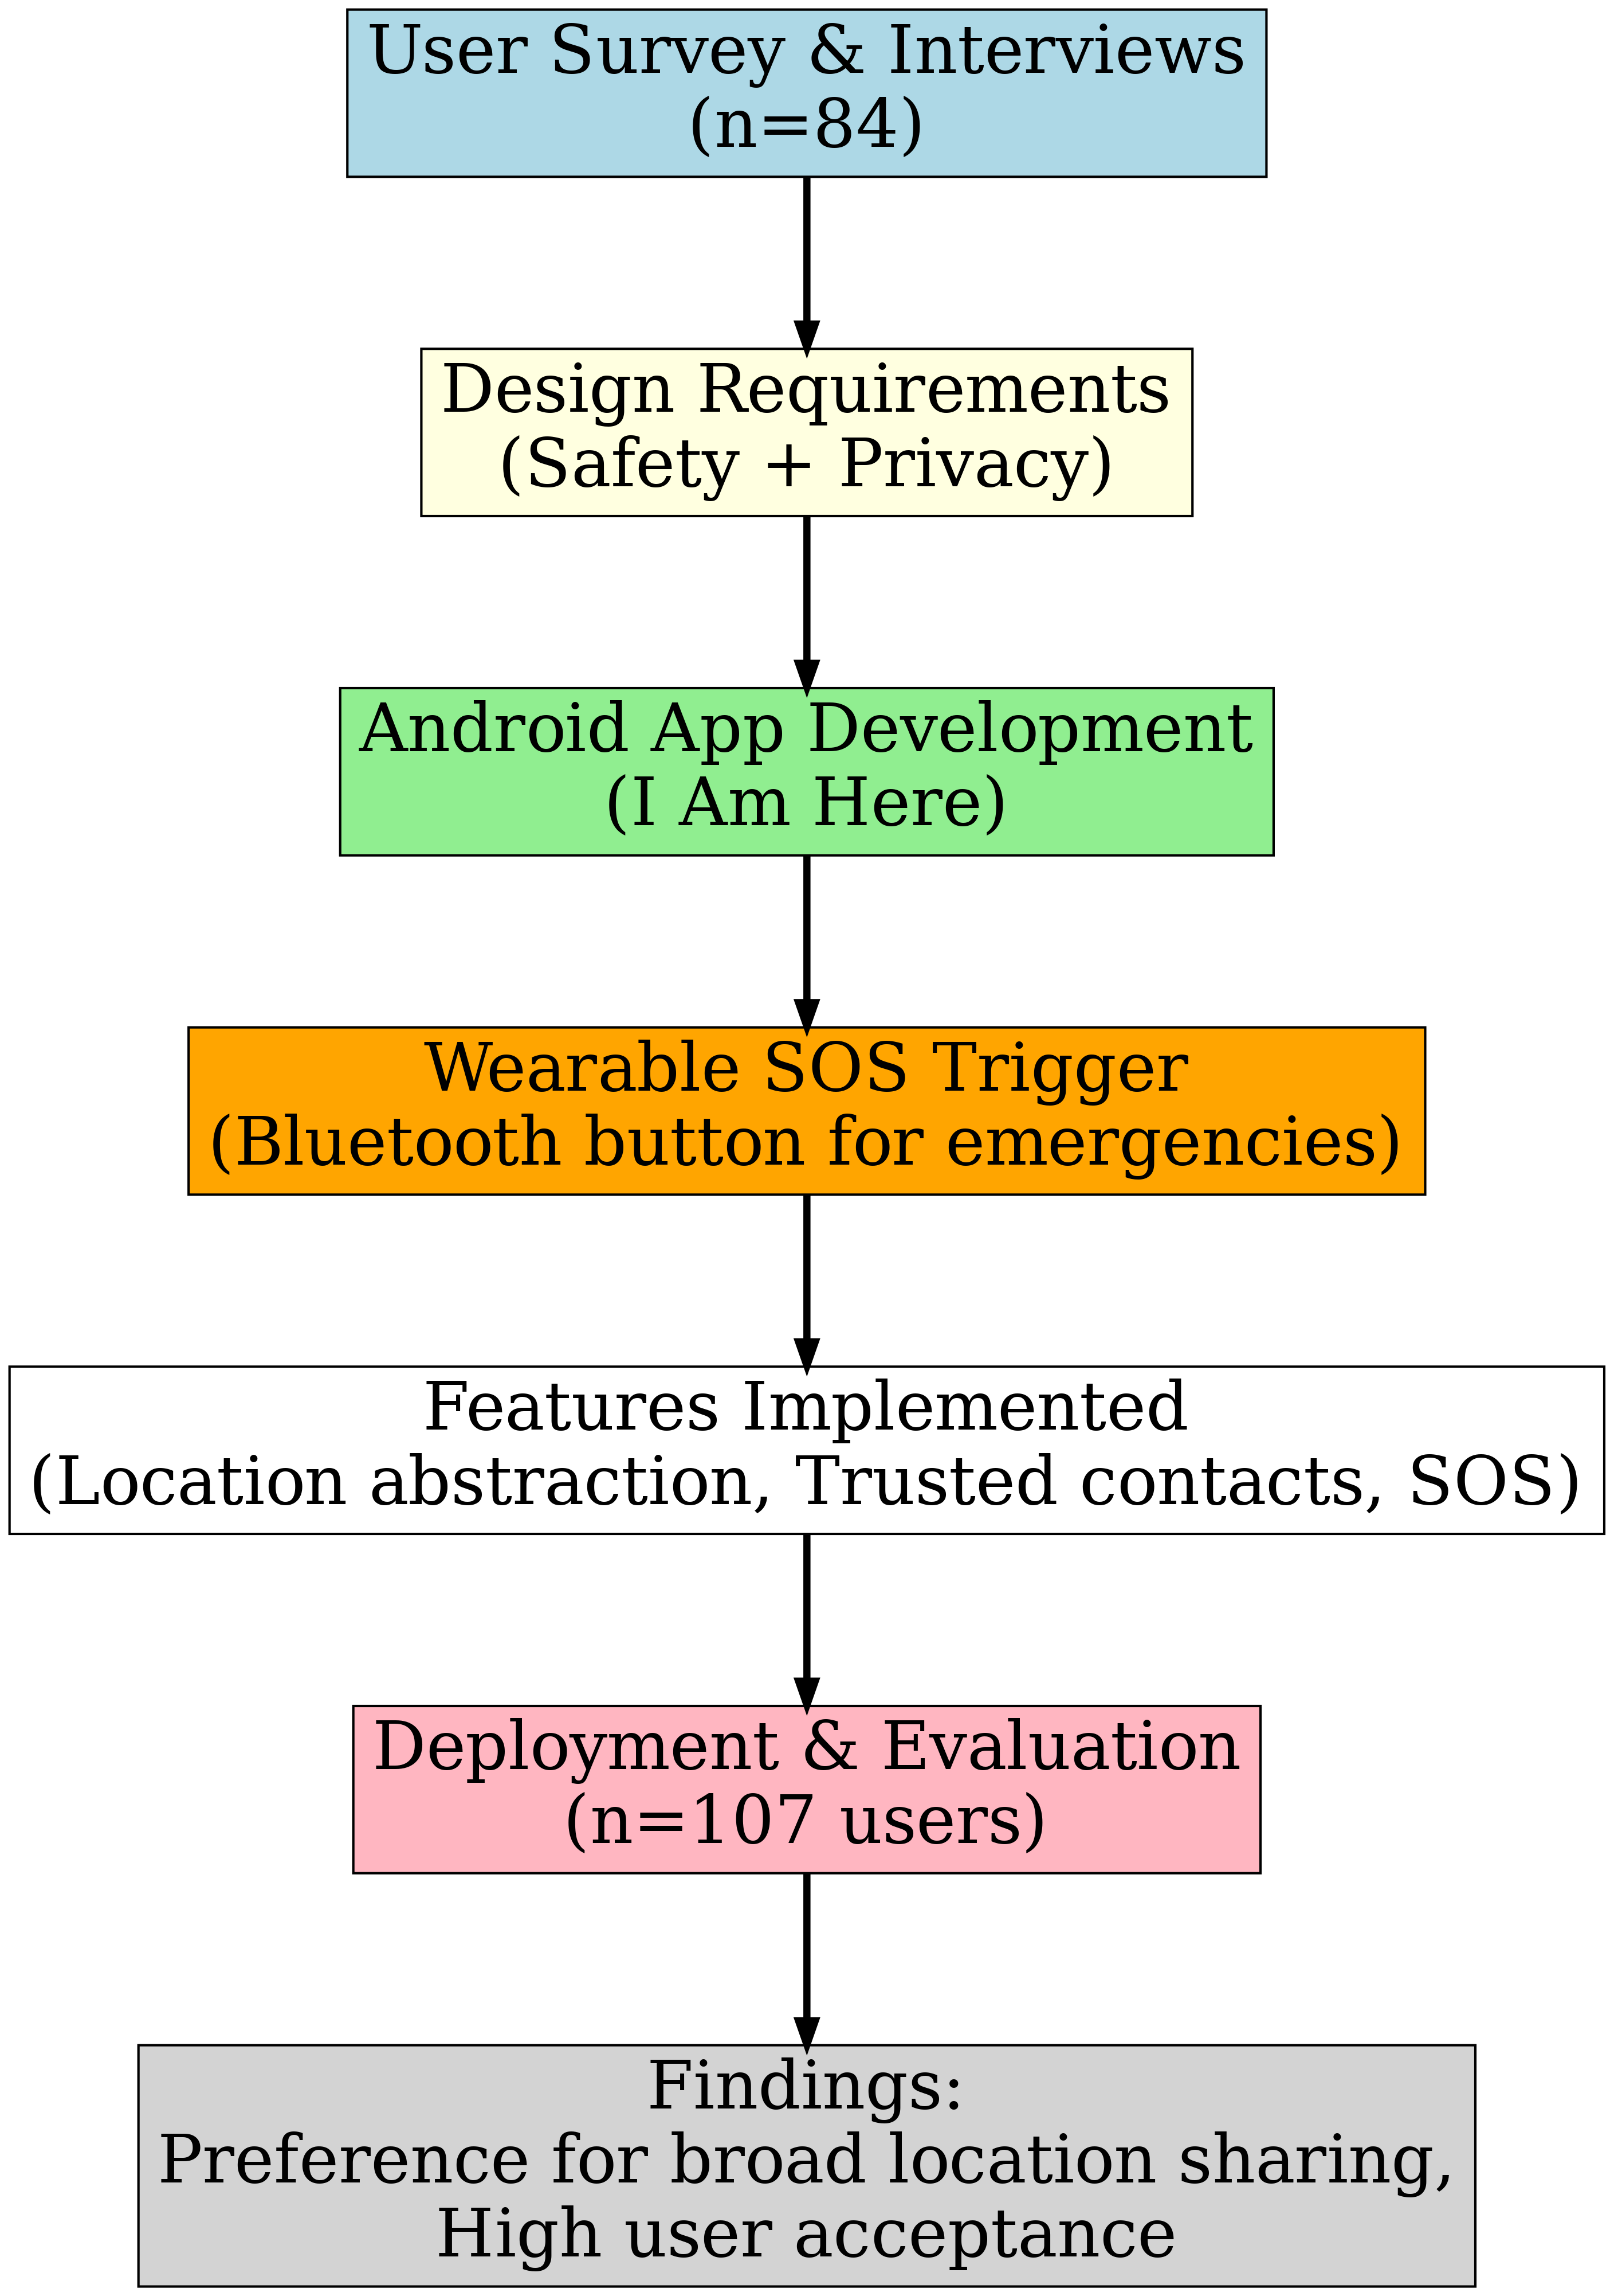
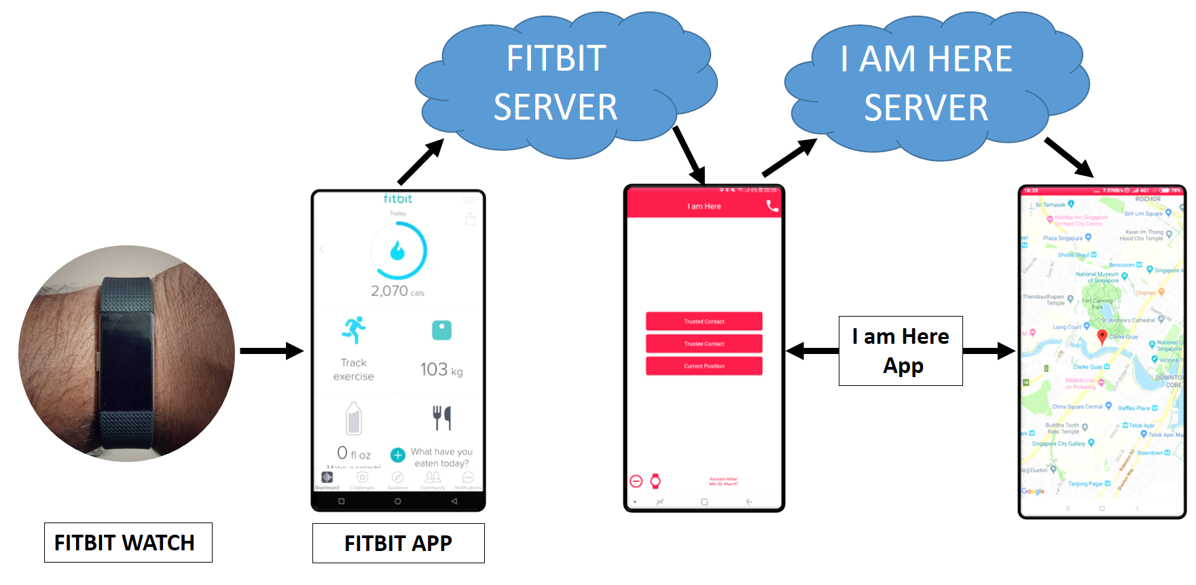
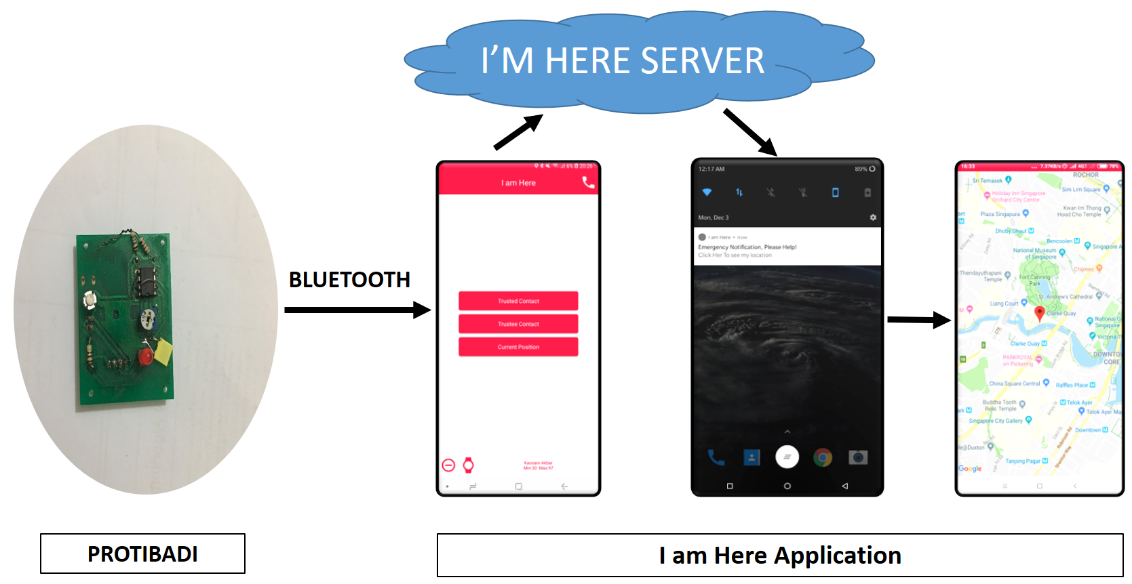
Previous Work Alignment towards PhD (BSc)
Relevance to the PhD Project (IMT Atlantique)
Context-Aware Filtering:
Capstone: User decides precision of shared location.
PhD: System decides which health sensor data is transmitted based on context.
Privacy-Preserving Local Processing:
Capstone: Processing & abstraction done on phone before transmission.
PhD: Local filtering/microservices on wearable/edge devices.
Edge + Wearable Integration:
Both involve lightweight, on-device processing.
User-Centric Design:
Both projects address real-world concerns (safety/privacy ↔ health/privacy).

Slide 11
Previous Work Alignment towards PhD (MASc)
Data Imputation & Curation
Imputed missing EV charging data using BiLSTM-CNN.
Alignment: Health data also suffers from missing/noisy signals → imputation methods transferable.
Context-Aware Signal Processing
Used supervised, semi-supervised, and ensemble methods to separate and forecast signals from aggregate data.
Alignment: Similar to filtering redundant sensor data in wearables using context.
Edge-Compatible ML Approaches
Explored lightweight regression models for real-time load forecasting.
Alignment: Resource-efficient models are needed for wearable and mobile health devices.
Handling Real-World Data Challenges
Worked with incomplete, noisy, and heterogeneous datasets in smart energy systems.
Alignment: Mirrors the challenges in continuous health monitoring (incomplete streams, noise, heterogeneity).

Slide 12
Motivation for this PhD
Why am I interested in this PhD position?
Growing importance of continuous health monitoring for chronic diseases (cardio, Alzheimer’s, elderly care).
How do I align for this role?
My research tackled noisy, incomplete, and large-scale sensor data (NILM, EV forecasting, imputation).
Experience with edge-compatible ML and data imputation (ResiDualNet) directly translates to wearable health data challenges.
Prior capstone (I Am Here) shows ability to design privacy-aware, context-driven, mobile + wearable systems.
Strong publication record and experience bridging data science + real-world applications.
My Motivation
Apply my expertise to build trustworthy, efficient, and human-centered health IoT systems that improve patient safety, data privacy, and healthcare outcomes.

Slide 13
Reference Paper Discussion
Data Acquisition, Curation and Use for a Continuously Learning Health System
Self-Care: Selective Fusion with Context-Aware Low Power Edge Computing for Stress Detection
Harmoni: Context aware Filtering of sensor data for continuous remote Health monitoring

Slide 14
Towards a Continuously Learning Health System
Importance & Trends
Health data growing rapidly: EHRs, wearables, genomics, patient-reported outcomes.
Potential to enable real-time learning, improve care, reduce costs, and accelerate research.
Problems
Data are often not shared across institutions.
Fragmented, inconsistent formats.
Limited patient access & control.

Slide 15
Towards a Continuously Learning Health System
Challenges
Cultural: Resistance to sharing by researchers & providers.
Technical: Interoperability, metadata quality, incomplete longitudinal data.
Regulatory: Issue with consent, ownership, complex rules.
Incentives: High cost for data holders, low perceived benefit.
Proposed Solutions
Promote a culture of sharing & openness.
Empower individuals with access & control of their own data.
Apply FAIR principles (Findable, Accessible, Interoperable, Reusable).
Strengthen national infrastructure & standards (APIs, interoperability).
Federal initiative for coordinated leadership (NIH, ONC, CMS, FDA).

Slide 16
Self-Care: Selective Fusion with Context-Aware Low Power Edge Computing for Stress Detection
What the Paper is About
Focus: Stress detection using wearable sensors.
Problem: Combining all sensor streams are computationally heavy and drains battery on wearables.
Goal: Stress detection with energy-efficient, context-aware edge computing.
Step 1: Preprocessing
The system starts with raw signals from four wrist sensors:
Accelerometer (ACC) – detects movement.
Blood Volume Pulse (BVP) – measures heart activity.
Electrodermal Activity (EDA) – measures skin sweat response.
Skin Temperature (TEMP).
These raw signals are noisy, so filters are applied to make the data clearer and easier to analyze.
Notes:
Accelerometer (ACC) – detects movement.
Blood Volume Pulse (BVP) – measures heart activity.
Electrodermal Activity (EDA) – measures skin sweat response.
Skin Temperature (TEMP).

Slide 17
Self-Care: Selective Fusion with Context-Aware Low Power Edge Computing for Stress Detection
Step 2: Context Identification
Feature Extraction (from ACC): Only motion features are extracted first, since movement directly affects the reliability of other signals.
Gating Model: A simple decision tree model looks at the motion features and decides which sensor combination to use.
Branch 1 (B1): BVP + EDA + TEMP
Branch 2 (B2): ACC + BVP + EDA
Branch 3 (B3): BVP + EDA
3. Performance-Energy Trade-off (δ):
δ (delta) is a knob that balances accuracy vs. battery life.
If δ is small → only the best branch is chosen (saves energy).
If δ is large → multiple branches may be used (more accurate, but more energy).
4. Early Fusion: Once the branches are chosen, the signals from those sensors are combined (features concatenated) and sent to the branch classifiers.
Notes:
Accelerometer (ACC) – detects movement.
Blood Volume Pulse (BVP) – measures heart activity.
Electrodermal Activity (EDA) – measures skin sweat response.
Skin Temperature (TEMP).

Slide 18
Self-Care: Selective Fusion with Context-Aware Low Power Edge Computing for Stress Detection
Step 3: Branch Classifiers
Each branch has its own classifier trained on its sensor combination.
Simple machine learning models are used instead of heavy deep learning, since they’re lightweight and efficient for wearables.
Each branch outputs a prediction like:“This 60-second segment looks like Stress with 70% probability.”
Step 4: Late Fusion
Since more than one branch may be active, their predictions need to be combined.
SELF-CARE uses a Kalman filter for fusion.
This filter not only merges predictions but also considers time dynamics.
Example: If stress is predicted at time t, the filter expects stress to continue at time t+1 unless strong evidence says otherwise.
This is smarter than simple voting (hard/soft voting), because it accounts for noise and trends over time.
Notes:
Accelerometer (ACC) – detects movement.
Blood Volume Pulse (BVP) – measures heart activity.
Electrodermal Activity (EDA) – measures skin sweat response.
Skin Temperature (TEMP).

Slide 19
Self-Care: Selective Fusion with Context-Aware Low Power Edge Computing for Stress Detection
Problems / Limitations
If δ is too strict, useful sensors may be skipped; if too loose, energy savings drop.
Single dataset, small sample size meaning model may not generalize well.
All participants treated the same, even though stress signals vary across individuals.
Does not test on broader health monitoring contexts.
Some accuracy is sacrificed for power savings.
Potential Solutions
Adaptive δ: Learn threshold dynamically per user or per context.
Personalization: Incorporate user-specific baselines (e.g., resting heart rate).
Larger datasets: Validate on multiple real-world datasets, not just WESAD.
Broader applications: Extend framework to other health monitoring tasks (e.g sleep monitoring).
Smarter fusion: Use reinforcement learning or attention mechanisms instead of a fixed gating model.
Notes:
Accelerometer (ACC) – detects movement.
Blood Volume Pulse (BVP) – measures heart activity.
Electrodermal Activity (EDA) – measures skin sweat response.
Skin Temperature (TEMP).

Slide 20
Harmoni: Context-Aware Filtering for Remote Health Monitoring
Introduction
Goal: Reduce redundant sensor data before transmission to backend.
Motivation: Wearables generate continuous streams → too much data = high cost, battery drain, privacy risk.
Approach: Context-aware filtering on mobile devices.
Step 1: Sensor Data Collection
Biomedical sensors (heart rate, SpO₂) worn by patients.
Continuous raw data streams is transmitted to mobile gateway (phone/PDA).
Step 2: Data Adaptation
Converts raw sensor outputs into a standard format.
Handles different communication protocols & sensor vendors.

Slide 21
Harmoni: Context-Aware Filtering for Remote Health Monitoring
Step 3: Event Engine (Context-Aware Filtering)
Applies context-dependent filtering rules:
Example: Office HR normal = 50–90 bpm, Gym HR normal = 90–170 bpm.
Step 4: Rule Manager
Ensures correct filtering rules are active.
Rules may change based on:
Local context: Office and Gym.
Remote updates: New rules from backend server (doctor updates thresholds).
Step 5: Local Action Manager
Triggers on-device actions without needing server communication.
Example: alarm if HR too high, reminder for medication.
Reduces dependency on backend for urgent events.

Slide 22
Harmoni: Context-Aware Filtering for Remote Health Monitoring
Step 6: Data Transmission
After filtering, only meaningful events are sent.
Data is compressed before transmission (over Wi-Fi, GPRS, 3G).
Saves bandwidth and battery.
Step 7: Backend Server
Collects filtered data for storage & analysis.
Runs a Rule Server that can update rules dynamically.
Supports personalization and clinician feedback.
Step 8: Evaluation & Findings
Tested with 4 participants (office vs. gym activities).
Context-aware filtering reduced transmission load by up to 72%.
Outperformed compression-only approaches.
Key insight: Correct context detection is critical — wrong context = inefficient filtering.

Slide 23
Harmoni: Context-Aware Filtering for Remote Health Monitoring
Problems / Limitations
Contexts defined manually (office, gym).
Very small study (only 4 participants).
Wrong context → filtering becomes inefficient.
Limited sensors tested (only HR, SpO₂).
Backend personalization not fully evaluated.
Potential Solutions
Automatic context detection (accelerometer, GPS, activity recognition).
Larger-scale trials with diverse users.
Adaptive rules learned dynamically per patient.
Integration with anomaly detection for smarter filtering.
Extend to more complex data (ECG, EEG).

Slide 24
PhD Plan (tentative)
Foundations
Literature review & gap analysis
Define health data use cases (with Premyom partners)
Initial prototypes for context-aware filtering
Workshop/conference paper
Development
Implement local filtering + imputation microservices
Automate data processing pipelines
Collect and analyze pilot datasets
Submit journal + conference papers
Evaluation & Contribution
Large-scale validation (trade-offs: accuracy, energy, privacy)
Refinement with clinician/user feedback
Finalize PhD framework & thesis
High-impact journal publications
Expected Outcome: A validated context-aware, privacy-preserving wearable health system framework with scientific contributions (papers + thesis) and practical impact.

Slide 25
Career Plan
Short-Term (After PhD):
Pursue a Postdoctoral position.
Continue research in healthcare data, IoT, and edge computing.
Collaborate with academia and industry R&D partners to apply research outcomes.
Long-Term:
Work towards becoming a faculty member.
Lead research in context-aware, privacy-preserving AI for health systems.
Mentor students and contribute to advancing this field.
Continue bridging academic research and industrial innovation.
Vision: To create human-centered AI systems that transform healthcare through collaboration between academia and industry.

Slide 26
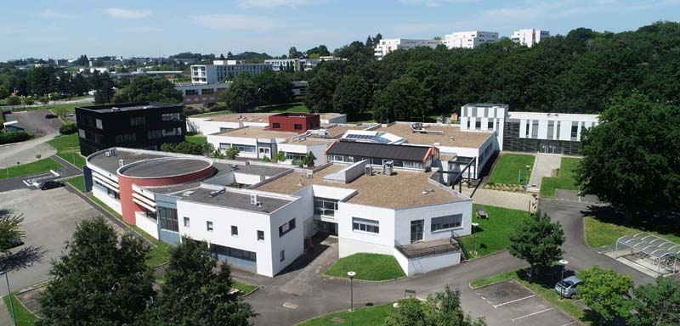
Thank You

