Slide 1



Information Systems
VAKSINA UZ — Cross-Platform Vaccination Management System
Bachelor Paper
Holmatov Akbarali
Supervisor: : Dr.sc,ing., Profesor, Jelena Caiko
April 2026

Slide 2


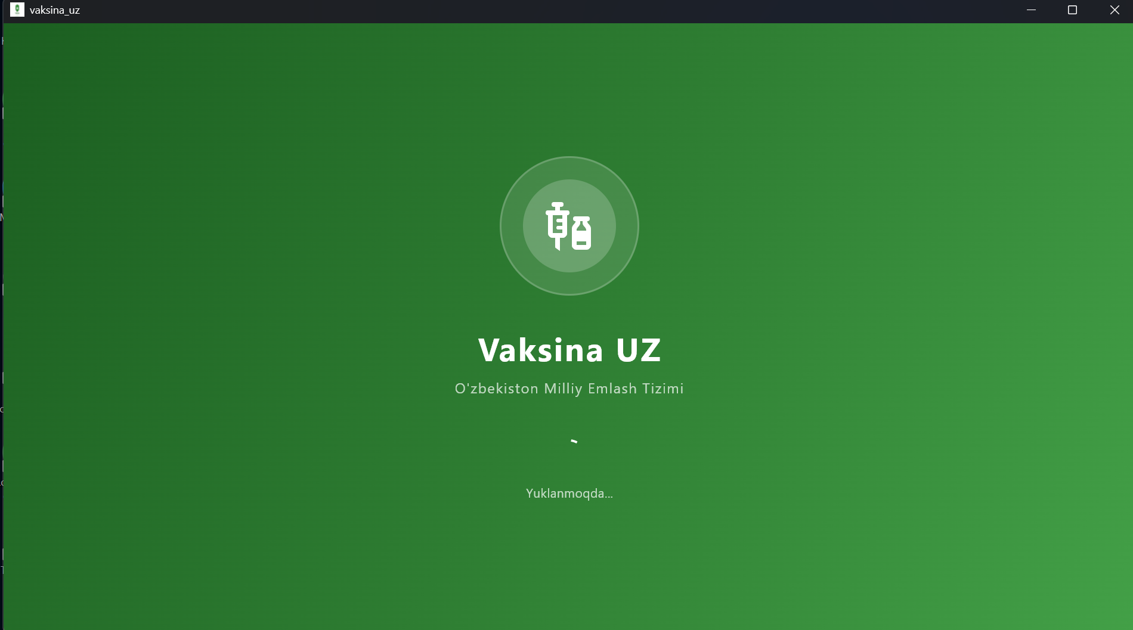
Scientific Base of Research
Research Problem
Medical staff in clinics manage vaccination records manually using paper journals and Excel — leading to missed vaccination dates, data errors, and no real-time visibility across polyclinics.
Research Object
VAKSINA UZ system — its architecture, functional modules, data models and integrated workflows for patient vaccination management.
Research Subject
Software methods, data models and technologies for automating patient registration, vaccination scheduling and status tracking in the Republic of Uzbekistan.

Slide 3
Aim and Hypothesis of Research
Aim: Develop and deploy VAKSINA UZ — a cross-platform mobile system that digitises the full vaccination lifecycle through role-based authentication, real-time scheduling and cloud data synchronisation.
Hypothesis: A structured, cross-platform, role-based vaccination management system will significantly reduce registration errors and improve scheduling efficiency compared to manual methods.
Result: All 5 tasks completed. System deployed on Android, iOS, Web and Windows from a single Dart codebase with Firebase Firestore backend.

Slide 4
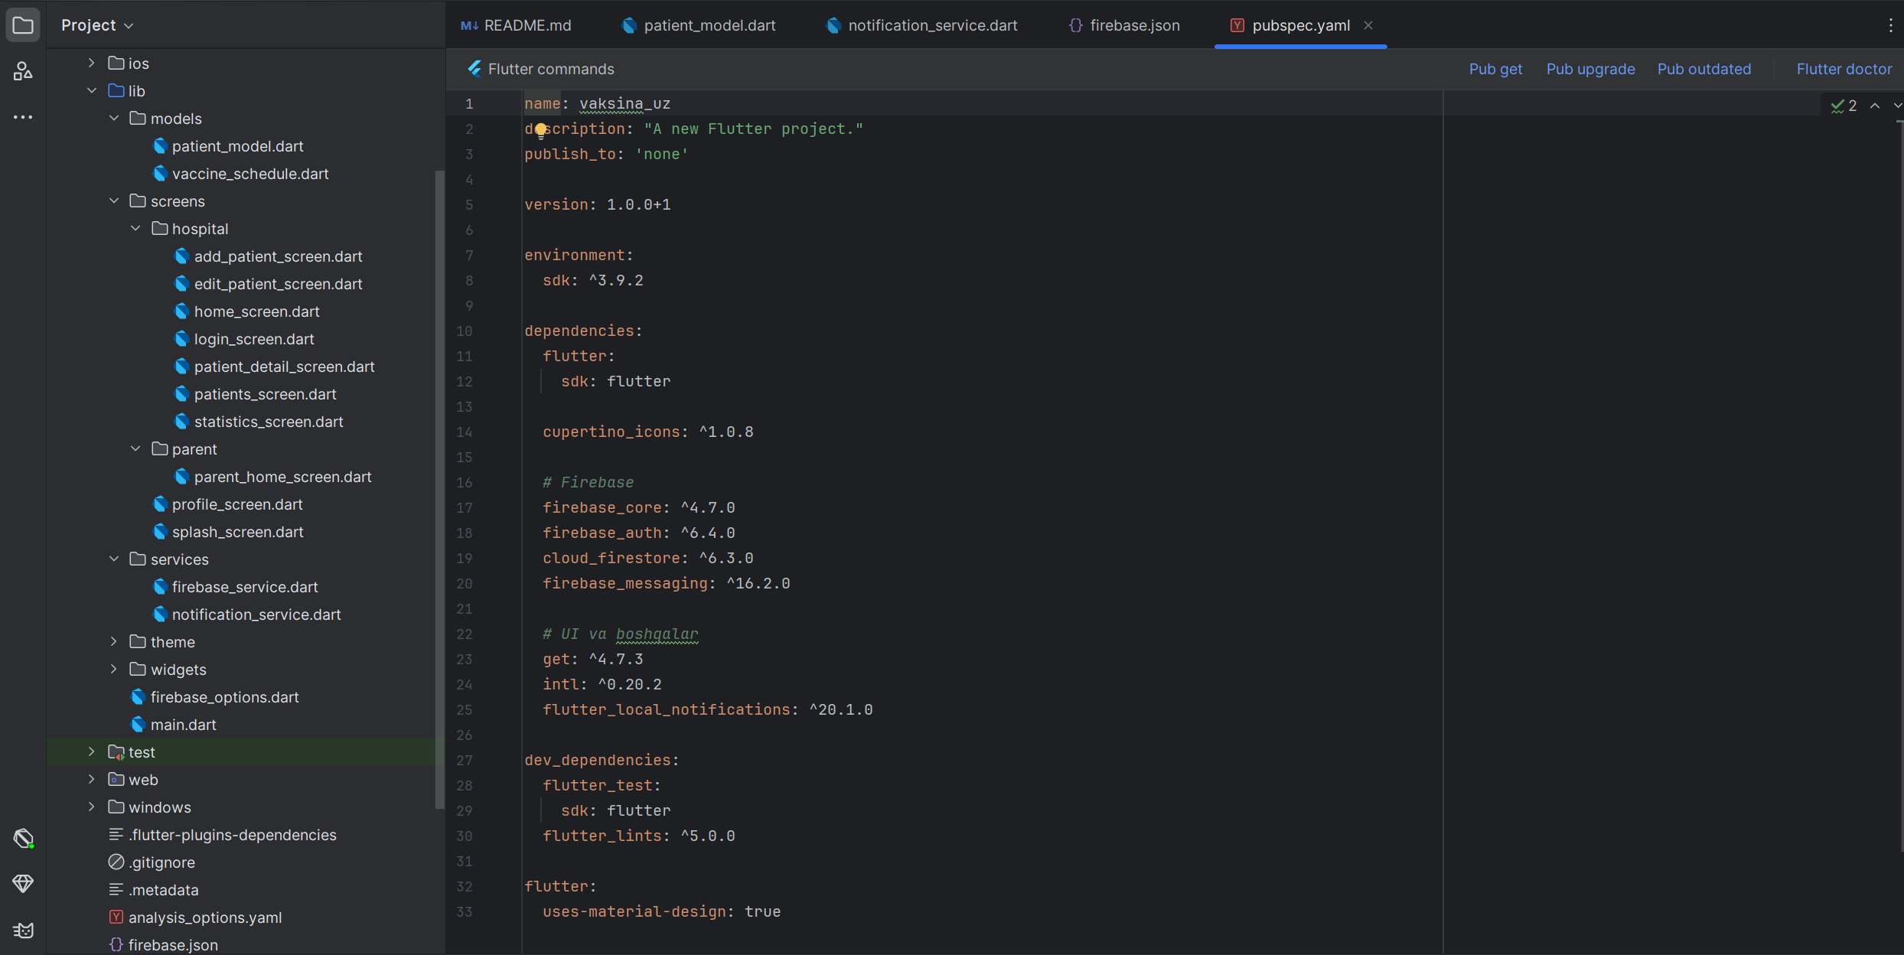
Tasks of the Study
Task 1 Analyse existing vaccination workflows and identify inefficiencies in Uzbekistan polyclinics
Task 2 Design a two-role architecture (Hospital / Parent) with Firebase Auth
Task 3 Implement the National Vaccination Calendar of Uzbekistan (23 vaccines, age 0–16)
Task 4 Develop cross-platform Flutter + Firebase application with real-time Firestore sync
Task 5 Implement automatic schedule calculation with 4-status tracking: Overdue / Due / Upcoming / Scheduled

Slide 5
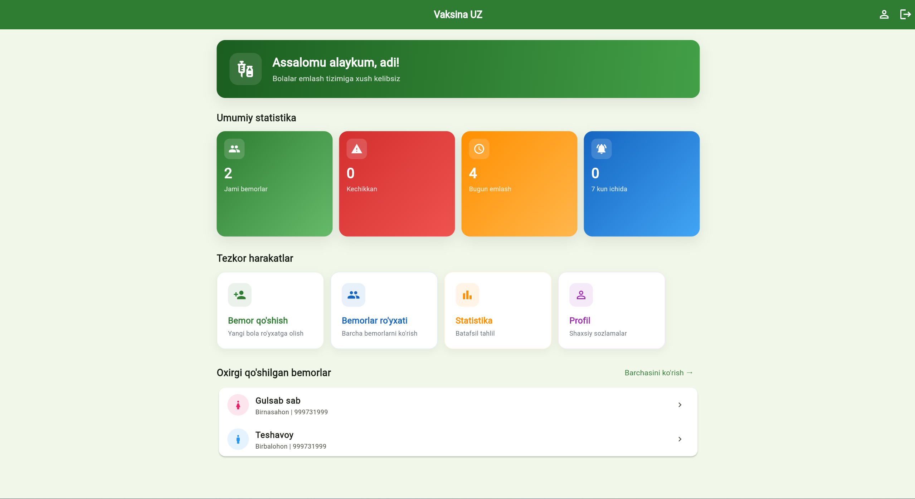
Research Methods
Theoretical
Literature review of mobile health systems, Firebase architecture, Flutter SDK and the Uzbekistan MoH vaccination regulations
Empirical
Observation of polyclinic workflows, user interviews with medical staff, prototype usability testing and UAT
Experimental
Agile development cycles, functional testing on 4 platforms (Android, iOS, Web, Windows), security review of Firestore rules and role-based access control

Slide 6
Key Functionality
✓ Role-Based Auth Hospital staff & Parents — separate dashboards
✓ Patient Registry Full CRUD — name, DOB, gender, parents, address, polyclinic
✓ National Calendar (23 vaccines) MoH Uzbekistan 2025 — from birth (VGB-1) to age 16 (ADS-M)
✓ Auto Schedule Calculation 4 statuses per vaccine: Overdue / Due / Upcoming / Scheduled
✓ Real-Time Sync Firestore Streams — live updates without page refresh
✓ Parent Portal View child vaccination schedule and urgent alerts

Slide 7
General Conclusion
All 5 Tasks Completed — Hypothesis Confirmed
● 23 vaccines of the National Calendar (MoH Uzbekistan 2025) fully implemented with automatic date calculation
● Role-based access (Hospital / Parent) with Firebase Auth ensures data integrity
● Real-time Firestore Streams enable live vaccination status monitoring without page refresh
● Identified critical security gaps (Firestore rules, parent filtering) documented as P0 priorities for v1.1
● System ready for pilot deployment in Uzbekistan polyclinics upon security hardening

Slide 8
Thank you!

