Slide 1
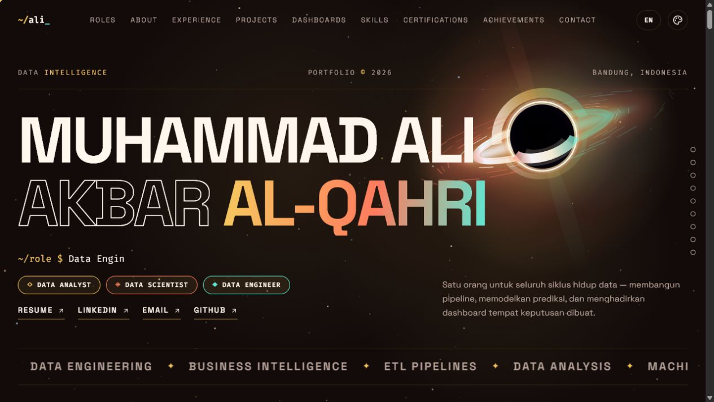
~/ SUNSET SIGNAL / DATA INTELLIGENCE
I turn raw data into decisions.
Reliable data. Applied models. Decision-ready products.
3.74 / 4.00 GPA
BEST PAPER
INDONESIA
LIVE PORTFOLIO / SAME DESIGN SYSTEM
Muhammad Ali Akbar Al-Qahri
DATA ANALYST / DATA SCIENTIST / DATABASE ENGINEER
akbaralqahri@gmail.com
A consistent visual language across web, PowerPoint, and PDF: cosmic dark surfaces, signal colors, monospaced labels, and decision-focused storytelling.
~/ali_ / DATA INTELLIGENCE PORTFOLIO
01

Slide 2
~/ POSITIONING
One profile covers the full data lifecycle.
From trusted inputs to decisions people can act on.
01
02
03
Data Analyst
Data Scientist
Database Engineer
Frames the question, defines KPIs, and communicates the decision.
Builds interpretable models and validates whether they generalize.
Designs reliable pipelines, transformations, and quality controls.
8 strategic dashboards
85.1% R² · 89% accuracy
10K+ questions automated
~/ali_ / DATA INTELLIGENCE PORTFOLIO
02

Slide 3
~/ EVIDENCE
The work is already measurable.
Three outcomes spanning business intelligence, automation, and machine learning.
40%
92%
89%
faster reporting
text-processing accuracy
classification accuracy
Across five Bank Indonesia branches
Gemini API workflow for question automation
Stock movement research · Best Paper
~/ali_ / DATA INTELLIGENCE PORTFOLIO
03

Slide 4
~/ EXPERIENCE
I have delivered across analytics, engineering, and enablement.
2024
2024–25
2025
2025–now
Bank Indonesia
Telkom University
Garda Abdi Negara
Cerebrum
Data Analyst Intern
Teaching Assistant
Database Engineer
Data Analyst
8 dashboards · 85% stakeholder satisfaction
500+ assignments · 30% performance lift
10K+ questions · 75% faster processing
MySQL ETL · Power BI KPI systems
~/ali_ / DATA INTELLIGENCE PORTFOLIO
04

Slide 5
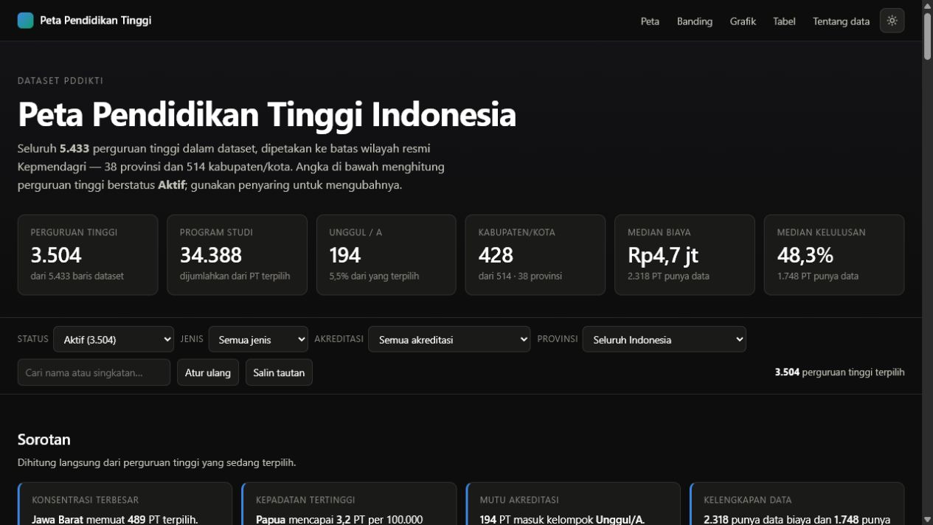
~/ FLAGSHIP PRODUCT
PDDIKTI turns fragmented education data into a national map.
A public exploration product for comparing higher-education coverage across provinces and cities—supported by explicit data-quality checks.
DEPLOYED WEB APP
5,433
38
34
institutions
provinces
quality checks
perguruan-tinggi-indonesia-nu.vercel.app
~/ali_ / DATA INTELLIGENCE PORTFOLIO
05

Slide 6
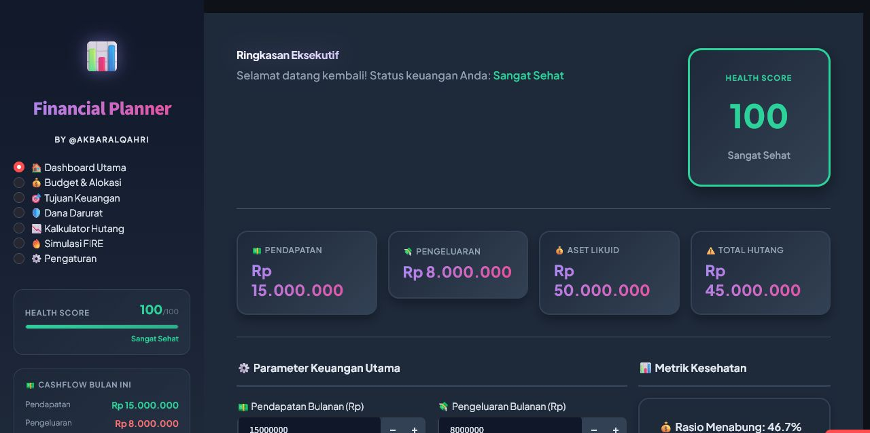
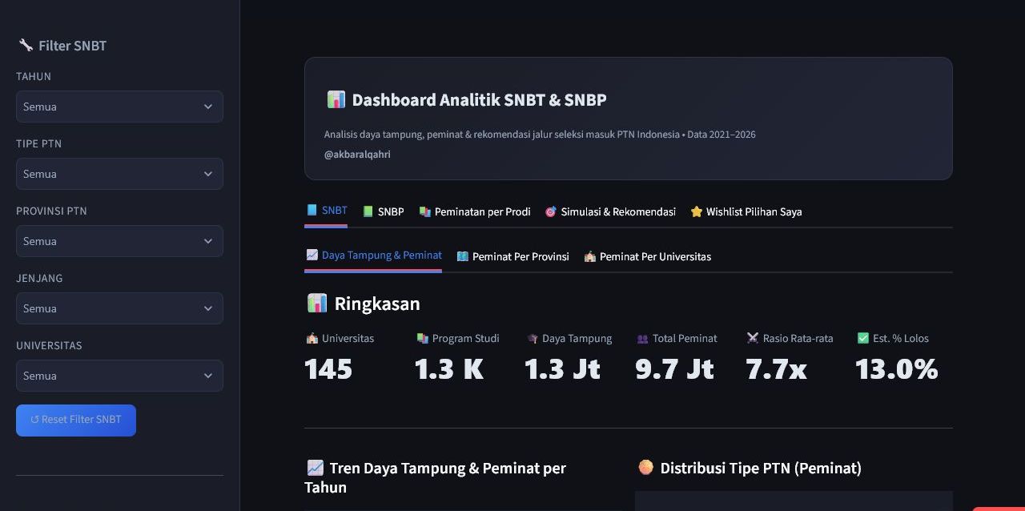
~/ DECISION PRODUCTS
Two deployed apps convert complex choices into guided analysis.
Financial Planner
STREAMLIT
SNPMB Analyst
STREAMLIT
Scenario-based financial planning with actionable summaries.
Exploration and comparison for Indonesia’s university admission pathway.
~/ali_ / DATA INTELLIGENCE PORTFOLIO
06

Slide 7
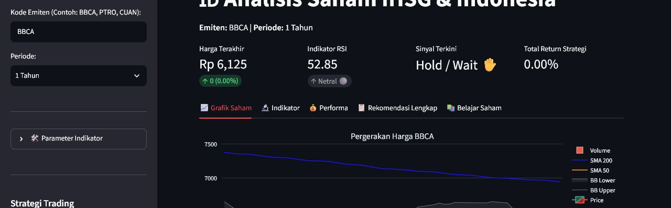
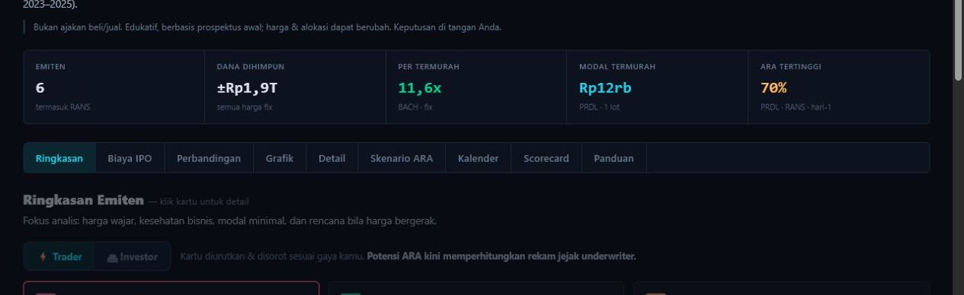
~/ MARKET INTELLIGENCE
Financial-market analysis becomes easier when the product leads the user.
IPO TERMINAL
IHSG ANALYSIS
Screen new listings with a focused workflow.
Explore market signals in one visual workspace.
A product view designed to reduce cognitive load while comparing IPO opportunities.
ypcsaham.streamlit.app
saham-ipo.vercel.app
~/ali_ / DATA INTELLIGENCE PORTFOLIO
07

Slide 8
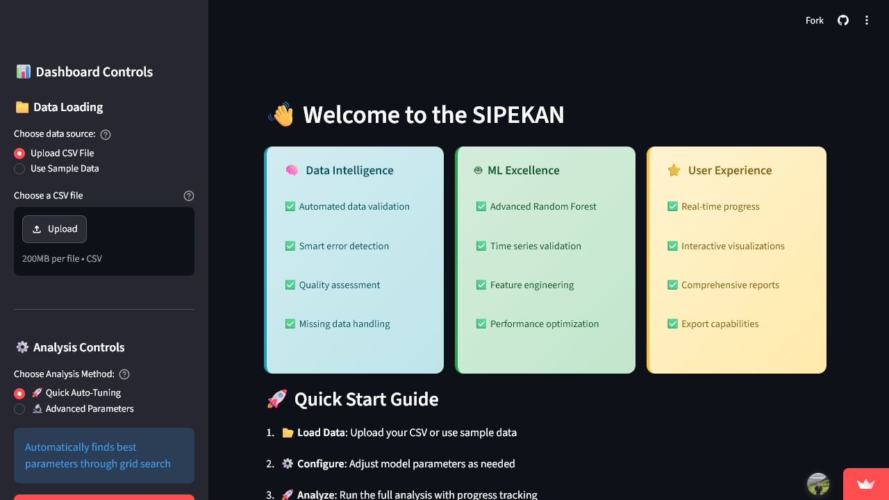
~/ APPLIED MACHINE LEARNING
Model quality matters most when it supports a real decision.
85.1%
89%
R² across 34 provinces
stock classification accuracy
Food Security Forecasting
Forecasting highlights provinces needing closer attention and turns model output into a public-facing analytical tool.
BEST PAPER · ICoDSA 2025
~/ali_ / DATA INTELLIGENCE PORTFOLIO
08

Slide 9

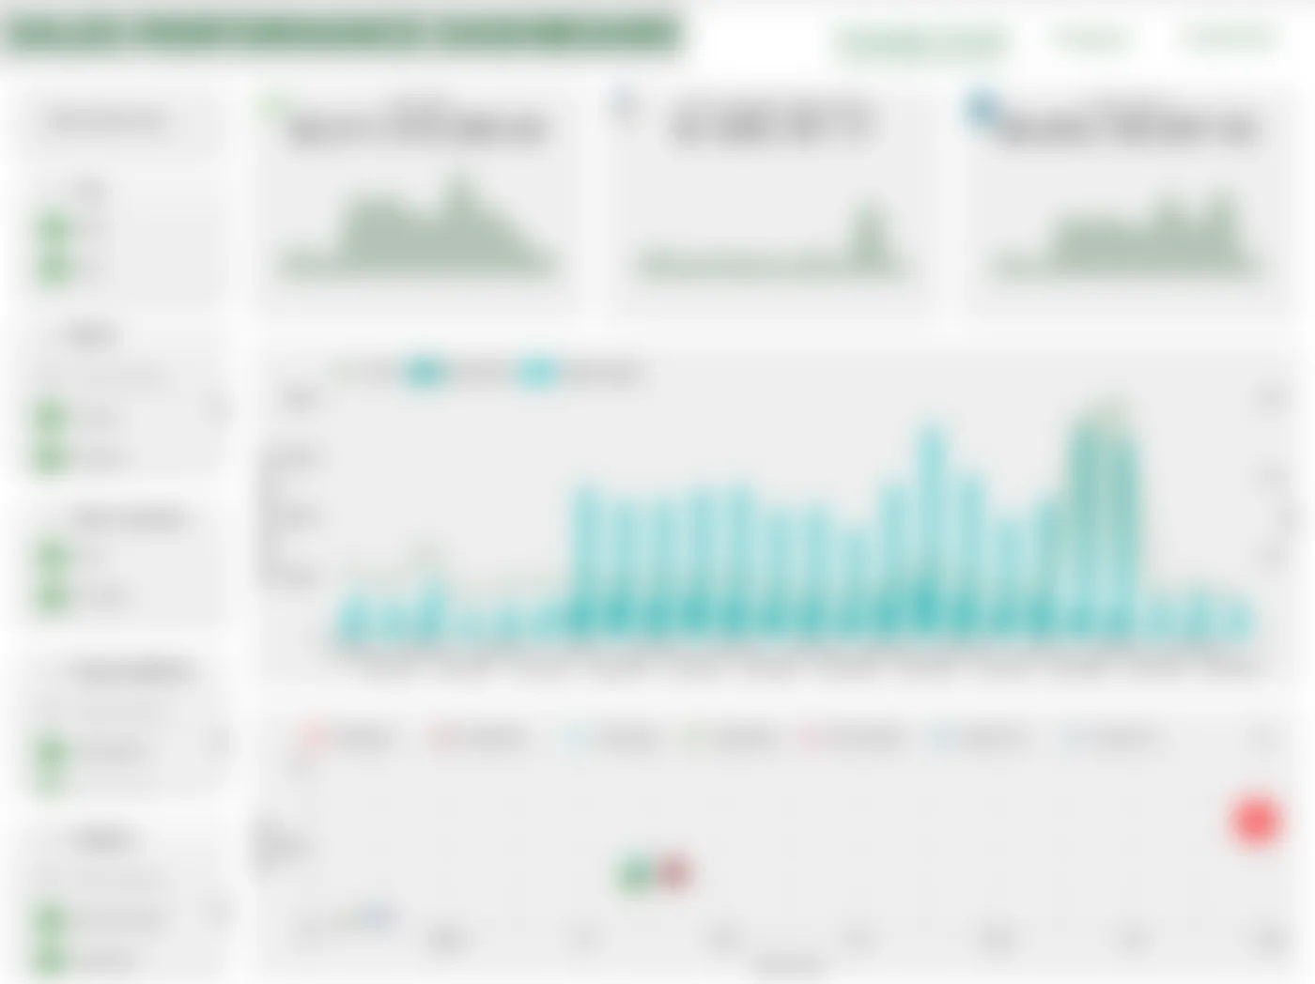
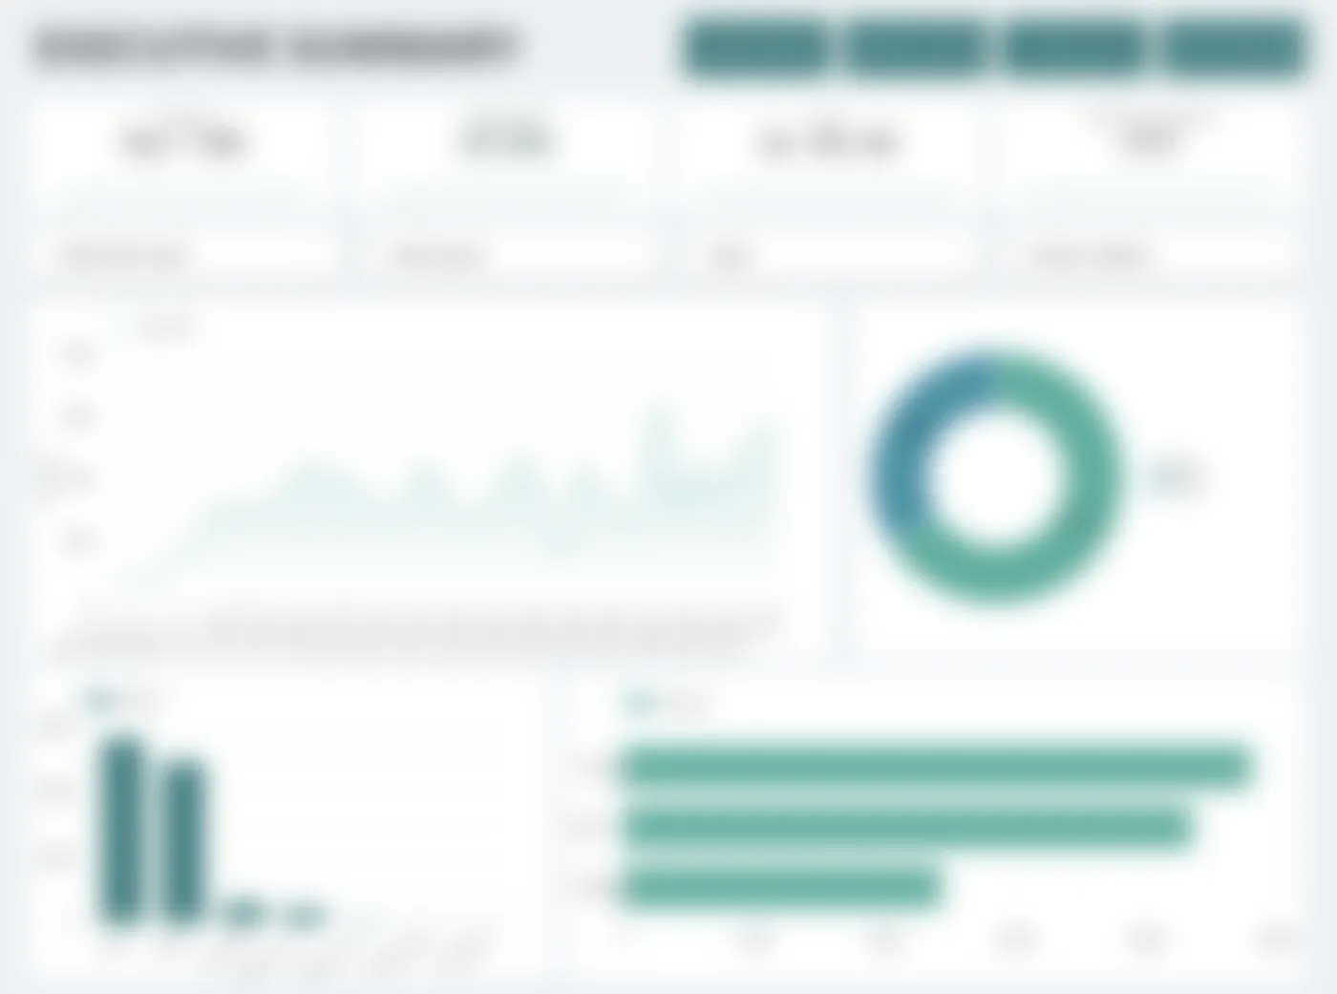
~/ BUSINESS INTELLIGENCE
Dashboards are delivery systems for decisions—not decoration.
Selected dashboard samples are intentionally blurred to protect sensitive information.
Revenue Monitoring
Sales Performance
Executive Summary
Power BI · KPI tracking
Looker Studio · trend analysis
Looker Studio · decision overview
~/ali_ / DATA INTELLIGENCE PORTFOLIO
09

Slide 10
~/ CAPABILITY
A production-ready stack—grounded in analytical judgment.
Analyze
Model
Engineer
Communicate
Python · SQL Pandas · NumPy Statistics · EDA
Scikit-learn XGBoost · TensorFlow Forecasting · NLP
MySQL · PostgreSQL ETL · Data quality Git · API workflows
Power BI · Looker Streamlit · Tableau Storytelling
CREDENTIALS
B.Sc. Data Science · GPA 3.74/4.00 | Best Paper, ICoDSA 2025 | NVIDIA DLI · Google Analytics · Alibaba Cloud
~/ali_ / DATA INTELLIGENCE PORTFOLIO
10

Slide 11
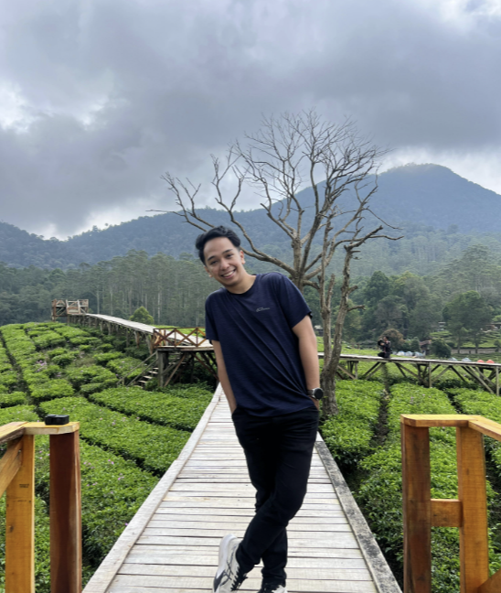
Let’s build decisions people can act on.
Available for data analyst, business intelligence, data science, and data engineering opportunities.
~/ EMAIL
akbaralqahri@gmail.com
DATA / MODELS / DECISIONS
linkedin.com/in/akbaralqahri akbaralqahri.github.io/portofolio
akbaralqahri.github.io/portofolio
+62 852 1194 4977
11

