Slide 1
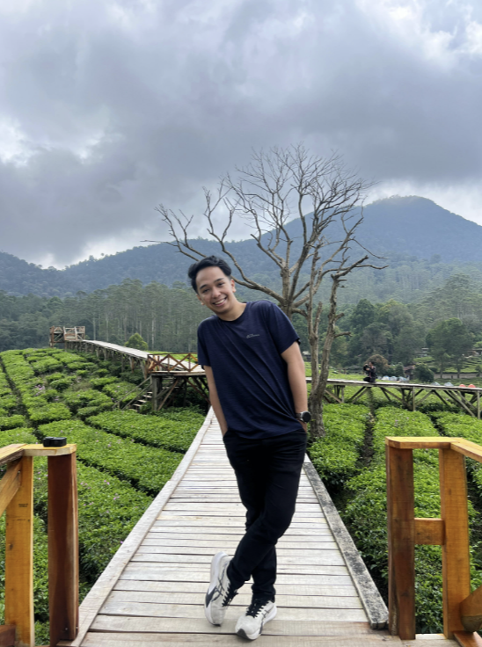
DATA INTELLIGENCE PORTFOLIO · 2026
Muhammad Ali Akbar
Al-Qahri
Analyst · Scientist · Engineer
ANALYZE
MODEL
ENGINEER
FULL PORTFOLIO · CASE STUDIES · LIVE PROJECTS
Data products built for decisions.
BUSINESS INTELLIGENCE / FORECASTING / DATA SYSTEMS
akbaralqahri@gmail.com
OPEN THE COMPLETE WEB PORTFOLIO
akbaralqahri.github.io/portofolio
~/ali_ / DATA INTELLIGENCE PORTFOLIO
01

Slide 2
POSITIONING
One profile spans analysis, modeling, and data systems.
The work stays connected from trusted inputs to decisions people can act on.
01
02
03
Data Analyst
Data Scientist
Data Engineer
Frames the question, defines KPIs, and communicates the decision.
Builds interpretable models and validates whether they generalize.
Builds reliable pipelines, transformations, and data-quality controls.
8+ strategic dashboards
85.1% R² · 89% accuracy
10K+ records automated
~/ali_ / DATA INTELLIGENCE PORTFOLIO
02

Slide 3
EVIDENCE
The work is already measurable.
Outcomes across business intelligence, automation, and applied machine learning.
40%
92%
89%
faster reporting
text-processing accuracy
classification accuracy
Across five Bank Indonesia branches
Gemini API workflow for question automation
Stock movement research · Best Paper
~/ali_ / DATA INTELLIGENCE PORTFOLIO
03

Slide 4
EXPERIENCE
Experience shaped by delivery, not just analysis.
2024
2024-25
2025
2025-26
Bank Indonesia
Telkom University
Garda Abdi Negara
Cerebrum
Business Intelligence Intern
Teaching Assistant
Database Engineer
Data Intelligence
8 dashboards · 85% stakeholder satisfaction
500+ assignments · 30% performance lift
10K+ questions · 75% faster processing
Analytics · forecasting · internal systems
~/ali_ / DATA INTELLIGENCE PORTFOLIO
04

Slide 5
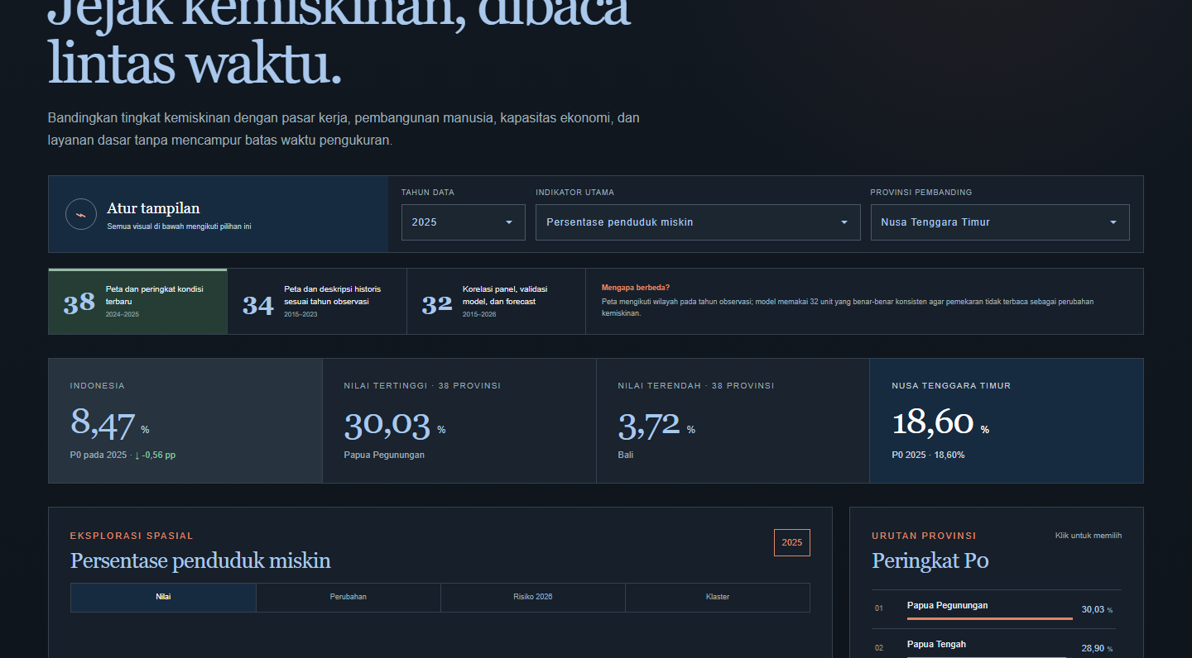
GEOSPATIAL INTELLIGENCE
Three national maps make regional patterns visible and comparable.
PDDIKTI maps higher education, SPPG Insight tracks service coverage, and Peta Kemiskinan combines BPS trends, spatial clustering, and forecast diagnostics.
3 DEPLOYED APPS
3
38
0.353
live geo portals
provinces covered
forecast MAE (pp)
OPEN PETA KEMISKINAN ↗
~/ali_ / DATA INTELLIGENCE PORTFOLIO
05

Slide 6
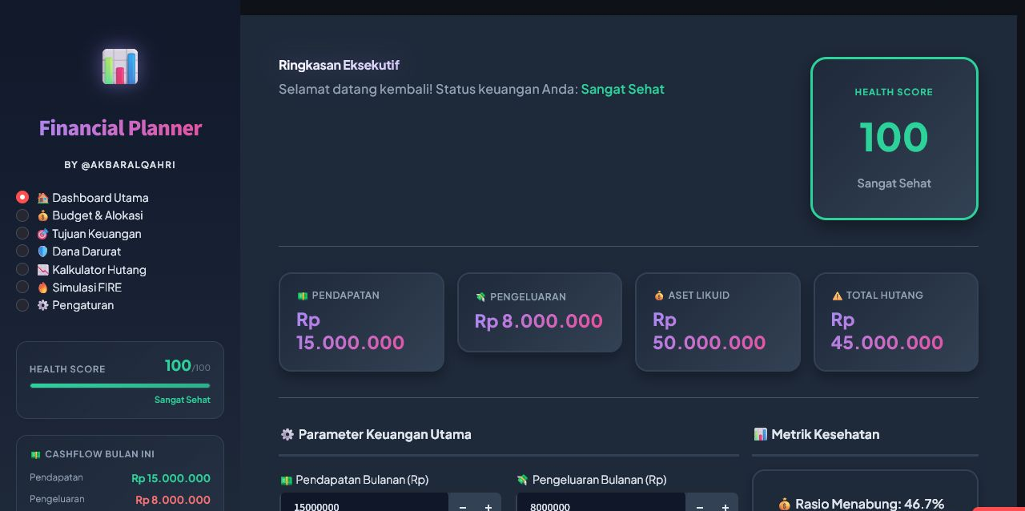
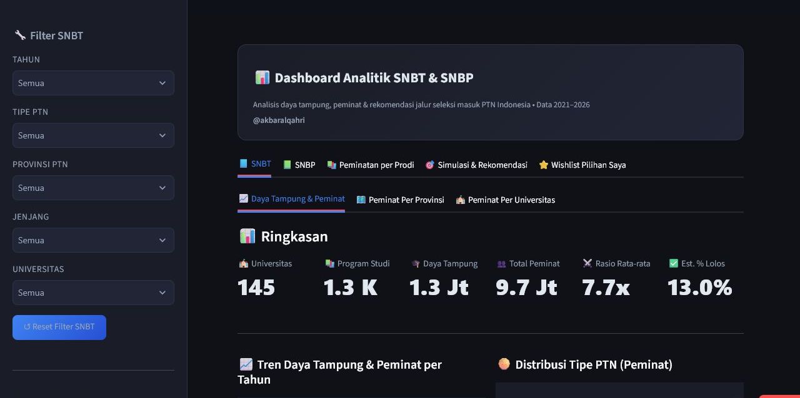
DEPLOYED APPLICATIONS
Deployed apps turn complex choices into guided analysis.
Financial Planner
STREAMLIT
SNPMB Analyst
STREAMLIT
Scenario-based financial planning with actionable summaries.
Exploration and comparison for Indonesia’s university admission pathway.
~/ali_ / DATA INTELLIGENCE PORTFOLIO
06

Slide 7
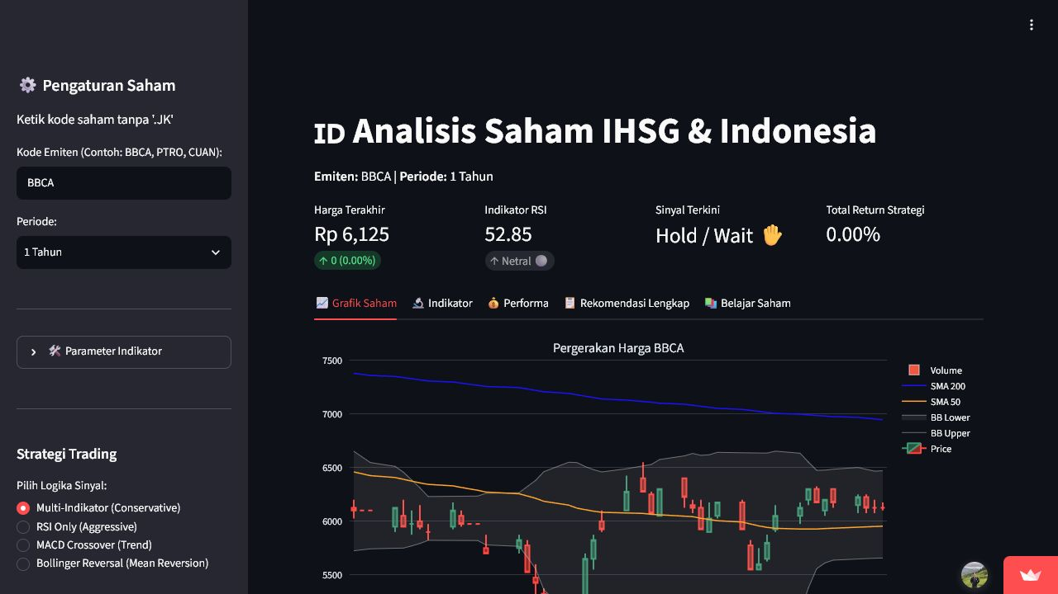
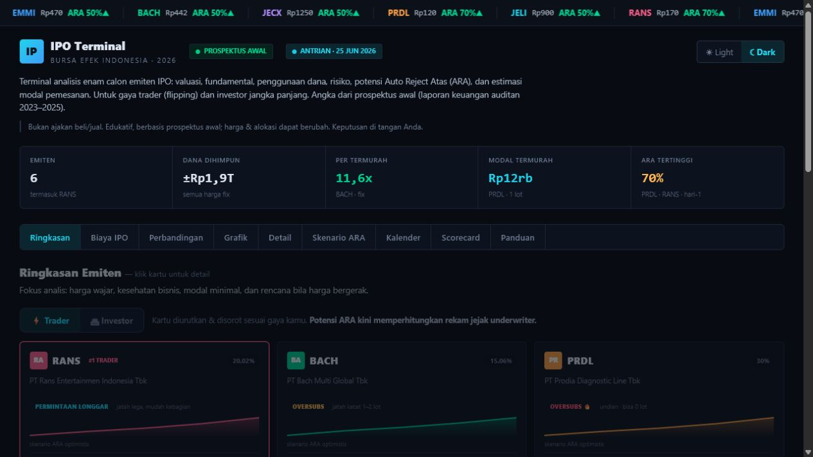
MARKET INTELLIGENCE
Financial-market analysis becomes clearer when the product leads the user.
IPO TERMINAL
IHSG ANALYSIS
Screen new listings
with a focused workflow.
Explore market signals
in one visual workspace.
A product view designed to reduce cognitive load while comparing IPO opportunities.
ypcsaham.streamlit.app
ypcemas.streamlit.app
~/ali_ / DATA INTELLIGENCE PORTFOLIO
07

Slide 8
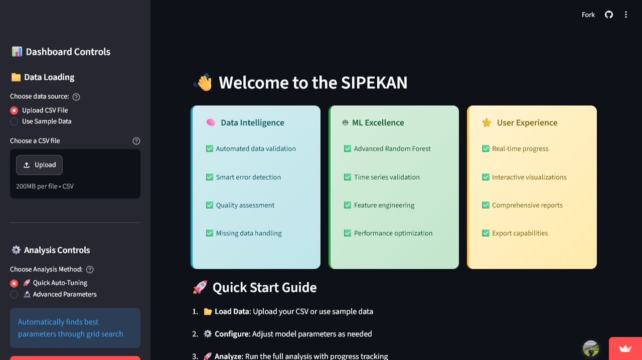
FORECASTING
Forecasting connects model quality to real planning decisions.
85.1%
TIME
SERIES
R² across 34 provinces
Cerebrum product forecasting
Food Security + Cerebrum Forecasting
Two forecasting tracks connect public-policy risk and education-product demand to practical planning.
BEST PAPER · ICoDSA 2025 / CEREBRUM FORECASTING · 2026
~/ali_ / DATA INTELLIGENCE PORTFOLIO
08

Slide 9

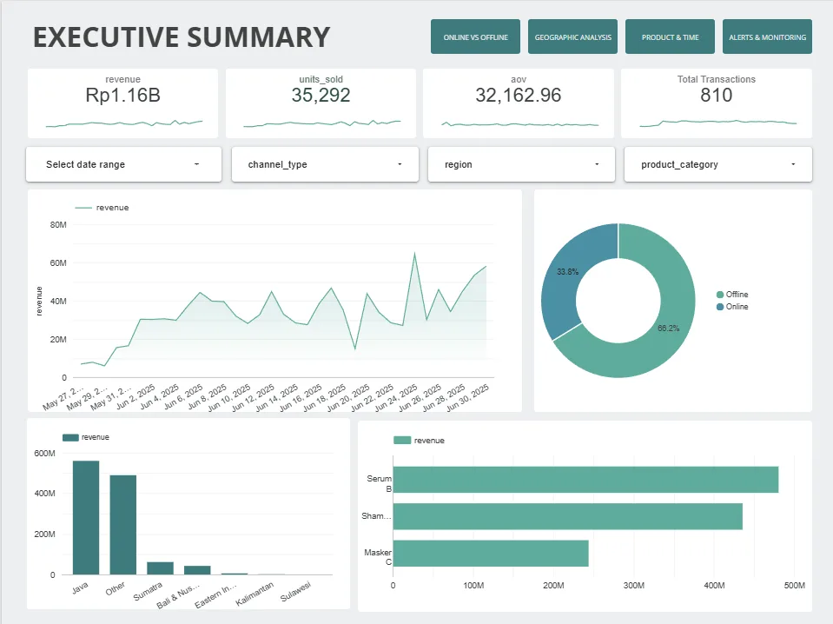
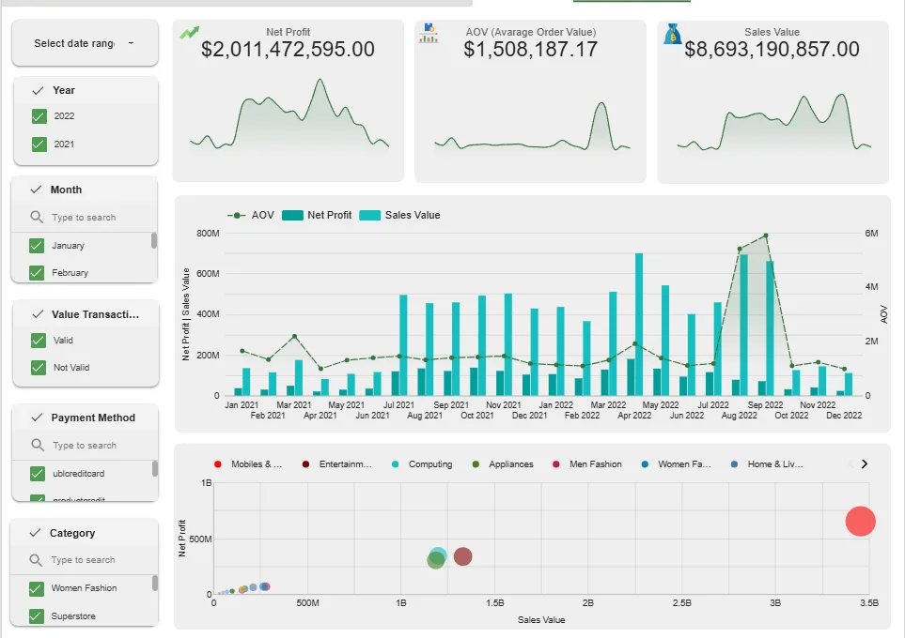
BUSINESS INTELLIGENCE
Public dashboards make analytical work easy to inspect.
One Power BI sample and two public Looker Studio projects.
Power BI Portfolio
Inteko Test
Sales Performance
KPI · revenue · user monitoring
5-page product sales analysis
Campaign · product · customer
~/ali_ / DATA INTELLIGENCE PORTFOLIO
09

Slide 10
INTERNAL AUTOMATION
Internal data products reduce manual operational work.
Task Management
QC Agent
Momentum & Quota
Live Class
Assignments
Revisions and deadlines
Task communication
Answer-key retrieval
Automated prepublish QC
Checkpointed reporting
Teacher capacity
Event schedules
Allocation visibility
Schedules and mentors
PIC follow-up
Attendance analytics
SYSTEM BASIS
Google Sheets & Apps Script dashboards · Node.js, Playwright & SQLite QC automation · safe synthetic previews
~/ali_ / DATA INTELLIGENCE PORTFOLIO
10

Slide 11
Let's build decisions
people can act on.
Available for data analyst, business intelligence, data science, and data engineering opportunities.
EMAIL
akbaralqahri@gmail.com
MORE PROJECTS · FULL CASE STUDIES
LINKEDIN · linkedin.com/in/akbaralqahri
WEB PORTFOLIO · akbaralqahri.github.io/portofolio
OPEN THE WEB PORTFOLIO
akbaralqahri.github.io/portofolio
+62 852 1194 4977
11

