Slide 1
S’SANDALS COMPANY
Image
Tugas Besar Kewirausahaan 1 - Nama mahasiswa
Company Web Address

Slide 2


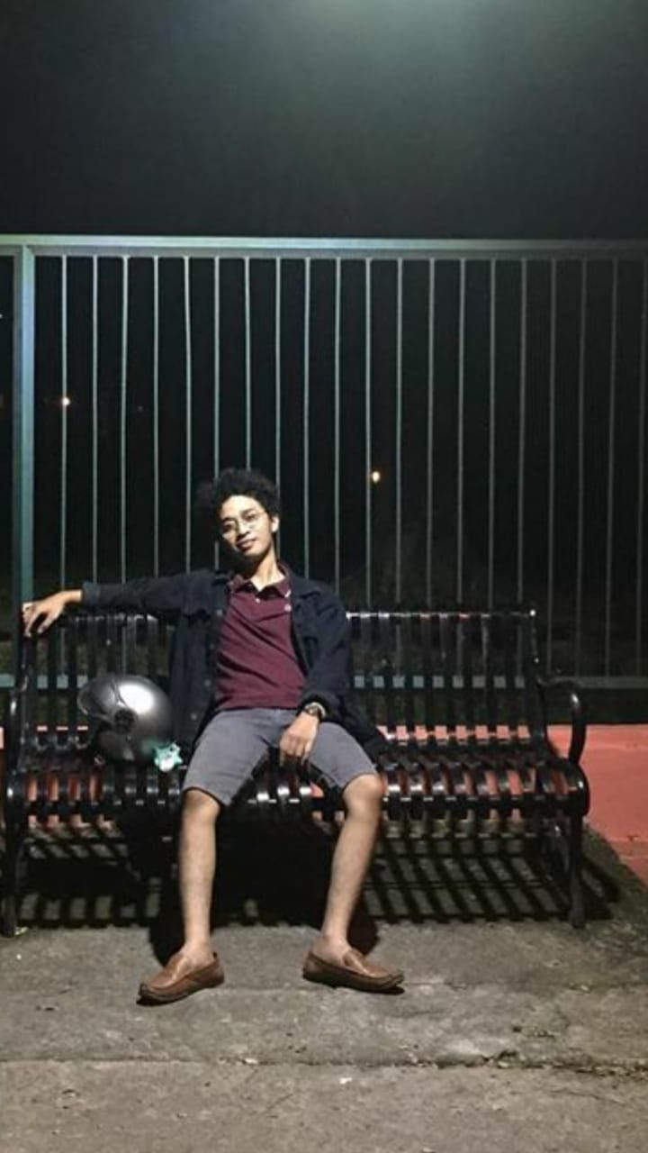


Team
Shalahuddin Ahmad Aziz
Team Leader
Mahasiswa
Project Manager
+62 896-4393-6991
Muhammad Faldy Faza
Anggota 1
Mahasiswa
Quality Control
+62 878-8025-2340
Rivo Yajnatantra Izzulhaq
Anggota 2
Mahasiswa
Marketing
+62 818-0732-2690
Afra Sausan
Anggota 3
Mahasiswa
Social Media Admin
+62 822-9838-2297
Arinda Amyus, S.Kom, MMSI
Meruya – Rabu, 10:15 – 12:45 – C-417 – Reg1
Notes:
Questions to answer:
Who is the dream team behind this business?
Why should we invest in you?
Show your relevance and passion here

Slide 3
Problems
Sekarang ini begitu banyak para penyandang disabillitas yang kurang diperhatikan, sebenarnya mereka juga ingin bisa beraktifitas layaknya seperti orang normal akan tetapi apakah itu bisa benar-benar terjadi (?)
Apakah penyandang disabilitas dapat beraktifitas layaknya seperti orang normal ?
Bagaimana caranya ?
Apakah aman ?
Notes:
Points to answer:
What are you aiming to tackle? What are the paint points?
Define the problem you are solving and for who
What are the current solution not answering the current needs?

Slide 4

Solution
Sendal Sensor
Dengan sendal ini para penyandang disabilitas dapat lebih mudah beraktifitas diluar rumah tanpa harus menghawatirkan benda-benda yang ada di sekitar mereka!
Notes:
Questions to answer:
What is your product/service about?
What is your unique value proposition?
What are you offering to the market needs displayed in the previous slide?
A link to a demo will be a plus

Slide 5
Target Customer
Example:
Komunitas peduli terhadap penyandang disabilitas
Rekan/kerabat dari penyandang disabilitas
Anggota keluarga dari penyandang disabilitas
Notes:
Questions to answer:
Who are your customers? Clearly define who you serve
Who are your stakeholders navigating around your company?
How do you segment your market?

Slide 6
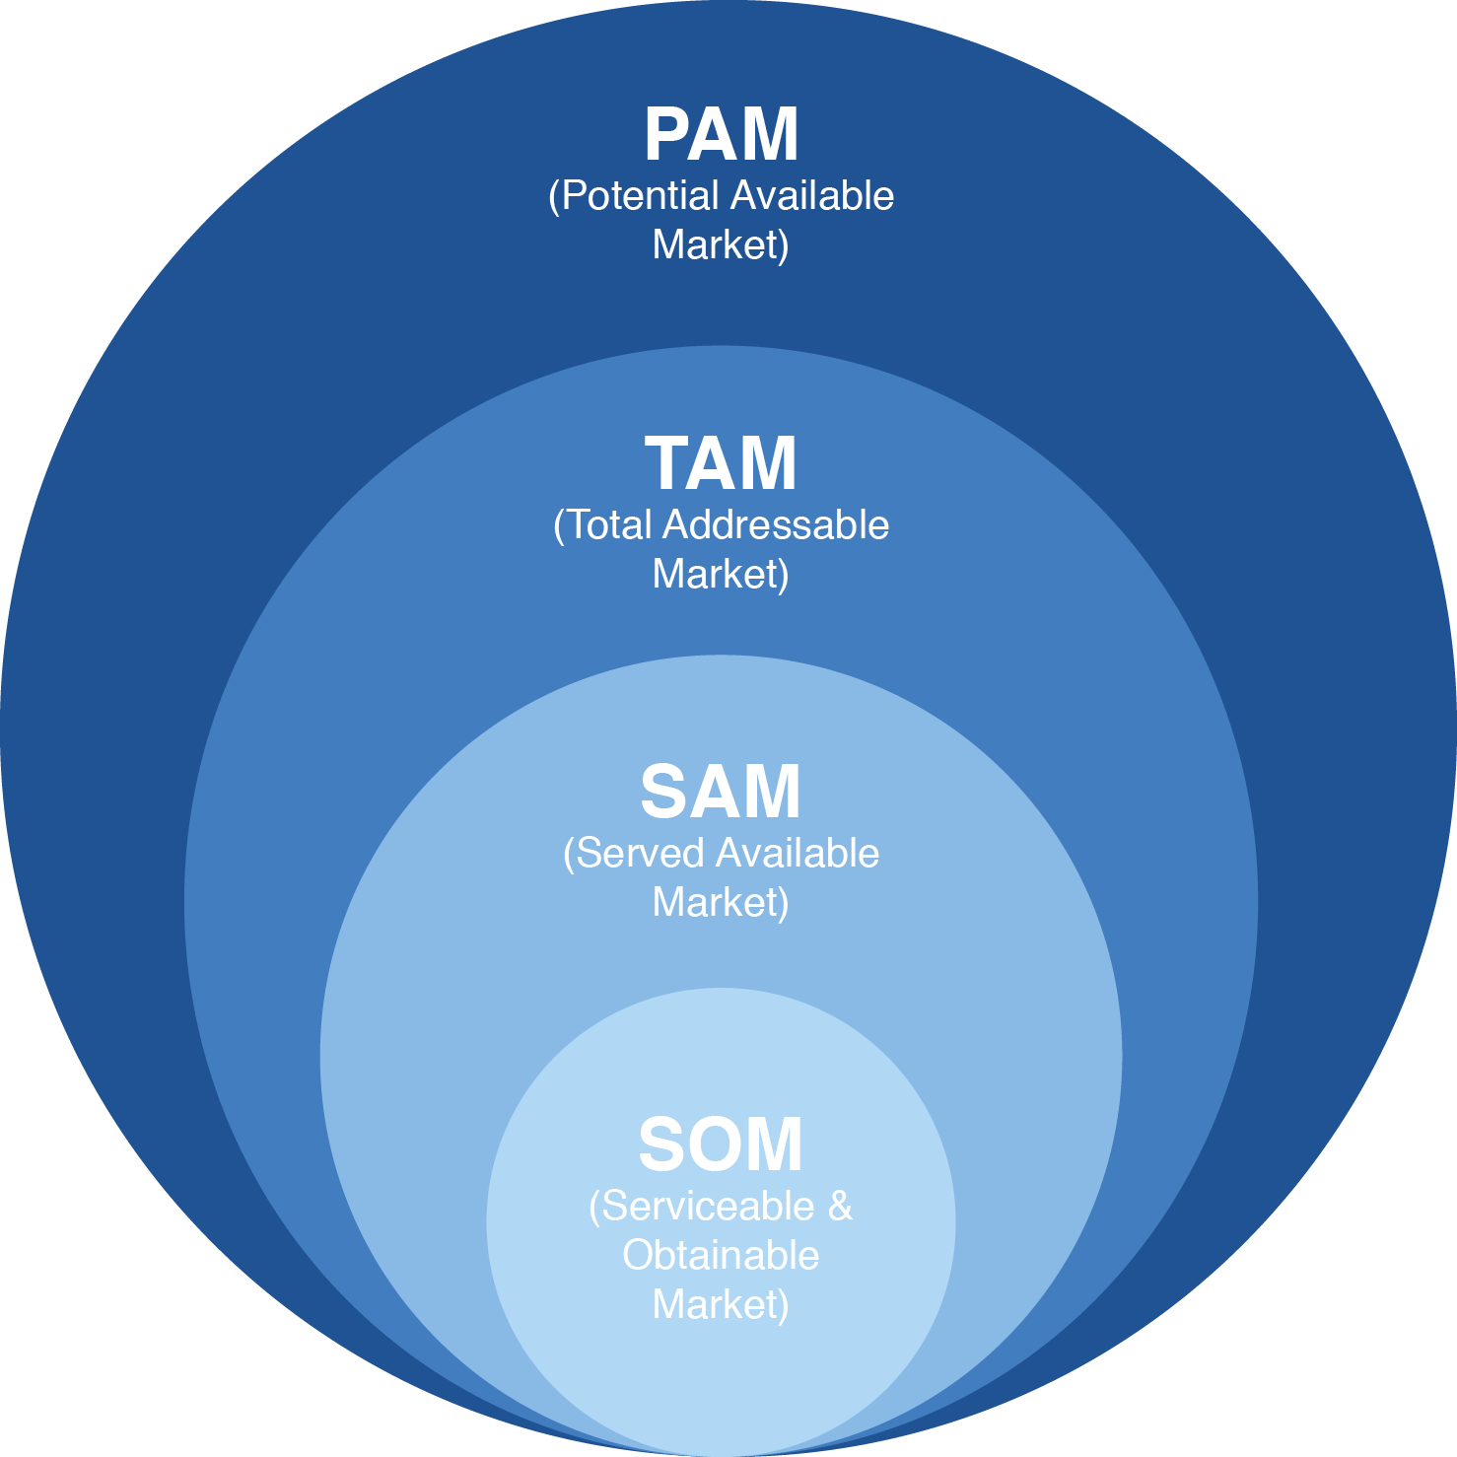
Market Sizing
Example:
Notes:
Questions to answer:
How do you proceed on computing your market sizing?
How big is the market you are operating in?
How much market share are you aiming to?
Data driven slide. Macro trends and insights that affect your market will be a plus

Slide 7
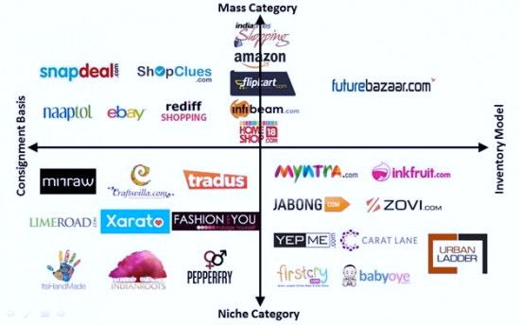
Competitor and Positioning
Example:
Notes:
Questions to answer:
Who are your direct and indirect competitors? How are they performing?
Where are your positioning yourself?
How will you win the market vs. competition?
What is your unique value proposition?

Slide 8
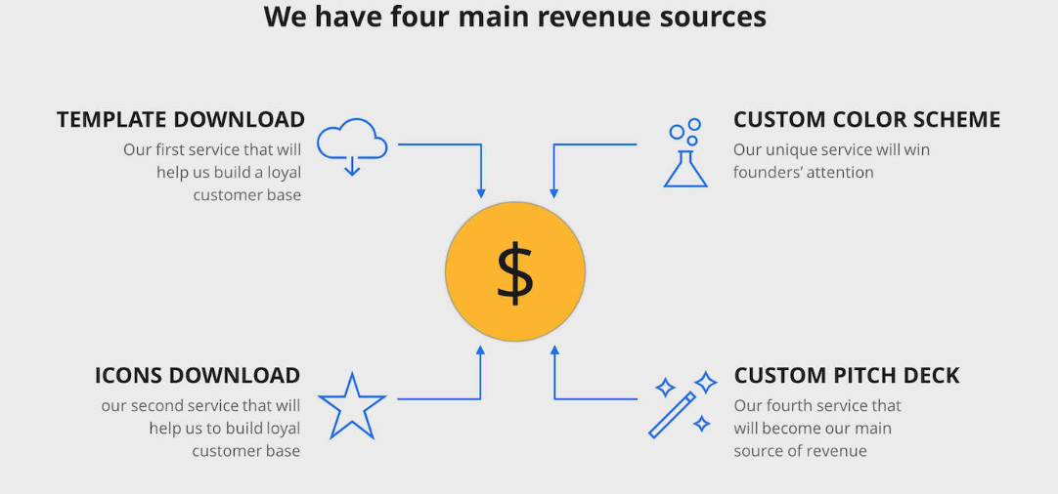
Monetization/Business Model
Notes:
Questions to answer:
What is the pricing model, How are you going to make money?
Where do you get the money from?
Show basic computation on revenues and conversion rates
Life-time value would be a plus

Slide 9
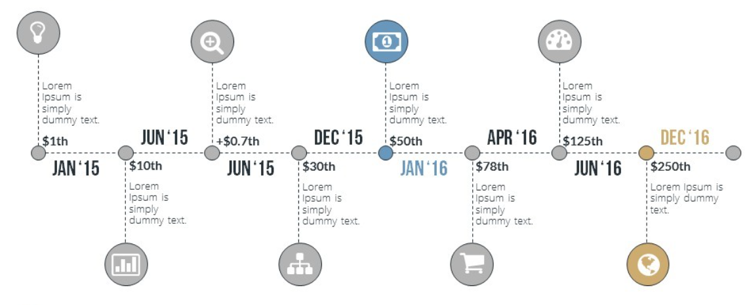
Milestones
Notes:
Questions to answer:
Show your timeline and milestones to date
What are the achievements? Revenue and number of customers to date (if exist)
Highlight press, partnerships, accolades
Customer success stories and/or testimonials

Slide 10
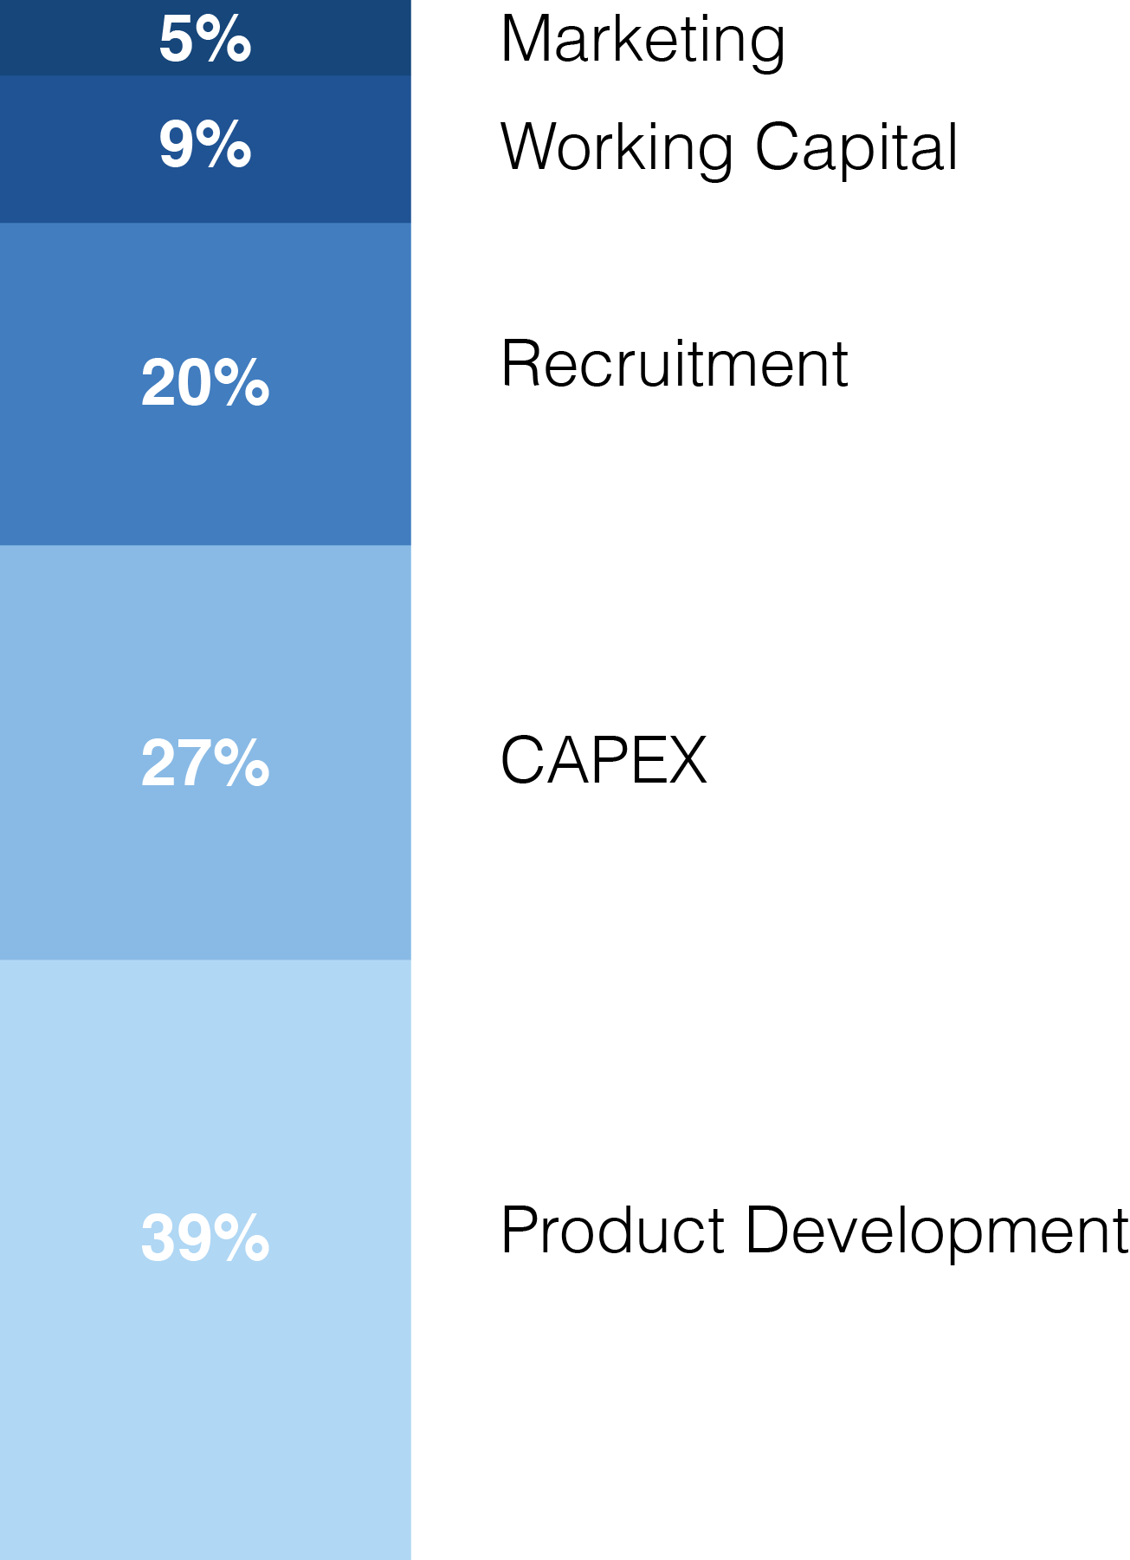
Funding Needs and Allocation
Total Funds Needed:
Rp. ??
Allocation :
Marketing : Rp.
Worksing Capital : Rp.
Recruitment : Rp.
CAPEX : Rp.
Product Development : Rp.
Notes:
Questions to answer:
How much funding do you need / how much of your company (% equity) will you give away for that?
How are you going to use the money? How will you allocate the resources?
When is your next funding need forecasted to be?

Slide 11
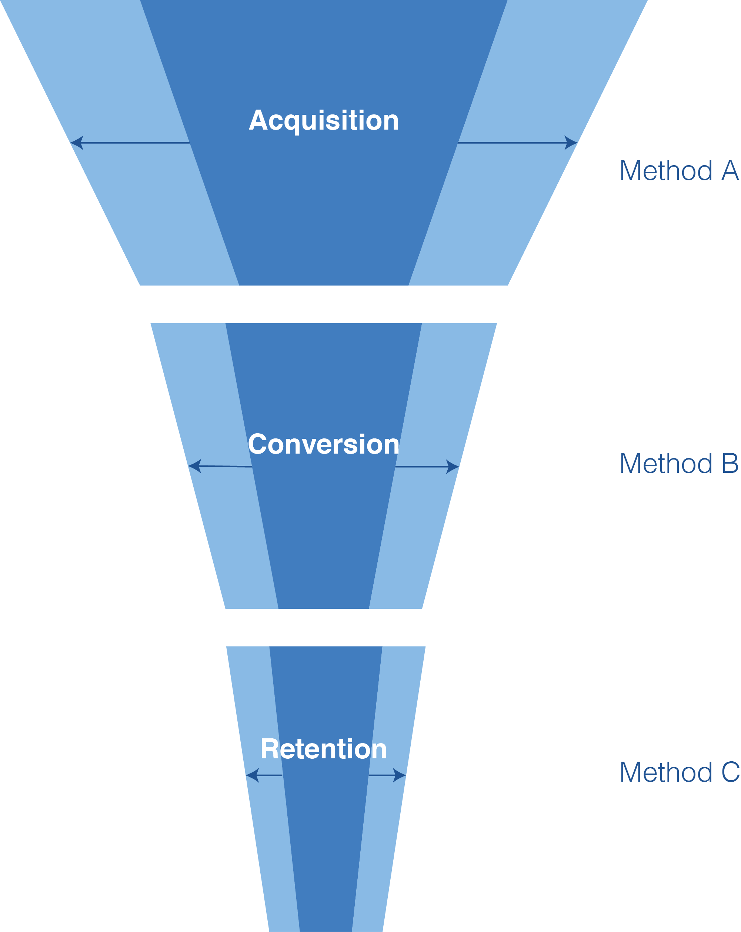
Marketing and Customer Acquisition
Example:
Notes:
Questions to answer:
How are you going to hack your customer growth?
How will you achieve your target growth rates?
What are the most important channels and methods you will use to find and win customers?

Slide 12

Contact Details
Address
ABC Street, Jakarta 12345
Phone Number
021-12345678/890
Email Address
info@companyname.com
Website
www.companyname.com
Notes:
Provide contact info.

