Slide 1
Magist in Brazilian market
Analyse by Dónal, Akbar and Rias

Slide 2
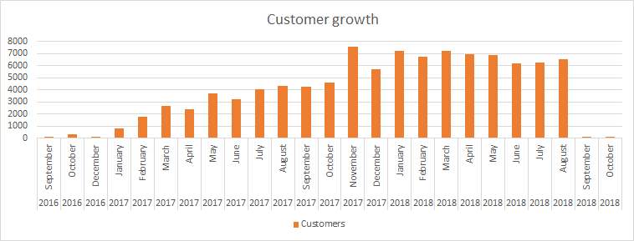
Business growth
customers
Significant drop in sales
Notes:
Since 2016 Magist had growing customer numbers/shown compelling growth.
However at end of 2018 it had a significant drop in sales.
Before committing to a contract with Magist, this would need to be explained, since it looks like an extraordinary event

Slide 3
Magist as a tech vendor
audio
cds_dvds_musicals
cine_photo
consoles_games
dvds_blu_ray
electronics
computers_accessories
pc_gamer
computers
tablets_printing_image
telephony
Time frame: 2016 - 2018
Total qty of sales: €112,650
Qty of tech product sales: €17,349
15.4% of their sales are tech products
Magist is familiar with tech products
Notes:
Good range of tech products categories.
Magist is familiar with tech products, but its not their main business

Slide 4
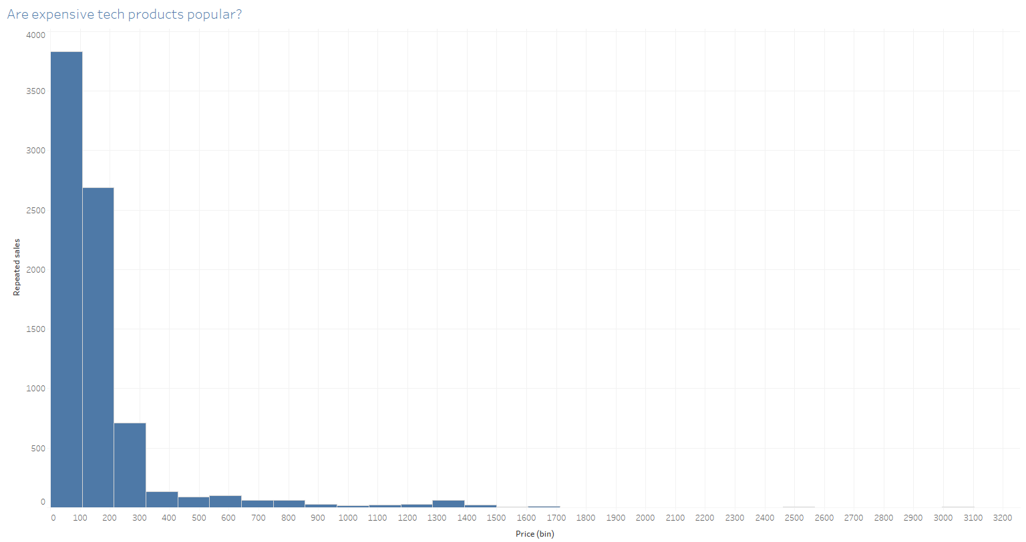
Magist as a tech vendor
Are expensive tech products popular?
Average monthly revenue for Magist tech vendors: €603
Average tech product price: Eniac €663 vs Magist €110
Repeated sales
Price (€)
Magist does not deal with large tech vendors
Magist does not sell expensive tech products
Notes:
Our average monthly revenue is ~€1,000,000

Slide 5
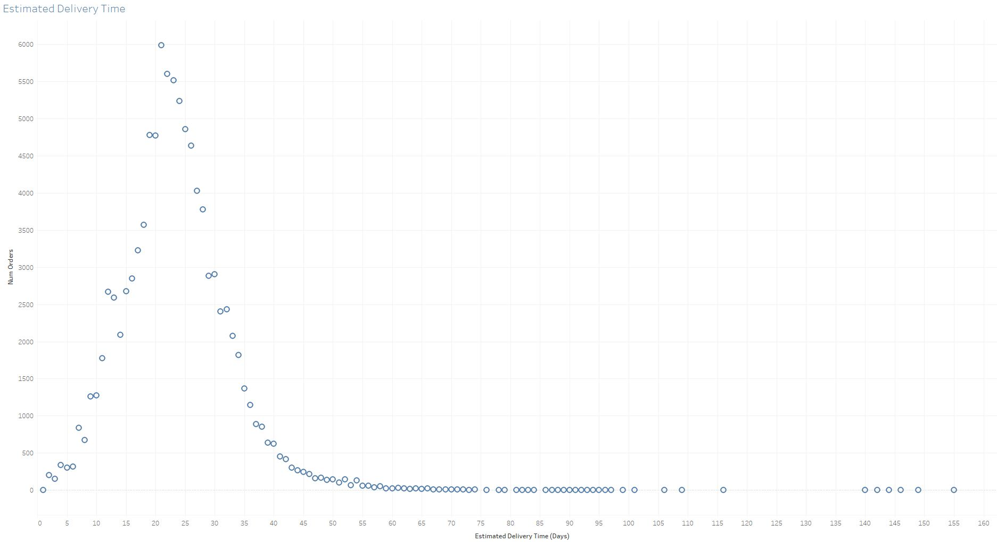
Deliveries
Delayed deliveries: 5.74%
Avg delivery time: 12 days
Delivery time estimates are unsatisfactory
Notes:
Most of the deliveries arrive on time.
However, deliveries of 12 days within a country are quite long and the delivery time estimates are extremely long.
Delivery time estimates of 3 weeks will not be appealing to potential customers

Slide 6
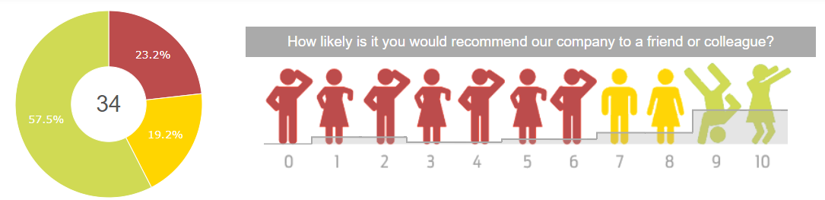
Customer satisfaction
Net promoter score
Notes:
KPI for measuring customer satisfaction
Scale of 1-10 translates to the Magist review metric of 1-5 stars
Promotor - 5 stars
indifferent - 4 stars
detractor - 3 or less stars
This could be due to deliveries, poor customer support or bad quality products.
This metric suggests that customers will not recommend this platform to their friends and it will not continue to grow

Slide 7

Recommendation of action
Magist has shown a significant drop in sales recently
Magist is not an established high-end tech marketplace
Magist may not have the capacity to handle the magnitude of our sales
Delivery times are not satisfactory
Customer satisfaction is adequate at best
No deal
Notes:
Deliveries may arrive as scheduled but when trying to attract new customers to the platform we would expect shorter estimates.
Brazil is also a highly urbanized country and these delivery times are unacceptable for cities.

