Slide 1





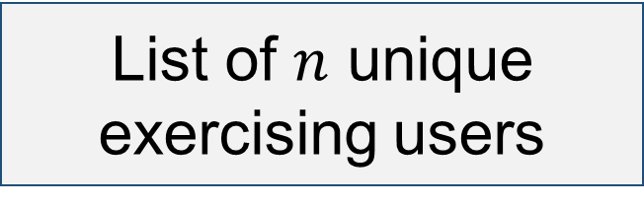
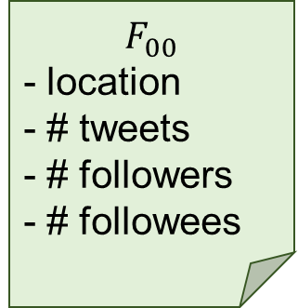
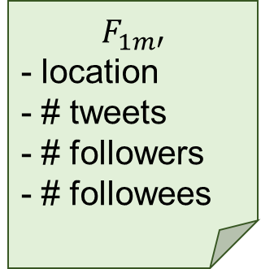
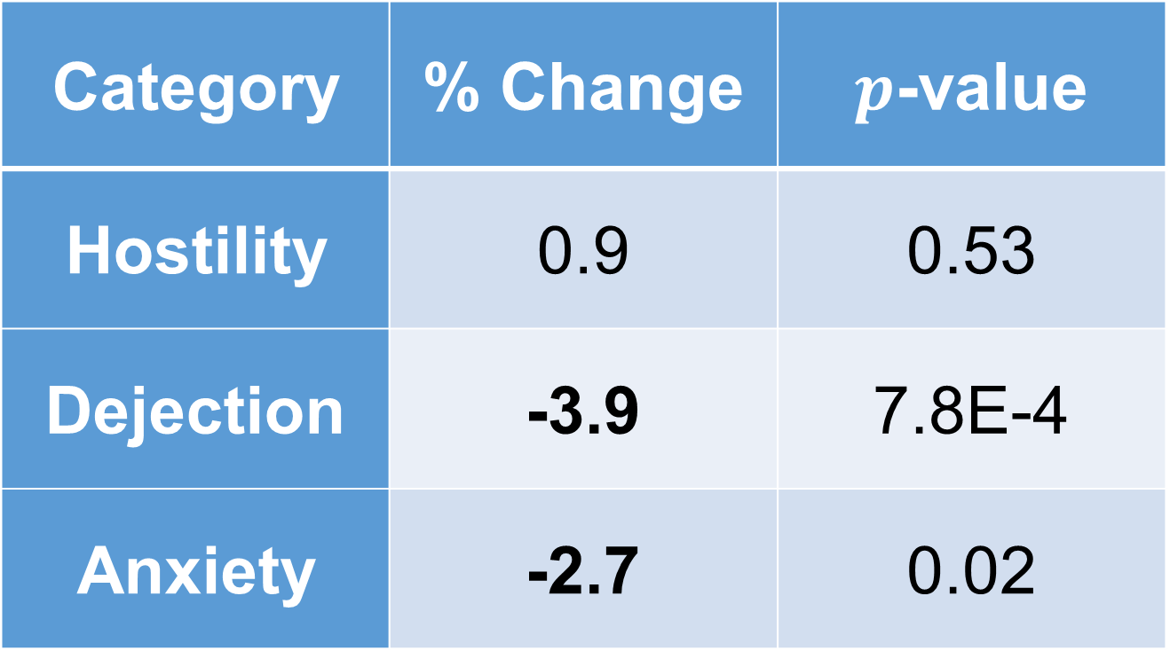
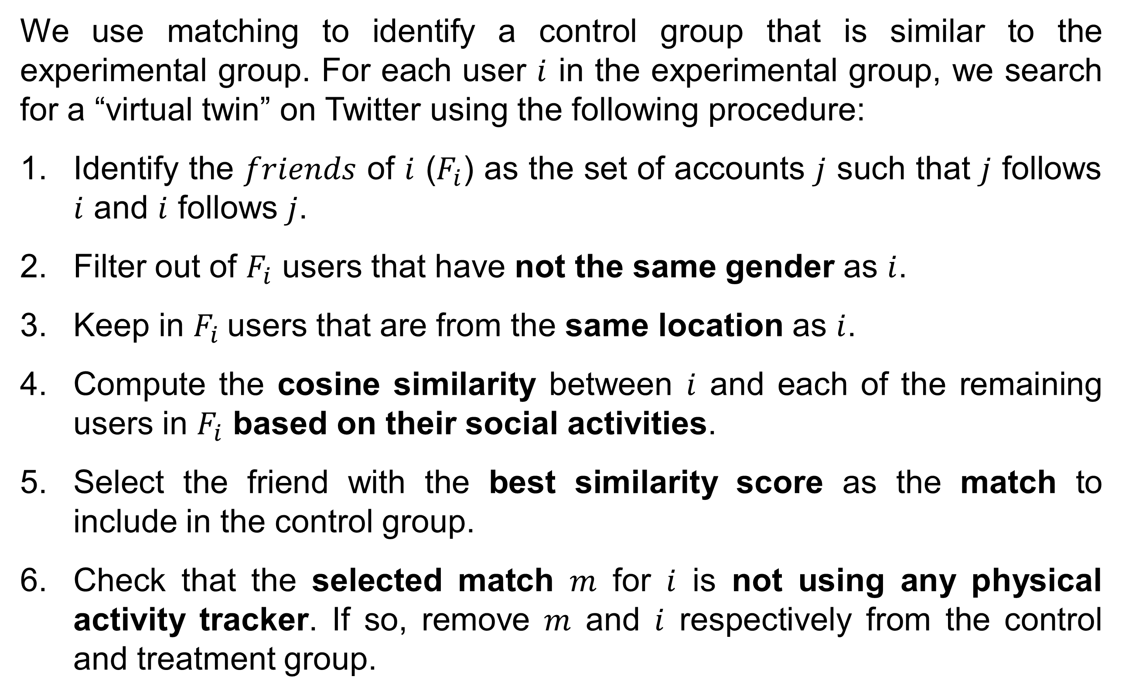
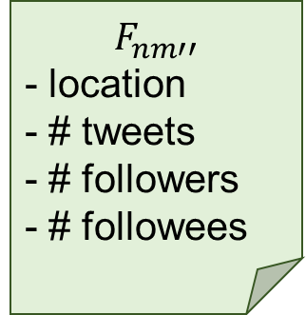
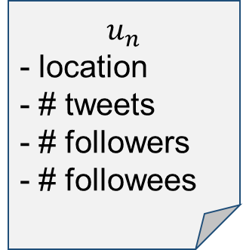

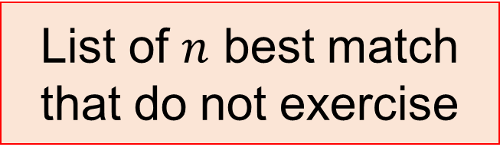



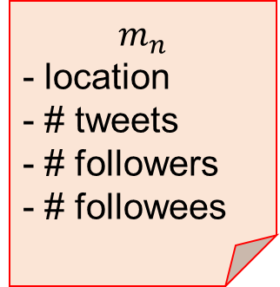




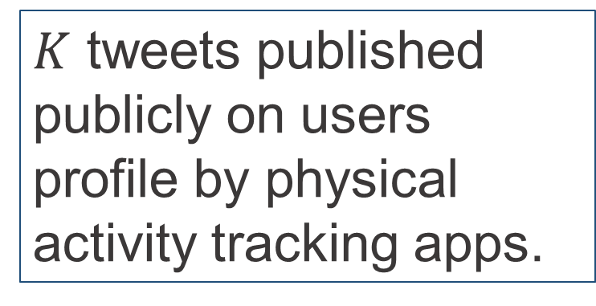

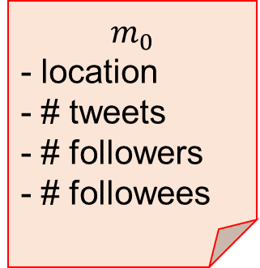
Using Matched Samples to Estimate the Effects of Exercise on Mental Health from Twitter
Virgile Landeiro Dos Reis and Aron Culotta - Department of Computer Science - Illinois Institute of Technology - Chicago, IL 60616
Motivation
Matching Users
Experiments
Traditional observational studies on the relation between exercise and mental health are limited by cost to small sample sizes and brief time windows.
Solution: use the online resources available for free (Twitter data)
We explore the potential of Web-scale observational studies in a specific research context: does exercise improve mood?
Traditional studies suggest that vigorous physical activity can lessen mild depression symptoms, improve self-image and social skills, and reduce anxiety.
Questions on how to obtain valid results when developing a framework to test this hypothesis using Twitter data:
1. How to annotate users according to mood and physical activity?
mood: a text classifier identifies three mood states (Hostility, Dejection, Anxiety) with 87% accuracy.
exercise: 10 physical activity tracking applications are used to find physically active users.
2. How to identify a suitable control set of users?
We provide an exact matching approach that identifies user with similar characteristics as the physically active set of users based on gender, location, and online activity as described in the figure below and detailed in the next paragraph.
We use matching to identify a control group that is similar to the experimental group. For each user $i$ in the experimental group, we search for a “virtual twin” on Twitter using the following procedure:
Identify the $friends$ of $i$ ($F_{i}$) as the set of accounts $j$ such that $j$ follows $i$ and $i$ follows $j$.
Filter out of $F_{i}$ users that have not the same gender as $i$.
Keep in $F_{i}$users that are from the same location as $i$.
Compute the cosine similarity between $i$ and each of the remaining users in $F_{i}$ based on their social activities.
Select the friend with the best similarity score as the match to include in the control group.
Check that the selected match $m$ for $i$ is not using any physical activity tracker. If so, remove $m$ and $i$ respectively from the control and treatment group.
We extend the Profile Of Mood States (POMS) lexicon using a context similarity method to obtain a lexicon of 300 terms.
We manually annotate a total of 2,367 tweets that contains mood keywords. Positive labels are spread as follow:
229 for the Anger/Hostility dimension
369 for the Depression/Dejection dimension
381 for the Tension/Anxiety dimension
We train a Logistic Regression classifier using feature selection to retain the top 160 features. Following are the classification results for each category:
Category | Accuracy | Precision | Recall | F1
Hostility | .901 | .490 | .358 | .410
Dejection | .870 | .620 | .447 | .514
Anxiety | .850 | .551 | .372 | .442
Average | .874 | .554 | .392 | .455
$$F_{00}$$
- location
- # tweets
- # followers
- # followees
$$F_{01}$$
- location
- # tweets
- # followers
- # followees
$$m_{0}$$
- location
- # tweets
- # followers
- # followees
$$F_{0m}$$
- location
- # tweets
- # followers
- # followees
$$u_{0}$$
- location
- # tweets
- # followers
- # followees
Results
$$F_{10}$$
- location
- # tweets
- # followers
- # followees
$$m_{1}$$
- location
- # tweets
- # followers
- # followees
$$u_{1}$$
- location
- # tweets
- # followers
- # followees
$$F_{11}$$
- location
- # tweets
- # followers
- # followees
After classifying the tweets of every user in the treatment and control groups, we obtain the following table as the estimated effect of exercise on mood using a Wilcoxon signed-rank test.
Treatment group
$$F_{1m′}$$
- location
- # tweets
- # followers
- # followees
List of $n$ best match that do not exercise
Category | % Change | $p$-value
Hostility | 0.9 | 0.53
Dejection | -3.9 | 7.8E-4
Anxiety | -2.7 | 0.02
{
“text”:“I ran 10 miles”,
“date”:“01/25/2015”,
“user”:”vlandeir”,
“hashtags”:”nikeplus”,
…
}
List of $n$ unique exercising users
Control group
$$u_{n}$$
- location
- # tweets
- # followers
- # followees
$$F_{n0}$$
- location
- # tweets
- # followers
- # followees
$$m_{n}$$
- location
- # tweets
- # followers
- # followees
$$F_{n1}$$
- location
- # tweets
- # followers
- # followees
$K$ tweets published publicly on users profile by physical activity tracking apps.
$$F_{nm′′}$$
- location
- # tweets
- # followers
- # followees
Friend
Match

