Slide 1
Quantitative analysis

Slide 2
Linear regression (OLS)

Slide 3
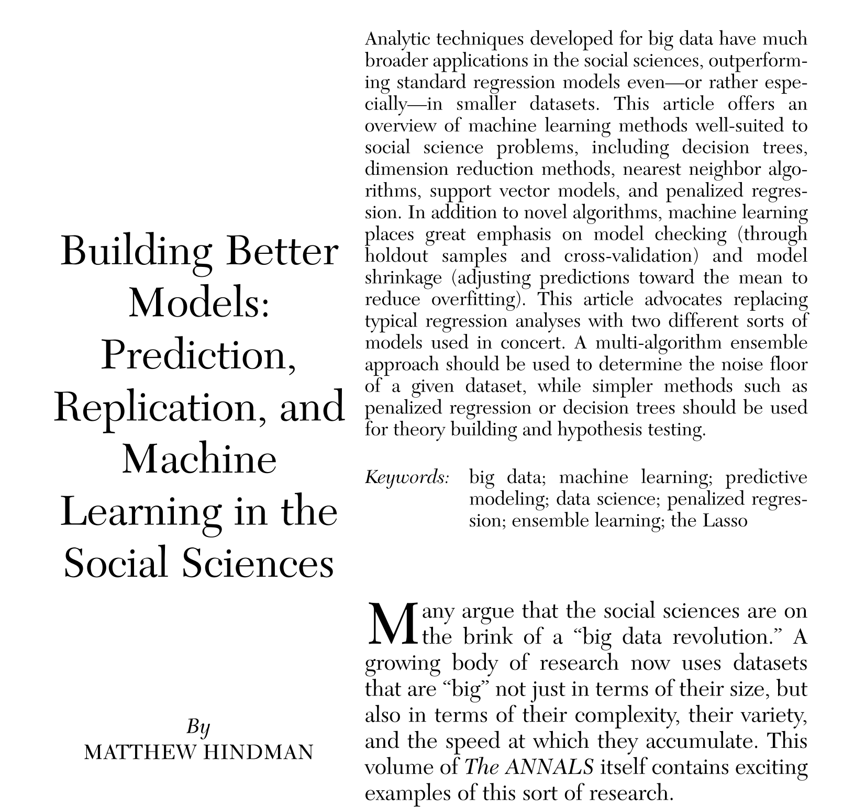

Slide 4
All data
This I use for developing the model
With this I test the model

Slide 5
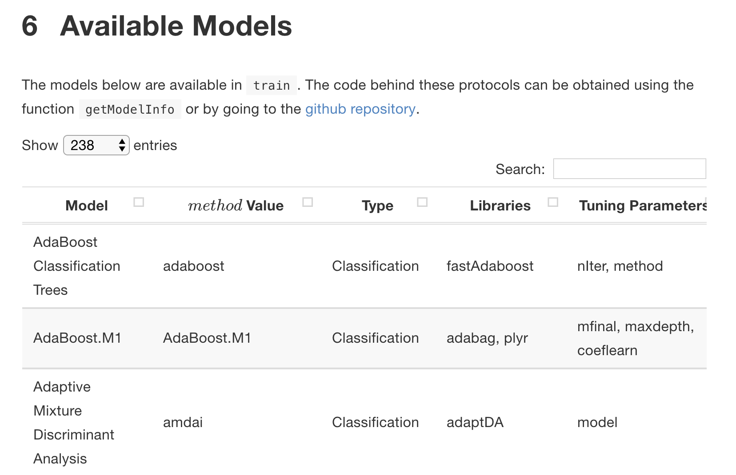

Slide 6


Slide 7
