Slide 2

Users (Hash)
“user_<emailed>” {
“email”:<email>,
“name”:<name>,
“password”:<hashed_password>
}

Slide 3
Recipe (Using a counter)
“recipe_name_”<counter>
“recipe_steps_”<counter>
“recipe_photo_”<counter>
“recipe_estimatedtime_”<counter>
“recipe_foodtype_”<counter>
“recipe_ingredients_quantity_”<counter>

Slide 4
Ingredients (Using Set)
“recipe_ingredients_”<counter>
[Ing 1, Ing 2, Ing 3, …..]

Slide 5
Mapping for recipes with users (list)
“recipe_user_+<emailed>”
{recipeNo1, recipeNo5, …}

Slide 6
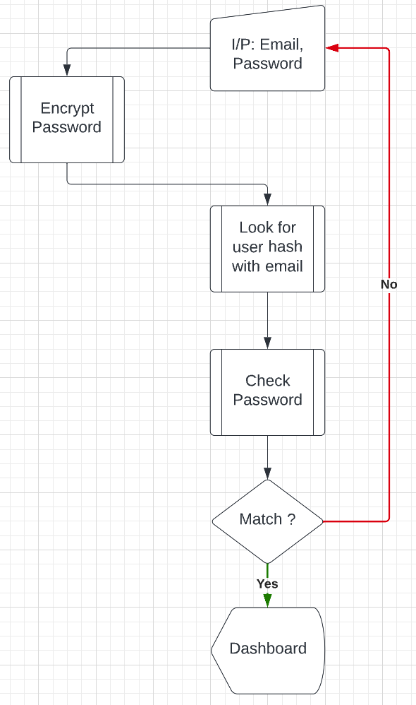

Slide 7
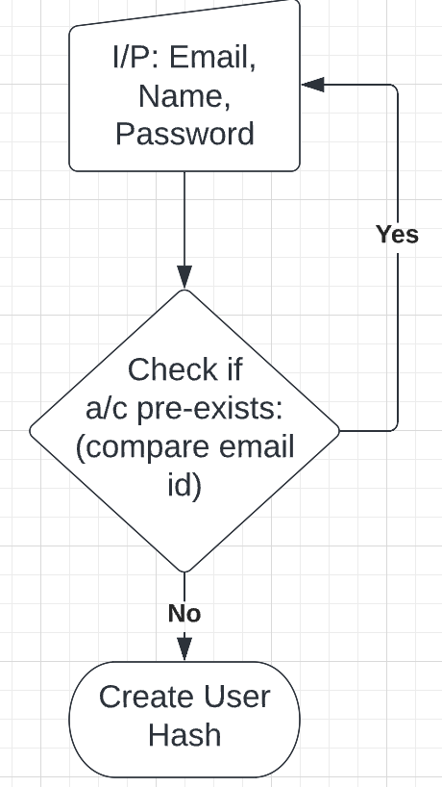

Slide 8
