Slide 1
LABORLENS
A Machine Learning Nowcasting Tool for Unemployment Rate
Using real-time labor market and macroeconomic data
[Duru Akbas] · [CMPSC-600] · Allegheny College

Slide 2
MOTIVATION
Forecasting Models and Limitations Under Economic Uncertainty
3.5% → 14.8%
1–2 months
Monthly
Models miss structural breaks
Machine Learning lags
Official data release
U.S. unemployment quadrupled from February to April 2020. Models trained on calm years expected the trend to continue.
A 2025 LSTNet study had its largest errors during regime shifts and caught the structural breaks one to two months late.
BLS releases the official rates monthly, and they might revise it after it is released depending on the economic conditions.
Abbouchi et al. (2025), “Forecasting Labor Markets with LSTNet: A Multi-Scale Deep Learning Approach,” arXiv:2507.01979

Slide 3
RELATED WORK AND THE GAP
Previous Study and The Gap
Xu & Liu (2025): DNN vs. ARIMA
Abbouchi et al. (2025): LSTNet
A deep neural network model beat ARIMA and linear regression models at predicting U.S. employment rates from macro, demographic, and job-posting data.
A deep LSTNet model forecasts industry employment from weekly BLS data, but its largest errors came at the structural breaks 1–2 months late.
Future work the authors mention:
Future work the authors mention:
Leading indicators
Mixing weekly, monthly, and quarterly data
Interpretability and uncertainty
More transparent models
Robustness to crises and policy shocks
Real-time economic indicators
The gap →
LaborLens: a deep neural network model that nowcasts U.S. unemployment from real-time, mixed-frequency indicators, tested on various previous economic shocks compared to the naive and ARIMA models, with transparent outputs.
Xu & Liu (2025), ICCSIE ’25, doi:10.1145/3759179.3759194 · Abbouchi et al. (2025), arXiv:2507.01979

Slide 4


AUDIENCE AND SCOPE
The Intended Audience and the Scope
Who it is for
What it covers
Economists tracking the business cycle in real time
Target: U.S. national unemployment rate
Policy analysts deciding when to act on rates, benefits, or job programs
Period: monthly, 2015–2026, including the 2020 shock
Main task: nowcast this month before BLS releases it
Forecasters who need a current estimate before the official release
Inputs: BLS, FRED, and Indeed Hiring Lab indicators published in the data period
Possible Extension: Forecasting the unemployment rate for the future months

Slide 5
RESEARCH QUESTION
Can a deep neural network, using real-time labor market and macroeconomic data, nowcast U.S. unemployment more accurately than naive and ARIMA baselines, especially around structural breaks?
Nowcasting
Structural break
More accurate
Training the model with previous data and estimating the current time’s rates
A sudden change in how the labor market behaves, like March 2020
Lower RMSE and MAE, with every model trained only on past data

Slide 6
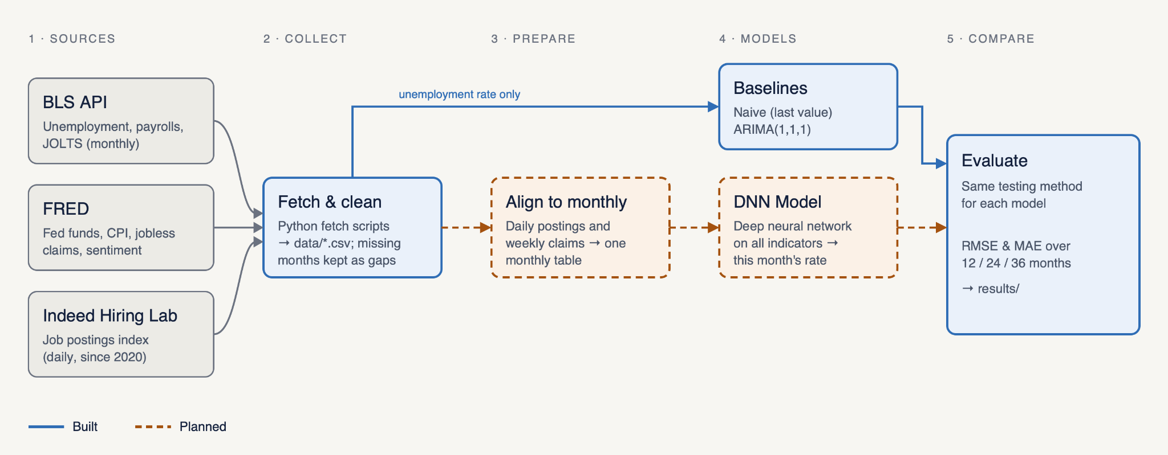
APPROACH
The Pipeline of LaborLens
Previous Data: The models are only trained on previously existent data
Same test: every model is tested on the 12, 24, and 36-month windows
Blue = built · orange dashed = planned

Slide 7


PROGRESS
Work Done and Future Work
Completed
Planned
Data pipeline: BLS, FRED and Indeed Hiring LAb data fetched by script
Align frequencies: daily and weekly series turned into monthly values
Honest gaps: October 2025 kept as missing, never invented
LLM Model: deep neural network trained on all indicators
Two baselines: naive and ARIMA(1,1,1)
Visualization: the output showcase, a dashboard
Fair testing: expanding window over 12, 24, and 36 months
Reproducible: anyone can rerun it with uv
Full comparison: DNN ML vs. naive and ARIMA on the same test
Further Testing: Testing the models with the edge cases

Slide 8



TECHNICAL WORK
Building the DNN model
Tool
Model
Data and checks
PyTorch: a Python library for building and training neural networks
Deep neural network (DNN): layers that learn patterns from the data
One monthly table: every source merged into monthly values
Runs on a laptop: the data is small, so no special hardware is needed
Input: the last few months of every indicator
Past data only: the model never sees the month it estimates
Output: an estimate of this month’s unemployment rate
Transparent: shows which indicators drove each estimate
Data plan
Extend the data from 2015–2026 to 1995–2026: about 380 months instead of 140, covering the 2001, 2008 and 2020 recessions. Keep the model small so it learns patterns instead of memorizing the data.
Notes:
0:25. “The AI part of LaborLens is a deep neural network, built in PyTorch. It looks at the last few months of every indicator and estimates this month’s unemployment rate. To prepare the data, I merge everything into one monthly table, and like the baselines, the model only trains on past months. I’ll also show which indicators drove each estimate, so it’s not a black box. The main challenge is data: about 140 months is small for deep learning, so I plan to extend back to 1995. That gives about 380 months and three recessions instead of one. And I’ll keep the model small so it doesn’t just memorize the data.” If asked: postings start in 2020 and JOLTS in December 2000, so earlier years use unemployment, claims, CPI, the Fed funds rate and sentiment.

Slide 9


ETHICS AND BROADER IMPACT
Who benefits, and what are the risks?
Risks and how I address them
Who benefits?
Risk | What I do
False alarms or missed downturns | Show the error with every estimate, and for every model (RMSE and MAE)
Biased data | Combine various datasets from different databases to eliminate the bias
Black-box AI | Show which indicators drove each estimate
Over-reliance on the model | Built as decision support; people make the final call
Privacy | Only public, aggregate statistics; no personal data
Policymakers
See a downturn sooner and respond earlier with rates, benefits, or job programs.
Workers and job seekers
Earlier responses can soften the impact of layoffs.
Researchers
An open pipeline on public data that others can test and extend.

Slide 10
LIVE DEMO · 2 MINUTES
Overview
1
2
3
Input
Run
Output
Open the raw BLS file: monthly unemployment, 2015–2026, with October 2025 missing.
Run the naive and ARIMA scripts; each refits month by month on past data only.
The RMSE / MAE table for three windows and the forecast plot
uv run python src/arima_baseline.py
Demo features: live data fetch, missing-month handling, two baselines, and scoring over three test windows.
Not yet: frequency alignment and the deep neural network model.

Slide 11
THANK YOU
Questions?

