Slide 1
Zero-Shot Relation Classification with LLMs: Binary Prompting and Relevance Elicitation
Sheila Alemany, Danielle Sullivan-Pao, Olga Simek
11th Workshop on Automated Knowledge Base Construction (AKBC)
at EMNLP 2026
October 28, 2026
DISTRIBUTION STATEMENT A. Approved for public release. Distribution is unlimited. This material is based upon work supported by the Combatant Commands under Air Force Contract No. FA8702-15-D-0001 or FA8702-25-D-B002. Any opinions, findings, conclusions or recommendations expressed in this material are those of the author(s) and do not necessarily reflect the views of the Combatant Commands.
© 2026 Massachusetts Institute of Technology. Delivered to the U.S. Government with Unlimited Rights, as defined in DFARS Part 252.227-7013 or 7014 (Feb 2014). Notwithstanding any copyright notice, U.S. Government rights in this work are defined by DFARS 252.227-7013 or DFARS 252.227-7014 as detailed above. Use of this work other than as specifically authorized by the U.S. Government may violate any copyrights that exist in this work.
Notes:
1
1

Slide 2
Relation Classification Pipeline
Relation Classification (RC) automatically classifies relationships between entities in text to enable downstream analysis
For social network analysis, this allows us to identify implicit relations that may not already be established in the network
Assumptions:
  The entities and relation types of interest are known in advance
  Sentence-level RC restricts entities and evidence to a single sentence
Knowledge graph construction
Question answering
Semantic search
Downstream Analysis
Known Entities
Relationships
Implicit relation extracted via documents or other sources of textual evidence
Explicit relations established within the social network (e.g., friends on Facebook)

Slide 3
Zero-Shot Closed Relation Classification
Given a sentence c, an entity pair (e_{h}, e_{t}), and predefined relation types R, we want to predict the relation, or “no relation”
Zero-shot: No annotated data, no fine-tuning, no examples in the prompt
Why? Text volumes outpace manual knowledge extraction, and new domains rarely have large, consistently labeled training sets
Example
“Steve Jobs, who was born in San Francisco, co-founded Apple in 1976.”
Apple
founded by →
Steve Jobs
Steve Jobs
city of birth →
San Francisco
San Francisco
no relation →
1976
  Gap: LLMs over-predict named relations instead of “no relation,” and existing prompts rely on
  manual, domain-specific templates

Slide 4
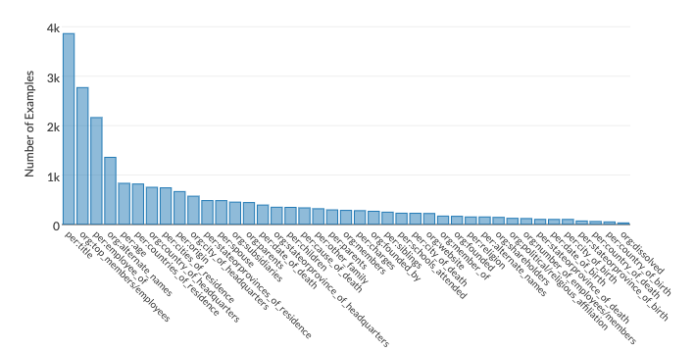
Dataset: TACRED
TACRED¹
  NIST Text Analysis Conference (TAC) Relation Extraction Dataset (RED)
  Sentences sourced from both newswire and discussion forums
  41 relation types
  Relations were labeled using a crowdsource platform, Amazon Mechanical Turk
  Notoriously noisy
    Some studies suggest a 50% error rate
  79.5% none-of-the-above or ‘no relation’ class
  Large dataset
    Train / Validation / Test: 68,124 / 22,631 / 15,509
TACRED: Named-Relation Class Distribution²
  Testing on the TACRED family of datasets allows us to evaluate robustness to annotation noise
Yuhao Zhang, Victor Zhong, Danqi Chen, Gabor Angeli, and Christopher D Manning. 2017. Position-aware attention and supervised data improve slot filling. In Proceedings of the 2017 conference on empirical methods in natural language processing, pages 35–45.
Image source: https://nlp.stanford.edu/projects/tacred/

Slide 5
Binary Relevance Elicitation (BRE)
BRE uses true/false prompting to simplify relation classification without manual customization
Relevance elicitation is a quantitative filtering technique to identify optimal relation types
Addresses LLM over-prediction tendency by treating each potential relation as a separate binary query
Inspired by prior work that demonstrated improved document ranking performance with a similar binary relevance quantifier
c, entity pair, r_{i}
r_{i} ∈ R_{valid}?
0
1
Binary Relevance Elicitation (BRE)
Confirmation LLM
TRUE, ρ(r_{i} )
FALSE
{r_{i}} ∪ r_{potential} for c, entity pair
Discard r_{i} as potential relation for c, entity pair
0
Checked all r_{i} in R_{valid}?
Legend
  BRE forces us to choose only the most relevant relations for a given entity pair
Input Data
1
LLM-generated
r_{pred} = argmax_{r} ρ(r_{potential})
Rule-based

Slide 6
BRE Evaluation: Performance
 | Macro-Average |  |  | Weighted-Average |  |  | Micro-F1
Model | Precision | Recall | F1 | Precision | Recall | F1 | Accuracy
Llama-3.2-3B | 22.9 | 46.0 | 25.4 | 75.2 | 54.2 | 61.1 | 49.8
Llama-3.1-8B | 23.6 | 59.8 | 30.2 | 78.1 | 51.7 | 58.6 | 48.0
Llama-3.1-70B | 54.7 | 50.7 | 50.5 | 84.0 | 84.8 | 83.9 | 83.4
Llama-3.3-70B | 52.3 | 62.1 | 55.1 | 86.8 | 84.9 | 85.6 | 84.1
Llama-4-Scout-17B-16E | 52.0 | 70.0 | 57.6 | 88.5 | 85.3 | 86.5 | 84.6
Mistral-7B | 39.0 | 60.1 | 43.2 | 83.0 | 72.9 | 76.5 | 72.3
Mixtral-8x7B | 47.7 | 60.1 | 49.8 | 84.4 | 78.7 | 80.9 | 77.4
Mixtral-8x22B | 48.0 | 63.6 | 52.6 | 86.1 | 84.2 | 84.9 | 83.1
Qwen2.5-VL-32B | 60.6 | 63.4 | 58.4 | 89.0 | 86.8 | 87.3 | 86.9
DeepSeek-R1-Distill-Qwen-32B | 43.3 | 61.0 | 47.7 | 83.8 | 81.4 | 82.2 | 79.2
Decrease after distillation
TACRED, NoTA-included, mean of 5 inference runs (%). Same prompt for every model.
  Top performers go beyond standard decoder-only transformers:
  Qwen2.5-VL-32B (multimodal pre-training) and Llama-4-Scout (mixture-of-experts)
Bold orange = best, bold = second best per column. BRE scores are means over 5 runs.
NoTA: none-of-the-above or the “no relation” class

Slide 7
BRE Evaluation: Baselines
Zero-shot Baselines:
  QA4RE¹: Reformulates relation classification as multiple-choice question-answer (QA) with valid entity pairs in pre-defined relation templates
  SUMASK²: Combines LLMs with natural language inference and chain-of-thought reasoning for iterative relation queries
  REA³: Employs a four-stage prompting strategy that looks at all relations within the same LLM context window
    Entity-type checking
    Candidate relation filtering
    Hypothesis generation with confidence scores
    Evidence-based selection
Few-shot Baselines:
  ODDA⁴: Iteratively generates diverse few-shot training examples through data augmentation based on relation extraction model predictions using attribute-based constraints
  ConsistRE⁵: Uses relation-specific keywords as generation constraints for consistency, but requires access to sufficiently informative external corpus
Zhang, Kai, Bernal Jiménez Gutiérrez, and Yu Su. "Aligning instruction tasks unlocks large language models as zero-shot relation extractors." ACL 2023
Li, Guozheng, Peng Wang, and Wenjun Ke. "Revisiting large language models as zero-shot relation extractors." EMNLP 2023
Layegh, Amirhossein, Amir H. Payberah, and Mihhail Matskin. "REA: Refine-estimate-answer prompting for zero-shot relation extraction." International conference on applications of natural language to information systems. Cham: Springer Nature Switzerland, 2024.
Zhong, Yijie, et al. "ODDA: An OODA-Driven Diverse Data Augmentation Framework for Low-Resource Relation Extraction." ACL 2025
Zheng, Yifan, et al. "Making LLMs as Fine-Grained Relation Extraction Data Augmentor." IJCAI 2024

Slide 8
BRE Evaluation: Baselines
Micro-F1 (%) | NoTA-included |  |  | NoTA-excluded
 | Re-TAC | TACREV | TACRED | Re-TAC | TACREV | TACRED
Zero-shot BRE (ours)
Qwen2.5-VL-32B | 85.6 | 90.0 | 86.8 | 74.7 | 82.4 | 73.9
Llama-4-Scout-17B-16E | 83.2 | 86.7 | 84.4 | 78.8 | 86.3 | 78.8
Llama-3.3-70B | 79.5 | 86.4 | 83.9 | 65.6 | 78.9 | 73.9
Mixtral-8x22B | 79.4 | 85.9 | 83.0 | 69.0 | 79.4 | 70.7
Llama-3.1-70B | 79.1 | 85.8 | 83.4 | 62.1 | 68.3 | 62.7
DeepSeek-R1-Distill-Qwen-32B | 74.5 | 80.8 | 79.3 | 66.7 | 75.7 | 68.5
Mixtral-8x7B | 72.4 | 78.7 | 77.7 | 65.9 | 71.3 | 68.0
Zero-shot Baselines
SUMASK · GPT-3.5-Turbo | 73.8 | 75.1 | 79.6 | – | – | 57.7
REA · Mixtral-8x7B | – | – | – | – | – | 58.0
REA · GPT-3.5-Turbo | – | – | – | – | – | 63.5
QA4RE · FLAN-T5 XXL | – | – | – | 67.3 | 54.3 | 54.5
QA4RE · GPT-3.5-Turbo | – | – | – | 61.2 | 59.4 | 59.4
Few-shot Baselines (8-shot)
ODDA · TYP Marker | 76.8 | – | 75.8 | – | – | –
ODDA · KnowPrompt | 84.1 | – | 81.0 | – | – | –
ConsistRE · TYP Marker | 71.8 | – | 72.6 | – | – | –
ConsistRE · KnowPrompt | 75.8 | – | 80.1 | – | – | –
Δ Best BRE vs. Best zero-shot | +11.8 | +14.9 | +7.2 | +11.5 | +26.9 | +15.3
Bold orange = best, bold = second best per column. BRE scores are means over 5 runs; baseline scores as reported in their papers (– = not reported). NoTA: none-of-the-above or the “no relation” class

Slide 9
BRE Evaluation: Baselines
Micro-F1 (%) | NoTA-included |  |  | NoTA-excluded
 | Re-TAC | TACREV | TACRED | Re-TAC | TACREV | TACRED
Zero-shot BRE (ours)
Qwen2.5-VL-32B | 85.6 | 90.0 | 86.8 | 74.7 | 82.4 | 73.9
Llama-4-Scout-17B-16E | 83.2 | 86.7 | 84.4 | 78.8 | 86.3 | 78.8
Llama-3.3-70B | 79.5 | 86.4 | 83.9 | 65.6 | 78.9 | 73.9
Mixtral-8x22B | 79.4 | 85.9 | 83.0 | 69.0 | 79.4 | 70.7
Llama-3.1-70B | 79.1 | 85.8 | 83.4 | 62.1 | 68.3 | 62.7
DeepSeek-R1-Distill-Qwen-32B | 74.5 | 80.8 | 79.3 | 66.7 | 75.7 | 68.5
Mixtral-8x7B | 72.4 | 78.7 | 77.7 | 65.9 | 71.3 | 68.0
Zero-shot Baselines
SUMASK · GPT-3.5-Turbo | 73.8 | 75.1 | 79.6 | – | – | 57.7
REA · Mixtral-8x7B | – | – | – | – | – | 58.0
REA · GPT-3.5-Turbo | – | – | – | – | – | 63.5
QA4RE · FLAN-T5 XXL | – | – | – | 67.3 | 54.3 | 54.5
QA4RE · GPT-3.5-Turbo | – | – | – | 61.2 | 59.4 | 59.4
Few-shot Baselines (8-shot)
ODDA · TYP Marker | 76.8 | – | 75.8 | – | – | –
ODDA · KnowPrompt | 84.1 | – | 81.0 | – | – | –
ConsistRE · TYP Marker | 71.8 | – | 72.6 | – | – | –
ConsistRE · KnowPrompt | 75.8 | – | 80.1 | – | – | –
Δ Best BRE vs. Best zero-shot | +11.8 | +14.9 | +7.2 | +11.5 | +26.9 | +15.3
Qwen2.5-VL-32B’s high overall scores stem largely from strong NoTA classification, while Llama-4-Scout maintains more balanced performance
Bold orange = best, bold = second best per column. BRE scores are means over 5 runs; baseline scores as reported in their papers (– = not reported). NoTA: none-of-the-above or the “no relation” class

Slide 10
BRE Evaluation: Baselines
Micro-F1 (%) | NoTA-included |  |  | NoTA-excluded
 | Re-TAC | TACREV | TACRED | Re-TAC | TACREV | TACRED
Zero-shot BRE (ours)
Qwen2.5-VL-32B | 85.6 | 90.0 | 86.8 | 74.7 | 82.4 | 73.9
Llama-4-Scout-17B-16E | 83.2 | 86.7 | 84.4 | 78.8 | 86.3 | 78.8
Llama-3.3-70B | 79.5 | 86.4 | 83.9 | 65.6 | 78.9 | 73.9
Mixtral-8x22B | 79.4 | 85.9 | 83.0 | 69.0 | 79.4 | 70.7
Llama-3.1-70B | 79.1 | 85.8 | 83.4 | 62.1 | 68.3 | 62.7
DeepSeek-R1-Distill-Qwen-32B | 74.5 | 80.8 | 79.3 | 66.7 | 75.7 | 68.5
Mixtral-8x7B | 72.4 | 78.7 | 77.7 | 65.9 | 71.3 | 68.0
Zero-shot Baselines
SUMASK · GPT-3.5-Turbo | 73.8 | 75.1 | 79.6 | – | – | 57.7
REA · Mixtral-8x7B | – | – | – | – | – | 58.0
REA · GPT-3.5-Turbo | – | – | – | – | – | 63.5
QA4RE · FLAN-T5 XXL | – | – | – | 67.3 | 54.3 | 54.5
QA4RE · GPT-3.5-Turbo | – | – | – | 61.2 | 59.4 | 59.4
Few-shot Baselines (8-shot)
ODDA · TYP Marker | 76.8 | – | 75.8 | – | – | –
ODDA · KnowPrompt | 84.1 | – | 81.0 | – | – | –
ConsistRE · TYP Marker | 71.8 | – | 72.6 | – | – | –
ConsistRE · KnowPrompt | 75.8 | – | 80.1 | – | – | –
Δ Best BRE vs. Best zero-shot | +11.8 | +14.9 | +7.2 | +11.5 | +26.9 | +15.3
BRE outperforms REA even when both methods employ the same foundational Mixtral 8x7B model, achieving 17% increase in accuracy on TACRED
Bold orange = best, bold = second best per column. BRE scores are means over 5 runs; baseline scores as reported in their papers (– = not reported). NoTA: none-of-the-above or the “no relation” class

Slide 11
BRE Evaluation: Baselines
Micro-F1 (%) | NoTA-included |  |  | NoTA-excluded
 | Re-TAC | TACREV | TACRED | Re-TAC | TACREV | TACRED
Zero-shot BRE (ours)
Qwen2.5-VL-32B | 85.6 | 90.0 | 86.8 | 74.7 | 82.4 | 73.9
Llama-4-Scout-17B-16E | 83.2 | 86.7 | 84.4 | 78.8 | 86.3 | 78.8
Llama-3.3-70B | 79.5 | 86.4 | 83.9 | 65.6 | 78.9 | 73.9
Mixtral-8x22B | 79.4 | 85.9 | 83.0 | 69.0 | 79.4 | 70.7
Llama-3.1-70B | 79.1 | 85.8 | 83.4 | 62.1 | 68.3 | 62.7
DeepSeek-R1-Distill-Qwen-32B | 74.5 | 80.8 | 79.3 | 66.7 | 75.7 | 68.5
Mixtral-8x7B | 72.4 | 78.7 | 77.7 | 65.9 | 71.3 | 68.0
Zero-shot Baselines
SUMASK · GPT-3.5-Turbo | 73.8 | 75.1 | 79.6 | – | – | 57.7
REA · Mixtral-8x7B | – | – | – | – | – | 58.0
REA · GPT-3.5-Turbo | – | – | – | – | – | 63.5
QA4RE · FLAN-T5 XXL | – | – | – | 67.3 | 54.3 | 54.5
QA4RE · GPT-3.5-Turbo | – | – | – | 61.2 | 59.4 | 59.4
Few-shot Baselines (8-shot)
ODDA · TYP Marker | 76.8 | – | 75.8 | – | – | –
ODDA · KnowPrompt | 84.1 | – | 81.0 | – | – | –
ConsistRE · TYP Marker | 71.8 | – | 72.6 | – | – | –
ConsistRE · KnowPrompt | 75.8 | – | 80.1 | – | – | –
Δ Best BRE vs. Best zero-shot | +11.8 | +14.9 | +7.2 | +11.5 | +26.9 | +15.3
BRE achieves state-of-the-art zero-shot performance, comparable to top few-shot approaches
Bold orange = best, bold = second best per column. BRE scores are means over 5 runs; baseline scores as reported in their papers (– = not reported). NoTA: none-of-the-above or the “no relation” class

Slide 12
What Drives Performance?
TACRED micro-F1 (NoTA-included, mean ± std over 5 runs), sorted by parameter count
p = 0.006
Parameter size: significant
p = 0.667
Release date: not significant
Regression controlling for both factors*
Rankings are stable: standard deviations stay ≤ 0.9 pts on TACRED
Based on N = 10 models
■ Llama ■ Mistral ■ Qwen ■ DeepSeek
  Scale over recency: parameter count, not release date, predicts performance
*also holds for NoTA excluded

Slide 13
Ablation Studies
Average Δ micro-F1 (pts) vs. full BRE, across models and datasets
1
Relevance elicitation drives gains
Score-only ≈ full BRE (−0.04). Binary-only loses 15.0 pts: macro recall rises (+15.3) but precision falls as the LLM affirms too many relations
2
Entity type filtering is essential
Without it, macro-F1 drops 47.5 pts and micro-F1 drops 7.5 pts
3
Definitions disambiguate
Removing them costs about 4% relative accuracy (p = 0.01)
  BRE benefits from ranking by relevance plus context that limits implausible candidates

Slide 14
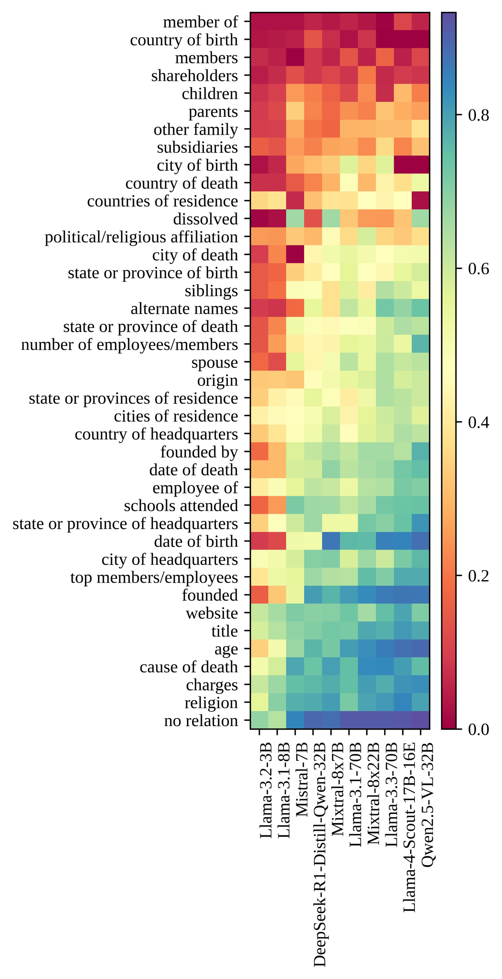
Conclusions and Future Work
BRE decomposes multi-class RC into independent binary decisions with relevance scoring
It successfully mitigates LLM over-prediction through simplified binary prompting and ranking
Limitation: Performance variation across relation types persists and remains an open research problem
Future directions: Relation-specific prompting or hybrid retrieval-augmented approaches for ambiguous cases
  We show a significant advancement toward reliable, interpretable zero-shot relation classification

Slide 15
Backup Slides
Zero-Shot

Slide 16
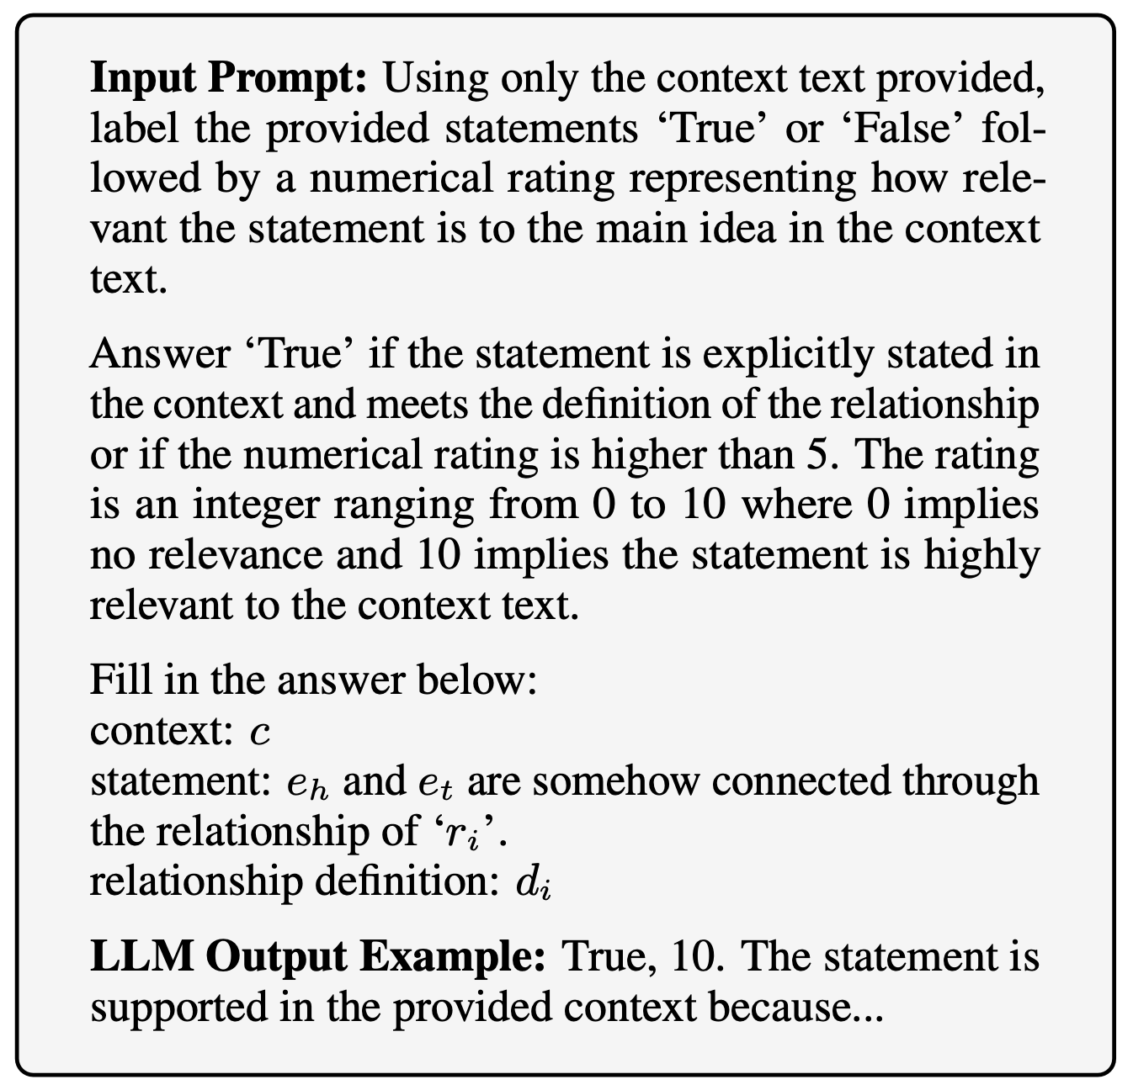
Binary Relevance Elicitation (BRE): Prompt
Relevance elicitation:
  Capture confidence from textual evidence to filter between explicitly stated, strongly implied, and merely plausible relations
  Single-query efficiency advantage over multi-stage approaches (e.g., REA¹)
Relation definitions:
  Establish clear semantic boundaries for relation types and contextual evidence
  Reduce semantic confusion by grounding LLM reasoning in explicit specifications and not relying on implicit learned associations
Entity-type constraints:
  Eliminate semantically invalid relation candidates (e.g., "founded by" between two location entities) before LLM inference
Layegh, Amirhossein, Amir H. Payberah, and Mihhail Matskin. "REA: Refine-estimate-answer prompting for zero-shot relation extraction." International conference on applications of natural language to information systems. Cham: Springer Nature Switzerland, 2024.

