Slide 1

Semantic Parsing for KBQA:
Robustness, Reasoning & Efficiency
Mausam
IIT Delhi
Joint work with Indrajit Bhattacharya, Daniel Preotiuc-Pietro
Prayushi Faldu, Mounica Maddela, Mayur Patidar, Riya Sawhney, Lingjue Xie,
Biswajit Chatterjee, Avinash Singh, Lovekesh Vig, Samrat Yadav.

Slide 2




Conversational AI: Information at our Finger Tips!
QA Paradigms
Parametric knowledge
RAG over textual corpus
Semantic Parsing over KB/DB

Slide 3


Three Paradigms of Information-Seeking Conversational AI
LLM as a Know-It-All
Knowledge in LLM Parameters
What papers has Chris Manning written in EMNLP?
  humongous models
  difficult to add/delete info
  hallucinations
  proprietary data
  no provenance
  good for popular info
  less computation at test
  one model for everything
Here are a few notable papers by Chris Manning in EMNLP:
** Lookup-Basedicens : A Framework for Compositional Vector Representations** (2014) - This paper introduced the concept of lookup-based compositional vector representations, which has had a significant impact on NLP research.

Slide 4


Three Paradigms of Information-Seeking Conversational AI
LLM as an inference engine over context (RAG)
Knowledge in Corpus
What papers has Chris Manning written in EMNLP?
  very slow at test time
  ~difficult to add/delete info
  errors multiply
  context length issues
  some hallucinations stay
  provenance
  proprietary data
  one arch. for everything
Here are a few notable papers by Chris Manning in EMNLP:
** GloVe: Global Vectors for Word Representation** (2014)
** HotpotQA: A dataset for diverse, explainable multi-hop question answering ** (2018)
query
documents

Slide 5

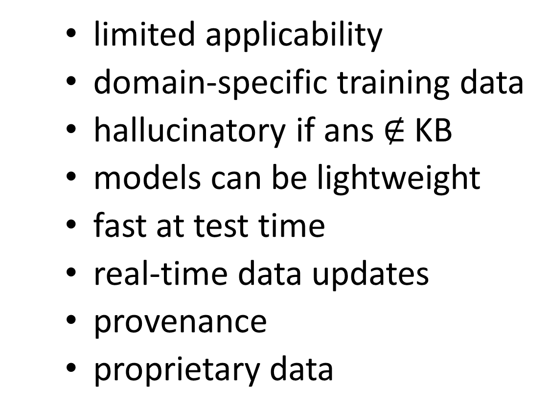
The Value of Semantic Parsing for QA
LM as a semantic parser (KBQA, Text2SQL..)
Knowledge in KB/DB
What papers has Chris Manning written in EMNLP?
  limited applicability
  domain-specific training data
  hallucinatory if ans $∉$KB
  models can be lightweight
  fast at test time
  real-time data updates
  provenance
  proprietary data
** GloVe: Global Vectors for Word Representation** (2014)
** HotpotQA: A dataset for diverse, explainable multi-hop question answering ** (2018)
logical
form
answers

Slide 6
Case Studies in Semantic Parsing
Reasoning: Answering complex analytical reasoning questions
Robustness: Handling unanswerable questions
Transfer Learning: Limited training data

Slide 7
Case Studies in Semantic Parsing
Reasoning: Answering complex analytical reasoning questions
Robustness: Handling unanswerable questions
Transfer Learning: Limited training data

Slide 8
Text → Query Languages
democratize access to databases
also relevant to agentic environments with proprietary DBs/KBs
Text2SQL
  52% professional developers regularly use SQL
  1/3rd professional developers must run complex SQL queries efficiently
Benchmark datasets for Text2SQL
  do not test complex reasoning capabilities

Slide 9
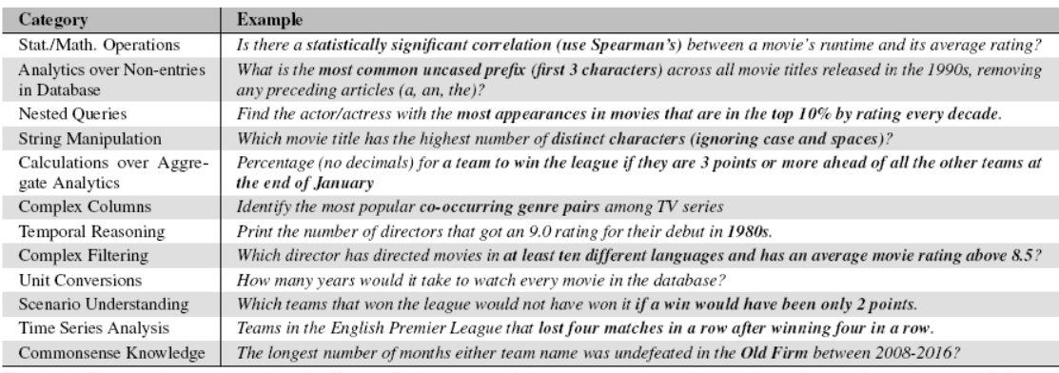
$∗$STARQA: Structured Data Analytics & Reasoning QA

Slide 10
Examples
Stat / Math operations
  Is there a statistically significant correlation (use Spearman’s) between a movie’s running time and its rating?
Complex columns
  Identify the most popular co-occurring genre pairs in TV series
Time series analysis
  English Premier League teams that lost four matches in a row after winning four in a row.

Slide 11
$∗$STARQA: Dataset Details
362 hand-written questions
  100: IMDB (movies)
  162: EuroSoccer (sports)
  100: Olist (e-commerce)
Answer type:
  299: tuples as answer
  55: single numeric answer
  8: null answer

Slide 12
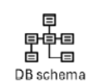

LLMs for Text2SQL
Q: find teams that won a league after they were not in top 3 at the end of December
SQL:
select team from …
DB
A: …

Slide 13
Proposal: Text 2 SQL + Code
Q: find teams that won a league after they were not in top 3 at the end of December
SQL
Decomposition:
DB: fetch sum of pts per league
DB: fetch sum of pts until Dec
Py: compute league winner
Py: compute top 3 until Dec
Py: find table 1 \ table 2
Py: return list of teams
Decomposition:
DB: fetch sum of pts per league
DB: fetch sum of pts until Dec
Py: compute league winner
Py: compute top 3 until Dec
Py: find table 1 \ table 2
Py: return list of teams
DB
data

Slide 14
Proposal: Text 2 SQL + Code
Q: find teams that won a league after they were not in top 3 at the end of December
Python
SQL
Decomposition:
DB: fetch sum of pts per league
DB: fetch sum of pts until Dec
Py: compute league winner
Py: compute top 3 until Dec
Py: find table 1 \ table 2
Py: return list of teams
Decomposition:
DB: fetch sum of pts per league
DB: fetch sum of pts until Dec
Py: compute league winner
Py: compute top 3 until Dec
Py: find table 1 \ table 2
Py: return list of teams
DB
data shape
data
answer

Slide 15
Discussion
SQL: primarily used for data fetch and subselect
Python: used for downstream reasoning
Variants
  Single: Run all three Text2SQLCode steps in a single LLM call
  Multi: Run all three Text2SQLCode steps in independent LLM calls
  Hybrid: Run Text2SQLCode only if multiple Text2SQL outputs don’t match

Slide 16
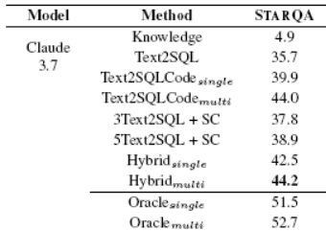
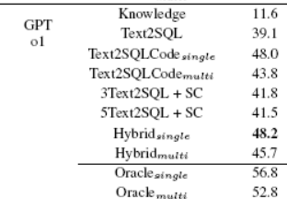
Results
[Maddella et al, EMNLP’25]
Text2SQLCode performs better than Text2SQL

Slide 17
Results
[Maddella et al, EMNLP’25]
Self Consistency over Text2SQL helps!

Slide 18
Results
[Maddella et al, EMNLP’25]
Different LLMs vary w.r.t. single vs. multi
tradeoff between one large prompt vs. error multiplication over pipelined prompts

Slide 19
Errors
Logical errors
  missed clauses
  inaccurate null processing
  missed steps
Inaccurate decomposition
  missed retaining information in SQL steps
Text2SQL prompts that are inter-dependent

Slide 20
TakeAways
Useful dataset for multi-agent system over a DB
Division of Labor
  Text2SQL: primarily for data subselection and fetch
  Text2Code: primarily for complex intents
  Plumbing: needed for smooth inter-operation
Calibration of LLMs via self consistency

Slide 21
Case Studies in Semantic Parsing
Reasoning: Answering complex analytical reasoning questions
Robustness: Handling unanswerable questions
Transfer Learning: Limited training data

Slide 22
Outline: KBQA
datasets
 | In-Domain Training |  | Transfer Learning
Answerable Only | SLM |  |  | LLM+
Answerable + Unanswerable |  |  |  | LLM+
*previous work
*our work

Slide 23
Outline: KBQA
datasets
 | In-Domain Training |  | Transfer Learning
Answerable Only | SLM | LLM+ |  | LLM+
Answerable + Unanswerable | SLM | LLM+ |  | LLM+
datasets
*previous work
*our work

Slide 24
Outline: KBQA
datasets
 | In-Domain Training |  | Transfer Learning
Answerable Only | SLM | LLM+ |  | LLM+
Answerable + Unanswerable | SLM | LLM+ |  | LLM+
datasets
*previous work
*our work

Slide 25
Background: Knowledge-Base Question Answering
Question
(Q)
Q: What papers have Chris Manning written in EMNLP?
Training Data:
  (Q, LF) pairs
Logical Form (LF) :
(And Paper (And (Join writes⁻¹ C. Manning) (Join published at EMNLP)))
KB: Set of Facts, defined by Schema
KB
Answer
(A)
Researcher
Paper
Conference
writes
published at
KB
C. Manning
Glove
EMNLP
writes
published at
A: Glove
Notes:
The problem of natural language question answering over knowledge bases (KBQA) has received a lot of interest in recent years. An important aspect of this task for real-world deployment is detecting answerability of questions. This problem arises for KBs due to various reasons, including schema-level and data-level incompleteness of KBs, limited KB scope, questions with false premises, etc. In such cases, a robust and trustworthy model should detect and report that a question is unanswerable, instead of outputting some incorrect answer. Answerability has been explored for different qa tasks such as extractive, conversational, boolean (Y/N) and MCQs (Raina and Gales, 2022). However, there is no existing work on answerability for KBQA. Benchmark KBQA datasets contain only answerable questions.

Slide 26
Background: Knowledge-Base Question Answering
Question
(Q)
Q: What papers have Chris Manning written in EMNLP?
Training Data:
  (Q, LF) pairs
Logical Form (LF) :
(And Paper (And (Join writes⁻¹ C. Manning) (Join published at EMNLP)))
KB: Set of Facts, defined by Schema
Schema Elements Entity Types Relations
KB
Answer
(A)
Researcher
Paper
Conference
writes
published at
KB
C. Manning
Glove
EMNLP
writes
published at
A: Glove
Notes:
The problem of natural language question answering over knowledge bases (KBQA) has received a lot of interest in recent years. An important aspect of this task for real-world deployment is detecting answerability of questions. This problem arises for KBs due to various reasons, including schema-level and data-level incompleteness of KBs, limited KB scope, questions with false premises, etc. In such cases, a robust and trustworthy model should detect and report that a question is unanswerable, instead of outputting some incorrect answer. Answerability has been explored for different qa tasks such as extractive, conversational, boolean (Y/N) and MCQs (Raina and Gales, 2022). However, there is no existing work on answerability for KBQA. Benchmark KBQA datasets contain only answerable questions.

Slide 27
Background: Knowledge-Base Question Answering
Question
(Q)
Q: What papers have Chris Manning written in EMNLP?
Training Data:
  (Q, LF) pairs
Logical Form (LF) :
(And Paper (And (Join writes⁻¹ C. Manning) (Join published at EMNLP)))
KB: Set of Facts, defined by Schema
Schema Elements Entity Types Relations
Data Elements Entities
Facts
KB
Answer
(A)
Researcher
Paper
Conference
writes
published at
KB
C. Manning
Glove
EMNLP
writes
published at
A: Glove
Notes:
The problem of natural language question answering over knowledge bases (KBQA) has received a lot of interest in recent years. An important aspect of this task for real-world deployment is detecting answerability of questions. This problem arises for KBs due to various reasons, including schema-level and data-level incompleteness of KBs, limited KB scope, questions with false premises, etc. In such cases, a robust and trustworthy model should detect and report that a question is unanswerable, instead of outputting some incorrect answer. Answerability has been explored for different qa tasks such as extractive, conversational, boolean (Y/N) and MCQs (Raina and Gales, 2022). However, there is no existing work on answerability for KBQA. Benchmark KBQA datasets contain only answerable questions.

Slide 28
Outline: KBQA
datasets
 | In-Domain Training |  | Transfer Learning
Answerable Only | SLM | LLM+ |  | LLM+
Answerable + Unanswerable | SLM | LLM+ |  | LLM+
datasets
*previous work
*our work

Slide 29
Limitations of Existing Data Curation Process
By Design
  all questions are answerable!
Cannot be true in real world
  User doesn’t always know what is inside KB and what is not?
  KBs are incomplete
Consequence
  models believe every question is answerable!
  researchers exploit this via execution guided feedback (EGF)
    showing “inflated” performance
    making models even less robust

Slide 30
Execution Guided Feedback
Q: What papers have Chris Manning written in EMNLP?
AI Model
no answer
Logical Form (LF) :
(And Paper (And (Join writes⁻¹ C.G. Neville-Manning) (Join published at EMNLP)))
KB

Slide 31
Execution Guided Feedback
Q: What papers have Chris Manning written in EMNLP?
AI Model
no answer
Logical Form (LF) :
(And Paper (And (Join writes⁻¹ C. Manning) (Join published at EMNLP)))
KB
A: Glove
Leads to “inflated” performance estimation of models

Slide 32
Limitations of Data Curation Process
By Design
  all questions are answerable!
Cannot be true in real world
  User doesn’t always know what is inside KB and what is not?
  KBs are incomplete
Consequence
  models believe every question is answerable!
  researchers exploit this via execution guided feedback (EGF)
    showing “inflated” performance
    making models even less robust
Goal: curate a dataset with both answerable + unanswerable questions

Slide 33
Two Forms of Unanswerability
answerable:
  Q admits a valid logical form l for KB
  AND
  l returns a non-empty answer set when executed over KB.
unanswerable:
  q does not admit a valid logical form l for G
  OR
  l returns an empty answer when executed over G.

Slide 34
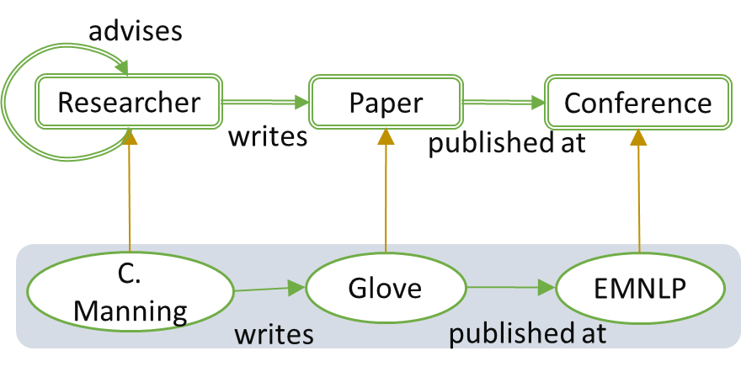
Creating Unanswerable Questions (Link Drop $⊂$ Data Drop)
l : (And Paper (And (Join writes Chris Manning) (Join R published at EMNLP)))
a : [Glove]
l : (And Paper (And (Join writes⁻¹ C. Manning) (Join published at EMNLP)))
a = [NA]

Slide 35
Creating Unanswerable Questions (Entity Drop $⊂$ Data Drop)
l : (And Paper (And (Join writes Chris Manning) (Join R published at EMNLP)))
a : [Glove]
l : (And Paper (And (Join writes⁻¹ C. Manning) (Join published at EMNLP)))
a = [NA]

Slide 36
Creating Unanswerable Questions (Entity Drop $⊂$ Data Drop)
l : (And Paper (And (Join writes Chris Manning) (Join R published at EMNLP)))
a : [Glove]
l* : (And Paper (And (Join writes⁻¹ C. Manning) (Join published at EMNLP)))
l = NK, a = [NA]

Slide 37
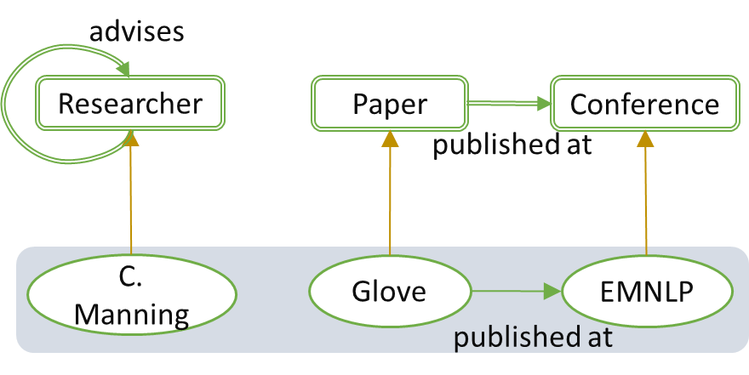
Creating Unanswerable Questions (Relation Drop $⊂$ Schema Drop)
l : (And Paper (And (Join writes Chris Manning) (Join R published at EMNLP)))
a : [Glove]
l* : (And Paper (And (Join writes⁻¹ Chris Manning) (Join published at EMNLP)))
l = NK, a = [NA]

Slide 38
Creating Unanswerable Questions (Type Drop $⊂$ Schema Drop)
l : (And Paper (And (Join writes Chris Manning) (Join R published at EMNLP)))
a : [Glove]
l : (And Paper (And (Join writes⁻¹ C. Manning) (Join published at EMNLP)))
l = NK, a = [NA]

Slide 39
GrailQAbility
[Patidar et al., ACL 2023]
GrailQA with only answerable questions [Gu et al 2021]
GrailQAbility with both answerable and unanswerable questions
GrailQAbility
  Balanced between various forms of data/schema drops
  Training Data: two settings
    Only A question training
    A+U question training

Slide 40

Outline: KBQA
datasets
 | In-Domain Training |  | Transfer Learning
Answerable Only | SLM | LLM+ |  | LLM+
Answerable + Unanswerable | SLM | LLM+ |  | LLM+
datasets
*previous work
*our work

Slide 41
Solution Paradigm: Retrieve then Generate (Bottom Up)
KB elements guide generation
Model learns to focus on paths
Overreliance on KB paths
  If gold path is absent, model chooses some path, generating wrong logical form
How to output l=NK? Not trained for it.
Researcher
Paper
Conference
writes
published at
C. Manning
Glove
EMNLP
writes
published at
Entity Linking, Retrieval, Path Enumeration
Entities: EMNLP, C. Manning
Generation (SLM)
(And Paper (And (Join published at EMNLP) (Join writes⁻¹ C. Manning)))
Schema: Paper, writes, published at
Paths: (Papers published at EMNLP),
(Papers writes⁻¹ C. Manning))
A: Glove
Notes:
The problem of natural language question answering over knowledge bases (KBQA) has received a lot of interest in recent years. An important aspect of this task for real-world deployment is detecting answerability of questions. This problem arises for KBs due to various reasons, including schema-level and data-level incompleteness of KBs, limited KB scope, questions with false premises, etc. In such cases, a robust and trustworthy model should detect and report that a question is unanswerable, instead of outputting some incorrect answer. Answerability has been explored for different qa tasks such as extractive, conversational, boolean (Y/N) and MCQs (Raina and Gales, 2022). However, there is no existing work on answerability for KBQA. Benchmark KBQA datasets contain only answerable questions.

Slide 42
Outline: KBQA
datasets
 | In-Domain Training |  | Transfer Learning
Answerable Only | SLM | LLM+ |  | LLM+
Answerable + Unanswerable | SLM | LLM+ |  | LLM+
datasets
*previous work
*our work

Slide 43
How to Generate l=NK? Simple Ideas…
Turn off EGF
Thresholding
  Pr_{gen}(l|q) > threshold
    output l
  else
    output NK
A+U Training

Slide 44
Experiments
Train | Model | Overall |  | Answerable |  | Unanswerable
 |  | F1 | EM | F1 | EM | F1 | EM
A | TIARA | 72.8 | 53.7 | 80.0 | 75.6 | 58.3 | 9.2
 | TIARA+T | 71.6 | 55.2 | 74.1 | 70.6 | 66.7 | 24.1
A+U | TIARA | 77.4 | 66.3 | 71.3 | 68.3 | 89.8 | 62.2
 | TIARA+T | 76.9 | 66.9 | 69.9 | 67.0 | 91.2 | 66.7

Slide 45
How to make one model robust to both answerable and unanswerable questions?

Slide 46
Issues → Ideas
Poor calibration for thresholding
  Last step should be a discriminative model rather than generative
Over-reliance on retrieved paths, leading to wrong logical forms
Solution: Combine sketch-based architectures with Retrieve-then-generate

Slide 47
Solution Paradigm 2: Sketch Filling (Top Down)
Researcher
Paper
Conference
Sketch Generation (SLM)
writes
published at
(And [type] (And (Join [relation] [entity]) (Join [relation] [entity])))
C. Manning
Glove
EMNLP
writes
published at
LF Integration
(And Paper (And (Join published at EMNLP) (Join writes⁻¹ C. Manning)))
(And Paper (And (Join published at EMNLP) (Join writes⁻¹ C. G. Neville-Manning)))
Entity Linking, Retrieval
Entities: EMNLP,
C. Manning, C.G. Neville-Manning
Schema: Paper, writes, published at
Reranking
(And Paper (And (Join published at EMNLP) (Join writes⁻¹ C. Manning)))
A: Glove
Notes:
The problem of natural language question answering over knowledge bases (KBQA) has received a lot of interest in recent years. An important aspect of this task for real-world deployment is detecting answerability of questions. This problem arises for KBs due to various reasons, including schema-level and data-level incompleteness of KBs, limited KB scope, questions with false premises, etc. In such cases, a robust and trustworthy model should detect and report that a question is unanswerable, instead of outputting some incorrect answer. Answerability has been explored for different qa tasks such as extractive, conversational, boolean (Y/N) and MCQs (Raina and Gales, 2022). However, there is no existing work on answerability for KBQA. Benchmark KBQA datasets contain only answerable questions.

Slide 48
RetinaQA
[Faldu et al., ACL 2024]
Researcher
Paper
Conference
Sketch Generation (SLM)
writes
published at
(And [type] (And (Join [relation] [entity]) (Join [relation] [entity])))
C. Manning
Glove
EMNLP
writes
published at
LF Integration + Generation
Entity Linking, Retrieval, Path Enumeration
(And Paper (And (Join published at EMNLP)) (Join writes⁻¹ C. Manning)))
(And Paper (And (Join published at EMNLP) (Join writes⁻¹ C. G. Neville-Manning)))
Entities: EMNLP, C. Manning
Schema: Paper, writes, published at
Reranking
Paths: (Papers published at EMNLP),
(Papers writes⁻¹ C. Manning))
(And Paper (And (Join published at EMNLP) (Join writes⁻¹ C. Manning)))
A: Glove
Notes:
The problem of natural language question answering over knowledge bases (KBQA) has received a lot of interest in recent years. An important aspect of this task for real-world deployment is detecting answerability of questions. This problem arises for KBs due to various reasons, including schema-level and data-level incompleteness of KBs, limited KB scope, questions with false premises, etc. In such cases, a robust and trustworthy model should detect and report that a question is unanswerable, instead of outputting some incorrect answer. Answerability has been explored for different qa tasks such as extractive, conversational, boolean (Y/N) and MCQs (Raina and Gales, 2022). However, there is no existing work on answerability for KBQA. Benchmark KBQA datasets contain only answerable questions.

Slide 49
Experiments: RetinaQA
[Faldu et al., ACL 2024]
Train | Model | Overall |  | Answerable |  | Unanswerable
 |  | F1 | EM | F1 | EM | F1 | EM
A | TIARA+T | 71.6 | 55.2 | 74.1 | 70.6 | 66.7 | 24.1
 | RETINA+T | 82.1 | 73.7 | 81.2 | 75.0 | 84.2 | 71.2
A+U | TIARA+T | 76.9 | 66.9 | 69.9 | 67.0 | 91.2 | 66.7
 | RETINA+T | 82.7 | 77.5 | 77.9 | 75.2 | 92.4 | 82.1

Slide 50
TakeAways: SLMs
Different model architectures have complementary strengths
  KB data retrieval for generation makes model susceptible to missing info
    but performs better on answerable queries
  Sketch based approaches handle unanswerable questions more gracefully
    but performance can be weaker on answerable queries
  generation systems have weaker calibration than discriminators
Robust KBQA necessitates a unified architecture
  to gracefully handle both answerable and unanswerable questions

Slide 51
Outline: KBQA
datasets
 | In-Domain Training |  | Transfer Learning
Answerable Only | SLM | LLM+ |  | LLM+
Answerable + Unanswerable | SLM | LLM+ |  | LLM+
datasets
*previous work
*our work

Slide 52
When would LLMs be superior to specialized SLMs? and how?

Slide 53
LLMs for KBQA
Q: What papers have Chris Manning written in EMNLP?
Logical Form (LF) :
(And Paper (And (Join writes⁻¹ C. Manning) (Join published_at EMNLP)))
KB
A: Glove

Slide 54
LLMs for KBQA
Q: What papers have Chris Manning written in EMNLP?
*language specific
- LLM likely knows
Logical Form (LF) :
(And Paper (And (Join writes⁻¹ C. Manning) (Join published_at EMNLP)))
KB
*KB specific
- LLM won’t know
- use traditional ML
A: Glove

Slide 55
LLMs for KBQA (In-Context Learning)
Q: What papers have Chris Manning written in EMNLP?
Few-shot exemplars
Logical Form (LF) :
(And Paper (And (Join writes⁻¹ C. Manning) (Join published_at EMNLP)))
KB
A: Glove
  Observation: LLM hallucinates; struggles on questions with diverse functions, multi-hop questions and choosing right relations.

Slide 56
LLMs for KBQA (Supervised Retriever Augmentation)
Q: What papers have Chris Manning written in EMNLP?
Sup. ML output for entity linking, rel/path retrieval
+ Few-shot exemplars
Logical Form (LF) :
(And Paper (And (Join writes⁻¹ C. Manning) (Join published_at EMNLP)))
KB
A: Glove
  Observation: Hallucination largely reduced when retrieval is correct. However retrieval models work poorly without sufficient training data

Slide 57
Fused Supervised & In-Context Learning for KBQA (FuSIC-KBQA)
Q: What papers have Chris Manning written in EMNLP?
Retrieval reranking
and subselection
Sup. ML output for entity linking, rel/path retrieval
+ Few-shot exemplars
Logical Form (LF) :
(And Paper (And (Join writes⁻¹ C. Manning) (Join published_at EMNLP)))
KB
A: Glove

Slide 58
In-domain Results
[Patidar et al, ACL’24]
Train Data Size | Model | F1
2217 (5%) | TIARA | 64.8
 | Pangu | 69.5
 | RetinaQA | 62.4
 | FuSIC-KBQA | 74.5
4,434 (10%) | TIARA | 67.2
 | Pangu | 72.4
 | RetinaQA | 68.3
 | FuSIC-KBQA | 75.6
44,337 (100%) | TIARA | 82.6
 | Pangu | 83.5
 | RetinaQA | 84.7
 | FuSIC-KBQA | 83.6
  Summary: LLMs + Supervised ML effective in low data settings.

Slide 59
Few-shot Transfer Learning
What medicines have Pfizer patented?, (And Med (And Join R patents Pfizer))
…, …
…, …
New (target) KB
Small number (e.g. tens) of labelled questions from target domain
What papers has Chris Manning written?, (And Paper (And Join R writes C. Manning))
…, …
…, …
Different (source) KB
  Source and target may have different domains, different relations and types, different distributions of questions and logical forms…

Slide 60
Few-shot Transfer Learning
What medicines have Pfizer patented?, (And Med (And Join R patents Pfizer))
…, …
…, …
New (target) KB
Small number (e.g. tens) of labelled questions from target domain
What papers has Chris Manning written?, (And Paper (And Join R writes C. Manning))
…, …
…, …
Different (source) KB
  Source and target may have different domains, different relations and types, different distributions of questions and logical forms…
  Still, they may have similar high-level structures

Slide 61
FuSIC-KBQA: Transfer Setting
Q: What papers have Chris Manning written in EMNLP?
Retrieval reranking
and subselection
Sup. ML output for entity linking, rel/path retrieval
+ Few-shot exemplars
Logical Form (LF) :
(And Paper (And (Join writes⁻¹ C. Manning) (Join published_at EMNLP)))
KB
A: Glove
  Supervised Retrievers trained on source KB; fine-tuned on target KB
  LLM reranking prompted in target domain

Slide 62
Transfer Results
[Patidar et al, ACL’24]
 | Model | GrailQA → GraphQA | GrailQA → WebQSP | WebQSP → GrailQA-Tech | WebQSP → GraphQA-Pop
Supervised | TIARA | 50.1 | 40.6 | 48.2 | 37.3
 | Pangu | 63.2 | 45.3 | 51.0 | 36.7
LLM ICL | KB-Binder | 35.2 | 55.7 | 68.0 | 31.5
Fusion | Gf-BLLM | 52.5 | 53.4 | 61.2 | 46.6
 | FuSIC-KBQA | 69.1 | 65.1 | 74.6 | 61.6
  Summary: LLMs + Supervised ML effective in transfer settings

Slide 63
TakeAways: LLM Workflows
Good performance by
  Supervised ML (hints)
  + retrieval
  → LLM prompting
  output SPARQL not a specialized language
LLMs: broad knowledge and capabilities
Supervised ML: specific knowledge alignment thru retrieval
Not very easy to beat supervised SoTA in standard NLP tasks, but doable
  in low-data settings: LLM’s IFT capabilities help
  in transfer settings: LLM’s pre-training broad knowledge helps

Slide 64
Outline: KBQA
datasets
 | In-Domain Training |  | Transfer Learning
Answerable Only | SLM | LLM+ |  | LLM+
Answerable + Unanswerable | SLM | LLM+ |  | LLM+
datasets
*previous work
*our work

Slide 65
How to use LLMs when some questions may be unanswerable?

Slide 66
Simple Ideas (FuSIC-U)
Remove Execution Guided Filtering
Prompt the LLM – “some questions may be unanswerable…”
Exemplar selection – provide some unanswerable questions
Not enough for good performance ☹
Key Ideas in Fun-FuSIC:
  Estimate LLM confidence
  Provide feedback to LLM

Slide 67
FuSIC-KBQA: Transfer Setting
Q: What papers have Chris Manning written in EMNLP?
Retrieval reranking
and subselection
Sup. ML output for entity linking, rel/path retrieval
+ Few-shot exemplars
Logical Form (LF) :
(And Paper (And (Join writes⁻¹ C. Manning) (Join published_at EMNLP)))
KB
A: Glove

Slide 68
Fun-FuSIC: Estimate LLM Confidence
Q: What papers have Chris Manning written in EMNLP?
Retrieval reranking
and subselection
Sup. ML output for entity linking, rel/path retrieval
+ Few-shot exemplars
Logical Form (1)
Logical Form (2)
…
Logical Form (K)
KB
A: Glove
If LFs are consistent, output most freq. LF
If LFs are inconsistent, output NK

Slide 69
Fun-FuSIC: Sequential Generation with Feedback
Q: What papers have Chris Manning written in EMNLP?
feedback
(e.g., syntactic correctness)
Retrieval reranking
and subselection
Sup. ML output for entity linking, rel/path retrieval
+ Few-shot exemplars
Logical Form (1)
Logical Form (2)
…
Logical Form (K)
KB
A: Glove

Slide 70
Fun-FuSIC: Semantic Feedback
Q: What papers have Chris Manning written in EMNLP?
feedback
(e.g., syntactic correctness)
Retrieval reranking
and subselection
Sup. ML output for entity linking, rel/path retrieval
+ Few-shot exemplars
Logical Form
KB
semantic
feedback
are they semantically equivalent?
A: Glove
Back-translated question

Slide 71
Experiments: Transfer Learning over Robust KBQA
[Sawhney et al, ACL Findings’25]
Data | Model | Overall |  | Answerable |  | Unanswerable
 |  | F1 | EM | F1 | EM | F1 | EM
WebQSP → GrailQAbility | FuSIC-U | 76.6 | 48.2 | 67.5 | 59.2 | 85.6 | 37.2
 | Fun-FuSIC | 76.1 | 60.2 | 67.1 | 61.2 | 80.0 | 59.2
WebQSP → GraphQAbility | FuSIC-U | 67.5 | 34.8 | 49.3 | 40.0 | 85.7 | 29.6
 | Fun-FuSIC | 70.0 | 53.8 | 50.7 | 42.8 | 89.2 | 64.8

Slide 72
TakeAways
Feedback to LLMs for solving more complex AI problems
Calibration of LLMs via self consistency

Slide 73
Outline: KBQA
datasets
 | In-Domain Training |  | Transfer Learning
Answerable Only | SLM | LLM+ |  | LLM+
Answerable + Unanswerable | SLM | LLM+ |  | LLM+
datasets
*previous work
*our work

Slide 74
The Value of Semantic Parsing for QA
LM as a semantic parser
Knowledge in KB/DB
What papers has Chris Manning written in EMNLP?
  limited applicability
  domain-specific training data
  hallucinatory if ans $∉$KB
  models can be lightweight
  fast at test time
  real-time data updates
  provenance
  proprietary data
** GloVe: Global Vectors for Word Representation** (2014)
** HotpotQA: A dataset for diverse, explainable multi-hop question answering ** (2018)
logical
form
answers

Slide 75
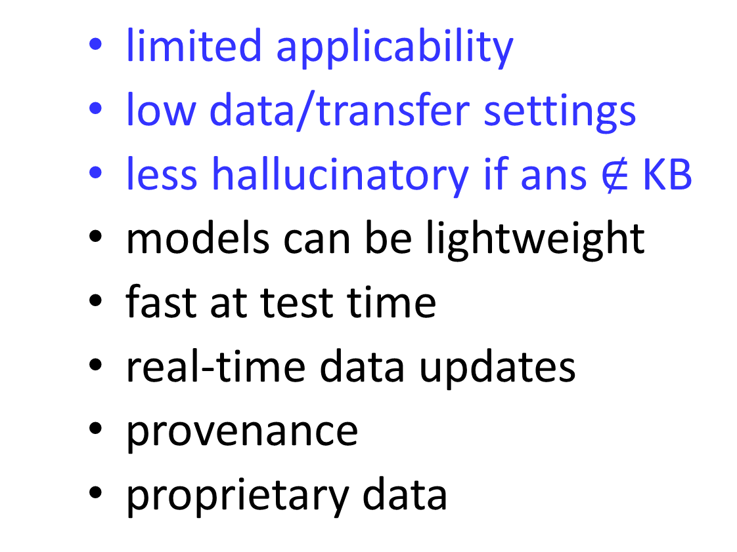
Three Paradigms of Information-Seeking Conversational AI
LM as a semantic parser
Knowledge in KB/DB
What papers has Chris Manning written in EMNLP?
  limited applicability
  low data/transfer settings
  less hallucinatory if ans $∉$KB
  models can be lightweight
  fast at test time
  real-time data updates
  provenance
  proprietary data
** GloVe: Global Vectors for Word Representation** (2014)
** HotpotQA: A dataset for diverse, explainable multi-hop question answering ** (2018)
logical
form
answers

Slide 76









Thanks!
Notes:
Tool use
Planning
Hallucinations
Ethics/Alignment/Personalization
Agentic architectures
Low-resource languages

