Slide 1







Explaining Textual Entailment
with Lexical Entailments
Using LLMs to Supply Lexical Relations
for Formal Proofs
Jorryt de Jong, Stefan Moraca, Ettore Cesari, Lasha Abzianidze
Towards Explainable
Natural Language
Reasoning for AI:
project DXQIL95775
Institute for
Language Sciences
Utrecht University
AKBC@EMNLP
October 28, 2026
Notes:
Longest title but it is not

Slide 2
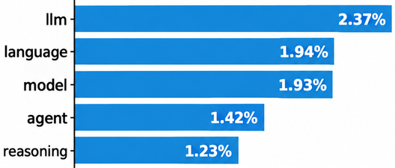
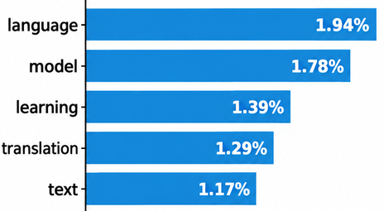

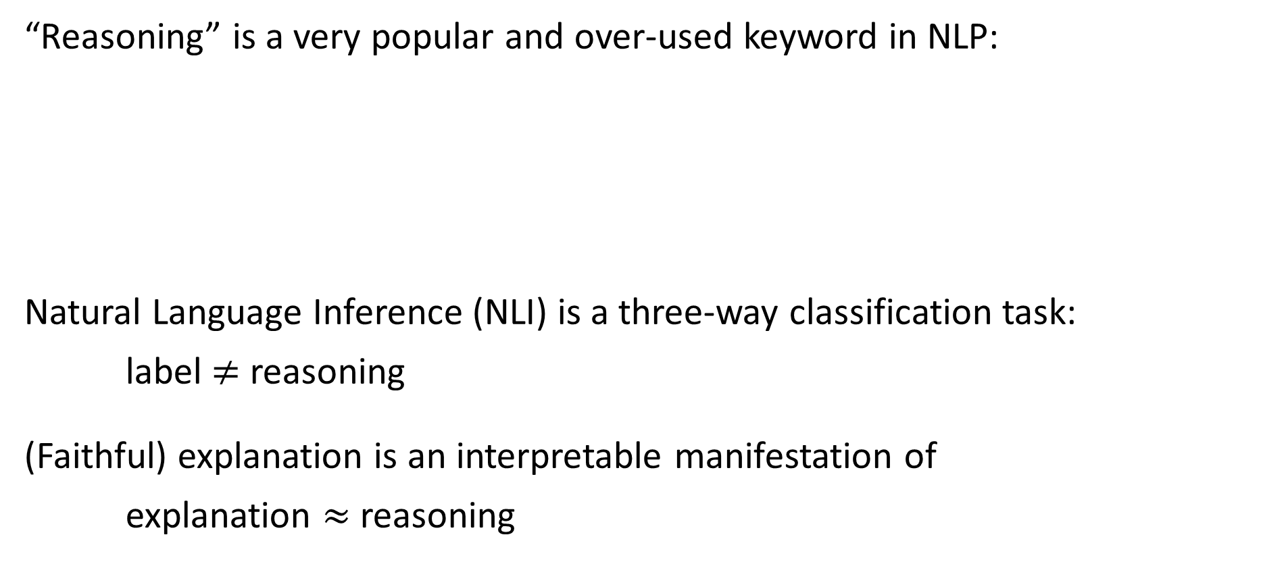
Reasoning & explanation
“Reasoning” is a very popular and over-used keyword in NLP:
Natural Language Inference (NLI) is a three-way classification task:
label $≠$ reasoning
(Faithful) explanation is an interpretable manifestation of
explanation $≈$ reasoning
EMNLP 2026
& co-events
EMNLP 2021
& co-events
#64 reasoning (0.29%)
#5 reasoning
label
reasoning

Slide 3


Variation: label & explanation
Human Label Variation is a hot topic
Label variation is more discussed than explanation variation
(Plank+, 2014)
Premise
Hypothesis
The dog is standing in front of a bike
The dog is in front of a bicycle
Entailment
Contradiction
Neutral
A bike means a bicycle
A bike has a motor and a bicycle doesn’t
A bike can be a bicycle but also a motorbike
Maybe the dog also stands in front of a bicycle
Label variation alone, without explanations, is of limited use.

Slide 4
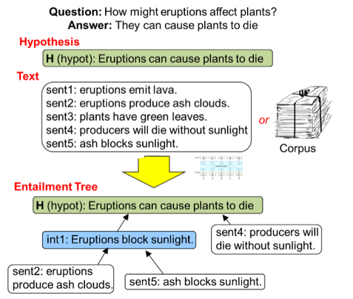
Structured explanations
Structured explanations are not applied to the existing NLI datasets
Instead, new synthetic reasoning datasets are created
Entailment trees
Dalvi+ (2021)
Only inter-sentence relations
Label
Free-text explanations
Answer=22
GSM8K
22 = (25-2)-1
Free-text explanations
e-SNLI
Camburu+(2018)
No reliable automated method for comparing free-text explanations
Specific domain with a huge answer space
Notes:
No, NLI is not solved!

Slide 5
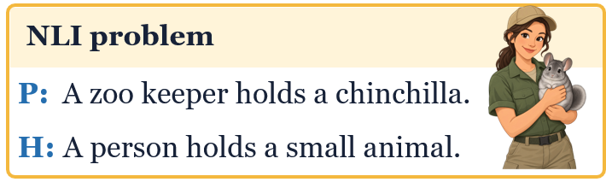

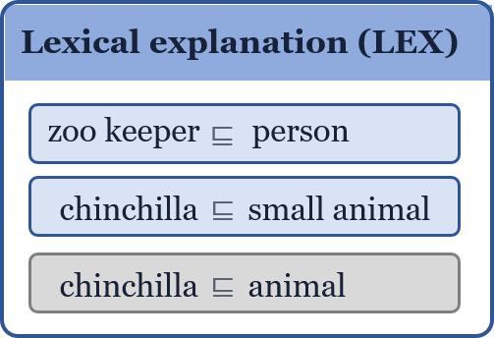
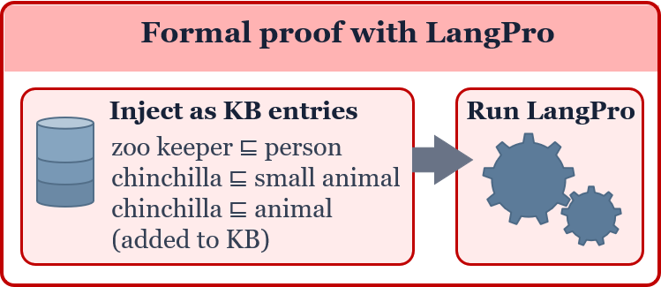
Our contributions
Novel task of explainable NLI, called LEX-NLI
adding structured expl. to ent. problems
restricted explanations to lexical relations
Intrinsic evaluation of LLMs on LEX-NLI
Predict label and a LEX set of relations
Extrinsically evaluate LLM-generated LEX
Neurosymbolic pipeline: LLM supplies KB
to a natural language reasoner
predict
predict
Intrinsic evaluation LEX-NLI
Label
entailment
Extrinsic evaluation

Slide 6
Data curation
Focus on entailment NLI problems and lexical entailment explanations:
  A set of lexical entailments, called a LEX set, as a structured explanation
  Lexical relations should be sensible out of the context:
  Skip relations licensed with word deletion:
  …
Embrace variation in structured explanations:
  Four annotators; each problem gets three explanations + optional 4th
female swimmer ⊑ woman
swimmer ⊑ woman
tall man ⊑ man
P: A woman observes a rusted antique car.
H: A woman looks at an old car.
Annotator 1
Annotator 2
Annotator 3
4th valid LEX
antique ⊑ old
observe ⊑ look
antique car ⊑ old car
observe ⊑ look
antique ⊑ old
observe ⊑ look at
antique car ⊑ old car
observe ⊑ look at

Slide 7


Intrinsic evaluation
Can LLMs predict an NLI label and a LEX set?
Evaluation set: 362 SICK/SNLI problems with possibly empty LEX sets
System | Exact match | Micro-F1
Against the best matching reference LEX set
Average annotator | 80.9 | 84.9
$Δ$=22.7
$Δ$=11.8
Claude Sonnet 4.5 | 58.2 | 73.1
Gemini 3.5 Flash | 58.1 | 71.9
GPT-5.4 | 57.5 | 69.3
WordNet & Rules | 50.0 | 51.0

Slide 8
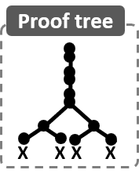






Extrinsic Evaluation
Data: 1K SNLI problems
Reasoner: Natural logic-based tableau theorem prover
Modes: simple & agentic prediction of LEX sets
(Abzianidze, 2015, 2017, 2020)
LangPro
WordNet
LLM
WordNet
NLP problem
157
+8
+22
LangPro
WordNet
Tableau prover
WordNet as KB
+23
+36
CCG parser
LLF gen.
Critic
LLM
Notes:
Classical pipeline

Slide 9



Limitations
Only entailment problems and relations
Only 362 problems in the test set
We need more diversity in explanations
Future research
Scale up: data size, variation in explanations, labels
Go beyond lexical relations in structured explanations
P: A man and a woman walk.
H: A woman and a man walk.
P: Not all birds fly
H: Some bird doesn’t fly

Slide 10
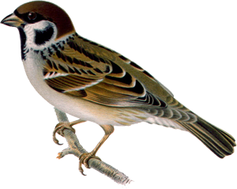






















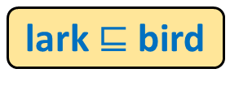























Natural Tableau in Action
$$a lark (not \left(be move\right))$$
A lark is not moving
C Every bird is flying
$$every S V$$
Proved
$$every bird \left(be fly\right)$$
$$S$$
$$c$$
$$V$$
$$c$$
$$lark$$
$$c$$
$$not (be move)$$
$$c$$
$$a S V$$
$$not X$$
$$\overline{a}$$
$$be X$$
$$\overline{a}$$
$$be X$$
$$\overline{a}$$
$$be move$$
$$c$$
$$S$$
$$c$$
$$X$$
$$\overline{a}$$
$$X$$
$$\overline{a}$$
$$X$$
$$\overline{a}$$
$$V$$
$$c$$
$$move$$
$$c$$
$X$
$$\overline{a}$$
$$bird$$
$$c$$
$$be fly$$
$$c$$
lark $⊑$ bird
KB
$Y$
$$\overline{a}$$
$$fly$$
$$c$$
fly $⊑$ move
WordNet
If $X⊑Y$

