Slide 1
Facial Expression Recognition
Team members:
Kunal Vartia
Arnab Chattopadhyay
Siddharth D P
Neeraj Udupa

Slide 2
Introduction: The Problem Statement
We explore the world of Computer Vision, one of the most exciting areas of Artificial Intelligence.
Motivation
Inspired by our online classes, we felt that video meetings can take advantage of the built-in camera to capture and recognize participants’ facial expressions in real time.
What we hoped to achieve
Build a face expression recognition system complementing the material covered in class:
Design a custom Convolutional Neural Network
Train it from scratch by feeding batches of images
Transfer learning with a standard architecture
Export it to reuse it with real-time image data

Slide 3
Our Approach
Image Problem + Deep learning =
Setting up a Convolutional Neural Network (CNN)
Easier implementation + Fast real-time interfacing =
OpenCV + Haar-cascades
Few training examples in Kaggle Dataset + CNNs =
Data Augmentation!

Slide 4
How does our algorithm work?
Batch normalization: Improves the performance and stability by providing inputs with 0 mean and unit variance
Dropout: Reduces overfitting by randomly switching off the weights of some nodes
Optimizer: Adam optimizer (computationally most effective)
Loss function: Categorical Cross-Entropy (multi-class classification)
Metric: Accuracy
Camera class script: To get the image stream from our webcam, detect faces using OpenCV and add bounding boxes convert the faces to greyscale, rescale them and send them to our pre-trained Neural Network.
- Get the predictions back and add the label to the webcam image. Output the final image stream.
Main script: Create a application that will render our image predictions into a popup window
Convolution: Extracts features from the input image using a kernel. Preserves the spatial relations between the pixels.
Activation: ReLU
Max Pooling: Reduces the dimensionality of features while retaining the most important information

Slide 5
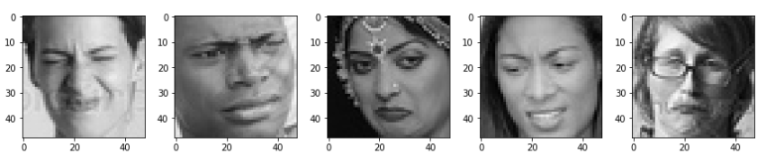
Methodology: The Data Set
Source
The data comes from the past Kaggle competition “Challenges in Representation Learning: Facial Expression Recognition Challenge”: https://www.kaggle.com/c/challenges-in-representation-learning-facial-expression-recognition-challenge
Description
48x48 pixel grayscale images of faces.
What we did new
We converted this data into raw images and split them in multiple folders.
Each image corresponds to a facial expression in one of seven categories (0=Angry, 1=Disgust, 2=Fear, 3=Happy, 4=Sad, 5=Surprise, 6=Neutral). A
Approximately 36K images.
80% of our images are contained inside the train folder, and the last 20% are inside the validation folder.
Setup data generators

Slide 6

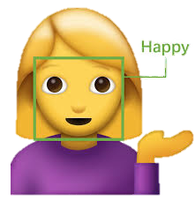

Overview of the Packages used and Code
Keras is a high-level Neural Network API, written in Python. We will use it to build, train and export out Neural Network.
Used Haar-cascade classifier that captures face features from real time.
OpenCV is a computer vision library with C++, Python and Java interfaces. We used this library to automatically detect faces in images.

Slide 7
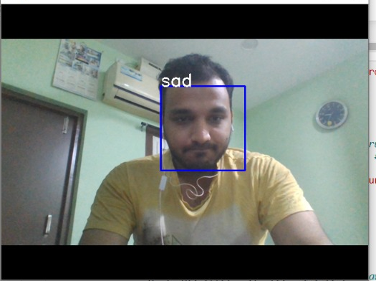
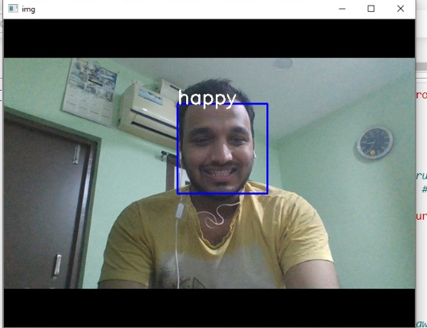
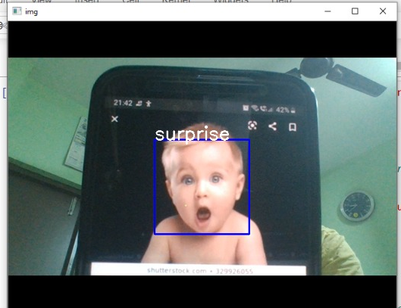
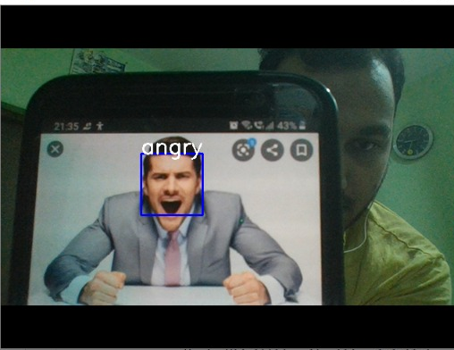
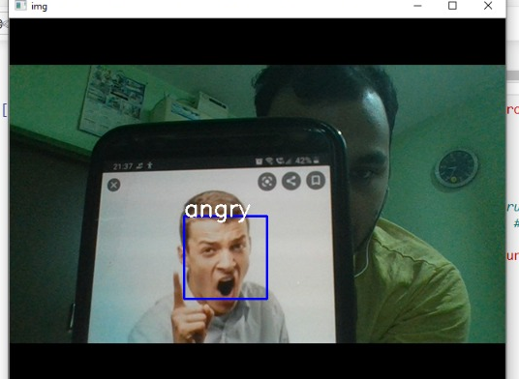
Results
A fairly accurate representation of the correct expression from the various test cases, both from Kunal’s side and on internet images.

Slide 8
Results: What it means...
The accuracy obtained on training data and that on the validation are 98.05 percent and 59.53 percent respectively.
The accuracies however maybe deceptive many a times in multi class classification problems.
We have to use a classification matrix to get a broader perspective of the false positives and false negatives.
Moreover, the facial expressions are abstract type of features since each expression is a blend of several other expressions.
This is one of the major challenges in identifying expressions even for humans sometimes(😁).
We would be using a better metric in the coming slides.

Slide 9
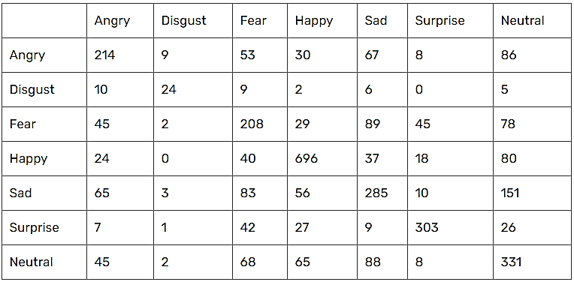
Results: What it means...
Clearly, accuracy should not express right impression for multi class classification problems. Confusion matrix of this model is demonstrated. We can see that there are 467 angry instances in test set. We can classify 214 angry items correctly. On the other hand, the model classified 9 items as disgust but these items are actual angry ones.

Slide 10
Conclusion: Our learning and Future Scope
Effectively employing Haar-cascades with Neural Networks for custom requirements.
Transfer learning with better test accuracies compared to our custom CNN.
For this project, we trained all the models from scratch using CNN packages in Keras. In future works, we would like to implement a Facial Action Coding System (FACS) for determining facial expressions.
This posits that expressions result from the change of facial parts and each muscular movement is tracked.
For this, we could investigate the efficacy of pretrained SOTA such as the Google-Net or Res-Net 50 or any recent published architecture.
Another extension would be the implementation of multi-face detection process, followed by the emotion prediction for each face.

