Slide 1
Customer Churn Analysis
GROUP 02
Akshay Belnekar | Rohit Sangem | Vaibhavi Hedaoo

Slide 2
TABLE OF CONTENTS
1.
Introduction
2.
Data Processing
Problem Statement and Dataset Overview
Data cleaning and feature engineering
3.
Data Analysis and Predictive Modeling
4.
Conclusion
Key findings and recommendations
Model Selection and Training

Slide 3
INTRODUCTION
Problem Statement
Key Factors influencing customer churn.
Predictive analysis to enhance customer retention.
Analyze all relevant customer data and develop focused customer retention programs.
Data Source
IBM Sample Data Sets - Telco Customer Churn Data
Notes:
7000 rows, 44 columns (2 tables combined)
Customer demographics, plan details, billing details, customer satisfaction rates
The aim of this project is to
Identify key factors influencing customer churn
Analyze the factors to draw important findings
Predictive model
Telecom companies can use this to target potential customers who are going to leave with targeted strategies for customer retention

Slide 4
2. Data Processing
Data cleaning:
Imputed null values in numeric features - tenure, Monthly Charges and Total Charges with their mean values.
Replaced 'No internet service' with 'No' to get consistent values for following features: Online Security, Online Backup, Device Protection, Tech Support, Streaming TV, Streaming Movies.
Feature Engineering:
Transformed the above 3 columns into a single vector and applied standard scaling on it to normalize them and avoid loss of information. (which happens in case of min max scaling)

Slide 5
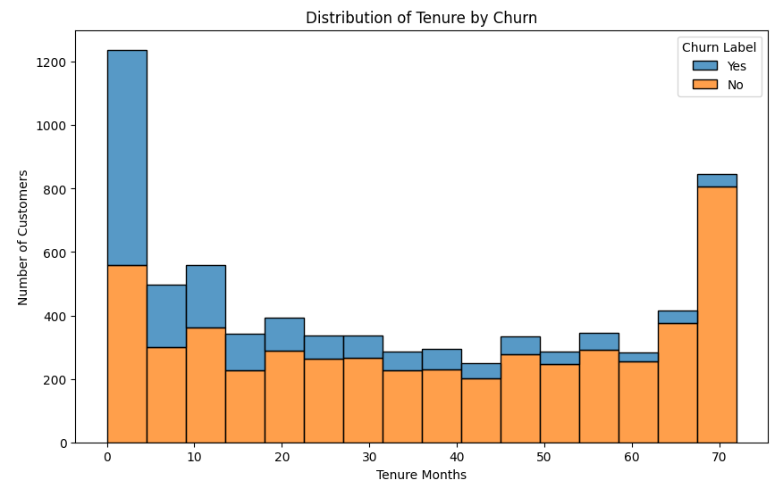
3. Data Analysis
Findings:
Churn Higher among customers with shorter tenure.
Increase in retention with increase in tenure months.
Notes:
Data exploration analysis to find out key factors that influence churn
early engagement is critical to customer retention.
customers stay beyond a certain period, they are much less likely to churn

Slide 6
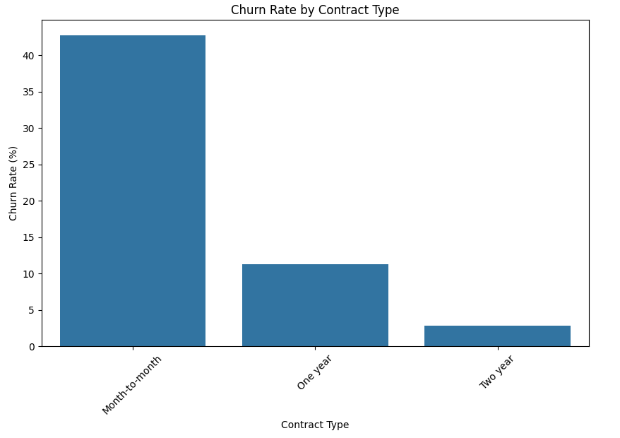
Findings:
Customers with month-to-month contracts are significantly more likely to churn compared to those with longer-term contracts
Notes:
In this plot we observed that customers with month to month contract have higher churn rate So companies can employ strategies to influence customers to subscribe to one year or two year contracts

Slide 7
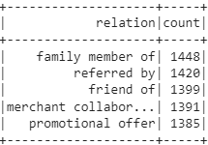
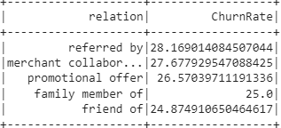
Spark SQL and GraphFrames
Dominant Factors of referral
Focus on incentivizing ‘family member’ referrals to attract more customers
Thorough evaluation of their referred by programs
Source of invitation Vs churn rate
Notes:
Spark SQl - data aggregation and analysis
Graphframes
We added dummy columns invitation source and referral ID to create relationship among customers

Slide 8
3. Predictive Model
To solve this binary classification problem, we tried predicting using 3 predictive models -
Logistic regression model
Decision tree model
Random forest model
2. Out of the 3 models, logistic regression model gave the highest accuracy of 95.55% when compared with the actual labels.

Slide 9
4. Conclusion
The company should consider revising its pricing strategy for the highest-spending customer segments like giving some rewards.
The company should conduct a thorough evaluation of ‘merchant collaboration programs’ to identify factors contributing to higher churn rates and try mitigating them.
The company should incentivize "family member" referrals, which appear to be the leading referral source.
Predictive model can help identify customers who are likely to churn in the near future, businesses can take proactive measures to retain them.

