Slide 1

Smith School Rankings Scrutinizers
Group 08
Team Members:
Abhishek Shetty
Akshay Belnekar
Rutuja Samant
Vaibhavi Hedaoo
4th December, 2023

Slide 2
Background
Users:
Prospective Students and Parents
Current Students
Faculty and Researchers
UMD Smith School
Data:
Ranking of Programs offered by R.H Smith School Of Business
Ranking Sources:
QS World University Rankings
Financial Times
U.S. News
Year of Ranking

Slide 3
Introduction
Mission Statement:
"To model a database for ranking various UMD Smith School programs, our mission is to provide a user-friendly platform that offers multi-year rankings for various graduate programs. Our goal is to enable the Smith School to draw valuable insights and facilitate data-driven decision-making regarding program rankings over the years."
Mission Objectives:
1. Find the top 5 ranked programs over the last 3 years to enhance transparency on the Smith School website.
2. Identify the top 5 improved/declined programs over the last 3 years for trend analysis.
3. Determine the top 5 programs with consistent rankings across all sources to assign singular ranks.
4. Identify the top 3 performing degrees based on program rankings for website display.
5. Determine the proportion of programs that improved/declined in the last year for tracking improvement efforts.

Slide 4
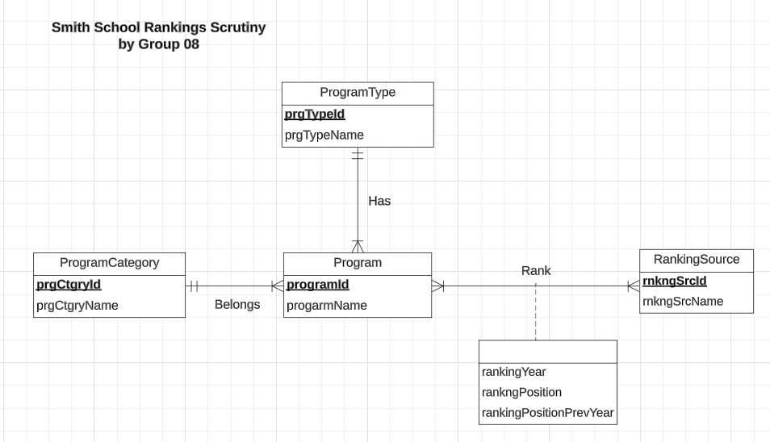
Conceptual Database Design: ER diagram
Notes:
w

Slide 5
Logical Database Design: Relational Schema
Relations:
Program (programId, programName, prgCtgryId, prgTypeId)
ProgramCategory (prgCtgryId, prgCtgryName)
ProgramType (prgTypeId, prgTypeName)
RankingSource (rnkngSrcId, rnkngSrcName)
Rank (programId, rnkngSrcId, rankingYear, rankingPosition, rankingPositionPrevYear)

Slide 6
Physical Database Design:
Program Table creation -
CREATE TABLE [RankingScrutiny.Program] (
programId VARCHAR (2) NOT NULL,
programName VARCHAR (50),
prgCtgryId VARCHAR (2),
prgTypeId VARCHAR (2),
CONSTRAINT pk_Program_programId PRIMARY KEY (programId),
CONSTRAINT fk_Program_prgCtgryId FOREIGN KEY (prgCtgryId)
REFERENCES [RankingScrutiny.ProgramCategory] (prgCtgryId)
ON DELETE CASCADE ON UPDATE CASCADE,
CONSTRAINT fk_ProgramType_prgTypeId FOREIGN KEY (prgTypeId)
REFERENCES [RankingScrutiny.ProgramType] (prgTypeId)
ON DELETE CASCADE ON UPDATE CASCADE
);

Slide 7
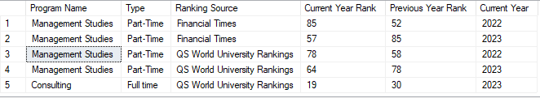
Business transactions:
Which programs have shown the most significant improvement or decline in rankings over the last 3 years?
GO
DROP VIEW IF EXISTS Top5ImprovedDeclinedPrograms
GO
CREATE VIEW Top5ImprovedDeclinedPrograms AS
SELECT TOP 5 p.programName 'Program Name', pt.prgTypeName 'Type',rs.rnkngSrcName 'Ranking Source', r.rankingPosition 'Current Year Rank', r.rankingPositionPrevYear 'Previous Year Rank', r.rankingYear 'Current Year'
FROM [RankingScrutiny.Program] p
JOIN [RankingScrutiny.Rank] r ON p.programId = r.programId
JOIN [RankingScrutiny.ProgramType] pt ON p.prgCtgryId = pt.prgTypeId
JOIN [RankingScrutiny.RankingSource] rs ON r.rnkngSrcId = rs.rnkngSrcId
WHERE r.rankingYear >= YEAR(GETDATE()) - 3
ORDER BY ABS(r.rankingPosition - r.rankingPositionPrevYear) DESC;
GO
SELECT *
FROM Top5ImprovedDeclinedPrograms;

Slide 8

Business transactions:
2. What is the proportion of programs that either improved or declined in rankings over the last year?
GO
DROP VIEW IF EXISTS ProgramsImprovementStatus
GO
CREATE VIEW ProgramsImprovementStatus AS
SELECT p.programId, p.programName, r.rankingYear, r.rankingPosition, r.rankingPositionPrevYear,
CASE
WHEN r.rankingPosition > r.rankingPositionPrevYear THEN 'Declined'
WHEN r.rankingPosition < r.rankingPositionPrevYear THEN 'Improved'
ELSE 'No Change'
END AS ImprovementStatus
FROM [RankingScrutiny.Program] p
JOIN [RankingScrutiny.Rank] r ON p.programId = r.programId
WHERE r.rankingYear = YEAR(GETDATE()) AND r.rankingPositionPrevYear IS NOT NULL;
GO
SELECT ImprovementStatus, COUNT(programId) AS ProgramCount, CAST(ROUND((COUNT(programId) * 100.0) / (SELECT COUNT(*) FROM ProgramsImprovementStatus), 2) AS decimal(18, 2)) AS Proportion
FROM ProgramsImprovementStatus
GROUP BY ImprovementStatus;

Slide 9
Thank You!

