Slide 1

Traffic Violations in Montgomery County, Maryland
BUDT 704
Presented by Group 22 - Beep Beep Oops
2023

Slide 2
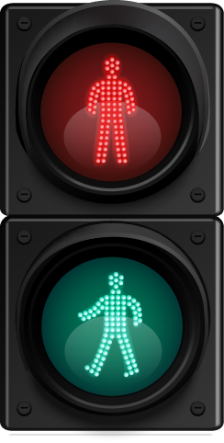
Introduction
BUDT 704
Montgomery County, MD
389 deaths.
48,655 crashes.
1 million+ violations in 12 years.
Every crash is preventable. Every life counts. Maryland’s Vision Zero project aims to have ZERO deaths due to crashes by 2030.
Our analysis aims to identify key reasons leading to crashes & implement as well as optimize evidence-based methods for Zero Deaths.
2023

Slide 3
Points of Interest
Identify areas with high violation frequency
Understand when (month, day, and time) violations occur the most
Examine the relationship between driver negligence and accidents or damage
Examine trends in the types of violations
Understand whether certain racial or community groups are more likely to be stopped, searched, and arrested for traffic violations

Slide 4
Data Processing and Cleaning
Our dataset was obtained from the dataMontgomery website.
The traffic violations dataset had to be processed and cleaned to prepare it for analysis. To do this, the team took several actions such as:
Identifying necessary approaches for processing the data
Understanding the data types of each column
Building assumptions based on research for handling missing data
Deleting columns that were deemed as irrelevant to the analysis
Conducting consistency checks

Slide 5
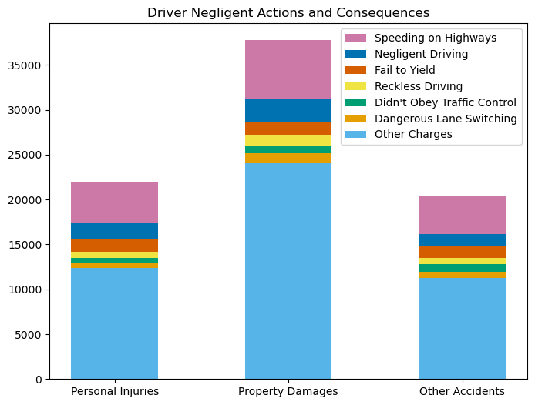
Accidents Caused by Driver’s Negligence
→ Every 1 out of 3 accidents are caused by 1 of 6 irresponsible actions of drivers.
→ Recurring behavior among drivers that could be addressed by Traffic Calming.
Notes:
We chose the colors that have been developed with the intention of being accessible to people who are colorblind.

Slide 6
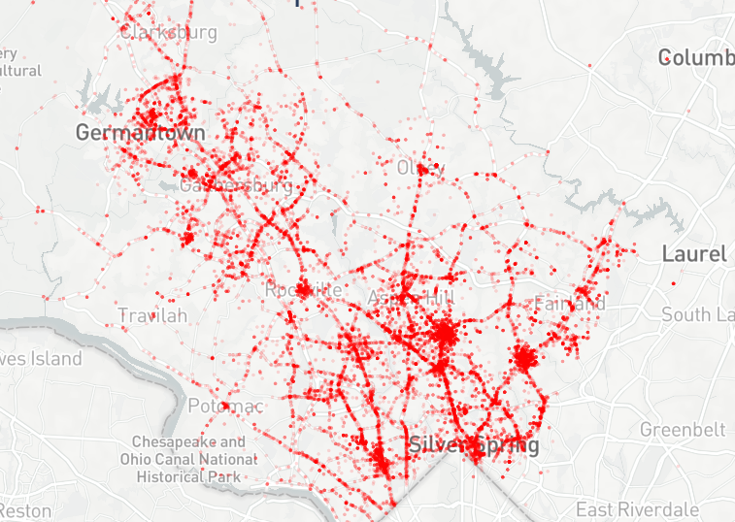
Accident Clusters in Montgomery County
→ Glenmont, White Oak, Bethesda, Silver Spring
→ Clusters present around intersections & main road junctions
→ Road design re-evaluated based on traffic flow

Slide 7
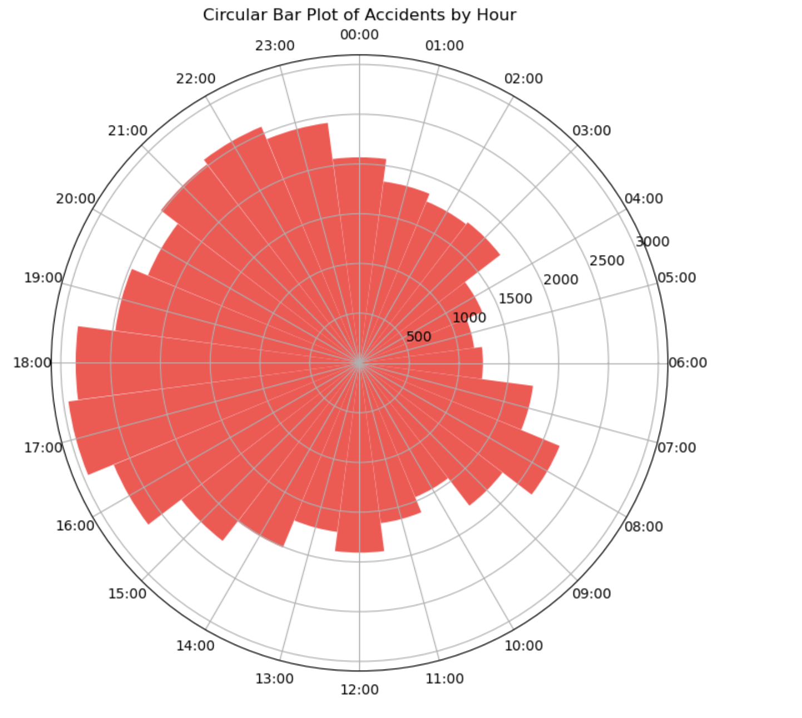
Accidents By Hour
→ Identification of accident peak hours
→ Rush hour, fatigue, ineffective road safety planning
→ Efficient resource allocation
→ Enhanced public transportation, traffic flow optimization, road maintenance & improvement

Slide 8
Recommendations
Koper Curve Theory: Visit hot spot locations for traffic violations on a random basis & patrol the area for 15-20 minutes. Potentially, reduce crashes by 22.56%.
Traffic Calming (TC):
Level 1: using an educational strategy
Level 2: implementation of traffic control devices. Reduced crashes by 14% in NYC.
Increase Seat Belt Fines: 95% of victims involved in accidents in Montgomery County, Maryland, were found to be without a seatbelt during impact.
Data-driven decisions for efficient resource allocation
Re-evaluating design of roads to encourage safer behaviour from drivers
Promote a transit-oriented community as opposed to heavy automobile usage

Slide 9
Conclusion
Traffic and Return to Offices: As we return to normal and offices call back employees, we anticipate increased traffic, leading to a rise in accidents and fatalities.
Importance of Safety Measures: It is imperative to implement measures to address driver negligence and enhance public safety.
Key findings:
Common misdemeanors that frequently contribute to accidents.
Identification of accident hot spots.
Peak times for accidents.
Recommendations for targeted prevention strategies.
Toward Zero Deaths: Utilizing these insights will take us a step closer to our goal of "Zero Deaths" on the roads.
Notes:
As we move towards normalcy and offices call back employees, we can expect more traffic resulting in higher accidents & fatalities. It would be imperative to proceed with implementations to curb driver negligence and promote public safety. Key components from our analysis - common misdemeanors leading to accidents, hot spots & peak times for accidents along with recommendations could be used for a more targeted approach to prevent crashes and take us a step further towards achieving our goal of Zero Deaths.

Slide 10
Thank You
Traffic Violations in Montgomery County, MD

