Slide 1
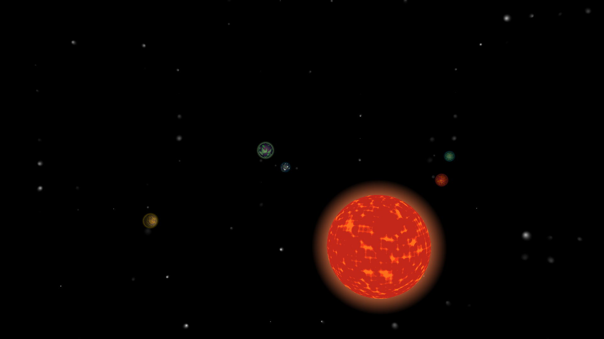
Procedural planets
TDT4230 final project by
Andreas K. Berg

Slide 2
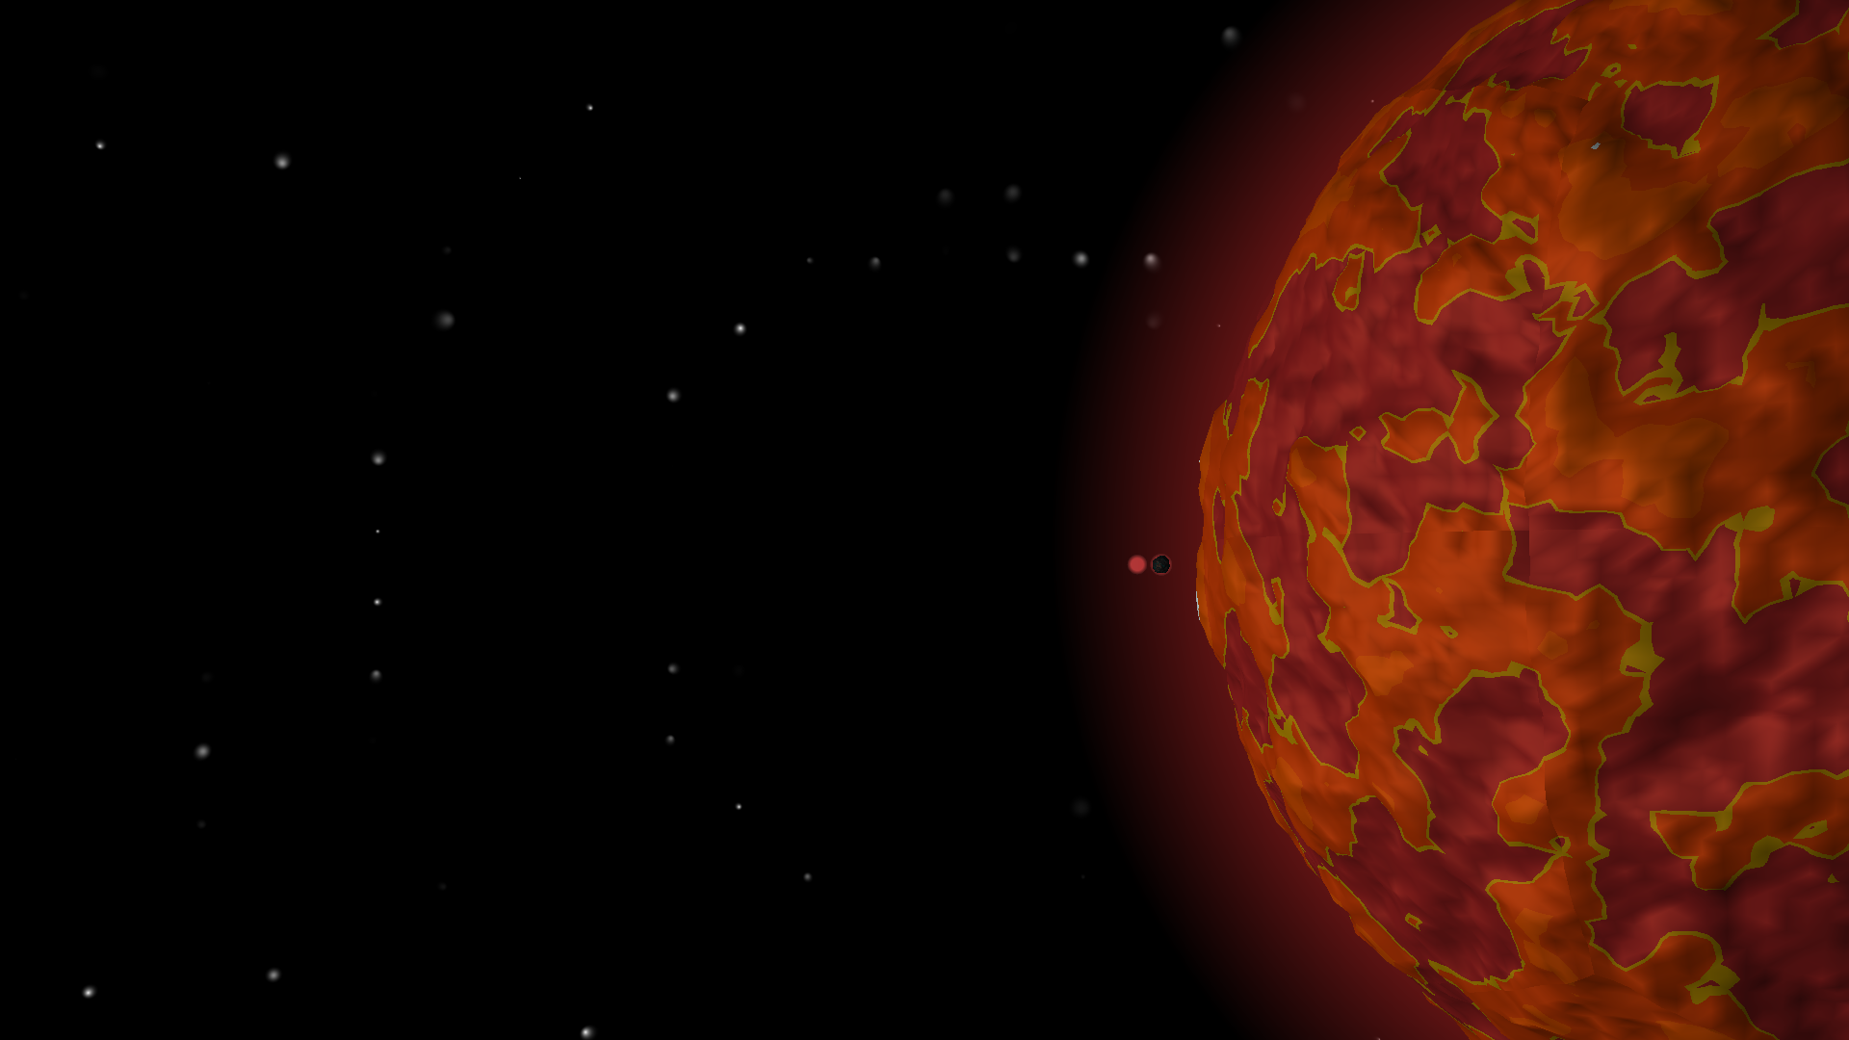
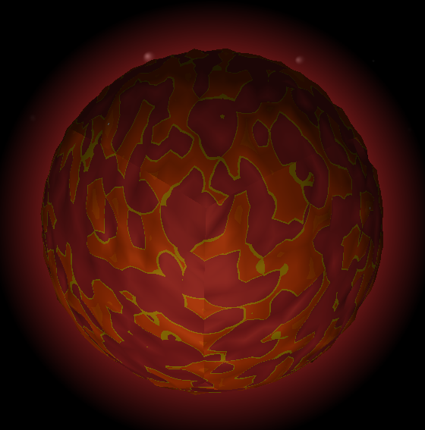
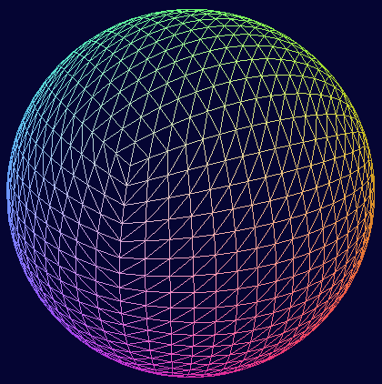
Cubesphere
Simple implementation
Intuitive subdivision
Visible seams :(

Slide 3
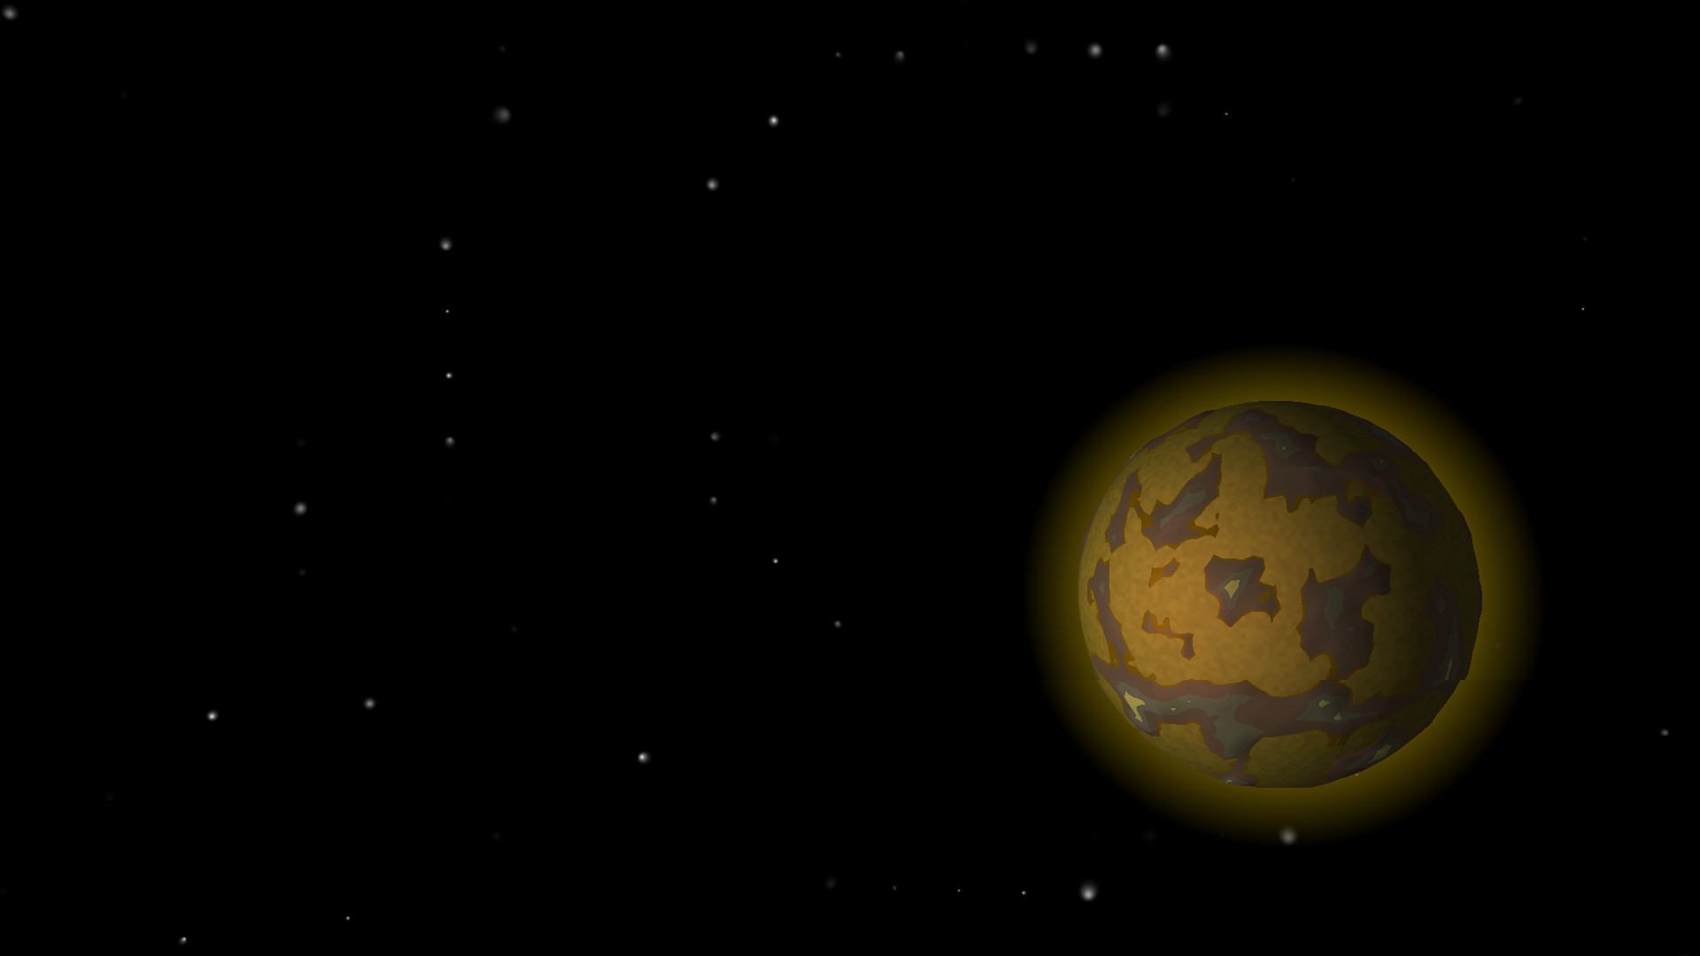
Noise
Perlin noise, fractal Brownian Motion for terrain
Height thresholds and colour map
Used a library noise.rs
  Computes on CPU
  Avoid duplication
  Noise used for collision detection
  when landed

Slide 4
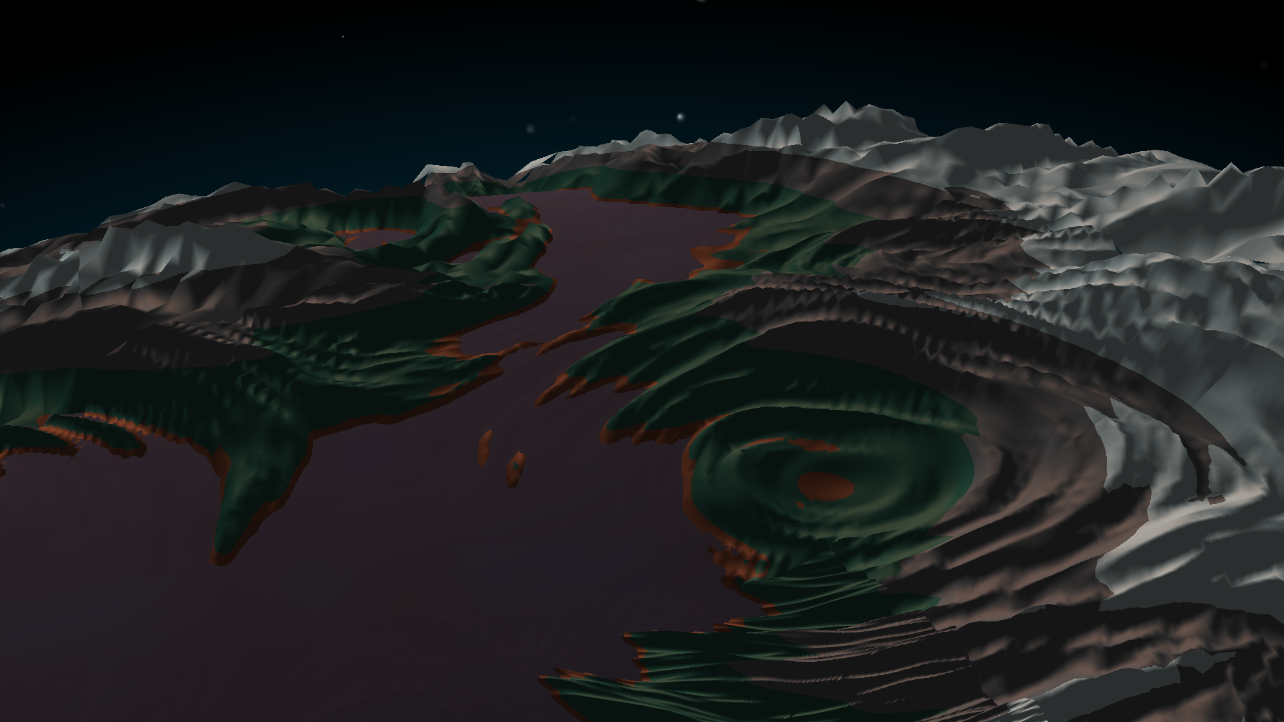
Noise
More parameters → more variation
Current noise is simple
  Cannot generate specific terrains, distinguish continents from mountains, etc
Noise is hard

Slide 5
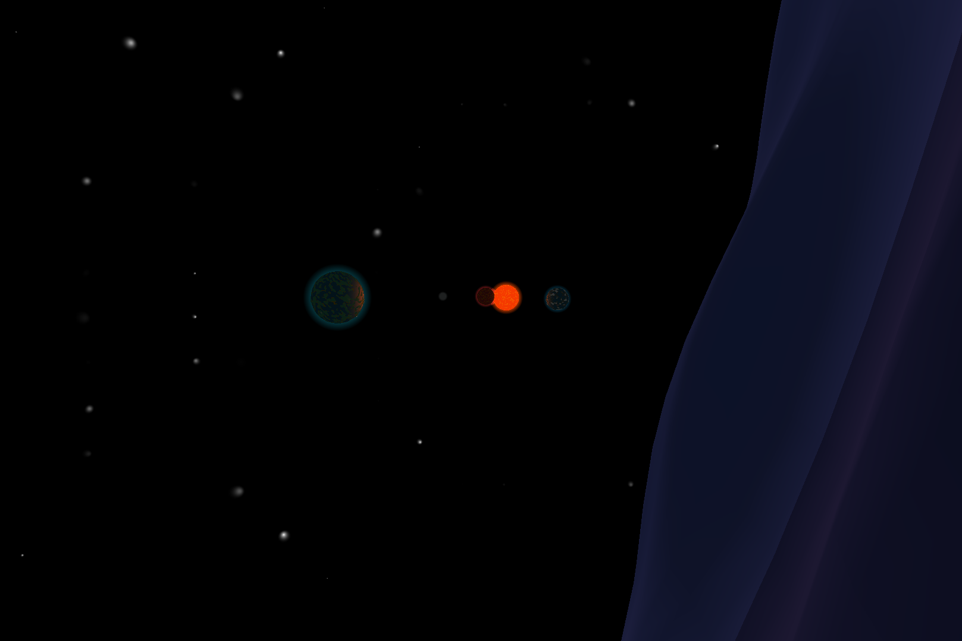
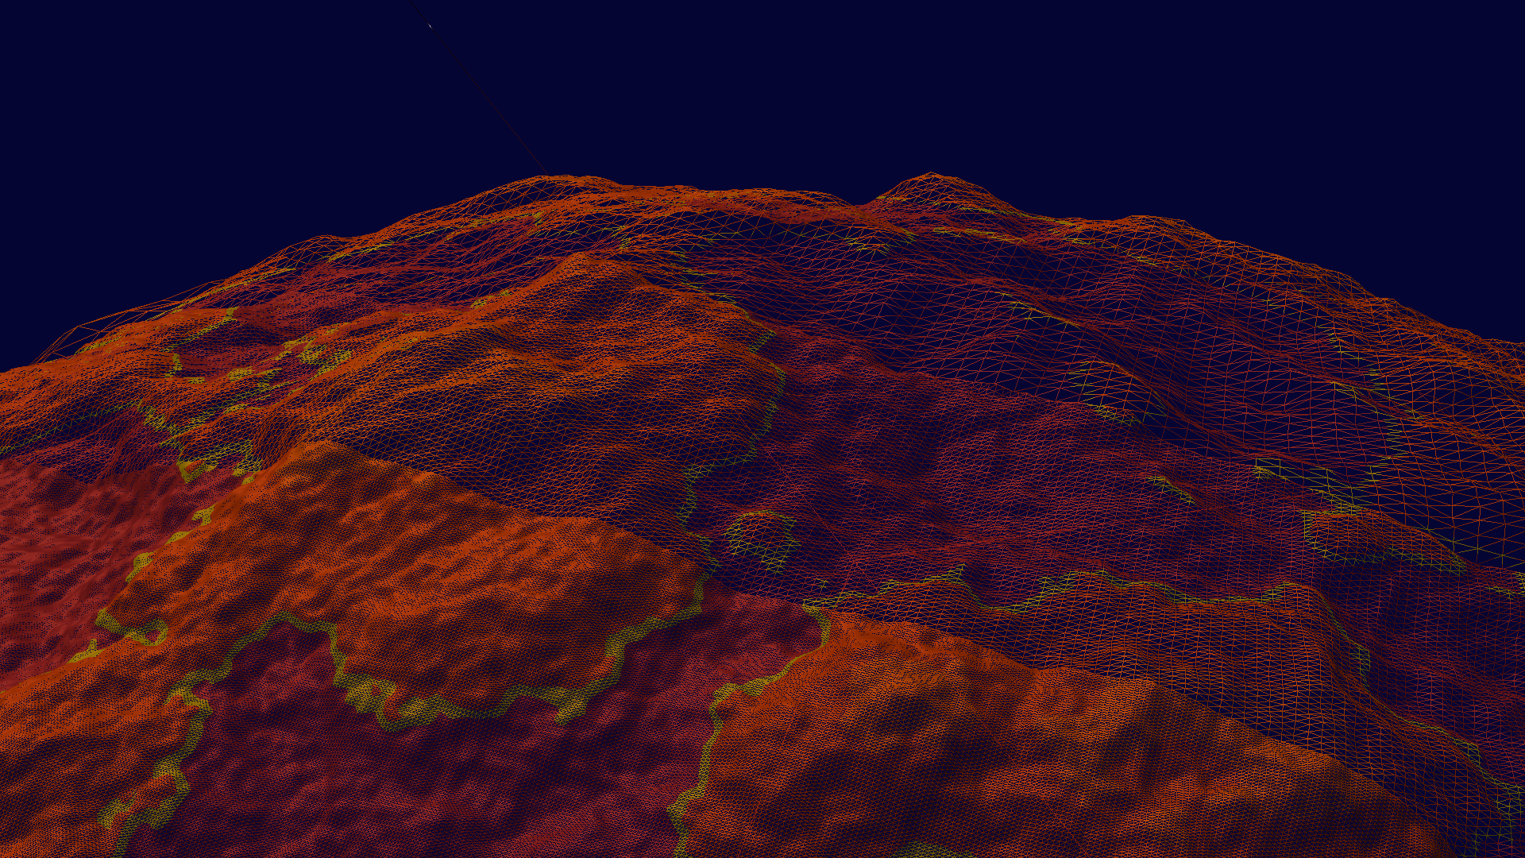
Level of Detail
Increasing detail for closer objects
  Generates stepwise higher resolution
  Subdivides sides of cubesphere

Slide 6
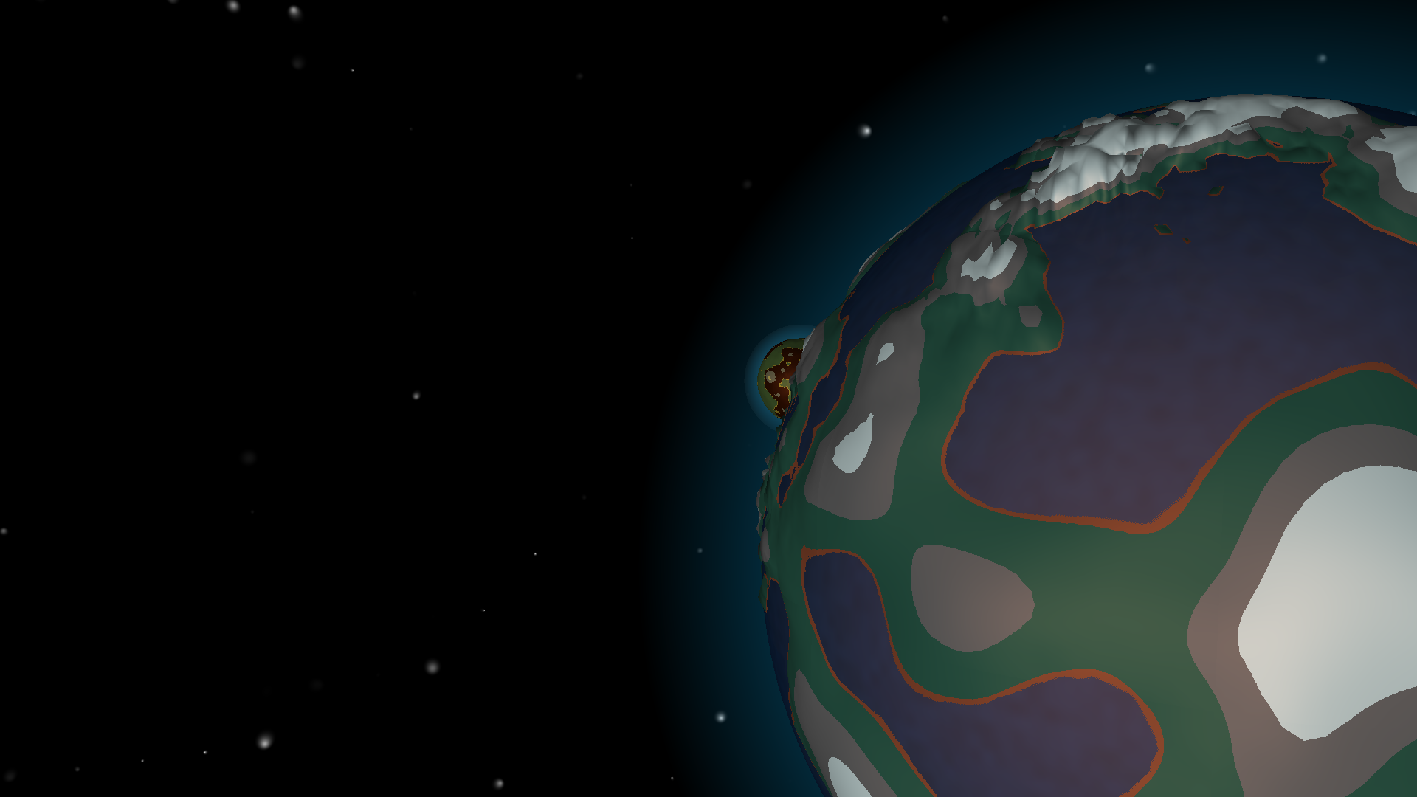
Level of Detail
Fearless concurrency – or so they say
  Avoid blocking the game loop
  Conjestion
Lowest LoD: coloured dot
  Discontinued attempt at implicit geometry
  Projected on skybox (causing some issues when overlapping), together with starry sky
  Doubles as atmospheric halo

Slide 7
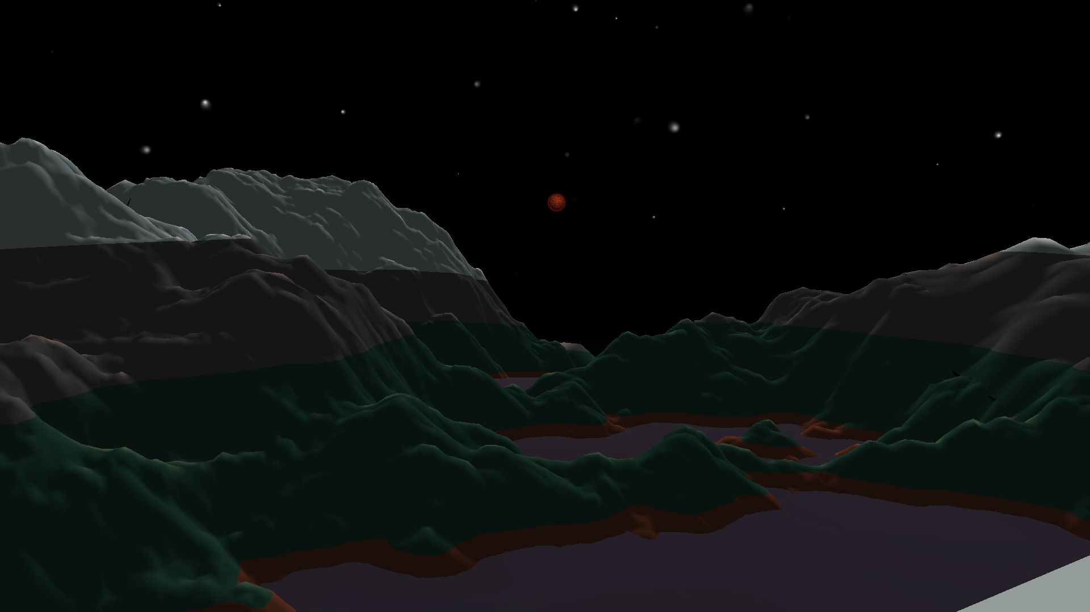
Adding physics
Make the scene more interesting
Planet trajectories
Anchor and gravity

Slide 8
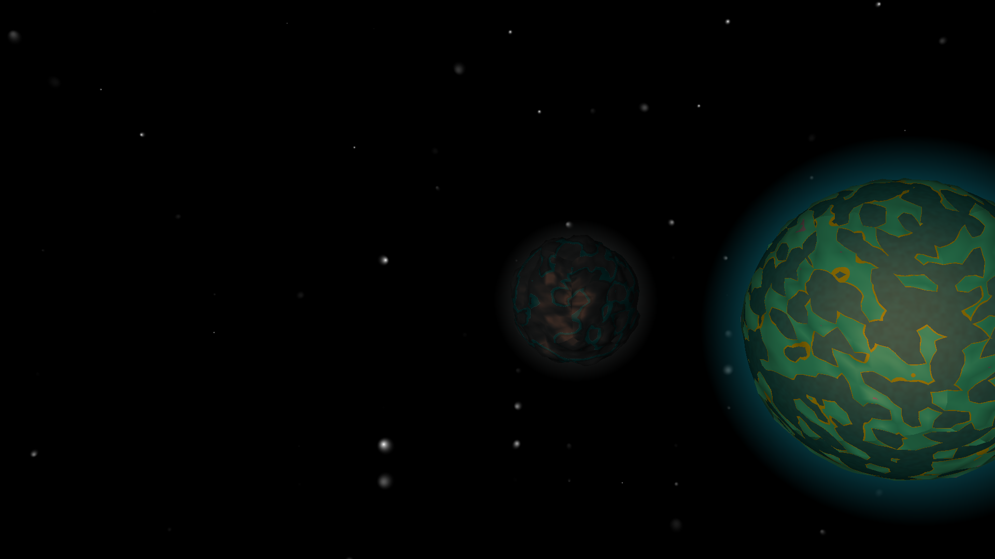
Scales and coordinates
Floating point errors causing troubles
  32 bit lacks precision when ranging many orders of magnitude
Scaled down entire scene
When anchoring: set focused planet in center
  Moving the sun inverse of planet’s trajectory
  Reduce moving parts and keep important movement close to zero
  Also scale up scene

Slide 9
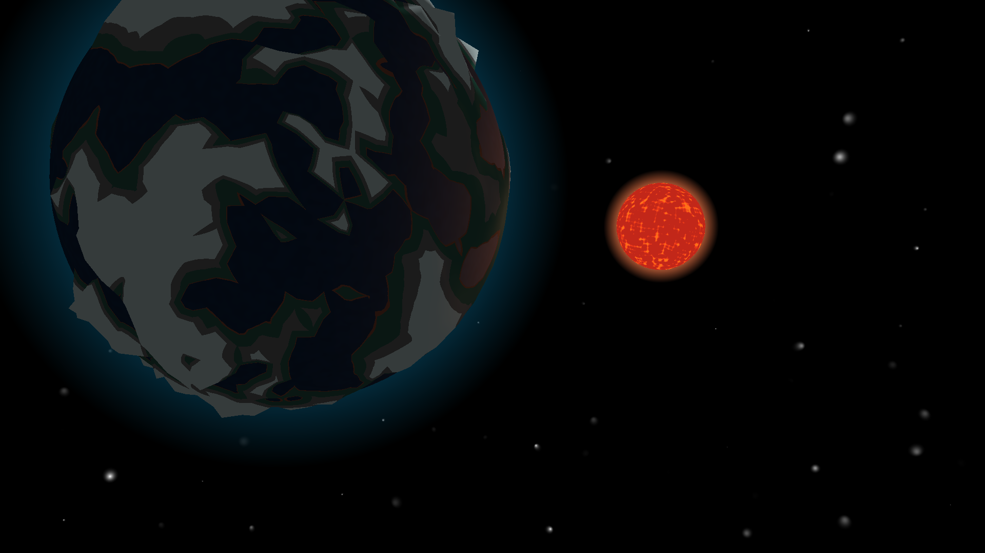
Demo time break some legs

