Slide 1

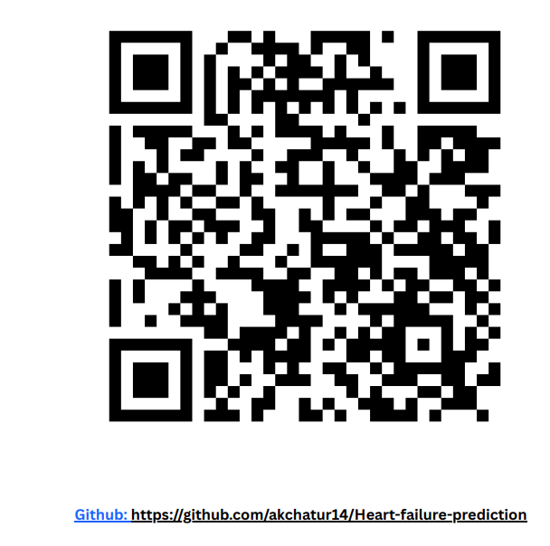
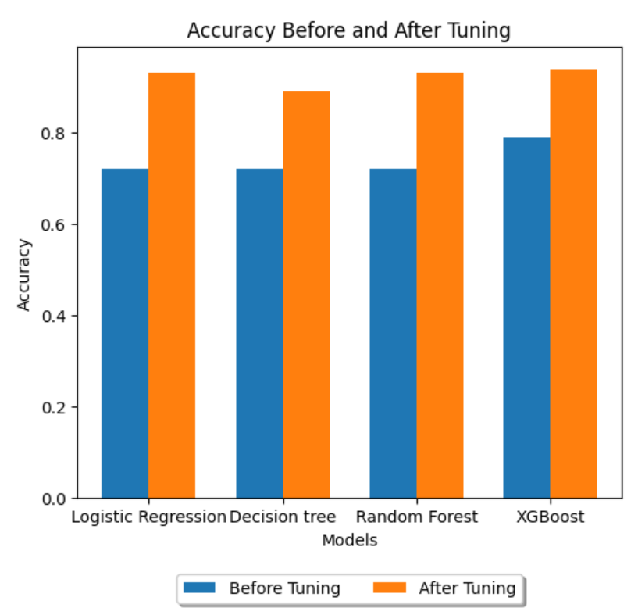
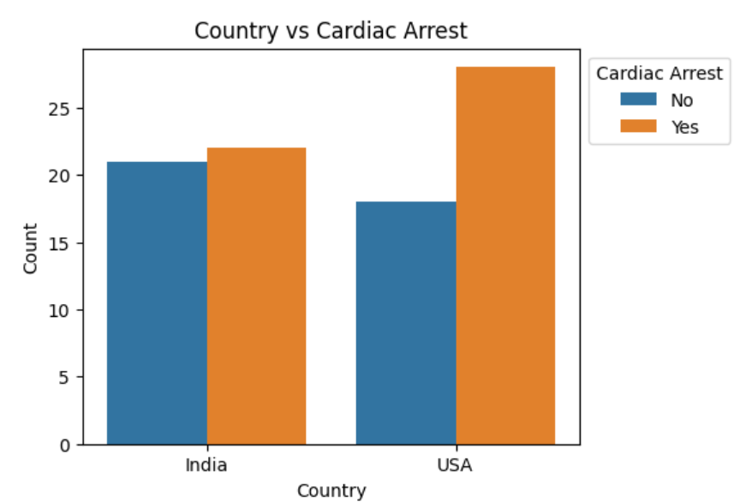
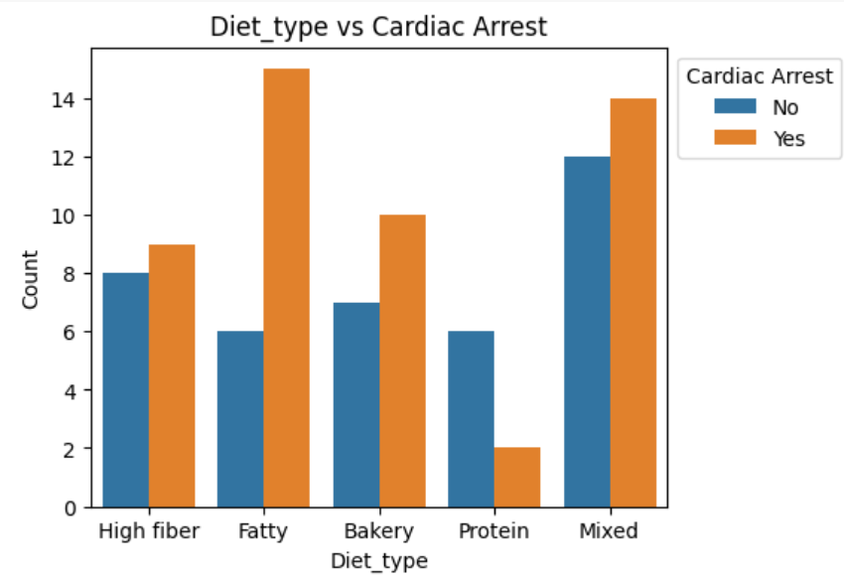
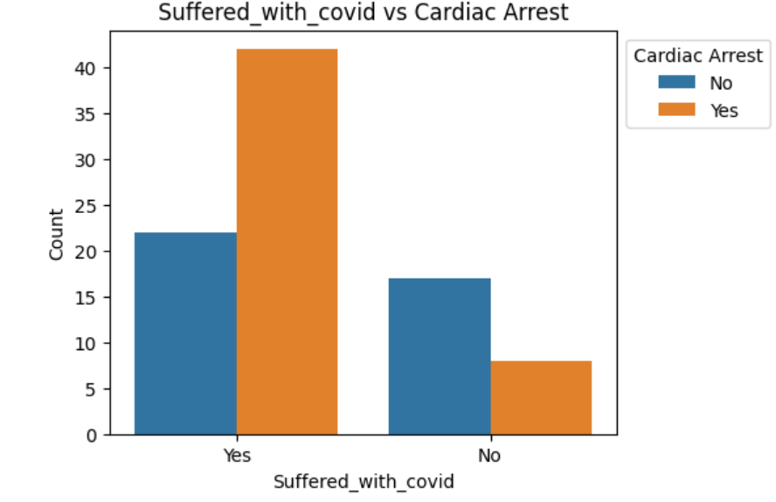
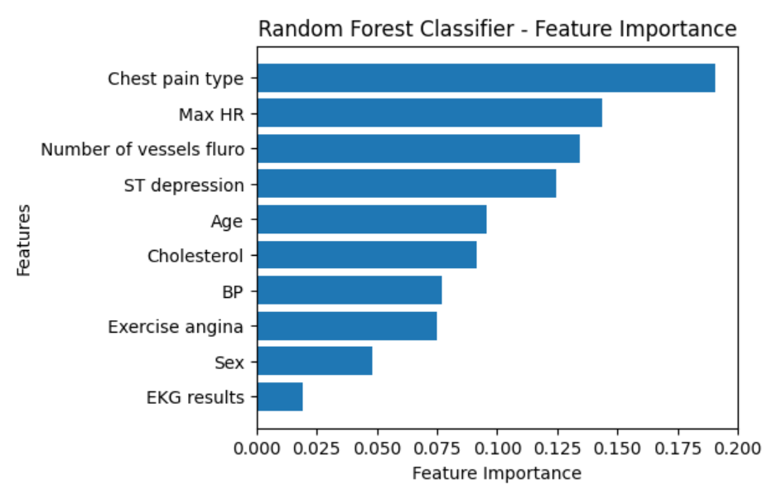
Cardiac arrest: risk assessment and analysis
Akanksha Chaturvedi, M.S Data Science 2023
Mentor: Dr. Christelle Scharff
Pace University, Seidenberg School of CSIS
Abstract:
CVD affects all ages; NHANES data (2017-2020) shows 48.6% prevalence, 127.9 million cases in 2020. Globally, heart disease and stroke caused 207.1 fatalities per 100,000 in 2020, surpassing cancer and respiratory disease combined. CVD-related fatalities rose from 874,613 (2019) to 928,741 (2020), the largest yearly increase since 2015. India experienced a 22% rise in heart attack mortality (2017-2021) and a 54% increase in the past decade. Urgent need for a predictive model considering lifestyle factors for assessing heart attack risk.
Dataset:
Datasets from reputed healthcare archives such as UCI medical data, Data World, and NHANES were combined.
One dataset (12 rows, 5111 columns) contains information about daily lifestyles such as marital status and smoking habits, while another (18 rows, 4239 columns) focuses on medical indicators such as BMI and cholesterol levels.
A smaller dataset (7 rows, 90 columns) covers COVID-19 status, country, and dietary preferences, resulting in a comprehensive collection for rigorous analysis in predicting heart failure.
Results:
Age Influence:: Age is a pivotal determinant of heart failure, with increased vulnerability as individuals age, even post-COVID.
Cardiovascular Risk Factors:: Elevated blood pressure and cholesterol levels significantly contribute to heart failure, with hypertension emerging as a leading factor.
Dietary Impact:: Dietary choices play a crucial role in heart health, influencing cholesterol, blood pressure, and BMI, particularly with high-fat diets.
COVID's Cardiac Surge:: Post-COVID, there's a noticeable surge in cardiac arrests across all age groups, highlighting a critical link between the pandemic and heart-related complications.
Regional Disparities: Cardiac arrest can occur due to regional differences as well due to different dietary habits. In USA cases of deaths due to cardiac arrest is more than India.
After Model tuning: Following model adjustment, logistic regression obtained an accuracy of 93%, decision tree achieved 90%, random forest achieved 94%, and XGBoost maintained 93%. Despite XGBoost's early advantage, the tuned random forest emerged as the most accurate predictor, showing the
Limitations:
Since, our models are giving very high accuracy there might be a chance of overfitting and overfitting to the training data could lead to an overly optimistic assessment of model performance.
We can consider exploring more health-related data to see what more factors can affect the heart health like a person’s medication routine.
Related work:
Conducted comprehensive literature analysis, developed four models combining machine learning, deep learning, and data mining, utilizing diverse medical industry data. Employed methods like random forest, decision tree, naive-bayes, XG boost, logistic regression, classification, PCA, and function SMO. Evaluated model accuracy through F1 score, confusion matrix, and silhouette's score, offering detailed insights into prediction capabilities. Generated ratings assessed accuracy and determined model viability for predictive analysis based on historical data.
Methodology:
Data Preparation: Conducted initial data manipulation, including thorough cleaning, to ensure data quality.
Feature Identification: Utilized heatmap analysis to identify key predictive features for heart failure.
Exploratory Data Analysis (EDA): Performed EDA to inform the training process, employing the train-test split paradigm.
Model Evaluation: Rigorous assessment of logistic regression, random forest, decision tree, and XG Boost models for heart failure prediction.
Enhanced Accuracy: Implemented cross-validation grid search for meticulous tuning, improving model accuracy.
Interpretability and Explainability: Leveraged eli5, SHAP, and LIME for interpreting and explaining model results, identifying important features.
Conclusion and future work:
Key predictors of cardiac arrest include chest pain type, heart rate, and depression, while age, COVID impact, and dietary habits are crucial determinants. Despite originally leading with 79% accuracy, the random forest model exceeded, obtaining 94% after refining. Future studies will concentrate on increasing feature sets, investigating deep learning models, and optimizing hyperparameters to improve forecasting accuracy.
Research Question:
What factors predict heart failure accurately, considering lifestyle, medical history, and physiological indicators?
How do post-COVID heart failure mortality rates compare in India and the USA, considering demographic and socioeconomic factors?
Bibliography:
https://data.world/uci/heart-disease
https://www.cdc.gov/nchs/hus/topics/heart-disease-deaths.htm
https://www.sciencedirect.com/science/article/abs/pii/S0002934320307051
Prior to Model Tuning: Prior to tuning the XGBoost model had excellent prediction performance, with an accuracy of 79%. In comparison, the logistic regression, decision tree, and random forest models had accuracy rates 72%, 74% and 72%.

