Slide 1
Agenda
What is data warehouse?
Why Snowflake?
Snowflake Overview.
Importing CSV file in snowflake.
S3 access in AWS
Take way task

Slide 2
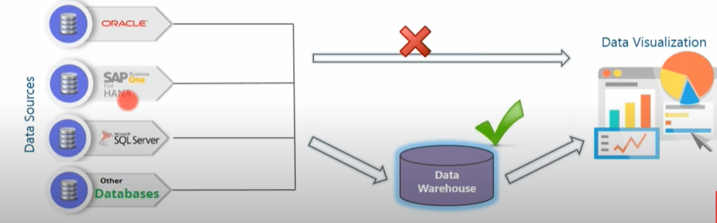
What is data warehouse?
Data collected from various sources and stored in various databases cannot be directly visualized.
The data first needs to be integrated and then processed before visualization takes place.

Slide 3
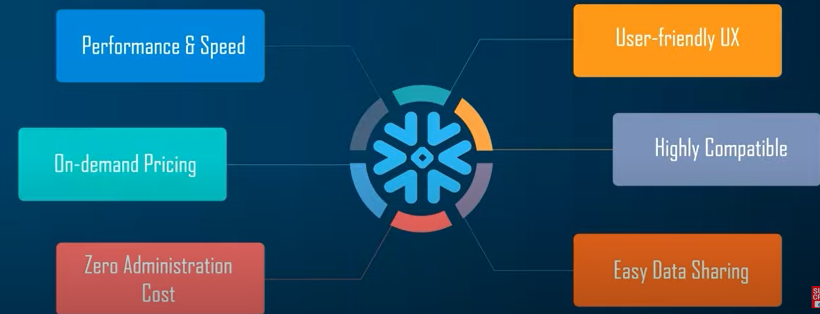
Why Snowflake?

Slide 4
AWS S3 bucket
It is a simple storage service(s3) which allows to store files in AWS cloud.

Slide 5
Take way task
Store News data files in S3 bucket.
Read data from S3 files into Snowflake.
Create a pipeline to auto ingest all incoming files.

