Slide 1
Proposal: Smart Aquarium Water-Chemistry Management Engine
TPJ65
Team # B01
PM1: Arun kumar chhetri
PM2: Manjot singh
Notes:
Add audio overlay notes here:

Slide 2
Summary: Project Description in <40 Words
An intelligent IoT-based aquarium automation system that continuously monitors and stabilizes pH, temperature, dissolved oxygen, and turbidity using real-time sensing, automated control mechanisms, and cloud-connected environmental monitoring.
Notes:
Add audio overlay notes here:

Slide 3
Why This Project Idea?
This project idea was selected because it combines embedded systems, industrial automation, environmental monitoring, intelligent control systems, and IoT communication into one realistic and scalable engineering solution. Unlike basic monitoring systems, the project uses closed-loop environmental control to continuously analyze water conditions and automatically maintain stability safely and intelligently.
The project also has strong real-world applications, demonstrates advanced engineering concepts, supports future modular expansion, and integrates both hardware and software engineering. Additionally, it addresses practical engineering challenges such as sensor calibration, multi-variable control, feedback systems, fault handling, environmental stability, and real-time automation, making it both technically valuable and visually impressive for showcase demonstrations.
Notes:
Add audio overlay notes here:

Slide 4
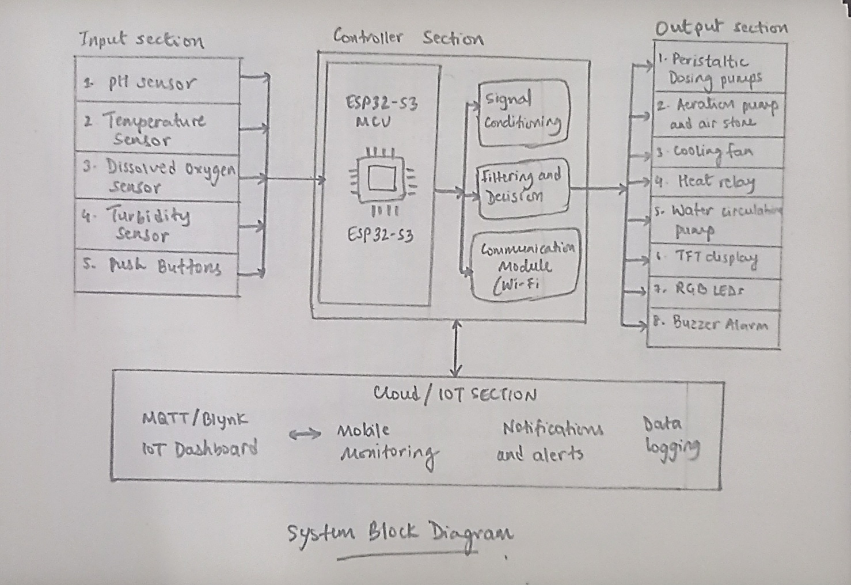
Proposed: System Block Diagram
Notes:
Add audio overlay notes here:

Slide 5
Proposed: Electronic Input Devices
Input Device | Purpose
Atlas Scientific pH Sensor | Measures water acidity/alkalinity
PT1000 RTD Temperature Sensor | Measures water temperature accurately
Dissolved Oxygen (DO) Sensor | Measures oxygen concentration in water
Turbidity Sensor | Measures water clarity and suspended particles
Push Buttons | Manual override and menu control
Rotary Encoder | Dashboard navigation and calibration settings
Notes:
Add audio overlay notes here:

Slide 6
Proposed: Electronic Output Devices
Output Device | Purpose
Precision Peristaltic Pumps | Automatic pH balancing chemical dosing
Aeration Pump + Air Stone | Increase dissolved oxygen levels
PWM Cooling Fan | Reduce water temperature
Heater Relay Module | Increase water temperature when necessary
Water Circulation Pump | Improve mixing and stabilize measurements
TFT Display Screen | Display live system status and sensor readings
RGB LEDs | Visual status indication
Buzzer Alarm | Critical warning and fault alerts
Notes:
Add audio overlay notes here:

Slide 7
Proposed: IoT Dashboard Software
IoT Platform: Blynk IoT Dashboard
Uses | Features | Communication Method
real-time sensor visualization remote monitoring cloud data logging mobile notifications alarm alerts remote manual control | live pH graph temperature graph dissolved oxygen graph turbidity graph actuator status warning notifications historical data trends system health status | ESP32 WiFi communication MQTT/Blynk cloud communication smartphone connectivity
Notes:
Add audio overlay notes here:

Slide 8
Anticipated Challenges For Phase 1
Component Selection, Prototyping, and Sensor Calibration
Identifying accurate and reliable input/output devices suitable for aquarium automation.
Procuring compatible sensors, actuators, and electronic components within budget and time constraints
Integrating multiple sensors and modules together on breadboard during initial prototyping
Managing unstable wiring connections and electrical noise during breadboard testing
Proper calibration of pH, dissolved oxygen, temperature, and turbidity sensors
Obtaining stable and repeatable sensor readings
Notes:
Add audio overlay notes here:

Slide 9
Anticipated Challenges For Phase 2
PCB Design, 3D Design, System Integration, and IoT Development
Designing a reliable and organized PCB layout for multiple sensors and actuators
Designing functional and visually professional 3D-printed components
Ensuring waterproofing and safe cable management around the aquarium
Correcting multi-variable interactions between temperature, dissolved oxygen, pH, and circulation systems
Developing safe dosing and control logic
Designing and configuring the IoT dashboard for real-time monitoring and control
Notes:
Add audio overlay notes here:

Slide 10
Anticipated Challenges For Phase 3
Final Assembly, Demonstration, and Showcase Preparation
Integrating all hardware subsystems into one stable working prototype
Managing enclosure layout, tubing arrangement, and wiring organization
Ensuring long-term reliability during extended testing
Fine-tuning automation behavior for smooth and intelligent system response
Managing time effectively before final showcase submission
Notes:
Add audio overlay notes here:

Slide 11
Plan To Overcome Each Major Challenge
Phase 1 Solutions
Challenge | Proposed Solution
Selecting suitable sensors and actuators | Research industrial-grade and widely tested components before procurement
Procurement delays or compatibility issues | Order components early and maintain backup components where possible
Breadboard instability | Use modular testing and verify each subsystem individually before combining
Sensor calibration difficulty | Use standard calibration solutions and repeated testing procedures
Inconsistent measurements | Install proper water circulation and stable sensor mounting system
Notes:
Add audio overlay notes here:

Slide 12
Plan To Overcome Each Major Challenge
Phase 2 Solutions
Challenge | Proposed Solution
PCB complexity | Use modular PCB design with detachable connectors and separated functional zones
3D design difficulties | Design simple modular parts first, then refine for final showcase
Waterproofing and cable management | Use sealed enclosures, cable sleeves, and waterproof connectors
Multi-variable sensor interaction | Implement centralized decision logic with gradual corrections and safety limits
Automation instability | Use hysteresis, filtering, timing delays, and controlled micro-adjustments
Dashboard integration issues | Develop and test IoT dashboard incrementally with one feature at a time
Notes:
Add audio overlay notes here:

Slide 13
Plan To Overcome Each Major Challenge
Phase 3 Solutions
Challenge | Proposed Solution
Full system integration difficulty | Perform subsystem testing individually before final assembly
Poor enclosure organization | Design separate compartments for electronics, dosing, and wiring
Long-term reliability | Conduct 24–48 hour continuous testing before showcase
Automation tuning | Use controlled test disturbances and gradual parameter adjustments
Time management pressure | Follow phased development schedule with weekly milestones
Notes:
Add audio overlay notes here:

Slide 14
References (MLA Format)
OpenAI. ChatGPT, response to “Guidance for TPJ655 Smart Aquarium Water-Chemistry Management Engine Project,” 17 May 2026, https://chatgpt.com/share/6a09471b-667c-83ea-b064-04b8be1a7664.
Notes:
Add audio overlay notes here:

