Slide 1
Process Re-engineering/ Redesign
Individual/Team Details
Complete Name of Individual / Team Member/s | Employee Code (IND/SEZ) | Vertical | Sub-Lob | Official Email ID | RM Name
GopalKrishnan Ramaswamy | 16498 | CaPS | CIDA-05 | G.Ramaswamy1@evalueserve.com | Biswanath Choudhary
Amarendra Chaudhary | 16598 | CaPS | CIDA-05 | Amarendra.Chaudhary@evalueserve.com | GopalKrishnan Ramaswamy
Avik Bhattacharya | 15901 | CaPS | CIDA-05 | Avik.Bhattacharya@evalueserve.com | GopalKrishnan Ramaswamy
Sumit Sarkar | 16324 | CaPS | CIDA-05 | Sumit.Sarkar@evalueserve.com | GopalKrishnan Ramaswamy
Manik Malhotra | 15223 | CaPS | CIDA-05 | Manik.Malhotra@evalueserve.com | GopalKrishnan Ramaswamy

Slide 2

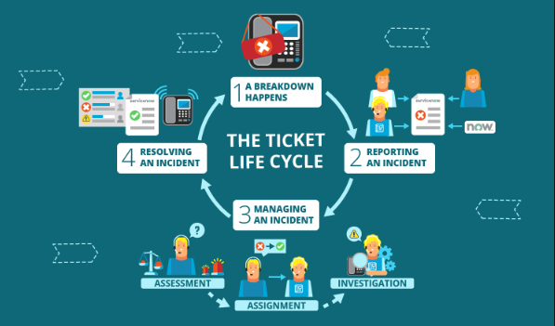

Automatic Speech Recognition
Overview
Everyone wants to keep track of their work, requests, incident. Thus, Market is flooded with numerous ticketing tools and with that it comes lots of time effort and require more resources resulting more cost.
As ticketing tool is occupying the market its getting cumbersome to maintain and keep track of things.
We tend to spend much more time just to create a basic incident with some mandatory fields which we generally are not aware of.
Time and cost consuming

Slide 3




Problem Statement
Making life easy
As the days of manual work is gone, we are automating the work of logging incident , request in any ticketing platform easy by using Voice Command
Whether its ServiceNow, JIRA, TFS we can just create an incident by giving a voice command.
To handle this manual workload, we came with ASR through which we can handle the manual hectic work within few minutes which will increase the productivity and scalability of the organization.

Slide 4
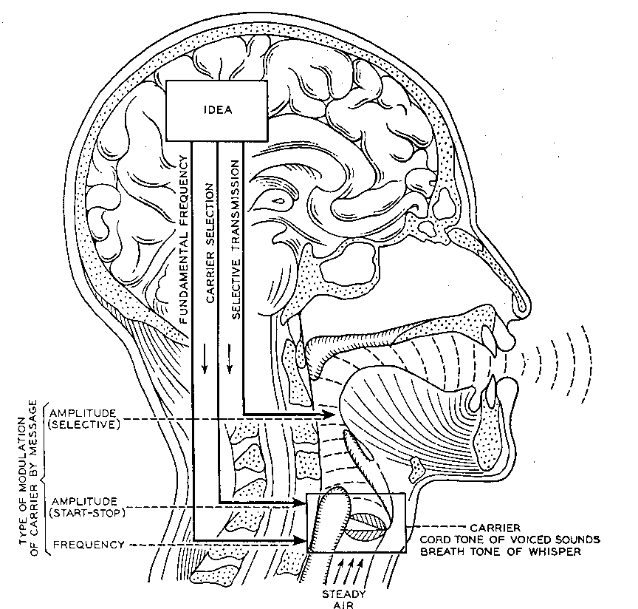
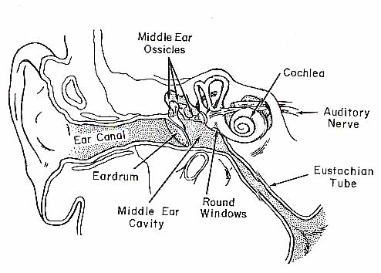

Impact of Innovation
As a organization, its very important to keep up the pace with the new technologies trend.
So keeping in mind, we have developed a code using latest technologies which will enhance the productivity of the organization and will be a powerful booster for the field of IT
Automatic Speech Recognition
Our Voice Command will allow the machines to perform certain task which include creating ticket and also basic operations like opening notepad, paint etc.

Slide 5
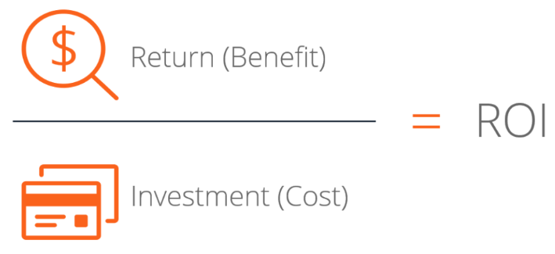


RoI
Keeping in mind the recent drift for AI/ML we can consider this as an better investment which will be increase the profitability of an organization and even time effectiveness.
This approach will definitely will be time effective which will be directly proportional to cost.

Slide 6






Process Maps
The Process map is quite simple as it follow the Voice command and passes to the code and called the JSON object to create an incident.
Voice Command Interpret using Python
Ticket is created with proper incident number

Slide 7
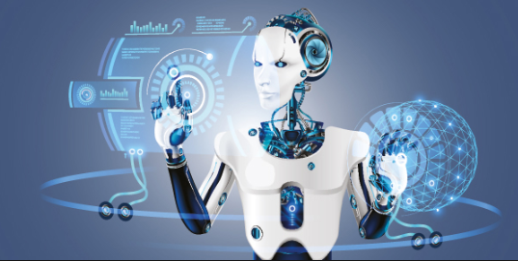
Impact Post Implementation
As an Organization it can reduce efforts on managing and creating incident on ticketing tool system
Developing ASR as an automation will open new paths in different horizontals
It will give us wider aspect of automating and working with machines through speech recognition
It can be cost effective for the organization as well as employees can learn and develop new innovative ideas.
ASR can make life easier in day to day operations.
Lastly –
“What good is an idea if it remains an idea? Try. Experiment. Iterate. Fail. Try again. Change the world.” – Simon Sinek

