Slide 1

Summer Product Sales Forecasting in E-commerce using Machine Learning
by
Akila Bala – 20MIA1052
Nithin Kodipyaka – 20MIA1075
Review - III
School of Computer Science & Engineering

Slide 2

Introduction
Wish is a retailer that sells millions of product to customers in a e-commerce marketplace. The data consists of the products under the tag “summer” showed during August 2020. We want to see which features can predict the units that will be sold in a specific product, and the accuracy that we get under the different machine learning algorithms.
The purpose of this project is to analyze and predict online product sales on the Wish.com platform using machine learning and data exploration techniques. The project aims to predict the units sold for each specific product.
Research Objective • Predict summer product sales on the Wish.com platform • Evaluate the effectiveness of XGBoost
and Random Forest algorithms • Identify key features impacting sales predictions • Explore the impact of supplementary category data Importance of Sales Prediction • Optimize inventory management • Enhance marketing strategies • Improve customer satisfaction

Slide 3

Data Collection and Preprocessing
Summer products listed on Wish in August 2020.
The dataset provided offers a comprehensive collection of information related to products listed for sale on the popular e-commerce platform, Wish. This dataset is valuable for e-commerce businesses, data scientists, and analysts seeking insights into product sales, pricing strategies, and customer behavior.
Size: The dataset consists of approximately 1573 rows and 43 columns.
Data Types: It includes a mix of data types, including numeric, character, factor, and logical.
Features: Some of the key features in the dataset include product attributes like price, retail price, shipping options, product color, size variations, and inventory levels. It also contains information on customer ratings, product tags, and seller profiles.
Data Preprocessing includes:
Clean data and handle missing values
Convert categorical variables for machine learning

Slide 4
Feature Selection and Engineering
Relevant Features
Gather the dataset containing information about summer products listed on Wish in August 2020.
Explore the dataset to understand its structure, features, and any missing or erroneous data.
Perform data preprocessing tasks, including data cleaning, handling missing values, and converting categorical variables into a suitable format for machine learning relevant features for predicting summer product sales will be:
Product attributes
Pricing
Category information
Feature Engineering
Engineer new features if necessary or analyze feature importances provided by Random Forest and XGBoost to understand which features have the most significant impact on sales predictions.

Slide 5
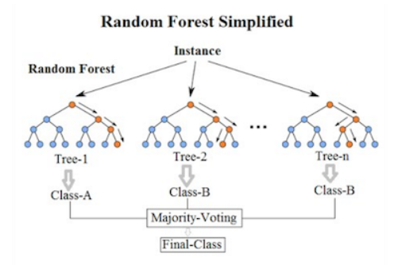
Model Selection and Training
Machine Learning Algorithms
Choose Random Forest and XGBoost as the machine learning algorithms for predicting sales due to their effectiveness in classification tasks and ability to handle complex data.
• XGBoost
• Random Forest
Model Training
Train Random Forest and XGBoost models on the training
dataset using appropriate libraries or frameworks
(e.g., scikit-learn for Random Forest and XGBoost library
for XGBoost).
Experiment with various hyperparameters
(e.g., number of trees, depth, learning rate)
through techniques like grid search or
random search to optimize model performance.
• Train models using appropriate libraries
• Optimize hyperparameters

Slide 6
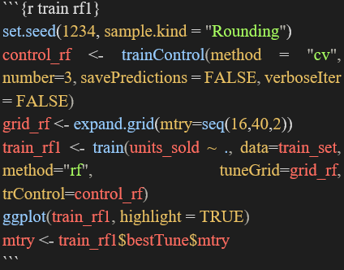
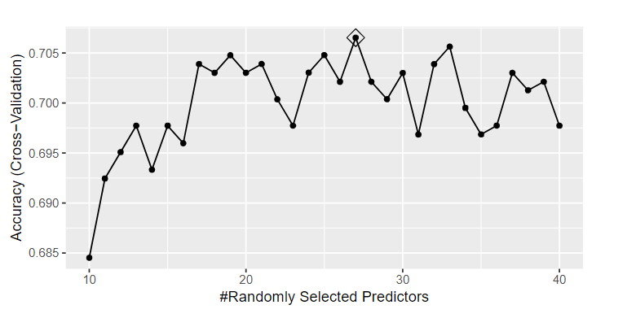
Model Evaluation
Evaluation Metrics
Evaluation of the models using appropriate classification metrics such as accuracy, precision, recall, F1-score, and ROC AUC, based on their predictions on the testing dataset.
Perform cross-validation to assess the models' robustness and generalizability.
• Mean Absolute Error (MAE)
• Root Mean Square Error (RMSE)
• Mean Absolute Percentage Error (MAPE)
Cross-Validation
• Assess model robustness and generalizability

Slide 7
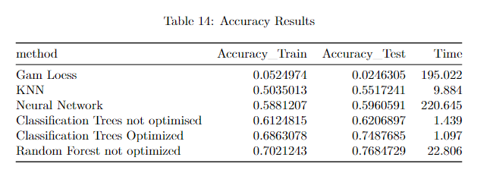
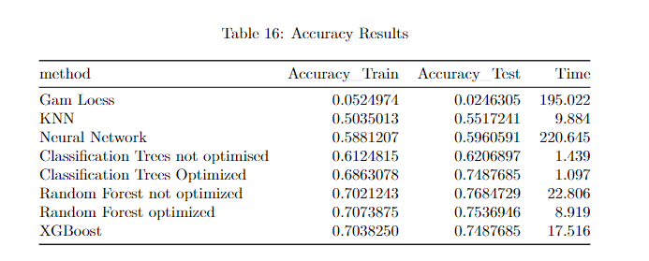
Experimental Analysis and Results
Comparative Results
• Evaluate predictive accuracy of XGBoost and Random Forest:
Key Features
• Identify features with greatest impact on sales predictions, the achieved peak accuracy is 0.704 when gamma is set to 1. Following the optimization of these parameters, attention is directed toward fine-tuning the colsample_bytree parameter. Analogous to mtry in Random Forest, colsample_bytree represents the fraction of features utilized in training each tree.
Impact of Supplementary Category Data
• Assess enhancement in predictive performance

Slide 8
Experimental Analysis and Results
In this specific study, the attained accuracy is highlighted, reaching its peak at 0.702. This underscores the efficacy of Random Forest in achieving accurate predictions across the dataset.
Furthermore, the concept of the optimal parameter mtry is introduced, representing the number of variables considered for splitting at each tree node. Notably, the text points out that the best accuracy is achieved when mtry is set to 34.
The optimization process begins by fine-tuning the hyperparameters of eta and maxdepth. In the initial model configuration, nodesize is set to 5, a standard value for multinomial categorical problems. The parameter eta, controlling the learning rate, is varied from 0.005 to 0.3, while max_depth, governing the maximum depth of the trees, is explored in the range of 4 to 12. It is noted that setting max_depth excessively high increases the risk of overfitting the model.
This systematic approach to hyperparameter optimization underscores the efficacy of XGBoost in achieving superior accuracy, with a strategic focus on controlling learning rates, tree depth, and feature sampling. The emphasis on parameter tuning aligns with the model's capability to adapt and excel across a diverse range of structured datasets.

Slide 9
Conclusion
Summary of Findings
In conclusion, this comprehensive exploration delved into the methodologies and practical implementation of Random Forest and XGBoost algorithms for predicting summer product sales on an e-commerce platform with the achieved peak accuracy is 0.704 when gamma is set to 1. The research highlighted the robustness of Random Forest's ensemble technique in handling complex data structures, particularly excelling in categorical variable handling. On the other hand, XGBoost, leveraging gradient boosting, demonstrated exceptional speed and performance in structured datasets. The R programming code snippets provided a hands-on understanding of the implementation process, emphasizing the importance of parameter tuning and the utilization of key libraries. The synthesis of methodologies, code implementation, and analytical insights offers a holistic understanding of predictive modeling, providing practitioners with valuable guidance in effective data science practices for informed decision-making in today's data-driven landscape.
Further Study
• Further research on interpretable attention mechanisms
• Addressing data quality issues
• Industry-specific adaptations

Slide 10
Reference Papers
Ribeiro, A., Seruca, I. and Durão, N., 2016, June. Sales prediction for a pharmaceutical distribution company: A data mining based approach. In 2016 11th Iberian Conference on Information Systems and Technologies (CISTI) (pp. 1-7). IEEE.
Tsoumakas, G., 2019. A survey of machine learning techniques for food sales prediction. Artificial Intelligence Review, 52(1), pp.441-447.
Vengatesan, K., Visuvanathan, E., Kumar, A., Yuvaraj, S. and Tanesh, P.S., 2020. An approach of sales prediction system of customers using data analytics techniques. Advances in Mathematics: Scientific Journal, 9(7), pp.5049-5056.
Gaikar, D. and Marakarkandy, B., 2015. Product sales prediction based on sentiment analysis using twitter data. International Journal of Computer Science and Information Technologies, 6(3), pp.2303-2313.
Ekambaram, V., Manglik, K., Mukherjee, S., Sajja, S.S.K., Dwivedi, S. and Raykar, V., 2020, August. Attention based multi-modal new product sales time-series forecasting. In Proceedings of the 26th ACM SIGKDD international conference on knowledge discovery & data mining (pp. 3110-3118).

