Slide 1
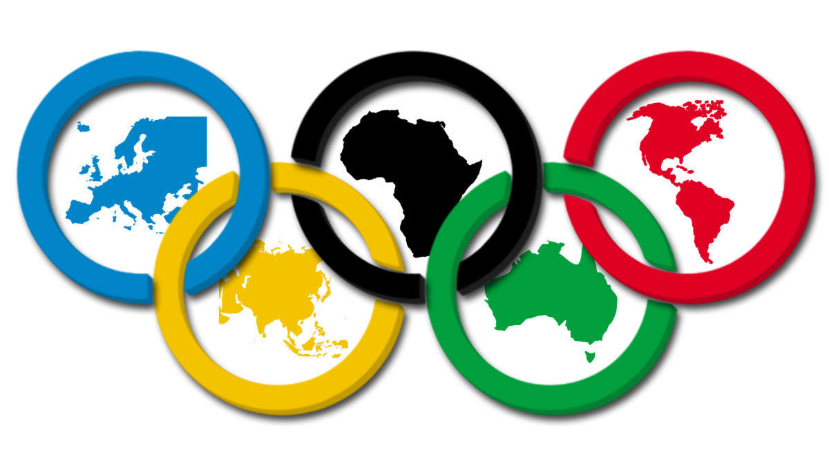

Presented By:
Akshay, Anjali and Sreeram

Slide 2

INTRODUCTION
Our dataset contains 271116 rows and 15 columns; Each row corresponds to an individual athlete competing in an individual Olympic event (athlete-events). This is a historical dataset on the modern Olympic Games, including all the Games from Athens 1896 to Rio 2016.
ID - Unique number for each athlete;
Name - Athlete's name;
Sex - M or F;
Age - Integer;
Height - In centimeters;
Weight - In kilograms;
Team - Team name;
NOC - National Olympic Committee 3-letter code
The six colors – blue, yellow, black, green, red, and the white background – were chosen because every nation’s flag contains at least one of them.
The 2012 London Games were the first Olympics in which all participating countries sent female athletes.
Women have been allowed to compete in the Olympics since 1900.
Games - Year and season;
Year - Integer;
Season - Summer or Winter;
City - Host city;
Sport - Sport;
Event - Event;
Medal - Gold, Silver, Bronze, or NA.

Slide 3
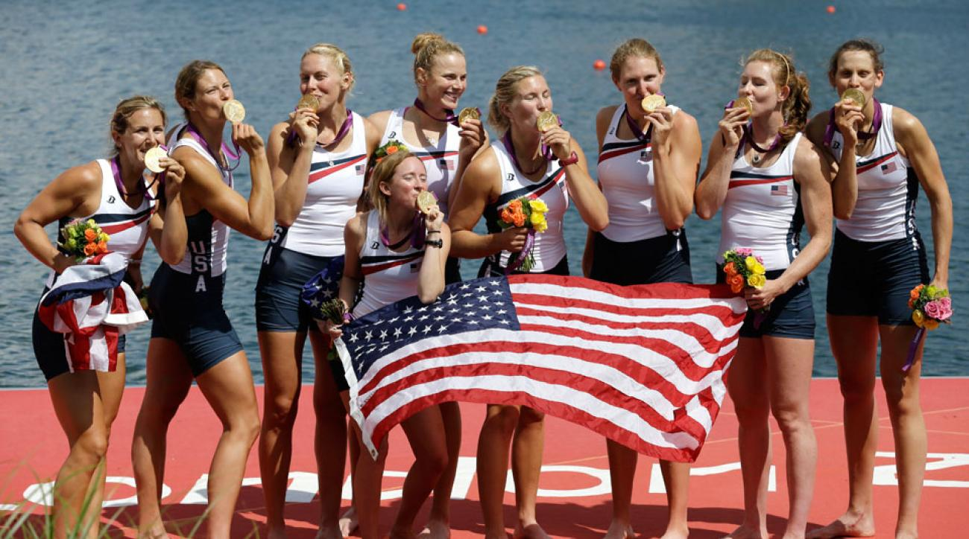
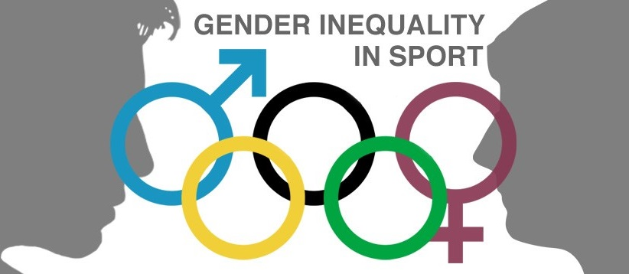
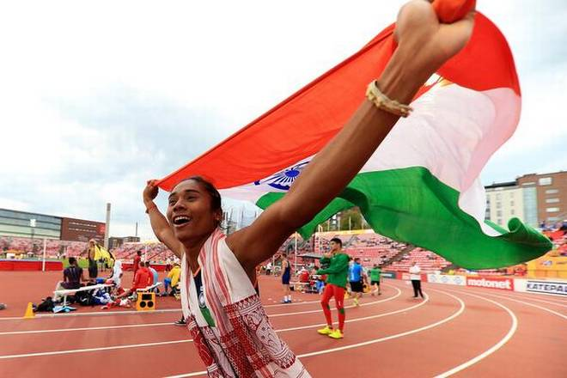
PROBLEM
STATEMENT
DEVELOPED COUNTRY : USA
HOW DIFFERENT IS GENDER EQUALITY IN OLYMPICS FROM THE PERSPECTIVE OF A DEVELOPED COUNTRY VS A DEVELOPING COUNTRY?
DEVELOPING COUNTRY : INDIA

Slide 4
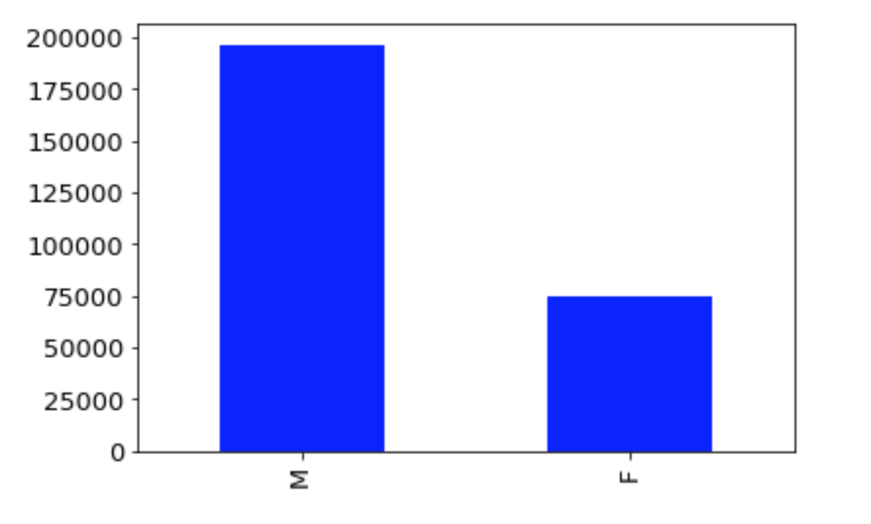
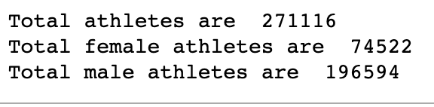
INSIGHTS
Sporting activity in Ancient Greece was generally reserved to men from the aristocracy who were physically perfect. Participation was limited to free Greek male citizens. Women were not permitted to attend the games much less participate.
Female athletes were excluded from the first modern Olympic Games in 1896 because its founder, Pierre de Coubertin, felt their participation would be inappropriate.
“No matter how toughened a sportswoman may be, her organism is not cut out to sustain certain shocks,” the French educator and historian said then.
M = 72.5%
F = 27.5%
Notes:
Female % 27.5
Male % 72.5

Slide 5
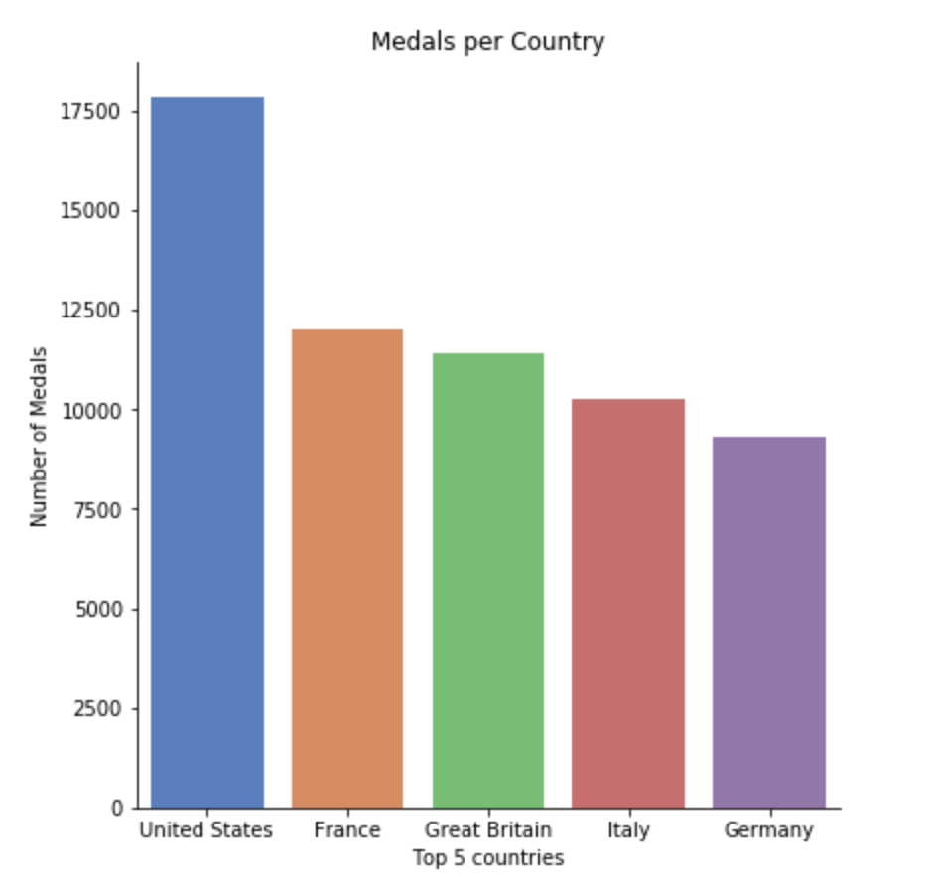
INSIGHTS
This graph shows the top 5 countries with the most medals in Olympics from 1896-2016.
The reason why USA has the most medals is because they have better corporate funding for Olympian training and they have better facilities.
US colleges offer scholarships to high performing high school athletes. This promotes sport. Also, they have state of the art training facilities.
We want to compare USA and India because the opportunities provided to Females in both the countries are radically different. This will further explain the gap of gender inequality between Developed and Developing Country.
Notes:
Female % 27.5
Male % 72.5

Slide 6

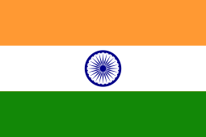
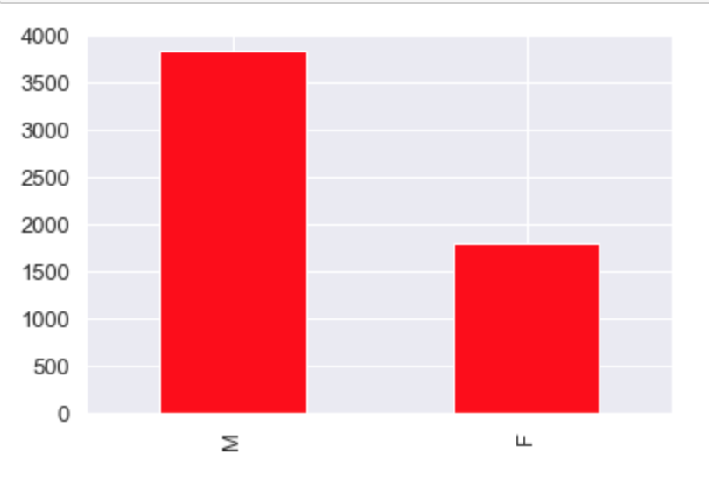
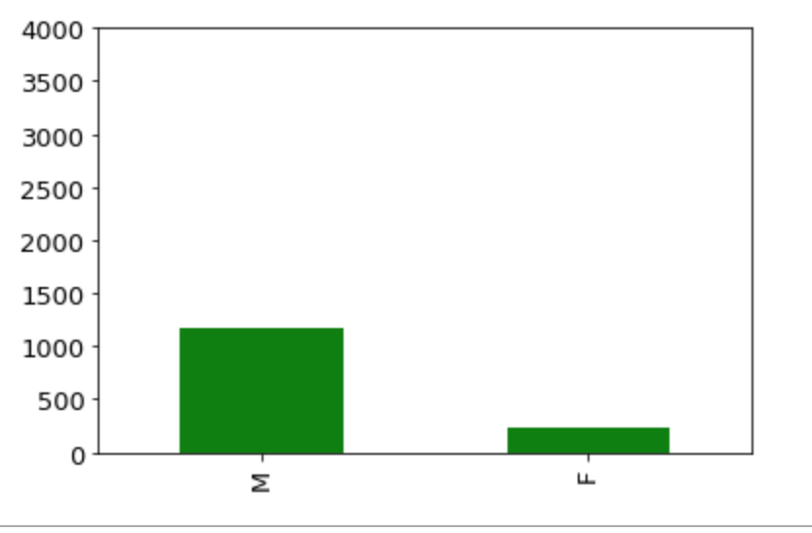
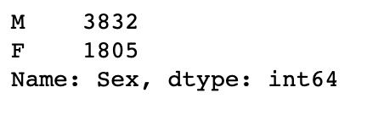
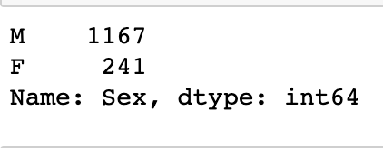
MALE-FEMALE ATHELETES SPLIT FOR BOTH THE COUNTRIES
M = 68%
F = 32%
M% = 83%
F% = 17%
Notes:
Compare %
US is above avg in female participation
India is below avg in female participation

Slide 7
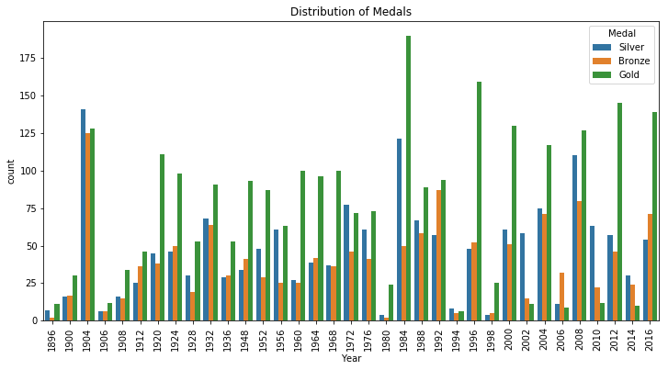
NUMBER OF MEDALS WON IN OLYMPICS FROM 1896-2016 FOR USA

Slide 8
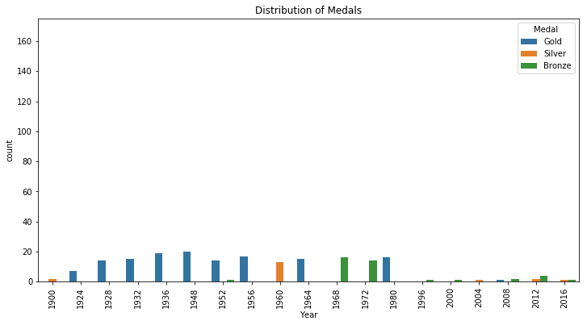
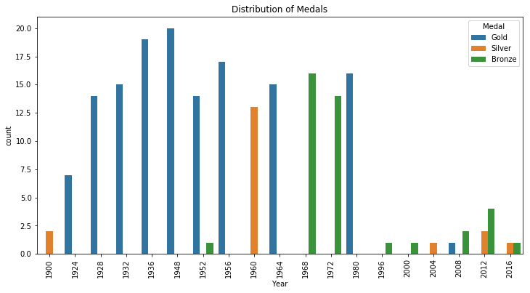
NUMBER OF MEDALS WON IN OLYMPICS FROM 1896-2016 FOR INDIA
Notes:
Compare %
US is above avg in female participation
India is below avg in female participation

Slide 9
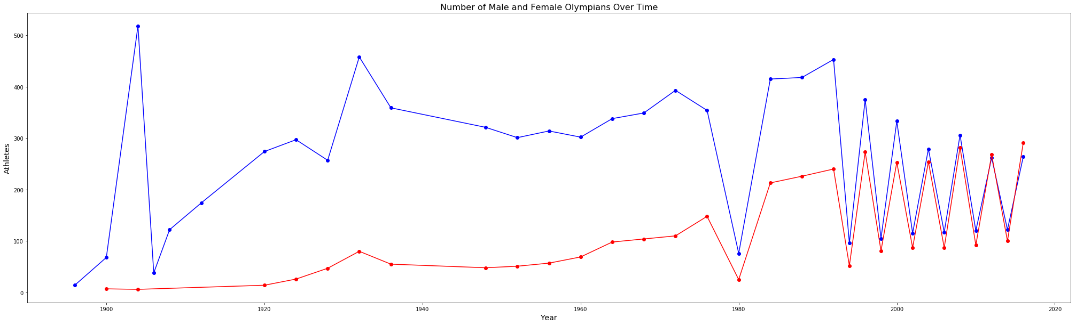
NUMBER OF MALE/FEMALE PARTICIPATION IN OLYMPICS FROM 1896-2016 FOR USA
Notes:
Compare %
US is above avg in female participation
India is below avg in female participation

Slide 10
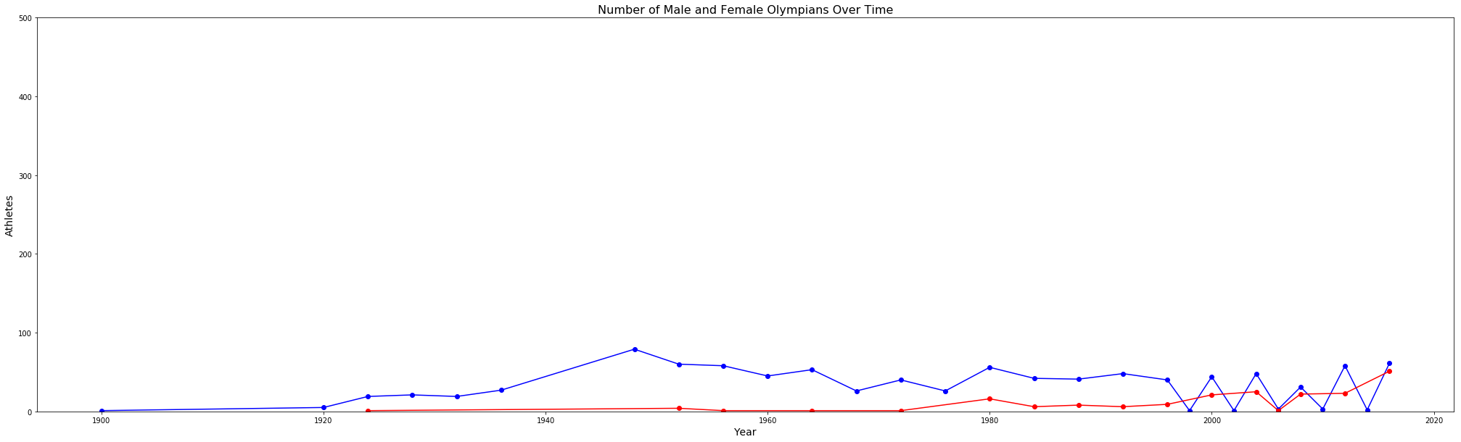
NUMBER OF MALE/FEMALE PARTICIPATION IN OLYMPICS FROM 1896-2016 FOR INDIA
Notes:
Compare %
US is above avg in female participation
India is below avg in female participation

Slide 11
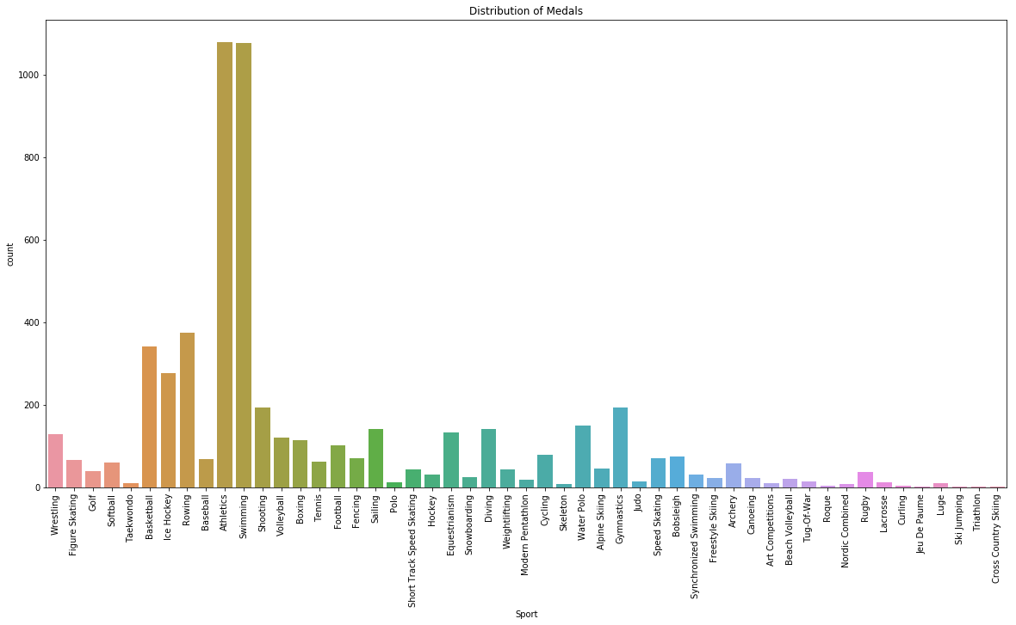
DISTRIBUTION OF MEDALS BY SPORT 1896-2016 USA
Notes:
Compare %
US is above avg in female participation
India is below avg in female participation

Slide 12
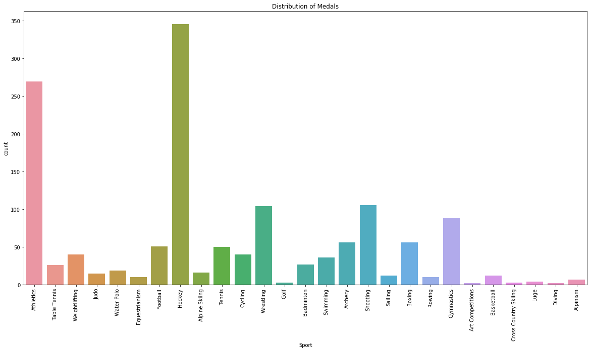
DISTRIBUTION OF MEDALS BY SPORT 1896-2016 INDIA
Notes:
Compare %
US is above avg in female participation
India is below avg in female participation

Slide 13
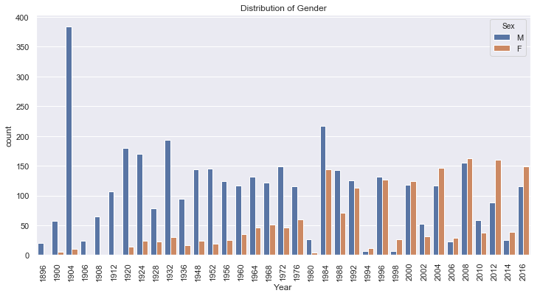
DISTRIBUTION OF MEDALS BY GENDER 1896-2016 USA
Title IX is part of the 1972 Education Amendments Act.-It prohibits gender discrimination in any educational programme that receives government funding.
The rule meant that schools and colleges must offer equal sport and athletic opportunities to both sexes.It had an immediate effect; in 1972 fewer than 300,000 women participated in high school athletics. By 2001, that number was 2.8 million.
Notes:
Compare %
US is above avg in female participation
India is below avg in female participation
the reason American women do so well at the Olympic Games, because government money and resources have been spent equally on women as on men.
the reason American women do so well at the Olympic Games, because government money and resources have been spent equally on women as on men.

Slide 14
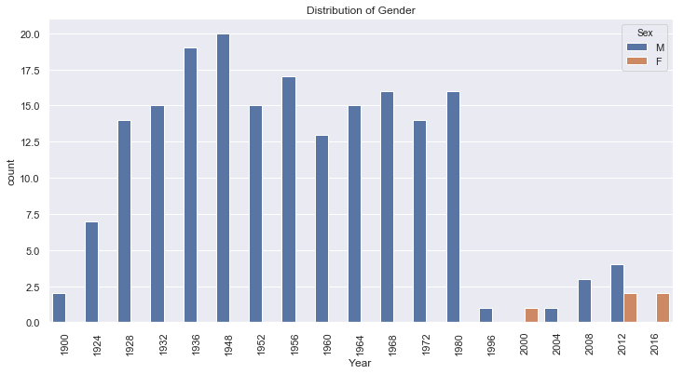
DISTRIBUTION OF MEDALS BY GENDER 1896-2016 INDIA
Notes:
Compare %
US is above avg in female participation
India is below avg in female participation

Slide 15
CONCLUSIONS
THE NUMBER OF WOMEN COMPETING AT THE GAMES INCREASED SIGNIFICANTLY OVER THE LAST 30 YEARS – FROM 26.1% TO 45.2%.
WE HAVE NOTICED AN INCREASING TREND IN THE NUMBER OF FEMALE PARTICIPATION IN OLYMPICS IN BOTH THE COUNTRIES BUT COMPARED TO EACH OTHER, INDIA HAS A LONG WAY TO GO IN ORDER TO ABRDIDGE THE GAP OF GENDER INEQUALITY AND TO IMPROVE ITS SPORTS FACILITIES AND TO PROVIDE EQUAL OPPORTUNITES TO BOTH GENDERS.

Slide 16



