Slide 1

PANTRY-TO-PLATE
Smart meal planning, from pantry to plate
A Nigerian-first platform that connects inventory, recipes, meal plans, groceries, nutrition and cooking in one continuous loop.
PLATFORM OVERVIEW • JULY 2026

Slide 2
PANTRY-TO-PLATE
WHY IT MATTERS
Meal planning breaks when every step lives somewhere else
Pantry-to-Plate turns a fragmented household routine into one connected decision flow.
01
02
03
Know what is available
Choose what makes sense
Keep the loop accurate
Track quantities, measurement units, expiry dates and low-stock items instead of relying on memory.
Match Nigerian recipes against the pantry, expose missing ingredients and plan meals around real preferences.
Turn planned meals into a shopping list, add purchases back to stock, then deduct ingredients after cooking.
The result: less guesswork, less waste and a clearer path to the next meal.
02

Slide 3
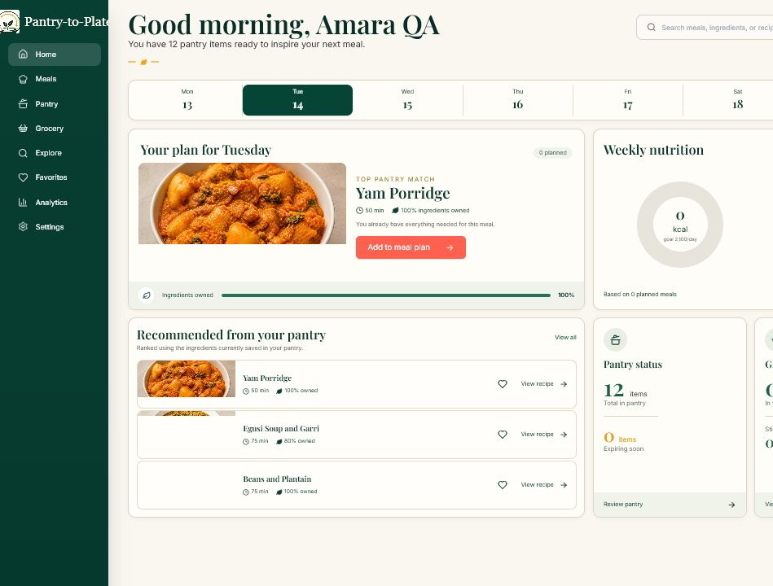
PANTRY-TO-PLATE
PLATFORM OVERVIEW
One dashboard brings the full food-planning loop into view
The home experience combines
Today’s meal
A clear next action, recipe progress and direct access to cooking mode.
Weekly nutrition
At-a-glance macro estimates and a direct route into deeper analytics.
Pantry signals
Recommendations, item counts, expiry warnings and grocery status in context.
03

Slide 4
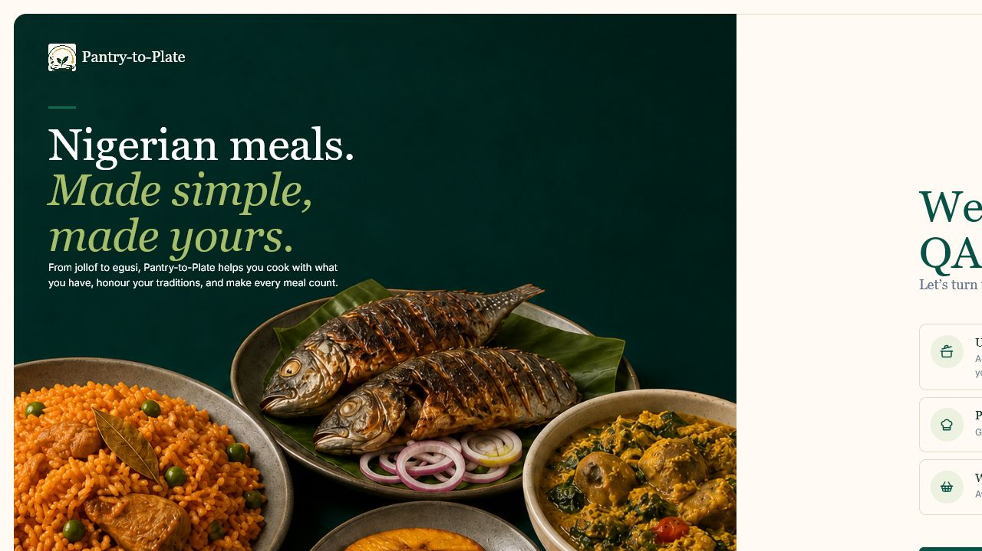
PANTRY-TO-PLATE
PERSONALIZATION
Onboarding builds a meal plan around the person, not a generic diet
Personalization captured
Food preferences
Meals and ingredients the user enjoys.
Cooking goals
Budget, speed, nutrition and waste priorities.
Dietary safeguards
Allergies, avoided ingredients and time limits.
Starting pantry
Existing ingredients become immediate recipe context.
04

Slide 5
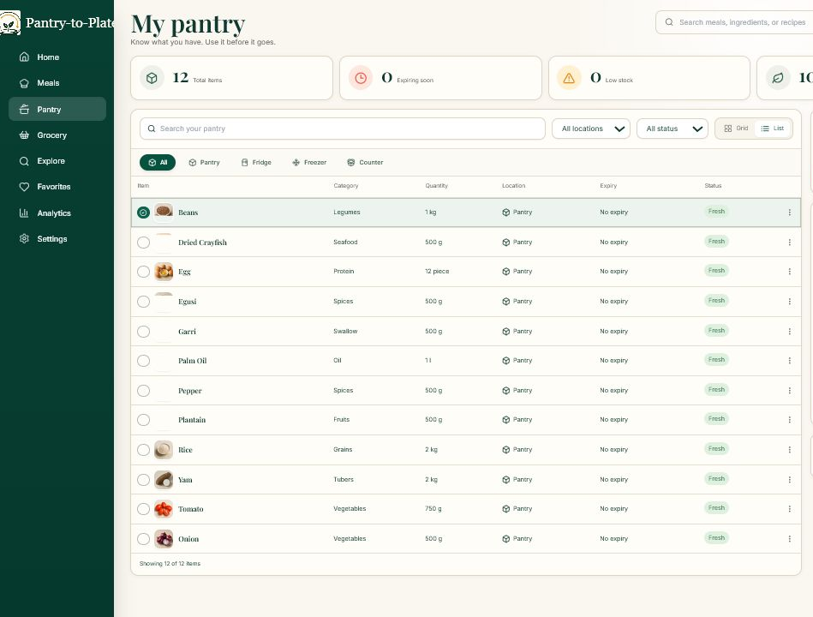
PANTRY-TO-PLATE
INVENTORY
The pantry is a living inventory, not a static checklist
Inventory intelligence
Quantities and units
Save realistic amounts using configurable measurement profiles.
Expiry and low stock
Surface urgent ingredients before they become waste or block a meal.
History and editing
Update, remove and review items while keeping the dashboard current.
05

Slide 6
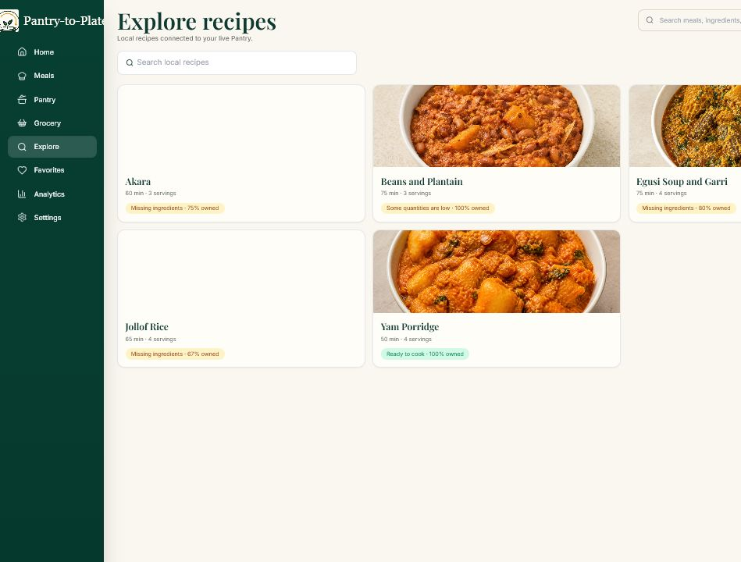
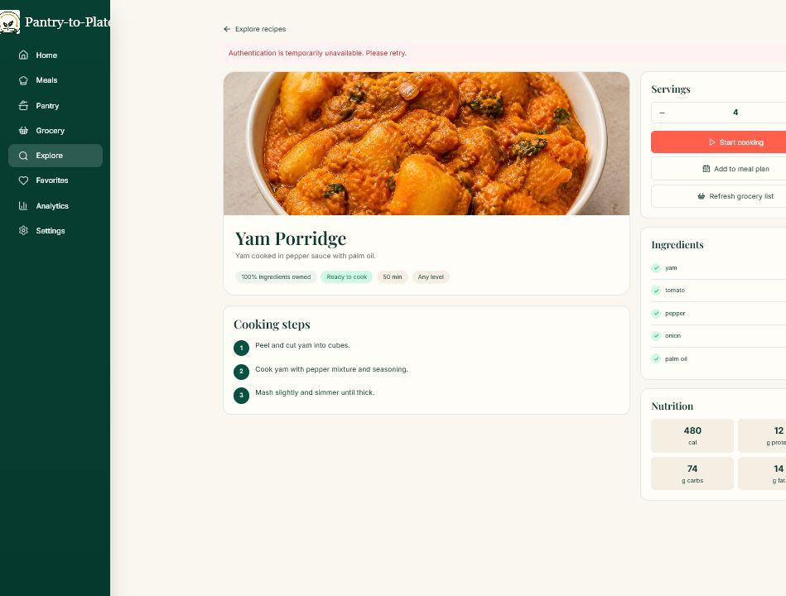
PANTRY-TO-PLATE
RECIPE INTELLIGENCE
The pantry becomes a recipe search engine
MATCH
Recipes are ranked against the user’s real pantry.
UNDERSTAND
Details show ingredients, missing items, steps and nutrition estimates.
06

Slide 7
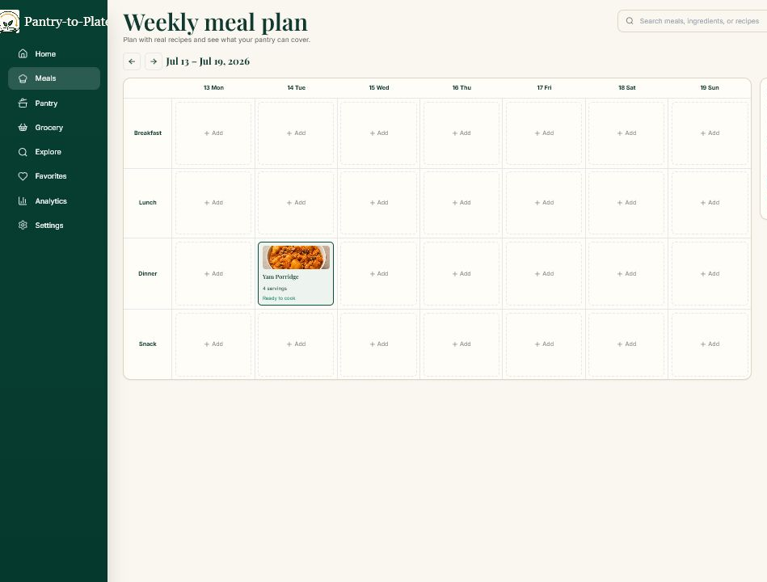
PANTRY-TO-PLATE
MEAL PLANNING
Weekly planning stays explainable and under the user’s control
1
Filter
Allergies, avoided ingredients and cooking-time limits.
2
Preview
Gemini selects only approved recipes; PlateSense provides a safe fallback.
3
Confirm
Nothing is saved until the user reviews and applies the plan.
The calendar remains editable after generation, so automation supports decisions instead of replacing them.
07

Slide 8
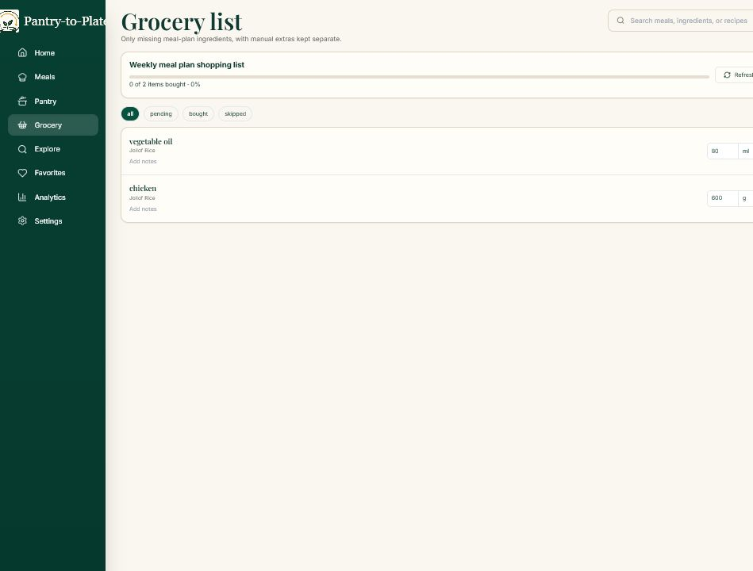
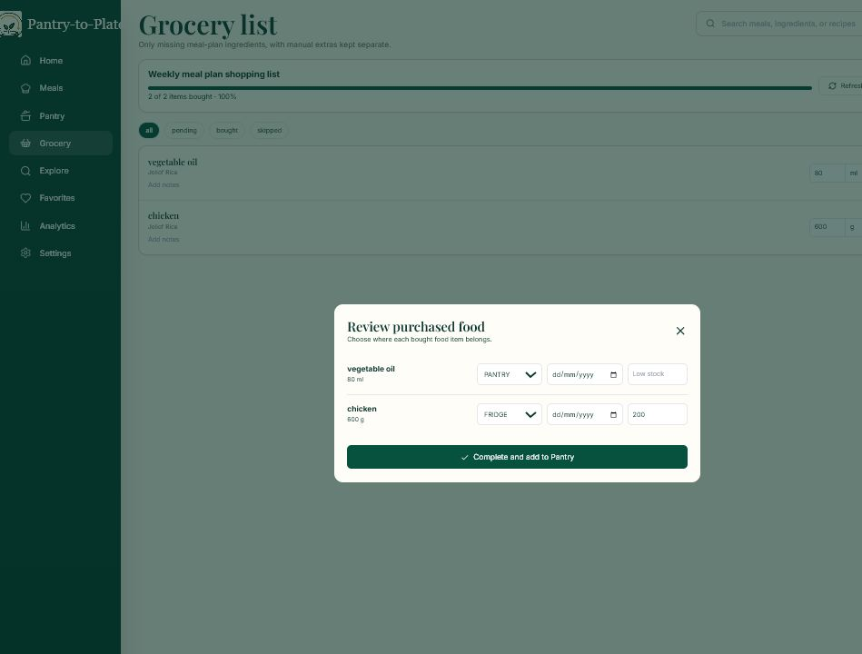
PANTRY-TO-PLATE
SHOPPING LOOP
A meal plan becomes an actionable grocery list — then returns to the pantry
→
Generate
Check off
Add to pantry
Missing ingredients are consolidated from recipes or the weekly meal plan.
Items can be marked as bought while shopping.
A purchase review converts bought items into updated inventory.
08

Slide 9
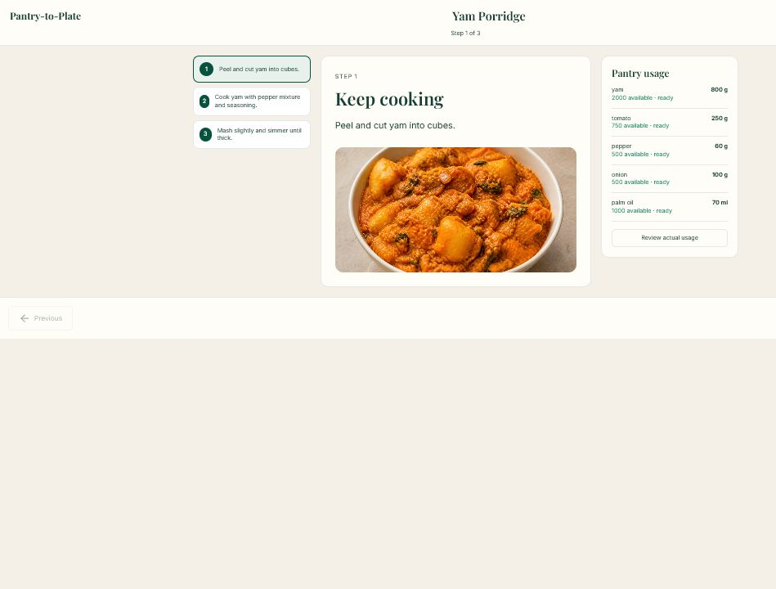
PANTRY-TO-PLATE
GUIDANCE AND INTELLIGENCE
Cooking closes the inventory loop while nutrition and AI add context
Three connected capabilities
Guided cooking mode
Step-by-step instructions keep the selected recipe and pantry usage in one place.
Automatic stock deduction
Completing a cooking session updates pantry quantities and records nutrition estimates.
Food Scan + analytics
Photo analysis identifies likely dishes, ingredients and allergens; weekly summaries remain clearly labeled as estimates.
Images are compressed in the browser and are not saved in Pantry-to-Plate storage.
09

Slide 10
PANTRY-TO-PLATE
TECHNOLOGY AND VALUE
Pantry-to-Plate connects every decision from stock to serving
PLATFORM LAYERS
WHAT THE PLATFORM NOW DELIVERS
Experience
React + Vite
Personalized onboarding, authentication, settings and favorites
Food intelligence
PlateSense + Gemini
Pantry, recipes, meal plans, groceries, nutrition and cooking in one loop
Nigerian-aware catalog intelligence with missing-ingredient detection
Application API
NestJS + Swagger
Server-side AI with validation, approved recipe IDs and preview-before-save safeguards
Data and identity
Prisma + Supabase PostgreSQL
A complete closed loop: plan smarter, shop with purpose, cook confidently and keep the pantry accurate.
10

