Slide 1
Classification Problem
Indix
Deepak K

Slide 2
Solution Proposal
Input file (tsv file) has product title, brand id and category Id.
Group all the product title and category Id where category id as key and product title as v values in Python dictionary.
Work Tokenizer –Bag of Words representation.
Stemming ( not used)
Performed Stop Words.

Slide 3
Solution Proposal …. Unsupervised Learning model.
Product title for all the categories are grouped and converted into unlabeled document.
Since there is not predefined category label's, I have proceeded with the unsupervised modeling approach.
Used LDA Model( Latent Dirichlet Allocatin) model to identify the topics/label for the brand.

Slide 4
Solution Proposal …. LDA Model.
Generated 10 topics out of the unlabeled document.
Used word cloud to figure out the Label based on the term frequence – Inverse Document frequency ( TF-IDF).

Slide 5
Naïve Bayes Rule
As said , generated the 10 topics through LDA model and using that as a predefined labels for the naïve bayes rule.
All the ten topics are stored in the list – considering as the Labels for the product title.
Providing as an input as “Sata Cable” to ensure whether it naïve bayes classifier returns “true”
If it is true the trained data set is Good.

Slide 6
Naïve Bayes Rule - Blind Data Set
Similar to train_data set , Blind data set values are grouped with category id and product title.
Product title are passed as an input to the implemented naïve bayes model.
To ensure the model is good enough.

Slide 7
Technologies
Python , Pandas Libraries.
Sci-kit and NLTK Packages.
Numpy libaries
Spyder – Python Development environment.
Used online web portal – wordle.net to look into the word cloud

Slide 8
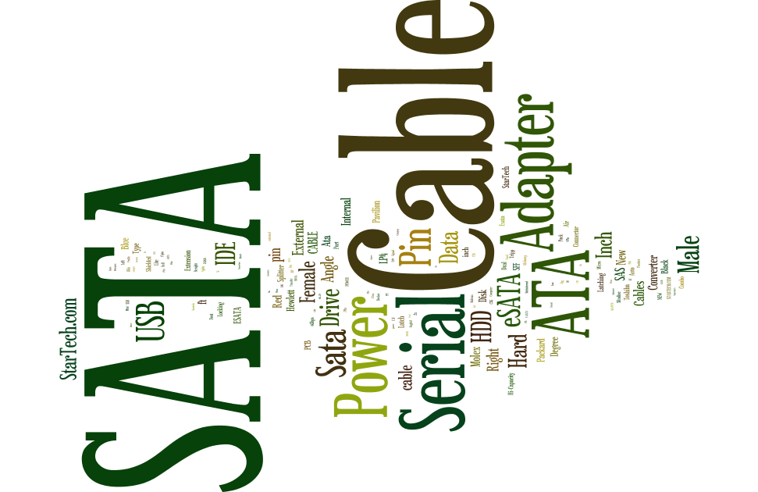
Sample - category Id : 425 word cloud

Slide 9
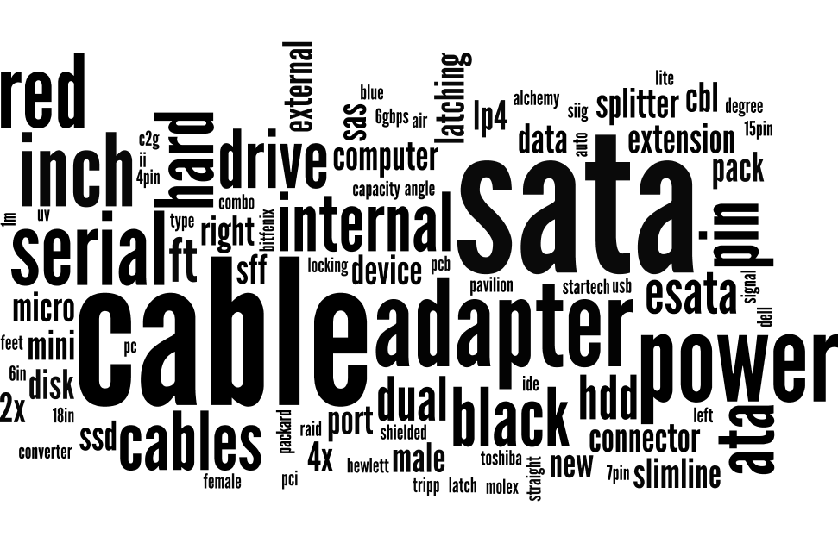
Sample – Topic generated -LDA

Slide 10
Thank you
Please let me know on any questions

