Slide 1
WELCOME

Slide 2
Android Application For Smart Parking System
Prepared by :
1.ABHILASH KARE
2.AKASH DIGHE
3.SWARAJ MIRAJKAR
4.SHUBHAM PATIL
Under the Guidance of : Prof. Sana Shaikh

Slide 3
Outline :
Introduction
Literature Survey
Existing System
Proposed System
System architecture
Flow chart
Implementation
Future Work
Conclusion.
References

Slide 4
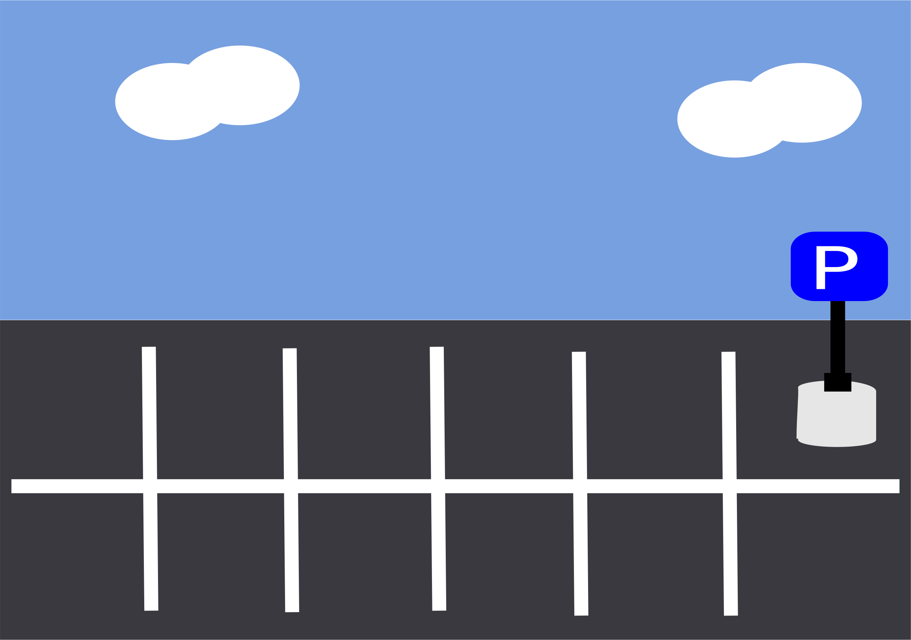
Introduction
Smart parking system is an integrated system to organize cars in public parks.
The system will be used for every slot in park.
The motivation of this project is to help drivers. And make the payment way easier.

Slide 5
Introduction
The smart parking system based on slot reservation is implemented, utilizing the Android application. The app having the features of slot allocation, by using the slot allocation method, user can reserve their own lowest-cost parking slot. It is an effective way in resolving the parking issues, which helps for traffic congestions and also provide the automated payment billing process.
This work gets extended as a fully automated system using multilayer parking method. We plan to broaden the testing on the real-time environment where users can have the "Smart Parking" system in their portable devices(Mobiles).
If the parking space is not available where customer wants to a park then this application helps the user to find the valid parking space nearby that location. This application helps the user to reserve the parking spot when they stay at home form not being frustrated of finding a parking spot.

Slide 6
Literature Survey
In this paper, smart parking systems obtain information about available parking spaces, process it and then place the car in that position. A prototype of the parking assistance system based on the proposed architecture has been built. A well-developed control system is necessary to combine the whole process. The monitoring system is designed as an integrated information system. The control system contains code, to perform all tasks. The efficient circular design is introduced with a special rack and pinion mechanism which is used to lift and place the car in a certain position
The goal of this project is to automate parking lots and cars as well. A scale model of an automated parking system that can organize and manage the number of cars that can be parked at a particular place at any time based on the availability of a parking space. Automated parking is a method of parking an existing car using a sensor. Entry and exit of the order are done by android application

Slide 7
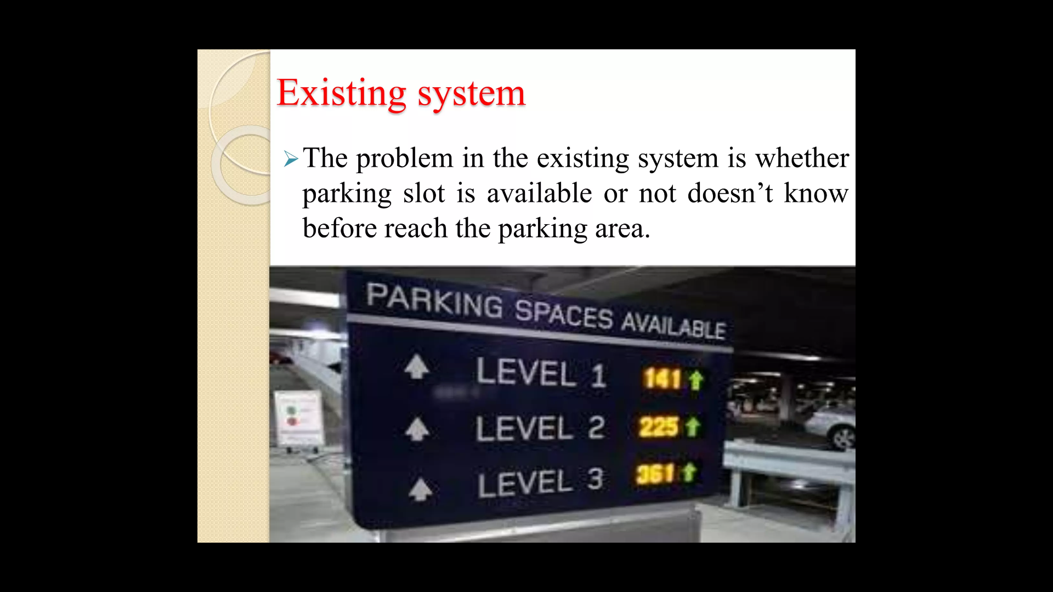
Existing System

Slide 8
Proposed System
Step 1: User registers for the system.
Step 2: User enters his/her location based on that the system will provide available parking areas considering available slots as well.
Step 3: User has to select one and enter car and personal details.
Step 4: Then ID will be generated for user which user has to tell admin at the entrance.
Step 5: Admin will record the enter time of the car. When car leaves admin will just enter the leaving time. Based on the time car was parked the user will be charged.

Slide 9
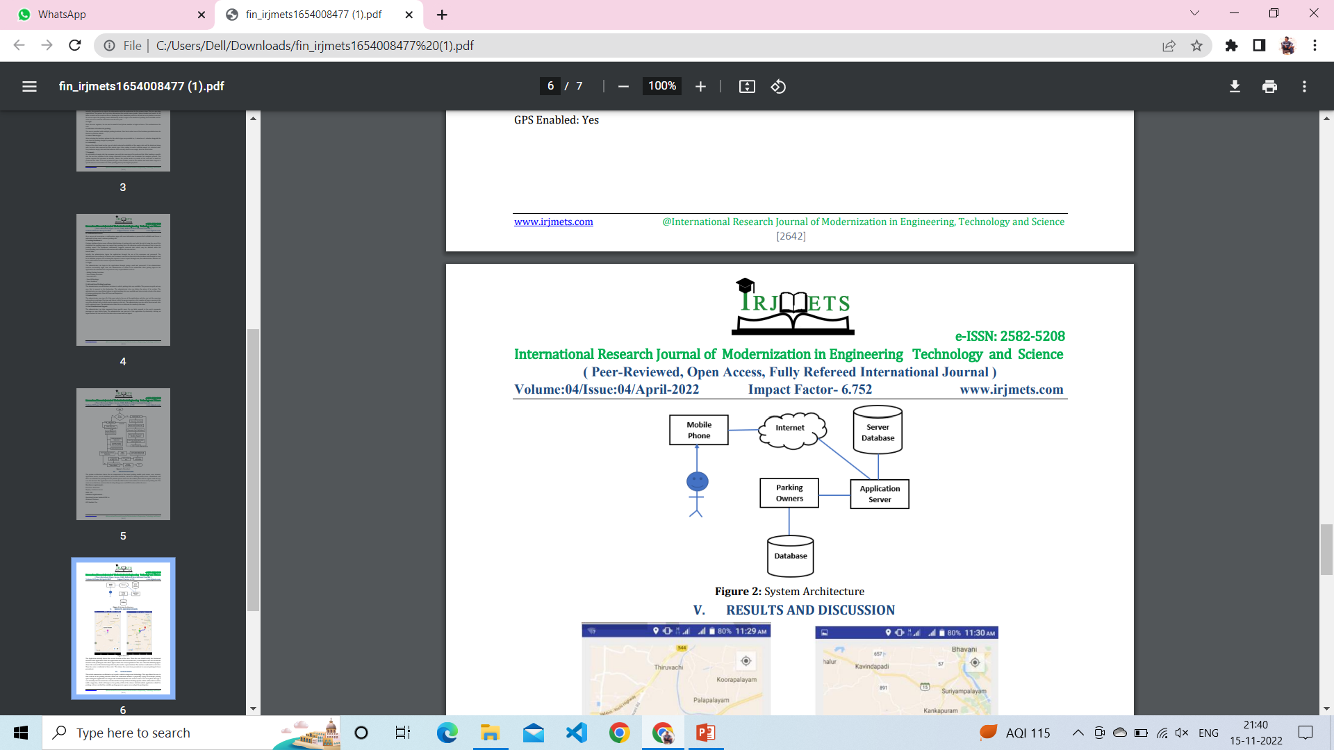
System Architecture

Slide 10
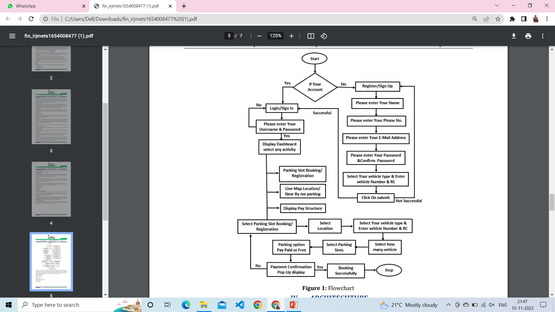
Flowchart

Slide 11
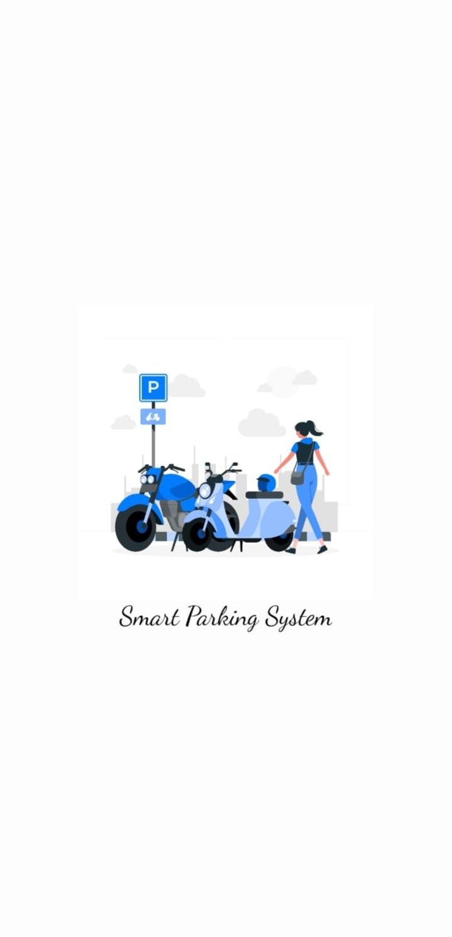
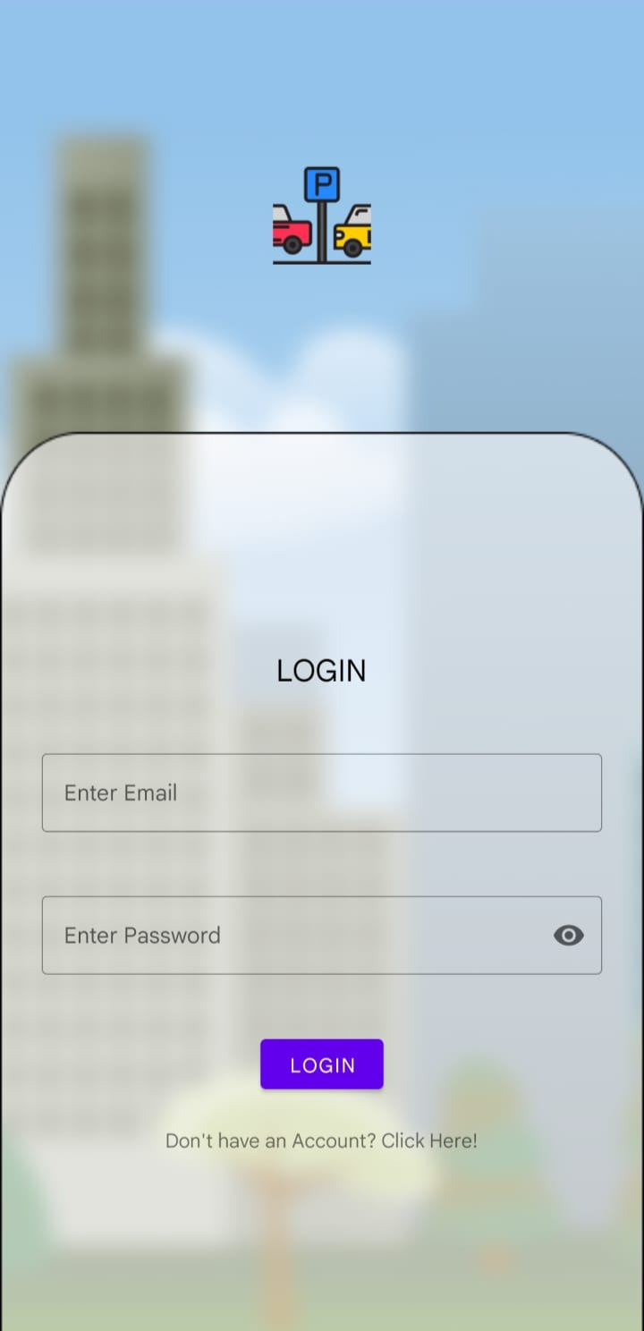
Implementation
Interface
Log in

Slide 12
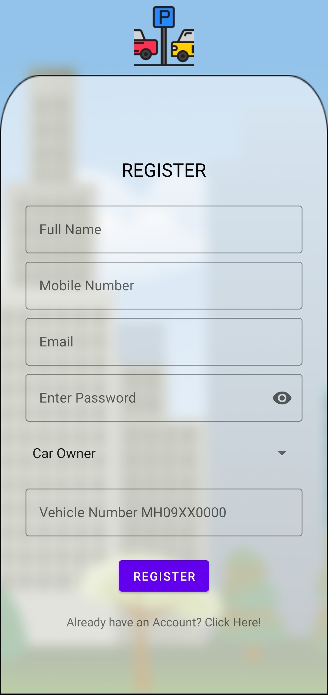
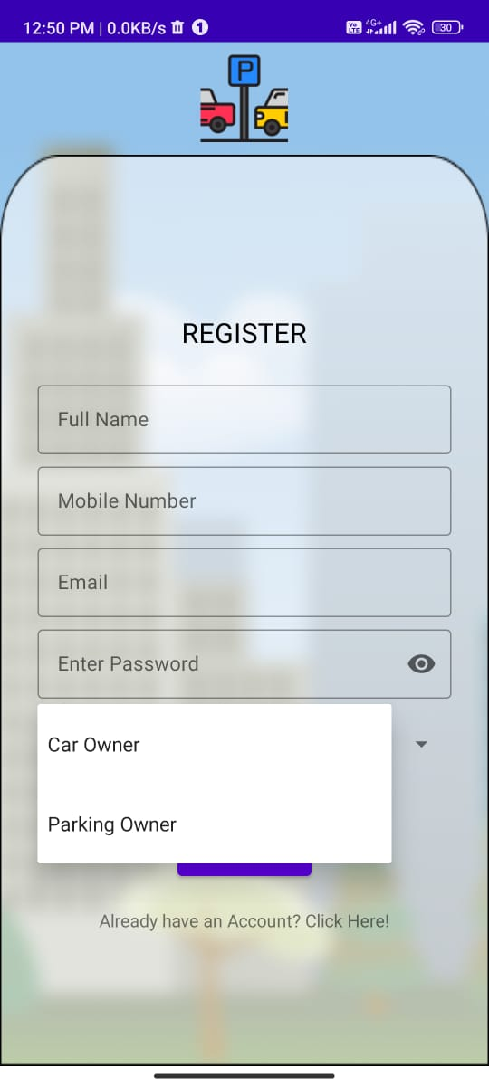
Here we are make the two types of registration 1. car owner 2. Parking owner
Registration
Car owner
Parking owner

Slide 13
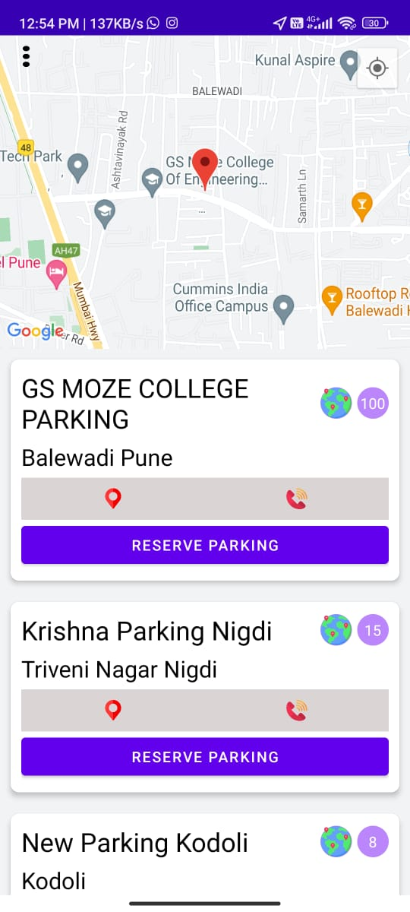
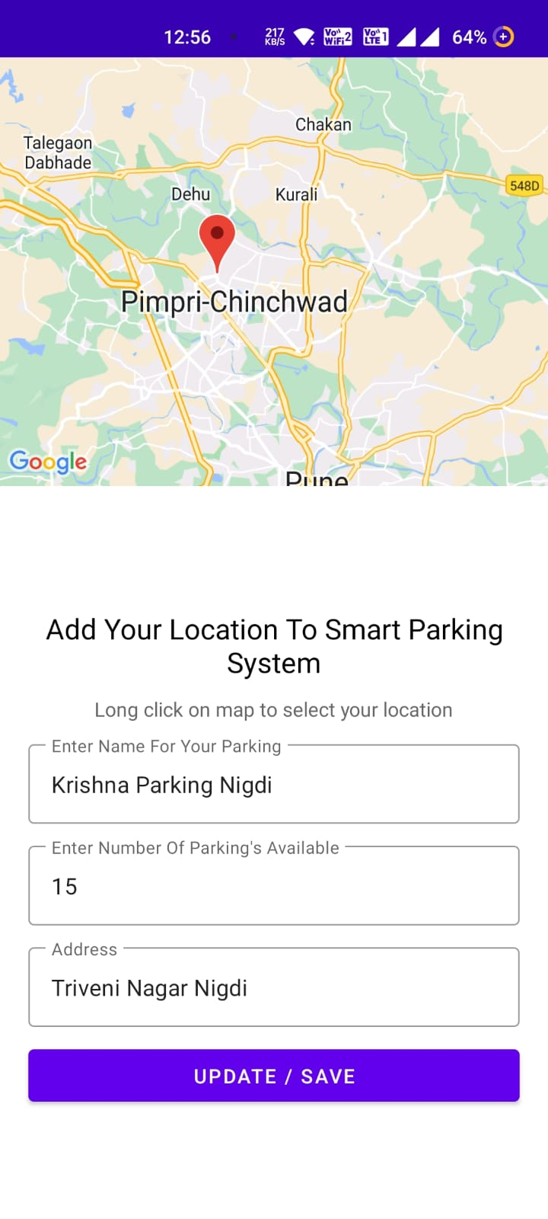
Log in Successfully
Car owner
Parking owner
Here by clicking on ‘RESERVE PARKING’
We book a slot for parking
Here we need to select the loction of parking and detail of parking.

Slide 14
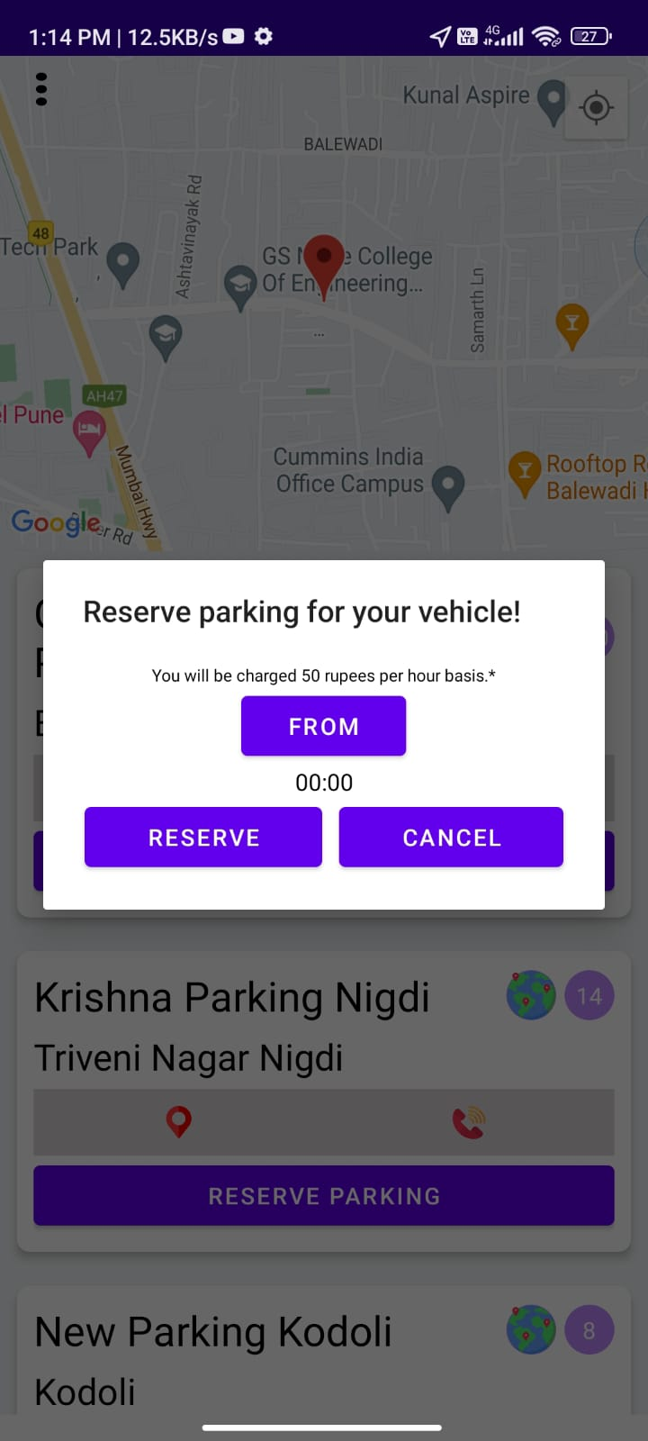
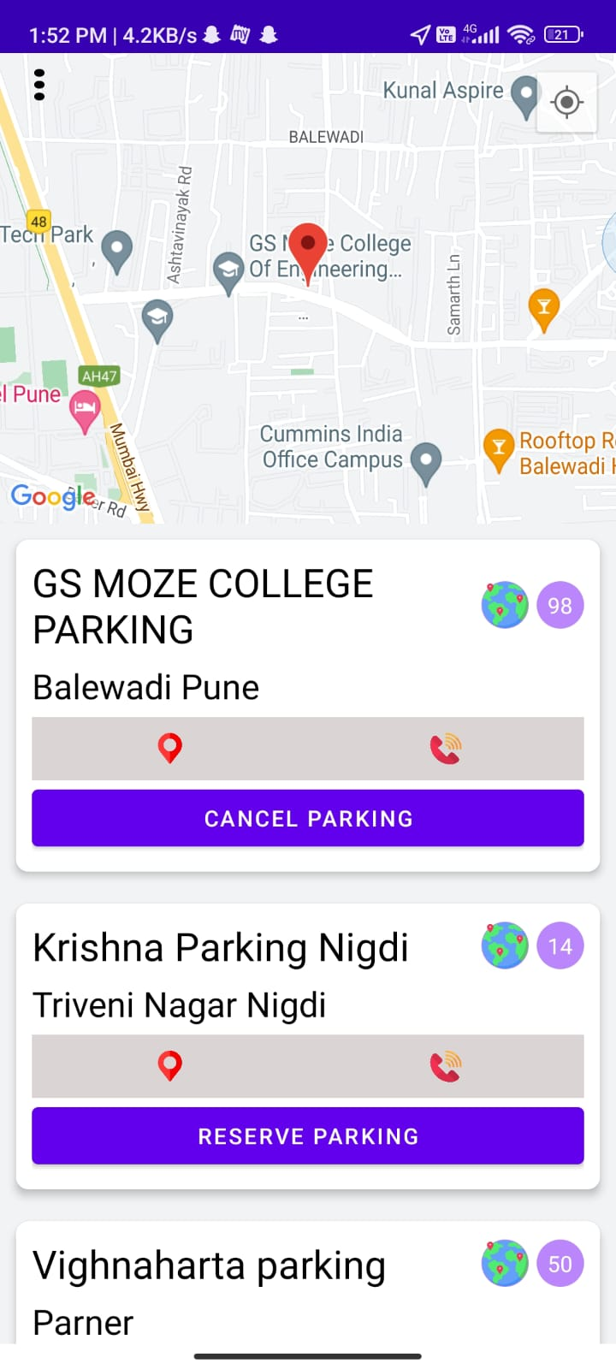
Booking
Here you need to select the time duration to book your slot
Parking book succefully.

Slide 15
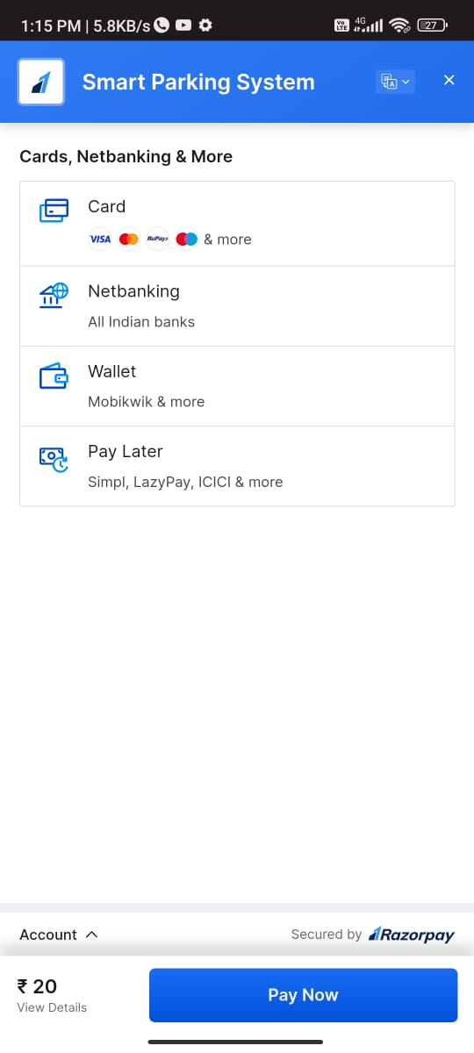
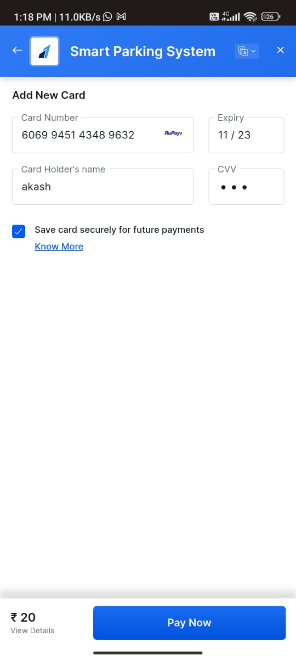
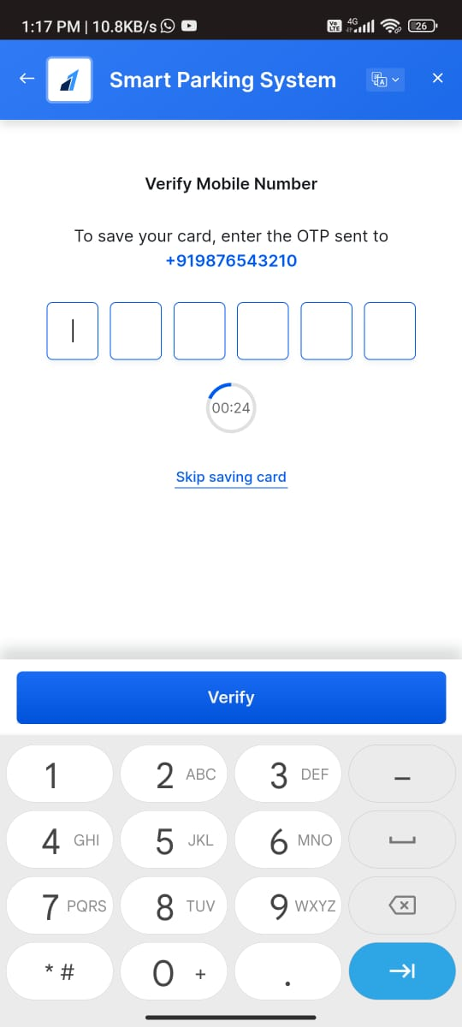
Payment
For payment we giver the above options.
Fill the card detail and pay the money.
This is the verification for the payment.

Slide 16
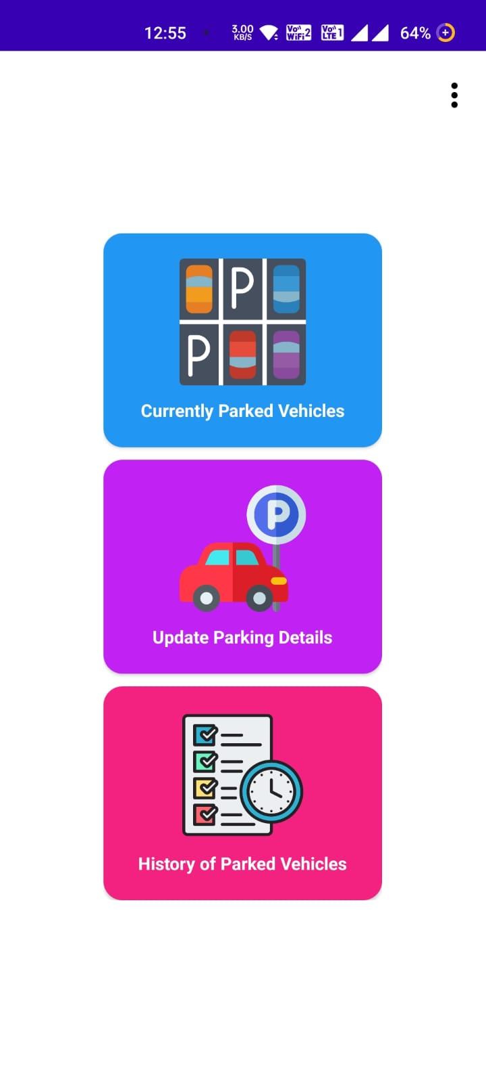
For Parking owner
After creating the parking the app shows the next page to the parking owner that is the home page
Here is the three options are given to the parking owner profile.
1. currently parked vehicle.
2. update parking details.
3. history of parking vehicle.

Slide 17
Details of parking owner home page
In ‘currently parked vehicle’ we khow the how many vehicle are parked into the parking lot
In update parking details owner can update the no. of parking available.
In History there are information of all the parked vehicle in the parking lot with booking time

Slide 18
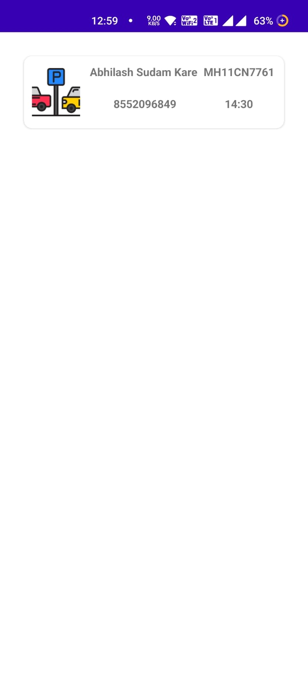
Currently parked vehicle
Here are the all information of the parked car, their owner ,mobile no. ,vehicle no. and time of parking.

Slide 19
Update parking details
Here parking owner can update the parking details like the name, no.of parking available.

Slide 20
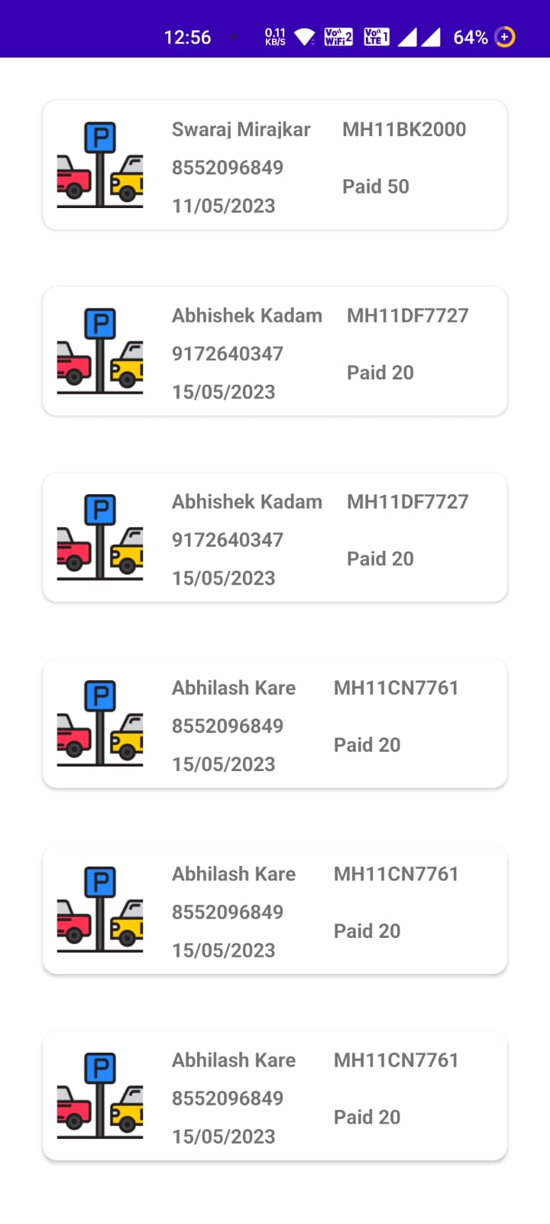
History of parked vehicles
Here are the history of all the cars parked into the parking lot.

Slide 21
Future Work
We can deploy this app on playstore.
Car owner can customize their booking slot as they want.
We can deploy this app on playstore.
We can also present this project to Businesses such as Tech Parks, Big Hotels, so that they can manage their parking system more efficiently.

Slide 22
Conclusion
What is smart parking system?
Our smart parking system project is planned to be integrated with another software application to help drivers to find the empty spot in parking lot more easily with less time.
Also our project implement most of the functionalities needed in a parking lot. for example, implement an automatic way for payment.
Basically smart parking system save time, money, space and help to simplify the often tedious task of parking.

Slide 23
References
[1] M. A. R. Sarkar, A. A. Rokoni, M. O. Reza, M. F. Ismail, “Smart parking system with image processing facility”, I. J. Intelligent System and Application, 41-47, 2012.
[2] D. J. Bonde “Automated car parking system commanded by android application” in Proc. IEEE Conf.,03- 05, Jan 2012.
[3] R. Yusnita, FarizaNorbaya, and Norazwinawati Basharuddin “Intelligent Parking Space Detection System Based on Image Processing”, Internationl Journal of Innovation, Management and Technology, 232-253, 2012.
[4] Tejal Lotlikar Minla Chandrahasan, Ankita Mahadik, Madhusmita Oke, Anjali Yeole “Smart Parking Application September 2016 International Journal of Computer Applications 149(9):32- 37DOI:10.5120/ijca2016911529

Slide 24
THANK YOU

