Slide 1
음성인식
Speech To Text

Slide 2
What is STT?
https://www.youtube.com/watch?v=5EqwwrzUsgo

Slide 3
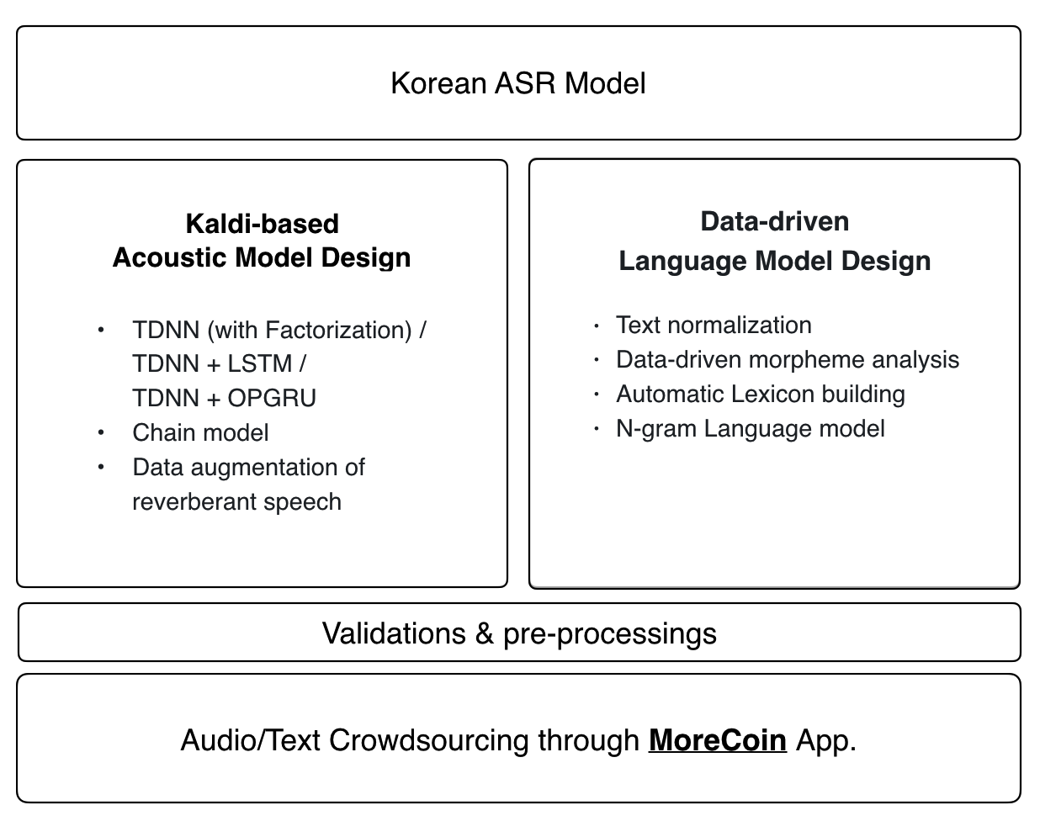
KALDI

Slide 4
Kaldi Online Demo
https://www.youtube.com/watch?v=pc8Fu_52tOE

