Slide 1
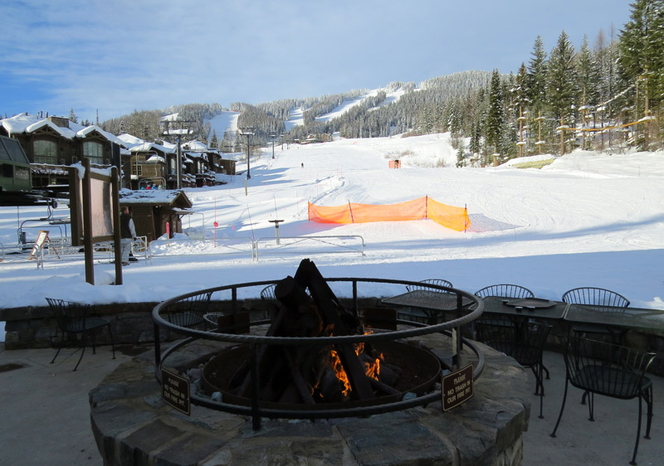
Big Mountain Ski Resort
Ticket Pricing Model

Slide 2
Purpose of this project
Provide guidance for pricing and future facility investment
Prepare a pricing model for ski resort tickets within their market segment.
Build a predictive model for ticket price
Number of facilities or properties at resorts
Provide insight into what facilities matter most to visitors
Which facilities they are most likely to pay for

Slide 3
Key Findings
Permanent closure of up to 10 of the least used runs
Can close upto 5 runs results in drop in ticket prices and revenue
Increase vertical drop by 150ft and addition of a chair lift
Justifies ticket price increase of $1.99 and additional revenue of $15 million
Number 2 plus the addition of 2 acres of snow making
Justifies ticket price increase of $1.99 and additional revenue of $18.5 million
Increase the longest run by 0.2 miles (boasting the longest run) and additional snow making of 4 acres
Results in no change in ticket price
Recommendation
Increase vertical drop by 150ft with the addition of a chair lift and 2 acres of snow making.
Justifies ticket price increase of $1.99 and will generate additional revenue of $18.5 million/year

Slide 4
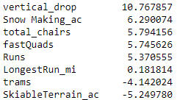
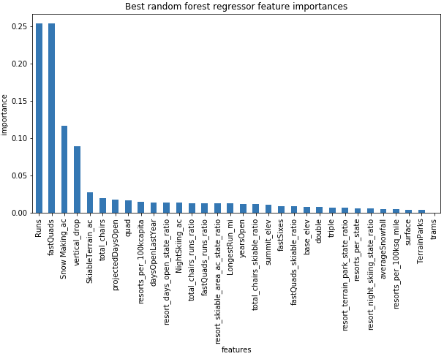
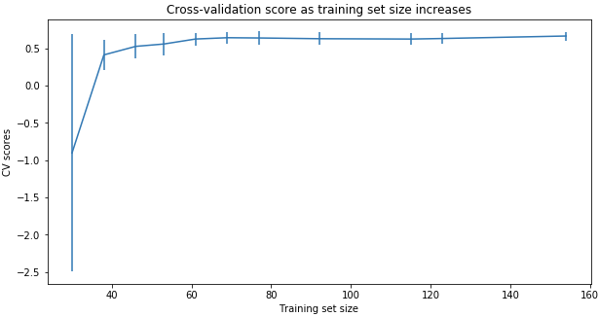
Modeling Comparison
Linear Regression Model vs. Random Forest Regression Model
( MAE, std) 10.499, 1.622 vs. 9.649, 1.505
Cross-Validation Score
Notes:
The random forest model has a lower cross-validation mean absolute error (MAE errors between paired observations expressing the same phenomenon) by almost $1. It also exhibits less variability. Verifying performance on the test set produces performance consistent with the cross-validation results. (10.499032338015294, 1.6220608976799664) vs. (9.649477185159107, 1.505326312688125)
This shows that you seem to have plenty of data. There's an initial rapid improvement in model scores as one would expect, but it's essentially levelled off by around a sample size of 40-50
<number>

Slide 5
Modeling Data
Modelled price is $95.16 vs. actual price $81.00
MAE = $10.40 suggests there is room for an increase
Pricing Assumptions
Other resorts set their prices according to the market
Big Mountain appears to be charging much less than prediction suggests
Is Big Mountain undercharging?
Are other resorts overpriced?
Is our model lacking some key data
Operating Costs

Slide 6
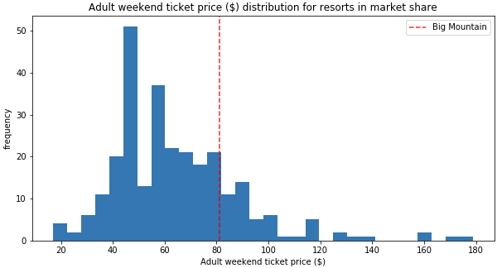
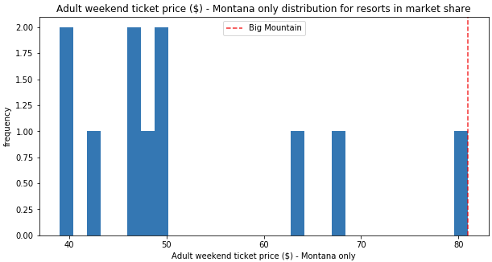
Big Mountain Resort Ticket Prices

Slide 7
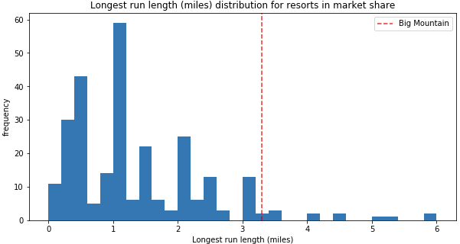
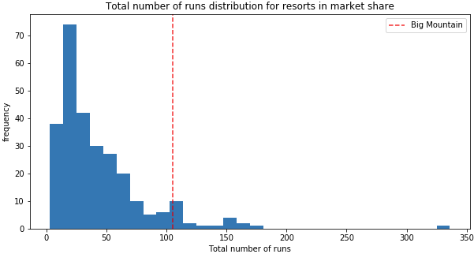
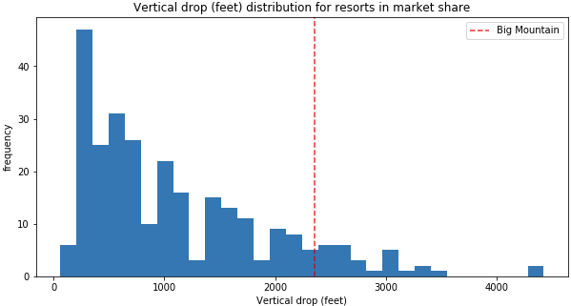
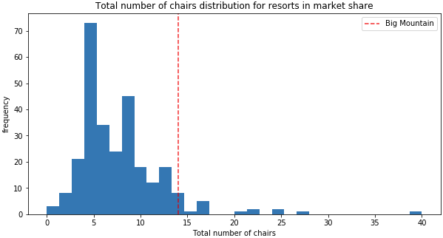
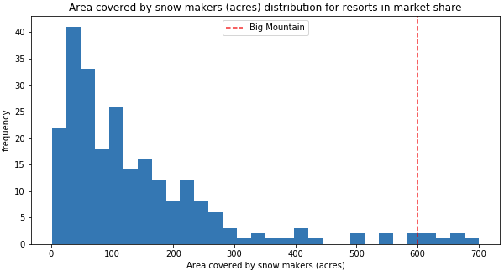
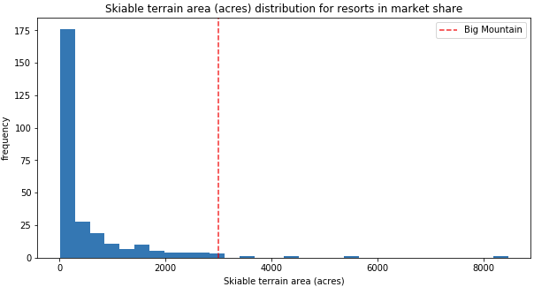
Feature Comparisons

Slide 8
Summary
Big Mountain Currently ranks among the top resorts
Skiable terrain
Number of Runs
Snow making capacity
Number of Chairs
Proposed Scenerios
Closure of 5 least used runs
Increase vertical drop with and without snowmaking
Increase longest run with snowmaking
By increasing the vertical drop either with or without snowmaking will provide the opportunity to increase revenues by $15-$18 million, however the increase cost of tickets must be considered.

