Slide 1
Me
Arash Rouhani
MSc. @ Chalmers University of Technology
  ”Datateknik” (~ CSE)
  CSALL
Top interests
  Haskell
  Programming competitions (Code Jam etc.)
    I'm organizing ”Programmeringsolympiaden” (Swedish IOI)

Slide 2
Contents of slides
Building a GUI
Building a Game
I'll tell you a story :)
FRP @ Facebook

Slide 3
FRP vs just FP

Slide 4
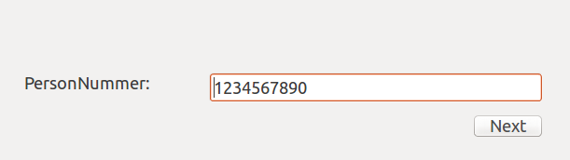
Building a GUI
We want something like this:

Slide 5
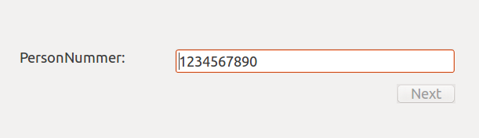
Building a GUI
And validation of pesonnummer
Greyed out

Slide 6
Building a GUI
Greyed out
validate :: String → Bool
validate = ”sum of digits is divisble by 7”
textField.onChangeEvent := \() →
button.enabled := validate( textField.text );

Slide 7
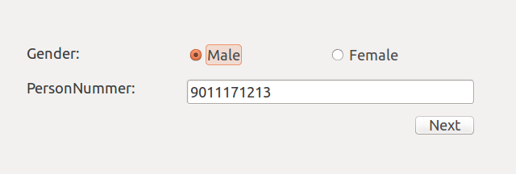
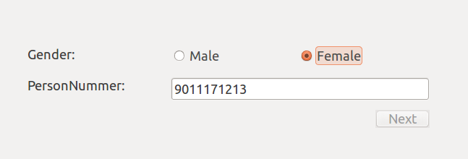
Building a GUI
It worked perfect!
Now make it look like this:

Slide 8
Building a GUI
validate :: String → Gender → Bool
validate = ”sum of digits is divisble by 7” && ”...”
textField.onChangeEvent := \() →
button.enabled := validate(
  textField.text, radioButtonMale.selected ? Male : Female );
radioButtonMale.onChangeEvent := \() →
button.enabled := validate(
  textField.text, radioButtonMale.selected ? Male : Female );
radioButtonFemale.onChangeEvent := \() →
button.enabled := validate(
  textField.text, radioButtonMale.selected ? Male : Female );
But there's a serious side effect ...

Slide 9
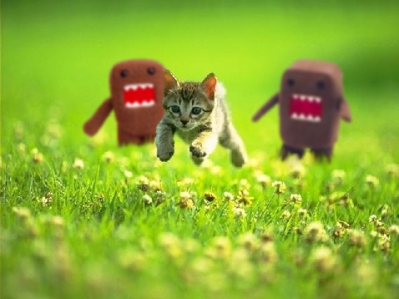
Building a GUI
Side effect: God just killed a kitten

Slide 10
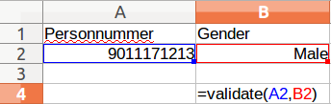
Inventing FRP
Excel Spreadsheet to the rescue!

Slide 11
Inventing FRP
:: Reactive(String)
:: Reactive(Gender)
validate ::
Reactive(String) →
Reactive(Gender) →
Reactive(Bool)
:: Reactive(Bool)

Slide 12
Inventing FRP
That's essentially it!
Now lets's have a demo!
Tarrasch/threepenny-personnummer

Slide 13
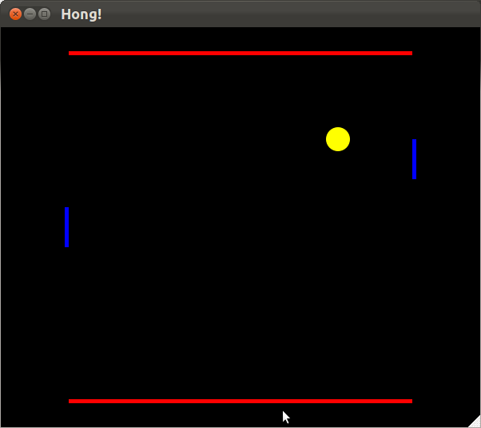
My Pong Clone
Focus on technology, not gameplay features

Slide 14
Technologies
Functional
  sum [] = 0
  sum (x:xs) = x + sum xs
Reactive
  a(t) = b(t) + c(t)
Testing
  it ”should bounce on walls”

Slide 15
Intro - Reactive programming
Functions of time
  We write: a = b + c
  We mean: a(t) = b(t) + c(t)
Declare, not assign!
  Equality (=) now bears its mathematical meaning
  aka. referential transparency
Useful for games!

Slide 16
Implementing the ball (1/2)
ballpos = (xpos, ypos)
ypos = …
xpos = integral xvel
xvel = 5

Slide 17
Implementing the ball (2/2)
xpos = integral xvel
xvel = 5, negate on xbounce
xbounce = lbounce or rbounce
rbounce = rdy < a and rdx < 0.00001
rdy = abs (rpy – ypos)
rdx = …
a
rpy
rdx
rdy
ypos

Slide 18
Testing – Why?
Our program must follow a specification
Let the tests be the specification
Tests pass → Product finished!

Slide 19
Testing pure functions
Side effects hinder testing!
FRP is side-effect free!
  My tests pass today ↔ they also pass tomorrow

Slide 20
IRL tests
describe "bounces on walls" $ do
let ss = run startState{ xVelocity = 0 }
it "always have ball inside" $ alwaysInside ss
it "bounces roof" $ ever (\s -> yVelocity s < 0) ss
it "bounces floor" $
ever (\s -> yPosition s < 0 && yVelocity s > 0) ss
Another demo!
Tarrasch/Hong

Slide 21
Story time!
(if time permits)

Slide 22
Anthill
The short story for FRP in Anthill is that it consumes a lot of configurations that change on different schedules, and usually the configurations change only partially, so it made sense to have an auto-memoizing event propagation system, and FRP in particular is a composable, side-effects-free, nice-to-use form of that.
    Alexey Spiridonov, engineer @ Facebook

Slide 23
Anthill
Lets build a continious image compresser
  1. A user uploads an image
  2. It should be compressed within 24 hours
  3. (For all images uploaded from now on)

Slide 24
Anthill
(Disclaimer, everything here is just made up!!)
Images stored in distributed database:
But then again, it's always a bit more complicated:
AA-CC
CC-EE
EE-GG
GG-II
AA-BB
EE-FF
BB-CC
FF-GG
CC-DD
GG-HH
DD-EE
HH-II

Slide 25

Anthill
Just to clarify,
Is stored in a:
AA-BB
EE-FF

Slide 26
Anthill
Each machine runs an instance of anthill
They have the following code:
AA-BB
EE-FF
Every 15 minutes:
For r in local_ranges:
compress_new_images(r)
r = ”AA-BB”
r = ”EE-FF”

Slide 27
Anthill
AA-BB
EE-FF
BB-CC
FF-GG
CC-DD
GG-HH
DD-EE
HH-II
Every 15 minutes:
For r in local_ranges:
compress_new_images(r)

Slide 28
Anthill
AA-BB
EE-FF
BB-CC
FF-GG
CC-DD
GG-HH
DD-EE
HH-II
Every 15 minutes:
For r in local_ranges:
compress_new_images(r)

Slide 29
Anthill
AA-BB
EE-FF
BB-CC
FF-GG
DD-EE
CC-DD
GG-HH
HH-II
Every 15 minutes:
For r in local_ranges:
compress_new_images(r)

Slide 30
Anthill
Value updates automatically!
AA-BB
EE-FF
BB-CC
FF-GG
DD-EE
CC-DD
GG-HH
HH-II
Every 15 minutes:
For r in local_ranges:
compress_new_images(r)

