Slide 1
TECHNICAL HANDOVER
JMeter performance testing
& Claims FPV2
01 PERFORMANCE TESTING
02 CLAIMS FPV2
Execution → CSV → Recap Generator → Reporting
Reference architecture & flow follow-up
EIKO • 22 October 2026

Slide 2
01
PART 1
Performance test execution
and reporting handover
From JMeter startup to the final Confluence and SharePoint deliverables.
EIKO / TECHNICAL HANDOVER

Slide 3
PART 1 / OVERVIEW
End-to-end performance test lifecycle
03
01
02
03
04
05
06
Prepare JMeter
Run campaign
Collect 5 CSVs
Run generator
Review outputs
Publish results
›
›
›
›
›
Proxy + SSL cert
Warm-up + 5 scenarios
One per user load
.env + main.py
Excel + Word
SharePoint + Confluence
Keep the five JMeter CSVs as source evidence. The generator creates a separate Excel workbook and Word report; both must be used to update the shared reporting locations.
EIKO / TECHNICAL HANDOVER

Slide 4
PART 1 / JMETER
Launching JMeter: proxy and SSL certificate
04
Execution steps — including SSL
LAUNCHER — COMMAND STRUCTURE
1 Launch JMeter using the existing .bat/.cmd file.
2 Load ProxyUser.properties through the -q launch argument.
3 Load the required SSL certificate in JMeter (SSL Manager or the configured keystore).
4 Open the IDP .jmx test plan; check proxy settings and HTTPS connectivity.
5 Start the campaign only after the connection check.
jmeter.bat -q "<path>/ProxyUser.properties"
# Then load the existing IDP .jmx test plan
Launcher, test plan & SSL certificate paths
ADD .BAT/.CMD + .JMX + APPROVED CERTIFICATE / KEYSTORE LOCATIONS
SSL prerequisite: load the approved certificate before HTTPS API requests. Proxy settings are loaded through -q; the BNS policy file has a separate fixed SharePoint location.
EIKO / TECHNICAL HANDOVER

Slide 5
PART 1 / JMETER
Campaign scheduling — 2-minute gaps
05
WARM-UP
Generate Token + 10 Purchase requests
WAIT 2 MIN
FIVE SEQUENTIAL LOAD SCENARIOS — WAIT 2 MINUTES BETWEEN EACH PAIR
1 USER
2 USERS
4 USERS
8 USERS
12 USERS
2
min
2
min
2
min
2
min
50 loops
10 s ramp-up
50 loops
10 s ramp-up
50 loops
10 s ramp-up
50 loops
10 s ramp-up
50 loops
10 s ramp-up
Only the number of threads changes (1 / 2 / 4 / 8 / 12); Loop Count = 50 and Ramp-up = 10 seconds for all scenarios.
EIKO / TECHNICAL HANDOVER

Slide 6
PART 1 / API SEQUENCE
One sequential thread — two conditional steps
06
Sale_BNS is always called after Purchase_Cpl: either immediately on failure, or after the CPL sequence on success.
Policy_Cpl
Generate PDF_Cpl
Cancel_Cpl
THREAD START
Generate Token
(once only)
YES
Loop iteration
Purchase_Cpl
Purchase
OK?
NO / ERROR
YES
Sale_BNS
Sale
OK?
Cancellation
_BNS
NO: skip
IF #1: Purchase success gates the three CPL calls. IF #2: Sale_BNS success gates Cancellation_BNS. No parallel branches.
EIKO / TECHNICAL HANDOVER

Slide 7
PART 1 / JMETER RESULTS
Five CSV files — the generator inputs
07
Collect exactly one results CSV for each load profile before running the Recap Generator.
1 user
2 users
4 users
8 users
12 users
CSV #1
CSV #2
CSV #3
CSV #4
CSV #5
IDP API_RESULTS_<users>*.csv → 1, 2, 4, 8, 12
Before you continue
Recap Generator input
Verify all 5 files are present, non-empty, and separated by user load.
Place the five CSV files in the folder configured as RESULTS_FOLDER.
File prefix shown as a pattern: keep the exact spelling and suffix configured in the JMeter CSV listeners.
EIKO / TECHNICAL HANDOVER

Slide 8
PART 1 / PERFORMANCE RECAP GENERATOR
One run produces two reporting deliverables
08
recap_scenarios.xlsx
5 JMeter CSVs
RESULTS_FOLDER
SharePoint
Recap Generator
python main.py
perf_template.docx
DOC_TEMPLATE
perf_result_output.docx
Confluence
The Excel output feeds the central SharePoint recap (response times and error rates). The Word output is uploaded to the Confluence performance test report.
EIKO / TECHNICAL HANDOVER

Slide 9
PART 1 / PERFORMANCE RECAP GENERATOR
Prerequisites, .env setup, and execution
09
Prerequisites
CREATE / UPDATE THE .env FILE
Python 3.10+
xlsxwriter
python-dotenv
Source: perfrecapgenerator.zip
RESULTS_FOLDER=<folder with the 5 JMeter CSV files>
OUTPUT_FILE=<path to recap_scenarios.xlsx>
DOC_TEMPLATE=<path to perf_template.docx>
DOC_OUTPUT=<path to perf_result_output.docx>
Run the generator
From the project folder, execute:
python main.py
Check that both output files exist and contain data for all five loads before publishing.
EIKO / TECHNICAL HANDOVER

Slide 10
PART 1 / REPORTING
Excel output → update the SharePoint recap
10
WORKBOOK: recap_scenarios.xlsx
SHARED RECAP: WHAT TO UPDATE
Data Time Response Time: average response time by API and load.
Data Error Rate: error percentage by API and load.
One scenario sheet per load: Samples, Avg, Min, Max, StdDev, Throughput, KB/s.
1 Copy the response-time results for each API/load.
2 Copy the error rates for each API/load.
3 Update the corresponding campaign / scenario rows.
4 Save and verify the consolidated recap.
SharePoint performance recap — file link
INSERT THE SHAREPOINT URL / SHARED WORKBOOK LOCATION HERE
The central SharePoint recap is a separate shared file. It must be updated using the generated Excel figures; uploading the XLSX alone is not the reporting step.
EIKO / TECHNICAL HANDOVER

Slide 11
PART 1 / REPORTING
Word report → publish on Confluence
11
01
Generate
02
Open Confluence
Confirm perf_result_output.docx was created from perf_template.docx.
Go to the performance test report page for the relevant campaign.
03
Upload the document
04
Publish and verify
Attach the generated Word file and insert a link/file reference into the page.
Save/publish the page; confirm the attachment and report are accessible.
Target Confluence performance report page
INSERT TARGET PAGE URL HERE — WORD REPORT ATTACHMENT / INSERTION
The generator user guide is documentation; it is not the target page for uploading each test campaign report.
EIKO / TECHNICAL HANDOVER

Slide 12
PART 1 / HANDOVER CHECKLIST
File locations and links to complete
12
JMeter launch script + test plan
ProxyUser.properties + SSL certificate
INSERT FIXED LAUNCHER (.BAT/.CMD) AND .JMX PATHS
INSERT PROXY FILE PATH AND SSL CERTIFICATE / KEYSTORE LOCATION
BNS policy properties — fixed SharePoint location
Shared SharePoint performance recap
INSERT FIXED SHAREPOINT / SYNCED PATH TO bnspolicy.properties
INSERT THE SHARED RECAP WORKBOOK LINK
Confluence report page
Recap Generator user guide
INSERT PAGE WHERE THE GENERATED WORD REPORT IS ATTACHED
Confluence: Performance Recap Generator – User Guide
BNS policy location is now a fixed reference — do not describe it as a parameter externalized at JMeter startup.
EIKO / TECHNICAL HANDOVER

Slide 13
02
PART 2
Claims FPV2 architecture
and flow follow-up
Reference diagram and operational status matrix.
EIKO / TECHNICAL HANDOVER

Slide 14
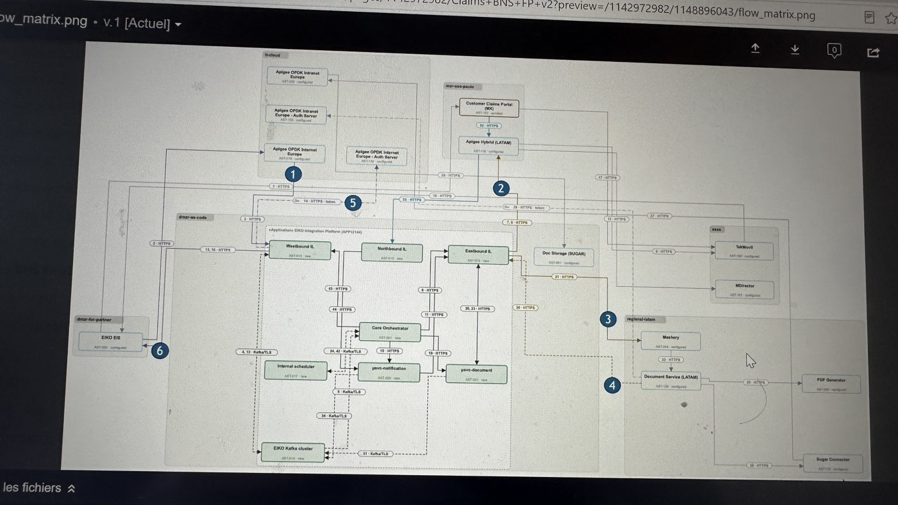
PART 2 / REFERENCE
Claims FPV2 — full-size reference diagram
14
Temporary screenshot supplied for handover; replace with the updated high-resolution flow_matrix.png when available.
EIKO / TECHNICAL HANDOVER

Slide 15
PART 2 / OPERATIONAL FOLLOW-UP
Using the Claims FPV2 reference material
15
Architecture / flow diagram
Operational flow matrix
Use the stand-alone diagram slide for the technical overview.
Replace the interim image with a higher-resolution export.
The drawing describes flows; it does not confirm that they are open.
Use the shared status matrix as the source of truth.
Track each flow: open / in progress / pending.
Keep owners, tickets, blockers, and updates synchronized.
Claims FPV2 flow status matrix
INSERT LINK TO THE OPERATIONAL STATUS MATRIX HERE
Final handover: keep the architecture picture and the status matrix together, but treat them as two distinct sources.
EIKO / TECHNICAL HANDOVER

