Slide 1

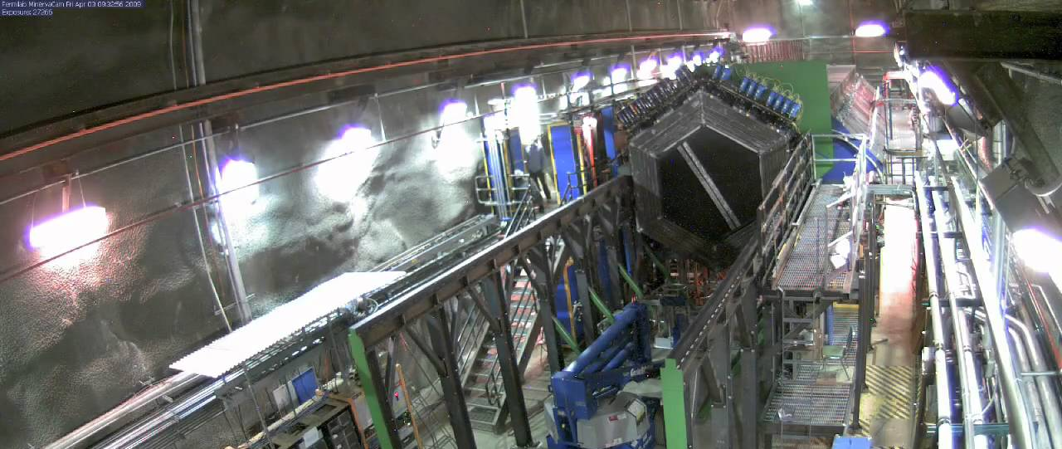
Saving muon prong clusters to facilitate future fuzz study
Akeem Hart

Slide 2
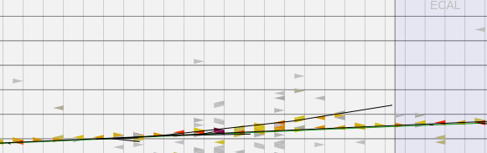
MUON FUZZ INTRODUCTION
Muon fuzz refers to bremsstrahlung photons, scattered electrons produced by a transiting muon
Fuzz electron
Muon track
Muon fuzz hits needs to be identified and it's energy associated with the muon so it isn't erroneously counted towards the hadronic energy

Slide 3
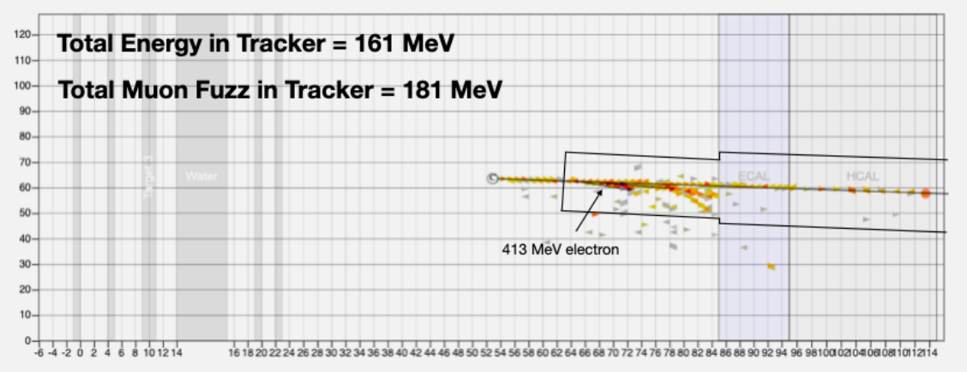
HOW FUZZ IS HANDLED
All hits in a cylindrical region are attributed to the muon and fuzz
R_tracker = 80cm, R_cal = 100cm
Currently, the cluster information in this fuzz cylinder excluding the muon prong is saved – (some) muon prong info saved separately
Mahbub, I. (2021) Energy Dependence in the Neutrino Scattering Data of MINERvA. thesis.

Slide 4
MOTIVATIONS – FUTURE MASTERS ANALYSIS
Currently, the fuzz within the cylinder is used for accurate energy reconstruction by making sure we don't overestimate hadronic energy in an event
Some muon fuzz will be effectively collinear with muon track and thus gets combined the muon prong,
Rik proposed an analysis for a Masters student that uses this muon fuzz contribution to the muon prong

Slide 5
MOTIVATIONS – FUTURE MASTERS ANALYSIS
We already know MC doesn't simulate fuzz perfectly, comparison between sim and truth for off-track fuzz has already been done [Lu Ren]. The student could do a similar thing for the fuzz along the track.
This would require muon prong information that isn't currently saved – Bare minimum would be some energy and positional information for each cluster in muon prong

Slide 6
CHANGES MADE
All changes contained within MasterAnaDev.cpp:reconstructEvent()
Each cluster in the reconstructed muon prong is looped over and info about each cluster is saved to a branch: muon_prong_cluster_energy
muon_prong_cluster_time
muon_prong_cluster_plane_id
muon_prong_cluster_z_pos

Slide 7
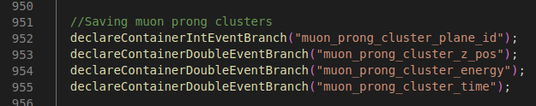
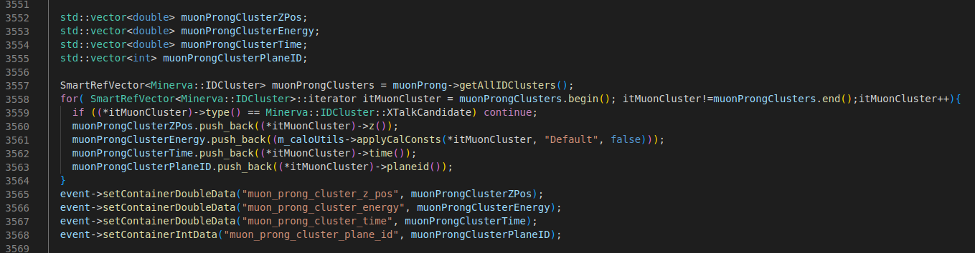
CHANGES MADE

Slide 8
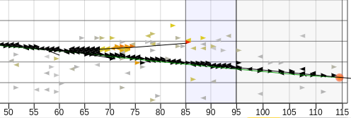
MUON PRONG CLUSTERS
Can sanity check what is being saved with in-browser modifications to arachne to highlight hits within the clusters I’m saving
SIM_minerva, Version:v21r1p1, Run: 111030, Subrun:30, Gate:93
Black hits: Hits within a cluster within reco muon prong

Slide 9
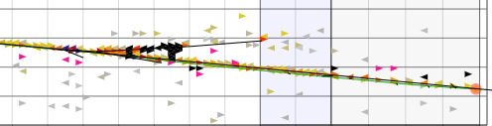
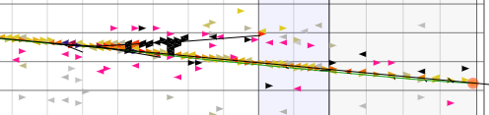
MUON FUZZ VALIDATION
Off track muon fuzz from existing data preservation code can be similarly inspected:
Top: r_{tracker} = r_{ecal}=r_{hcal} = 80mm
Bottom: r_{tracker} = r_{ecal}=r_{hcal} = 150mm
Both: d_{vtx} = 300mm
SIM_minerva, Version:v21r1p1, Run: 111030, Subrun:30, Gate:93
Black hits: Fuzz hits as determined by cylinder.
Pink: Hits within the fuzz cylinder that we eliminated as PMT cross talk

Slide 10
NEXT STEPS
Run this all by Rik
Code review/equivalent?
Push changes??

