Slide 1
Superstore business report
Week 4 task prepared by akeji joy
Tool used: Microsoft power bi

Slide 2
Dataset overview
Retail sales dataset (SUPERSTORES SALES DATASET)
It contains sales transaction from 2014 – 2017
It includes information on sales, profit, orders, categories, regions, segments etc.
Number of rows : 9994
Number of column: 19
Objectives: To analyze sales performance, regional performance and profit to support better business decision making.

Slide 3
Data cleaning and preparation
No duplicates were found in the dataset
Row ID was verified to ensure there were no duplicate records.
The country column was remove because all records contained United States which provided no analytical value.
The Postal code column was removed as it was not required for the analysis
Checked for missing value using column quality in power query
Data type was checked for data and numeric field.

Slide 4
Business question
Which region generates the most profit?
Which region generates the most sales?
Which products are underperforming?
which products are the most profitable?
How has sales changed overtime?
Which sub-categories contribute most to profit?

Slide 5
Kpis defined
Total Sales: Overall Revenue generated ($2.30M)
Total Orders: Numbers of orders processed (5K)
Total Profit: Overall Profit generated ($286.4K)
Profit Margin: Sales percentage of profit acquired (12%)
Average Discount: Average discount of sales (15.62%)
Total quantity Sold: Total quantity of good sold (38k)

Slide 6
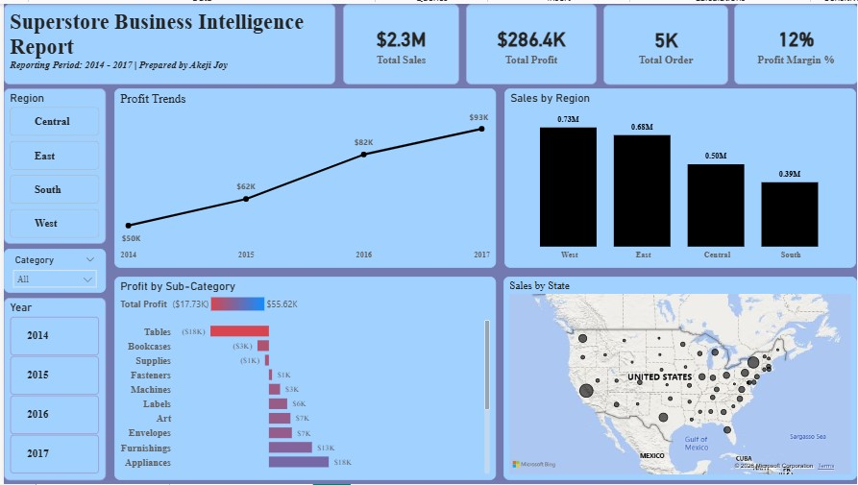
Dashboard
This dashboard provide an interactive overview of sales performance across regions, categories, products and time periods. Users can analyze key metrics, track trends and explore using interactive slicers such as Region, Category and Year.

Slide 7
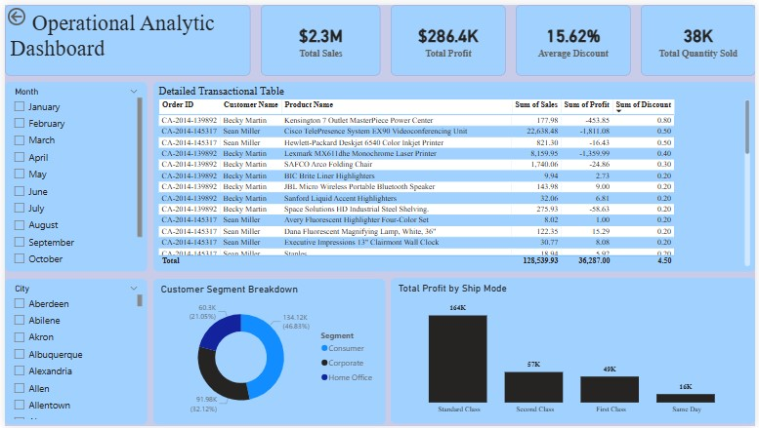
Dashboard

Slide 8
Key insights
The dashboard reveals the West Region as the undisputed leader in performance, contributing approximately 31.6% of overall sales with strong, sustainable margins.
Technology is the primary profit engine(Highest Margin). Furniture, despite driving significant transactional and logistics volume, represents less than 7% of total company profits.
Office Supplies generated the highest volume of total units sold (highest quantity), driven by frequent, smaller-value transactions.

Slide 9
recommendation
Set strict caps on promotional discounts, especially in states like Texas and Illinois, to prevent high-volume sales from resulting in an absolute financial loss.
Shift budget from heavy furniture storage and logistics to high-yield technology product categories like copiers, phones, and accessories.
Restructure pricing or consider discontinuing the tables product line in underperforming markets to protect profit margins.

Slide 10
conclusion
Shift to Margin-First: Transition from a revenue-driven mindset to strict profit-margin optimization.
Scale What Works: Duplicate the success of the West Region and heavily prioritize high-yield Technology lines.
Plug the Leaks: Implement immediate discount caps in Texas and Illinois, and restructure or drop the Tables line in low-performing markets.
The Bottom Line: Turn high sales volume into actual net profit.

