Slide 1

NearBy app (in class 4)

Slide 2
Algorithm
Implemented thresholding logic
Maintain the selected beacon in a variable
Check the list for target beacons
Change the selected beacon iff its RSSI < bad RSSI(60)
And new beacon in region has RSSI> good RSSI (75)
If list is empty show all regions
If there is no beacon with RSSI better than good RSSI show all regions

Slide 3
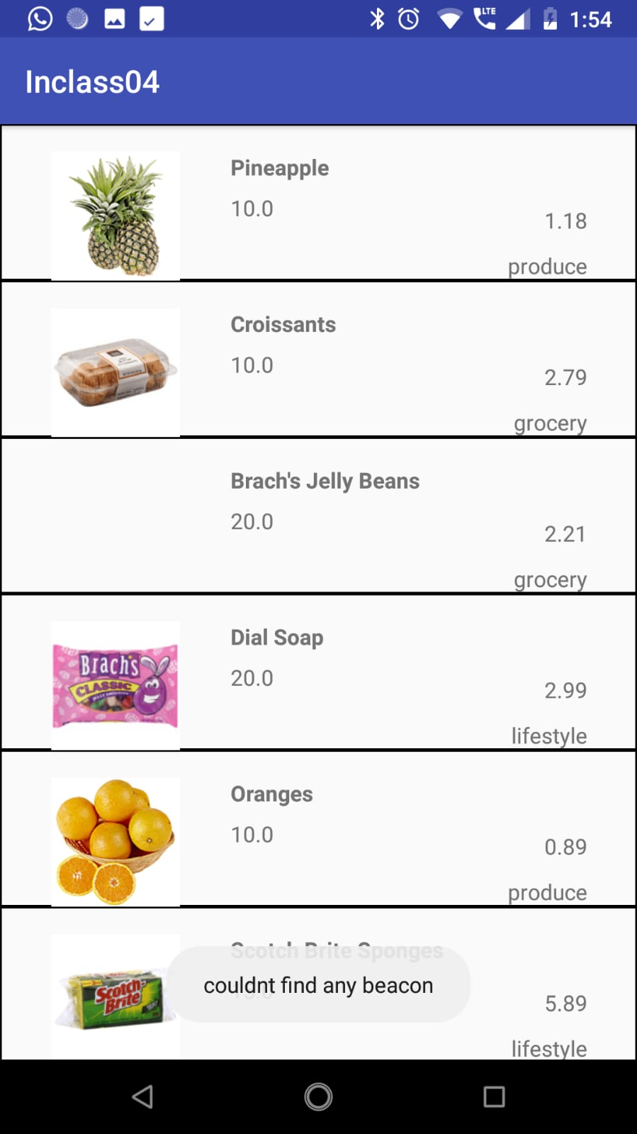
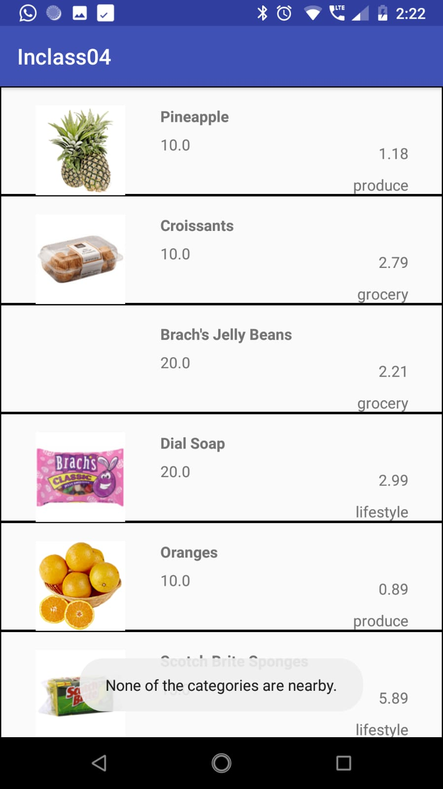
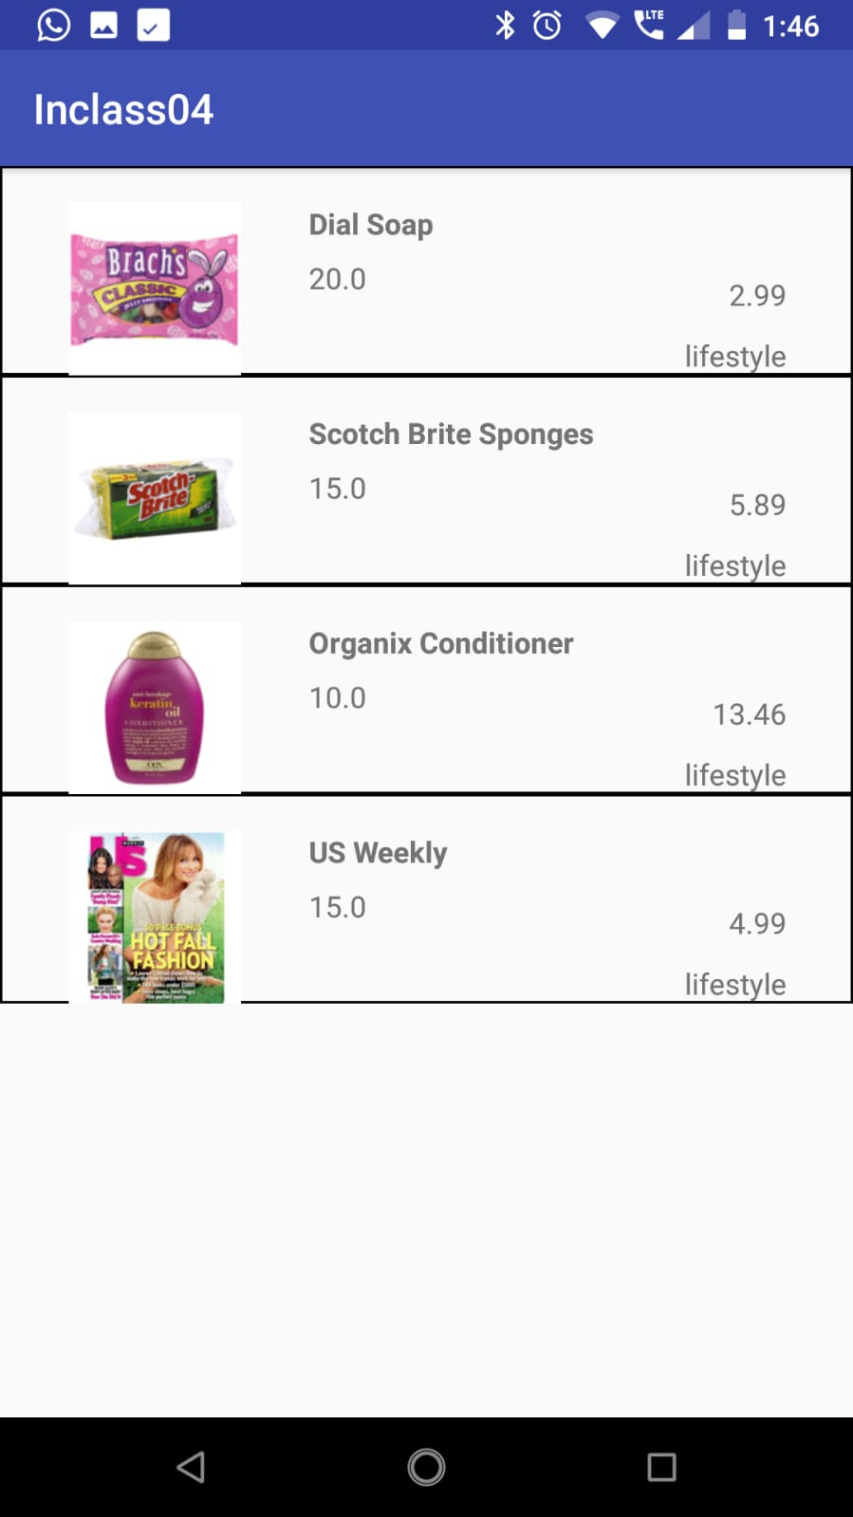
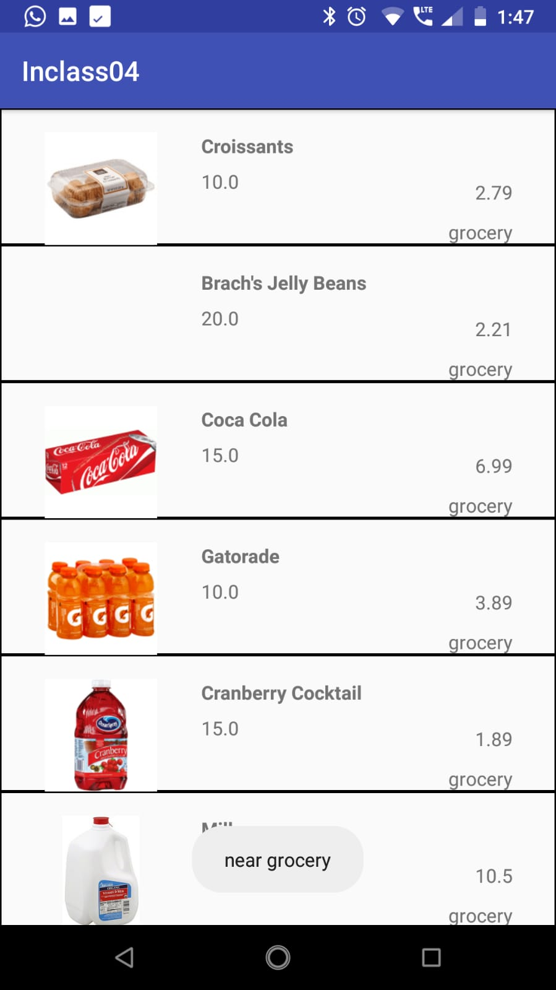
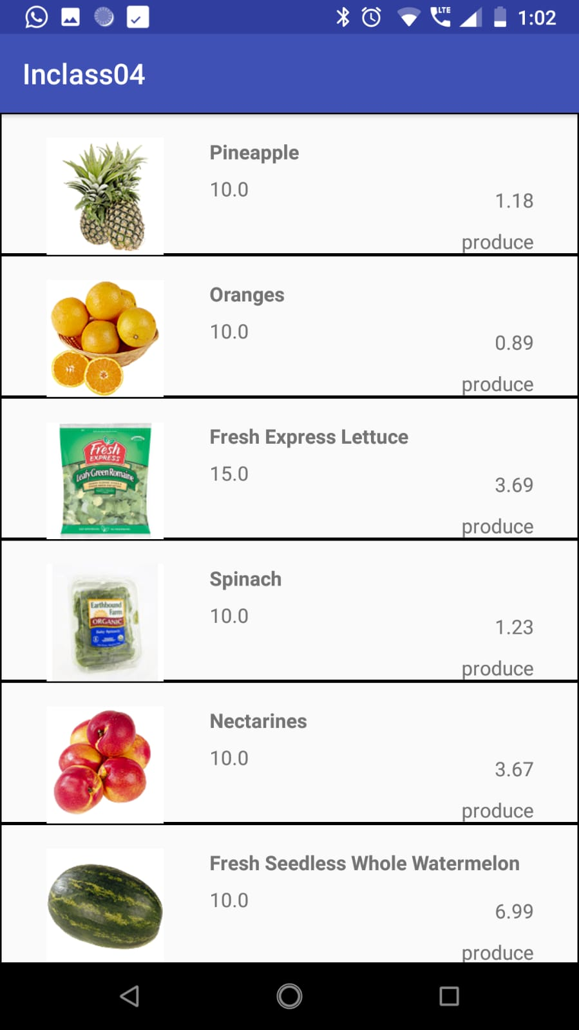

Slide 4
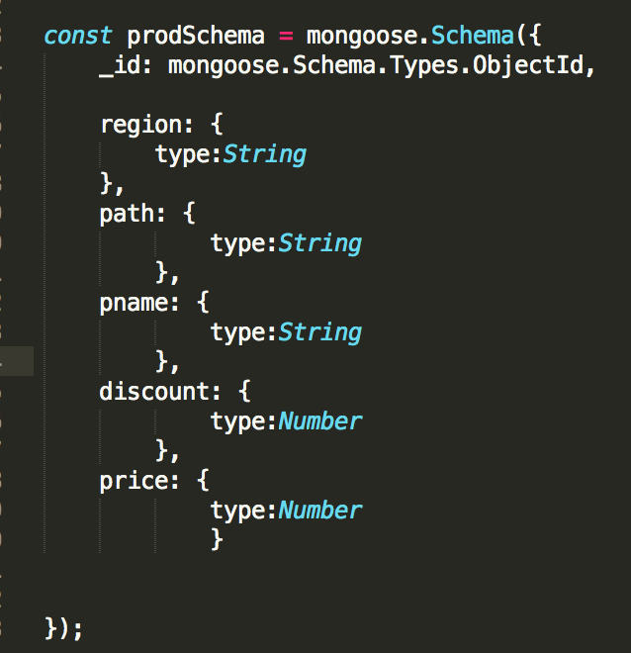
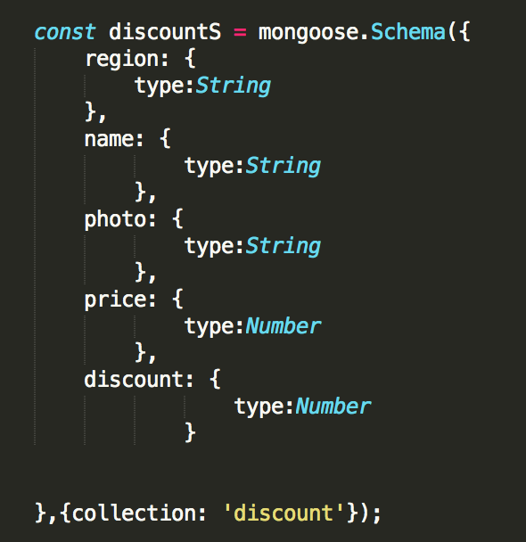
DB Schema

Slide 5
API Implementation
Images/static resources are served on server using express.static middleware function
API functions to fetch Products based on the region:
getProducts() – to get product List based on the region id present in the request body
getDiscounts()- to get product information
saveProduct() – to save the product to MongoDB

