Slide 1

SMS Gateway App (In class 5)

Slide 2
Description
Focuses on developing a mobile SMS gateway using an Android app which is deployed on phone to enable the sending and receiving of SMS.
Notifies Gateway server on receiving an SMS from Registered user.
Web app enables the registration of new user, addition of new devices with a registered user, show the list of messages sent and received to the registered user.
Web app also allows the admin to access the list of developers and the devices they have added
The registered user can also receive back an SMS from target number through Gateway

Slide 3
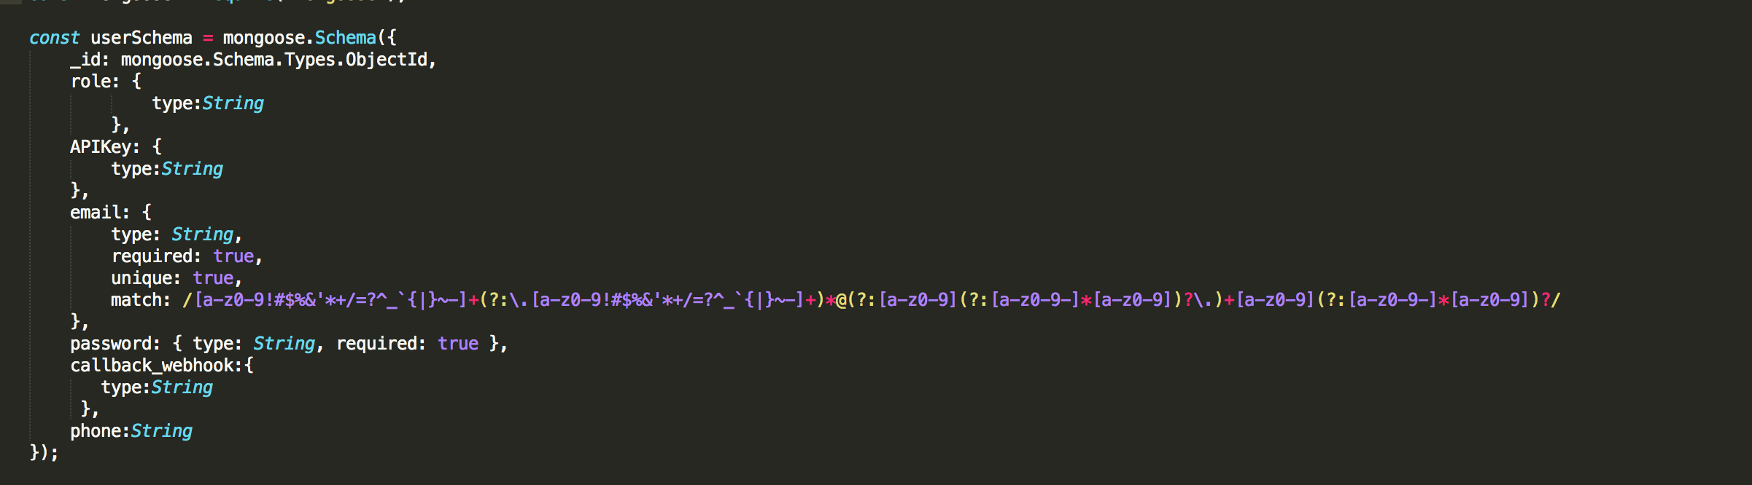
DB Schema

Slide 4
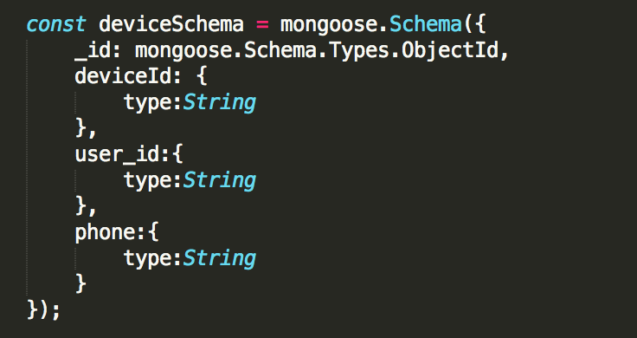
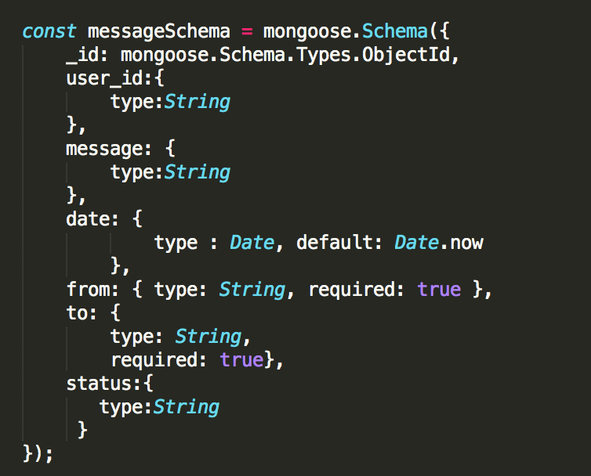

Slide 5
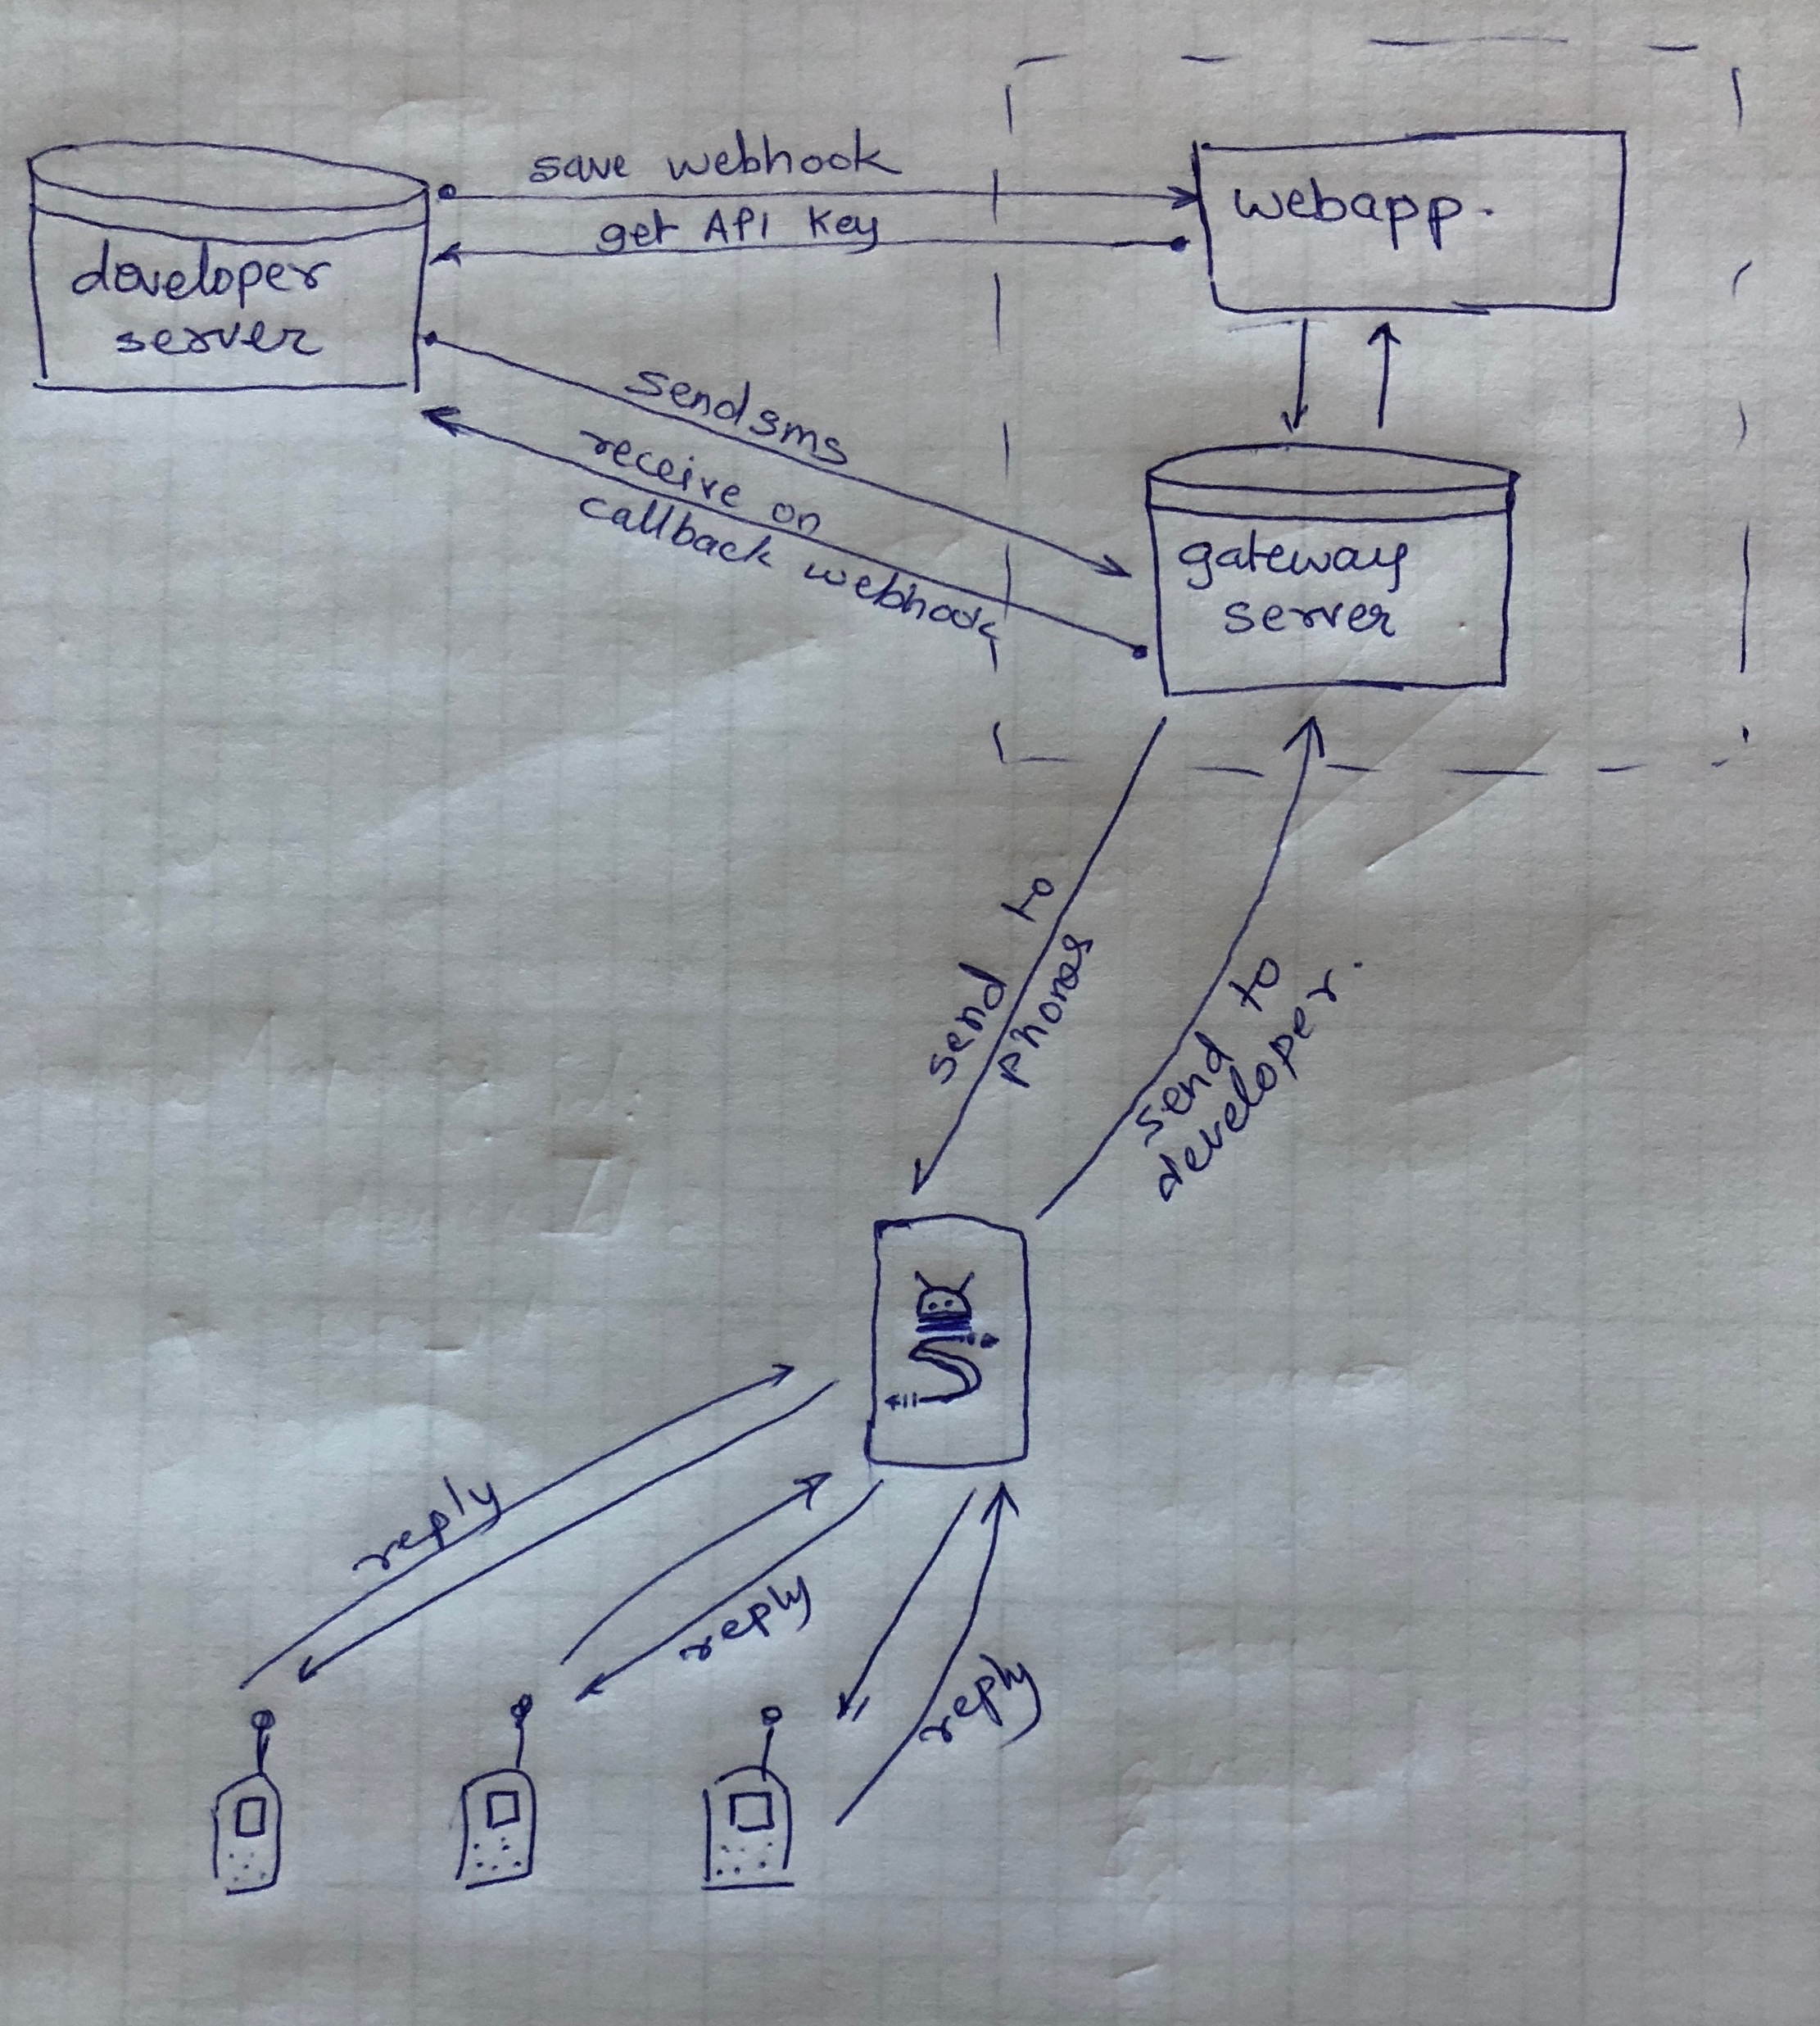
Design

Slide 6
API Implementation
User Sign Up and Login
Adding Device to the respective user on login with the mobile app mapping the device ,phone number and user id.
Send to Device: The SMS is sent to the client from the user’s callback webhook to the Gateway server which is mapped through the device ID.
Receive to Device: The SMS is received from the client through the device ID which is mapped to the user on Gateway server and is sent to the user through the callback webhook

Slide 7
Add Messages: Messages are added to the logs whenever the user receive or send SMS.
Show Messages: The users can view their message logs
Show Developer Details: user can view their details
Show Developers List: admin can view the developers registered
Show Devices: Show devices of the registered user through API Key

Slide 8
Tasks
gateway server app - login and signup
gateway server app – show Developers
gateway server app – show DeveloperDetail
gateway server api- send (from developer to gateway server)
gateway server api- SendMessage (from server to mobile)
gateway server api- RecievedMessage (from mobile to server)
gateway server api- toCallBackURL (from server to developer)
Generating API Token
Mobile App- Login and Get Push notification from server
Mobile app – Send and Read SMS
Mobile App – fetch device ID and phone number

Slide 9
Tasks to be completed
Running mobile app in background.

