Slide 1
TEAM4OARS Online Apartment Rental System PRESENTATION Spring 2016
Team Member
TL: Bertol Salgado
SQA: Ben Wightmen
DBA: Joseph Nguyen
DBA: Stephen Carver
TM: Joshua Wilburn
TM: Ali Elsaadi
TM: Garrett Bellomy

Slide 2





TEAM4OARS Online Apartment Rental System
Technologies

Slide 3


TEAM4OARS Online Apartment Rental System

Slide 4
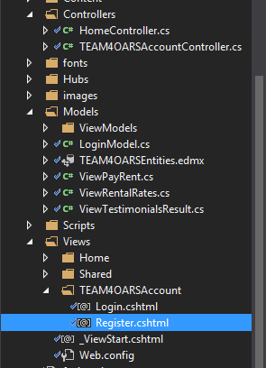
TEAM4OARS Online Apartment Rental System
MVC Folders

Slide 5
TEAM4OARS Online Apartment Rental System
UML USE CASES
# of Actors: 5
# of UCs: 19
# of Functional Requirements: 19
# of Non Functional Requirements: 6

Slide 6
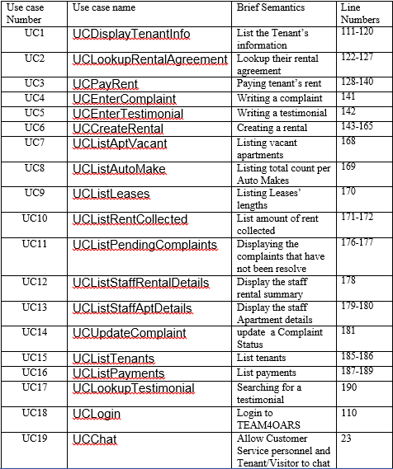
TEAM4OARS Online Apartment Rental System
UML USE CASES

Slide 7
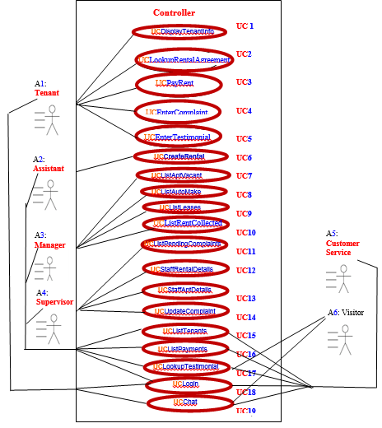
TEAM4OARS Online Apartment Rental System
UML USE CASE DIAGRAM

Slide 8
TEAM4OARS Online Apartment Rental System
Data Analysis
# of Es: 9
# of Rs: 7
# of Vs: 16
# of Ts: 0
# of Ds: 16 (# of Es + # of Rs)
# of Cs: 25 (# of Es + # of Vs + # of Ts)

Slide 9
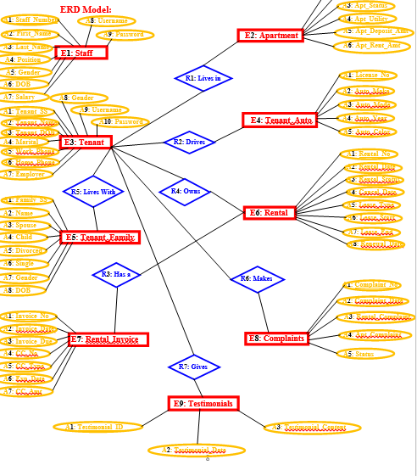
TEAM4OARS Online Apartment Rental System
Model

Slide 10
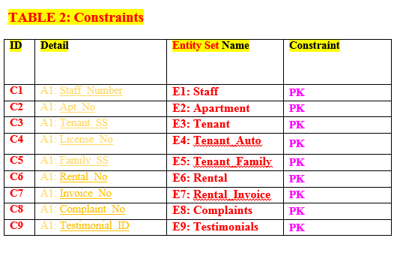
TEAM4OARS Online Apartment Rental System
Constraints

Slide 11
TEAM4OARS Online Apartment Rental System
Chat
SignalR 2
JavaScript for client side
Can be use to real time Notifications
Can send update to groups, client, or All

Slide 12
TEAM4OARS Online Apartment Rental System
Database Class Model
Entity Framework
Creates Model Classes from Database
Add Data Validation and Format on model class

Slide 13
TEAM4OARS Online Apartment Rental System
Demo
Team4oars.azurewebsites.net

