Slide 1
INGI2145: CLOUD COMPUTING (Fall 2014)
Web Programming
27 November 2014
Lecture slides adapted from Upenn NETS212 by A. Haeberlen, Z. Ives Reproduced with permission

Slide 2



Where we are
Browser
Internet
User
"Cloud" / data center
So far: The 'backend'
Large-scale distributed system processes lots of data
Economic model, architecture, programming (MapReduce)
Next: The 'frontend'
How to get the data to the users
How to build interactive web applications

Slide 3
Goals for the next two lectures
Architecture of the Web
Key concepts: Hyperlink, URI/URL, ...
Building blocks: HTML, HTTP, DNS, ...
Servers (esp., web servers)
Client/server model
State, and where to keep it
Architecture: Threads, thread pools, events
Web applications
Dynamic content; maintaining state
Java servlets, Node.js

Slide 4

The World Wide Web (WWW)
A service that runs on the Internet
Not identical to the Internet!
A collection of interconnected documents and other resources
Not a hierarchy - any document can reference any other!

Slide 5
Where did the web come from?
1989: Tim Berners-Lee is at CERN
CERN is a large organization with high turnover
Useful information (e.g., about projects) is constantly being lost because it cannot be found
Need to organize information - but how?
Hierarchical structure is not flexible enough
Writes "Information management: A proposal"
"The hope would be to allow a pool of information to develop which could grow and evolve with the organisation and the project it describes"
"CERN meets now some problems which the rest of the world will have to face soon"
http://www.w3.org/History/1989/proposal.html

Slide 6
Was the Web invented from scratch?
http://www.w3.org/History.html
1945: Vannevar Bush's article on the Memex
Could make+follow links between documents on microfiche
1960: Doug Engelbart's oNLine System (NLS)
Hypertext browsing+editing, email, etc.
Invents the mouse for this purpose
1989: Tim Berners-Lee writes "Information Management: A proposal" (at CERN)
Recirculated in 1990. In September, Berners-Lee's boss OKs purchase of a NeXT cube for the project
Berners-Lee writes the first web server and browser; demonstrable by Christmas 1990

Slide 7
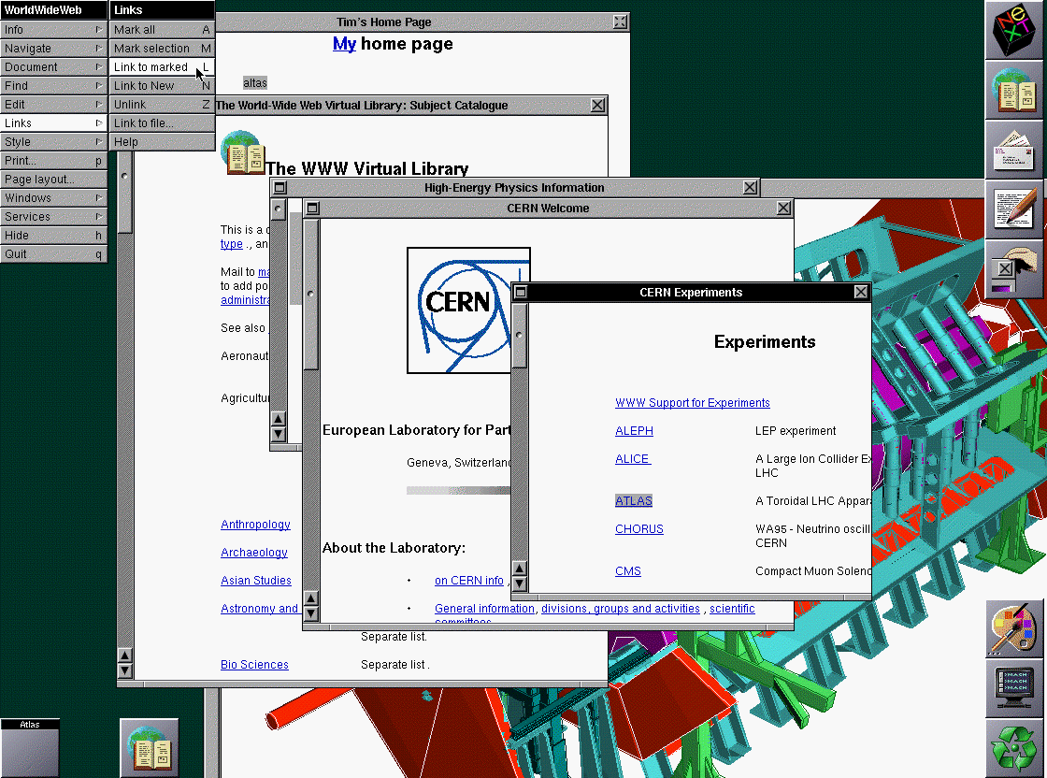
The first browser
http://www.w3.org/History/1994/WWW/Journals/CACM/screensnap2_24c.gif

Slide 8
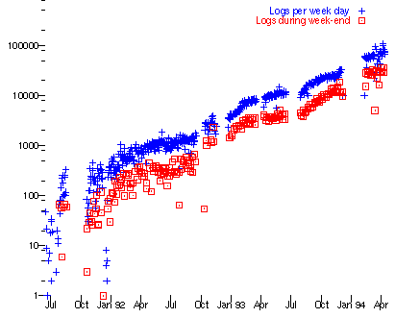
A brief history of the WWW
Situation as of 1992:
Competing system (Gopher) is already in place
No graphical browsers for platforms other than NeXT
1993: Turning point
Feb: First alpha release of Marc Andreesen's "Mosaic for X"
Andreesen would later be a co-founder of Netscape
Feb: U. Minnesota announces it will charge license fees for its Gopher server
Apr: CERN says WWW will be freely usable by anyone
http://www.w3.org/History/1994-plot/slide.gif
Load on the first web server (info.cern.ch)

Slide 9
Making the Web: Ingredients
What do we need to build the Web?

Slide 10
What do we need to make the Web work?
Formats for writing the documents
A program for displaying documents
Unique names for the documents
A way to find documents
A system for delivering documents
Architecture
Efficient implementation
A protocol for transferring documents
A way to make content dynamic
Programming model
Keeping state
HTML
Browser
URIs, URLs
DNS
Client/server model
Threads; event-driven prog.
HTTP
Scripting; servlets
Cookies

Slide 11
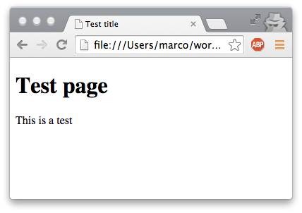
HTML: Presentation and representation
<!doctype html> <html> <head> <title>Test title</title> </head> <body> <h1>Test page</h1> <p>This is a test</p> </body> </html>
Representation (bits and bytes in the document)
Presentation (document displayed by the browser)
Original idea: Separate the two
Document representation would only describe the structure and the semantic content
Browser would take care of the visual layout
Pros and cons of this approach?
Do you think people are following it today?

Slide 12
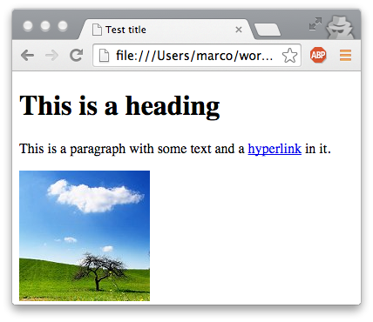
A simple web page
Begin tag
Content
<!doctype html> <html> <head> <title>Test title</title> </head> <body> <h1>This is a heading</h1> <p>This is a paragraph with some text and a <a href="foo.html">hyperlink</a> in it.</p> <img src="cloud.jpg" alt="Cloud"> </body> </html>
End tag
Attributes
General structure: Elements, tags, content
Most elements have a begin tag and an end tag (denoted by /)
Tags may have attributes, e.g., <img> has URL of the image
Hierarchy of elements

Slide 13
Some basic HTML elements
Basic template for a HTML document:
Header: Contains the title; may contain metadata, e.g., author
Body: Contains the actual content
Typical HTML elements:
Headings (several levels): <h1>...</h1>, <h2>...</h2>, ...
Paragraphs: <p>This is a paragraph</p>
Forced linebreak: This is a line.<br>This is the next line.
Unordered lists: <ul><li>Item 1<li>Item 2<li>Item 3</ul>
Links: This is a <a href="url">link</a>
Images: <img src="url" alt="Description">
<!doctype html>
<html>
<head>
<title>My title</title>
</head>
<body>
... content ...
</body>
</html>

Slide 14
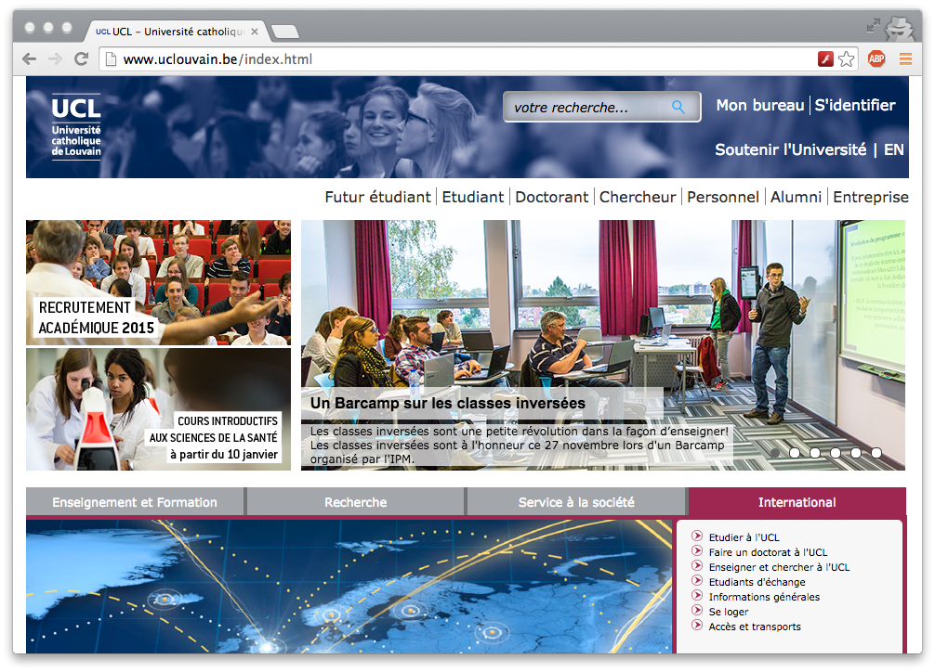
Is basic HTML rendering enough?
vs.

Slide 15
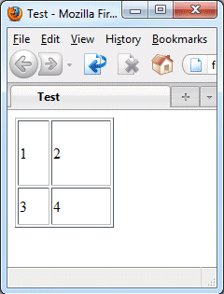
Taking control over the presentation
You can explicitly tell the browser how to render certain elements:
Font: <font size="17" color="red" face="Helvetica">
Style: <b>bold</b>, <i>italics</i>, <tt>teletype<tt>, ...
You can define tables with a specific layout
<table border="1">
<tr height="70">
<td width="30">1</td>
<td width="60">2</td>
</tr>
<tr height="40">
<td width="30">3</td>
<td width="60">4</td>
</tr>
</table>

Slide 16
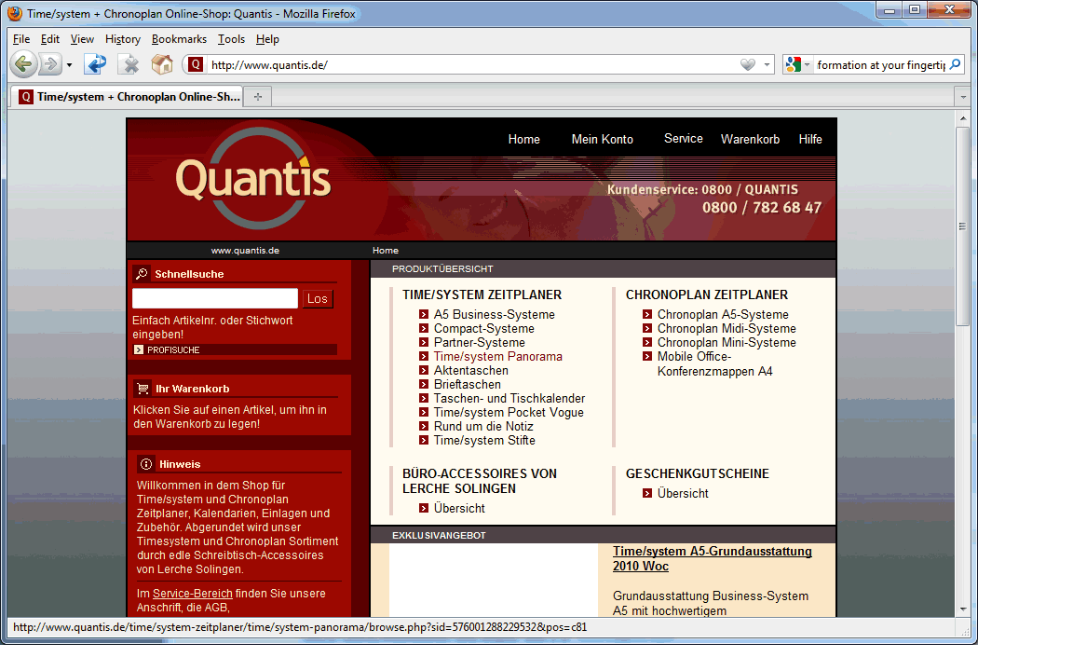
The world before CSS
Implemented by lots of tables
Web designers used tables and formatting to create very complex layouts
Result: Documents were huge (lots of redundancy) and basically unreadable

Slide 17
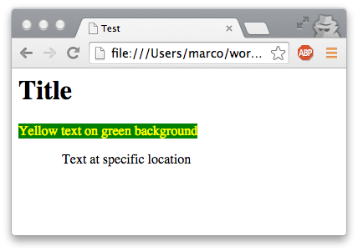
Today: Cascading Style Sheets
<html> <head><title>Test</title></head> <link rel="stylesheet" href="test.css"> <body> <h1>Title</h1> <span class="ytext">Yellow text on green background</span> <span class="loc">Text at specific location</span> </body> </html>
Reference
.ytext { color:yellow; background:green }
.loc { position:absolute; top:100px; left:60px }
Idea: Separate content and formatting again
Formatting instructions are kept in a separate file that is linked from the document
Document is annotated with references to the formatting instructions, via class="xxx" attribute or special elements (<span>...</span>, <div>...</div>)

Slide 18
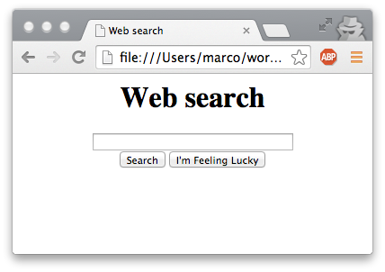
Forms
<html> <head><title>Web search</title></head> <body> <center><h1>Web search</h1> <form action="search.html" method="post"> <input type="text" size="40" name="term"><br> <input type="submit" value="Search"> <input type="button" value="I'm Feeling Lucky"> </form></center> </body> </html>
What if we want the user to input some data?
<form> element creates and input form in the document
Several input types available: Single line of text, multiline text, radio buttons, checkboxes, buttons, dropdown boxes...
Data is sent over the network once the form is submitted
One way to create interactive 'web applications'; more about this later

Slide 19
Recap: Hypertext Markup Language
Separation of content and visual layout
Elements, tags, attributes
Hierarchical structure; elements contain other elements
Some common elements
Standard elements: <html>, <head>, <title>, <body>
Structure: <h1>, <br>, <p>, <a>, <ul>, <img>
Tables: <table>, <tr>, <td>
Formatting: <font>, <b>, <i>, <pre>
Forms: <form>, <input>
Cascading Style Sheets
Usually in a separate file + referenced from the main file

Slide 20
What do we need to make the Web work?
Formats for writing the documents
A program for displaying documents
Unique names for the documents
A way to find documents
A system for delivering documents
Architecture
Efficient implementation
A protocol for transferring documents
A way to make content dynamic
Programming model
Keeping state
HTML
Browser
NEXT

Slide 21




The peer-to-peer model
Alice
How the Web could work (but doesn't):
Each machine locally stores some documents
If a machine needs a new document, it asks some other machines until it finds one that already has the document
No machine is special - they are all 'peers'
Pros and cons of this approach?

Slide 22

The client-server model
Request
Response
Servers
Clients
How the Web actually works today:
Some machines (servers) offer documents
Other machines (clients) use documents
Clients can request documents from servers
Model is used for many other services, not just for the web
Pros and cons of this approach?

Slide 23

Servers
Please send email #447
Server: A machine that offers services to other machines
Examples: Mail server, file server, chat server, print server, terminal server, web server, name server, game server, ...
Protocol often uses request/response pattern

Slide 24

Port numbers and well-known ports
Please send index.html
80
443
Please send email #447
A single machine can host multiple services
Typically distinguished by TCP port number
Many services have well-known port numbers, e.g., web servers use port 80, SSH servers use port 22, ...

Slide 25
State, and where to keep it
What if clients make multiple related requests?
Example: Open file, read data, read more data, close file
Need to remember some state between requests, e.g., which file was opened, or how much data has already been read
Who should keep this state: Client, server, or both?
If it is kept on the client, how does the server access it?
If it is on the server, how does the client reference it?
If there is no state, or the client keeps all of it, we can build a stateless server
Server can forget everything about completed requests
Pros and cons of such a design?

Slide 26
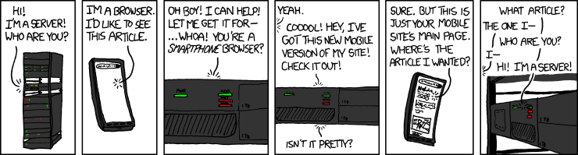
Server attention span
http://xkcd.com/869/

Slide 27
Recap: Client-server model
Many possible system architectures
Examples: Client/server and peer-to-peer
Each has its own set of tradeoffs
Web uses client/server, but it could have been otherwise
Client-server model
Functionality implemented by special machines
Request/response pattern
State, and where to keep it
Could be on the client, on the server, or on both; pros/cons
Stateless servers

Slide 28
What do we need to make the Web work?
Formats for writing the documents
A program for displaying documents
Unique names for the documents
A way to find documents
A system for delivering documents
Architecture
Efficient implementation
A protocol for transferring documents
A way to make content dynamic
Programming model
Keeping state
HTML
Browser
URIs, URLs
DNS
NEXT
Client/server model

Slide 29
URIs, URNs, and URLs
Scheme name
Scheme-specific part
http://sites.google.com/site/uclingi2145/schedule
Identifies a server (for HTTP)
Path on the server (for HTTP)
Uniform Resource Identifier (URI)
Comes in two forms: URN and URL
Uniform Resource Name (URN)
Specifies what to find, independent of its location
Example: urn:isbn:1449311520 (for the course textbook)
Uniform Resource Locator (URL)
Specifies where to find something
<scheme>://[user[:password]@]<server>[:port]/[path][/resource][?param1=value1&param2=value2&...]

Slide 30
DNS namespace
Top-level domains
arpa
com
org
gov
mil
net
be
biz
info
name
...
de
fr
sg
uk
...
ebay
google
facebook
ulg
uclouvain
...
docs
groups
...
www
icampus
student
Hierarchical namespace
First level managed by the Internet Corporation for Assigned Names and Numbers (ICANN)
Authority over other levels is delegated
Second level generally managed by registrars
Further levels managed by organizations or individuals
Given a DNS name, how can we find the corresponding host?
mail

Slide 31
Name servers
Root servers
Root zone
arpa
com
org
gov
mil
net
be
biz
info
name
...
de
fr
sg
uk
ebay
google
facebook
ulg
uclouvain
...
Authoritative server for uclouvain.be
docs
groups
...
www
icampus
student
mail
Namespace is divided into zones
TLDs belong to the root zone
Each zone has an authoritative name server
Authoritative server knows, for each name in its zone, which machine corresponds to a given name, or which other name server is responsible

Slide 32


Name resolution in DNS
A
Root server
?!
www.google.com?
com?
Ask B!
www.google.com?
google.com?
B
Server for 'com'
Ask C!
D
www.google.com?
Alice
Alice's local DNS server
D
C
Server for 'google.com'
e.g., HTTP request
D
Name lookup is recursive
Domain name is resolved step by step, starting with the TLD
Name servers cache results of lookups
Why?

Slide 33
Recap: Naming
Web documents are referenced with URLs
URL: Scheme name, domain name, path to document
DNS maps domain names to machines
Hierarchical namespace; root managed by ICANN
Distributed system of domain name servers
Recursive name lookup
Caching

Slide 34
What do we need to make the Web work?
Formats for writing the documents
A program for displaying documents
Unique names for the documents
A way to find documents
A system for delivering documents
Architecture
Efficient implementation
A protocol for transferring documents
A way to make content dynamic
Programming model
Keeping state
HTML
Browser
URIs, URLs
DNS
Client/server model
HTTP
NEXT

Slide 35
The HTTP protocol
How to communicate with a web server?
Use the HyperText Transfer Protocol (HTTP)
A very simple protocol
First specified in 1990
Runs on top of TCP/IP
Default port 80 (unsecure), or 443 (secure, with SSL)
Originally stateless (HTTP/1.0), but current version (HTTP/1.1) added support for persistent connections
Why?
Development continues (e.g., SPDY)
The current proposal for HTTP 2.0 is based on this!

Slide 36
Example: A simple HTTP request
URI
Method
GET /marco.canini/ingi2145/test.html HTTP/1.1 Host: perso.uclouvain.be
Accept: */* User-Agent: Mozilla/5.0 (...) If-Modified-Since: Wed, 26 Nov 2014 14:12:37 GMT
Headers
Status
HTTP/1.1 200 OK Date: Wed, 26 Nov 2014 14:18:19 GMT Server: Apache/2.2.3 (CentOS) Last-Modified: Wed, 26 Nov 2014 14:15:46 GMT Content-Length: 103 Content-Type: text/html
<html><head><title>Test document</title></head> <body><h3>Test</h3><p>This is a test</p></body> </html>
Headers
Content (optional)

Slide 37
Common HTTP methods
GET
Retrieve whatever information is identified by the URI
HEAD
Like GET, but retrieves only metadata, not the actual object
PUT
Store information under the specified URI
DELETE
Delete the information specified by the URI
POST
Adds new information to whatever is identified by the URI
Intended, e.g., for newsgroup posts; today, used mostly to implement dynamic content via forms

Slide 38
Forms and GET/POST
<html> <head><title>Web search</title></head> <body> <center><h1>Web search</h1> <form action="search.html" method=" "> <input type="text" size="40" name="term"><br> <input type="submit" value="Search"> <input type="button" value="I'm Feeling Lucky"> </form></center> </body> </html>
foo
What happens when we hit 'Search'?
With method="get":
GET /search.html?term=foo HTTP/1.1 Accept: text/html
With method="post":
POST /search.html HTTP/1.1 Accept: text/html term=foo

Slide 39
GET or POST?
GET should be used for idempotent requests
Requests that are safe to re-execute without side-effects, such as making a purchase or committing an edit
Browser warns user when resending a POST, but not a GET
GET has length restrictions
Data is put into the URL, whose length is restricted
GET should only be used with text
POST works with arbitrary data (including binaries)

Slide 40
Headers
GET /index.html HTTP/1.1
Host: www.uclouvain.be
Connection: keep-alive
Accept: text/html,application/xhtml+xml,application/xml;q=0.9, image/webp,*/*;q=0.8
User-Agent: Mozilla/5.0 (Macintosh; Intel Mac OS X 10_9_5) AppleWebKit/537.36 (KHTML, like Gecko) Chrome/38.0.2125.122 Safari/537.36
Referer: https://www.google.com/
Accept-Encoding: gzip,deflate,sdch
Accept-Language: en-US,en;q=0.8
HTTP/1.1 200 OK
Date: Wed, 26 Nov 2014 14:28:13 GMT
Server: Apache/2.2.3 (CentOS) Set-Cookie: JSESSIONID=62CC31...; Path=/cps
Set-Cookie: CPSSESSIONID_ucl=SID-E...; Path=/
Expires: Wed, 26 Nov 2014 14:28:13 GMT
Connection: Keep-Alive
Content-Type: text/html;charset=UTF-8
<html>...
Both the request and the response can contain headers with additional information

Slide 41
Status codes
Server sends back a status code to report how the request was processed
Common status codes:
200 OK
301 Moved Permanently
304 Not Modified
401 Unauthorized
403 Forbidden
404 Not Found
500 Internal Server Error

Slide 42
Recap: HTTP
HTTP - a simple, stateless protocol
Server does not (need to) remember past requests
Request and response contain headers
Used to exchange additional information, e.g., to request content in specific formats, or to exchange metadata
Common HTTP methods:
GET - Retrieve a specific document
HEAD - Get metadata for a specific document
POST - 'Add' information to a document (used for forms)

Slide 43
What do we need to make the Web work?
Formats for writing the documents
A program for displaying documents
Unique names for the documents
A way to find documents
A system for delivering documents
Architecture
Efficient implementation
A protocol for transferring documents
A way to make content dynamic
Programming model
Keeping state
HTML
Browser
URIs, URLs
DNS
Client/server model
NEXT
Threads; event-driven prog.
HTTP

Slide 44
A simple web server
socket = listen(port 80);
while (true) { connection = accept(socket); request = connection.read(); if (request == "GET <document>") { data = filesystem.read(document); connection.write("HTTP/1.1 200 OK"); connection.write(data); } else { connection.write("HTTP/1.1 400 Bad request"); } close(connection); }
Is this a good (web) server? If not, why not?

Slide 45
The need for concurrency
What if the server receives lots of requests?
Idea #1: Process them serially
Problem: Slow client can block everyone else
Idea #2: One server for each request
Problem: Wasteful
Server needs to handle requests concurrently
Available resources are multiplexed between requests
How do we do this?
Threads, thread pools
Events

Slide 46
Refresher: Threads and processes
Physical machine has some fixed number of processor cores - say, c
What if we need more than c threads of execution?
Idea: Time-share cores
A single core works on one thread for a while, then context-switch to another one
Switching can be done cooperatively: Each thread yields the core to another thread when it has nothing to do
Switching can also be preemptive: Each thread gets to run for a fixed amount of time (quantum, typ. 10-100ms)
Pros and cons of preemption?
Difference between a thread and a process?

Slide 47
A simple thread-based web server
worker(connection) { request = connection.read(); if (request == "GET <document>") { data = filesystem.read(document); connection.write("HTTP/1.1 200 OK"); connection.write(data); } else { connection.write("HTTP/1.1 400 Bad req"); } close(connection); } main() {
socket = listen(port 80); while (true) { connection = accept(socket); (new Thread).run(worker, connection); } }
Worker thread (one per connection)
Main loop (accepts new connections and launches new threads)

Slide 48
Thread-based servers
Relevant Java constructs:
Worker can be a subclass of Thread + implement run()
Worker w = new Worker(); w.start();
Alternative: Worker implements Runnable
Thread t = new Thread(w); t.start();
What if the threads share some resources?
Potential race conditions + consistency issues
Can use synchronization and locking
Need to be careful about deadlock, livelock, starvation

Slide 49
Thread pools
Problem: Threads operations are expensive
Creating and destroying a thread takes time
Context switching between threads takes time
Making too many threads can exhaust available resources
Idea: Keep a thread pool with a fixed number of worker threads
When a worker is done handling a request, it is assigned another one
When there are more concurrenct requests than workers, requests must wait in a queue until a worker is available
When there are few requests, some workers may be idle
How many threads should we put into the pool?

Slide 50
Event-driven programming
What benefits did the threads really give us?
If we have one core and run 1,000 threads on it, does the work really get done faster than with one thread?
The server's work is driven by events, e.g.:
Incoming connection: Need to set up data structures
Request arrives: Need to parse + start reading document
Document read: Need to send back to the client
Entire document sent: Close connection, clean up structures
Why not base server architecture on events?
All we need is a single thread!

Slide 51
An event-based web server
handleNewConnection(e) { startReading(e.connection); } handleRequestRead(e) { if (e.request == "GET <document>") { issueFilesystemRead(document); } else {
issueWrite(e.connection, "HTTP/1.1 400 Bad req"); } } /* other handlers go here */
main() { EventQueue q; while (true) { e = q.getNextEvent(); case e of { NewConnection: handleNewConnection(e); RequestArrived: handleRequestRead(e); FileReadCompleted: handleFileRead(e); AllDataWritten: handleDataWritten(e); } } }
Event handlers (must not block)
Who puts events into the queue?
Dispatch loop (distributes events to handlers)

Slide 52
Continuations
What if, in response to some event, we must perform a blocking system call?
Example: Request arrives; now we need to read the file from disk (blocking read() call) and send it back to the client
What would happen if we called read() in the event handler?
Solution: Write two event handlers:
Handler A parses the request and issues a non-blocking read (using a special system call)
Handler B is called when the read completes and sends data to client
What if handler A has some state that handler B needs to know?
Must be saved explicitly in a continuation

Slide 53
Event-driven programming in Node
var getStudents = function(coursename, callback) {
simpleDB.getAttributes({DomainName:'students', ItemName: coursename},
function (err, data) {
if (err) {
console.log("Error occurred!");
callback(null);
} else if (data.Attributes == undefined) {
console.log("No results!");
callback(null);
} else {
console.log("Got data for course: " + coursename);
console.log("The data is: "+data);
callback(data);
}
}
);
};
Must always call callback, even if the operation has failed!
Inner callback has access to the state of the outer function!
Node programs are event-driven
If a function needs to block (e.g., network I/O), it must take a callback function and call that function once the blocking operation completes
Where is the continuation?

Slide 54
Pros and cons
Thread-based server or event-driven one?
Event-driven servers typically have better performance
Event-driven servers do not need as much synchronization
Just a single thread - no concurrency!!! (on a single core)
However, may need some flags if events can share resources
Thread-based servers are typically easier to write+maintain

Slide 55
Recap: Web servers
Need to process requests concurrently
Otherwise, extremely difficult to achieve high throughput
Common server architectures:
Single-threaded
Multithreaded
Thread pools
Event-driven
Event-driven architecture:
Harder to program, but very efficient
Most of this also applies to other kinds of servers, not just to web servers

Slide 56
What do we need to make the Web work?
Formats for writing the documents
A program for displaying documents
Unique names for the documents
A way to find documents
A system for delivering documents
Architecture
Efficient implementation
A protocol for transferring documents
A way to make content dynamic
Programming model
Keeping state
HTML
Browser
URIs, URLs
DNS
Client/server model
Threads; event-driven prog.
HTTP
NEXT

Slide 57

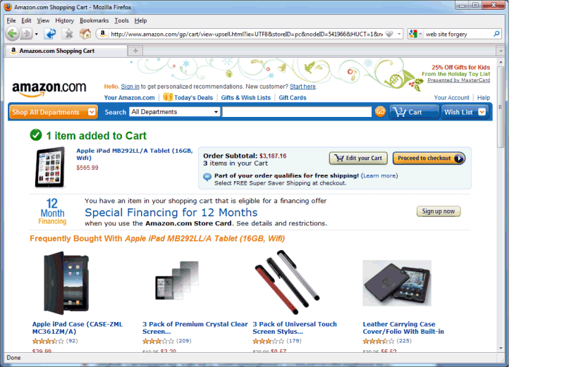
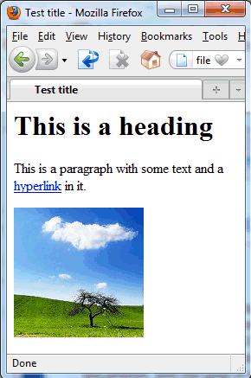

Web applications
So far: Writing and delivering static content
But many web pages today are dynamic
State (shopping carts), computation (recommendations), rich I/O (videoconferencing), interactivity, ...

Slide 58
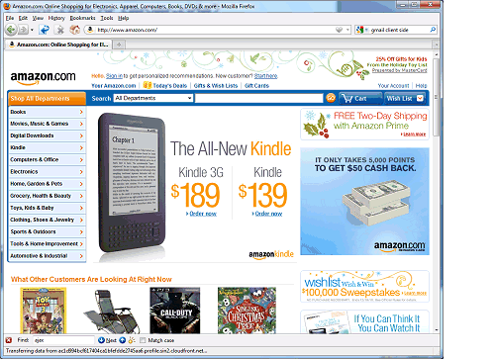
Client-side and server-side
Internet
Web server
Client (web browser)
User
Where does the web application run?
Can run on the server, on the client, or have parts on both
Modern browsers are highly programmable and can run complex applications (example: client-side part of Google's Gmail)
Some believe the browser will be 'the new operating system'
Client-side technologies: JavaScript, Java applets, Flash, ...
Server-side technologies: CGI, PHP, Java servlets, Node.js, …

Slide 59
Dynamic content
Web application technologies
Background: CGI
Java Servlets
Node.js / Express / EJS
Express framework
SimpleDB bindings
Example application: Dictionary
Session management and cookies
NEXT

Slide 60
Dynamic content
How can we make content dynamic?
Web server needs to return different web pages, depending on how the user interacts with the web application
Idea #1: Build web app into the web server
Why is this not a good idea?
Idea #2: Loadable modules
Is this a good idea?
Pros and cons?

Slide 61
CGI
x=2 y=3
Perl script
GET /add.cgi?x=2&y=3
<html> ... 5 ... </html>
200 OK ... <html>...5...</html>
Web server
Client (browser)
Common Gateway Interface (CGI)
Idea: When dynamic content is requested, the web server runs an external program that produces the web page
Program is often written in a scripting language ('CGI script')
Perl is among the most popular choices

Slide 62
CGI
A little more detail:
Server receives HTTP request
Example: GET /cgi-bin/shoppingCart.pl?user=ahae&product=iPad
Server decides, based on URL, which program to run
Server prepares information for the program
Metadata goes into environment variables, e.g., QUERY_STRING, REMOTE_HOST, REMOTE_USER, SCRIPT_NAME, ...
User-submitted data (e.g., in a PUT or POST) goes into stdin
Server launches the program as a separate process
Program produces the web page and writes it to stdout
Server reads the web page and returns it to the client

Slide 63
Drawbacks of CGI
Each invocation creates a new process
Time-consuming: Process creation can take much longer than the actual work
Inefficient: Many copies of the same code in memory
Cumbersome: Must store session state in the file system
CGIs are native programs
Security risk: CGIs can do almost anything; difficult to run third-party CGIs; bugs (shell escapes! buffer overflows!)
Low portability: A CGI that runs on one web server may not necessarily run on another
However, this can also be an advantage (high speed)

Slide 64
What is a servlet?
Unload
Servlet 3
Servlet 17
HTTP frontend
Load
Storage
Servlet container (e.g., Apache Tomcat, Jetty...)
Client (browser)
Servlet: A Java class that can respond to HTTP requests
Implements a specific method that is given the request from the client, and that is expected to produce a response
Servlets run in a special web server, the servlet container
Only one instance per servlet; each request is its own thread
Servlet container loads/unloads servlets, routes requests to servlets, handles interaction with client (HTTP protocol), ...

Slide 65
Servlets vs CGI
 | CGI | Servlets
Requests handled by
Copies of the code in memory
Session state stored in
Security
Portability
Processes (heavyweight)
Threads (lightweight)
Potentially many
One
File system
Servlet container (HttpSession)
Problematic
Handled by Java sandbox
Varies (many CGIs platform-specific)
Java

Slide 66
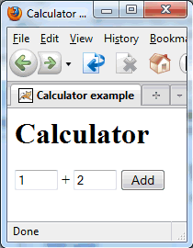
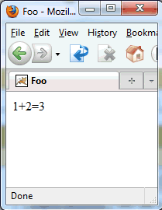
A simple example
47+11=58
47
11
Running example: A calculator web-app
User enters two integers into a HTML form and submits
Result: GET request to calculate?num1=47&num2=11
Web app adds them and displays the sum

Slide 67
The Calculator servlet
import java.io.*; import javax.servlet.*; import javax.servlet.http.*; public class CalculatorServlet extends HttpServlet { }
Numbers from the GET request become parameters
public void doGet(HttpServletRequest request, HttpServletResponse response) throws java.io.IOException { }
int v1 = Integer.valueOf(request.getParameter("num1")).intValue(); int v2 = Integer.valueOf(request.getParameter("num2")).intValue();
response.setContentType("text/html"); PrintWriter out = response.getWriter(); out.println("<html><head><title>Hello</title></head>"); out.println("<body>"+v1+"+"+v2+"="+(v1+v2)+"</body></html>");
Two easy steps to make a servlet:
Create a subclass of HttpServlet
Overload the doGet() method
Read input from HttpServletRequest
Do not use instance variables to store session state! (why?)
, write output to HttpServletResponse

Slide 68

Dynamic content
Web application technologies
Background: CGI
Java Servlets
Node.js / Express / EJS
Express framework
SimpleDB bindings
Example application: Dictionary
Session management and cookies
NEXT

Slide 69

What is Node.js?
A platform for JavaScript-based network apps
Based on Google's JavaScript engine from Chrome
Comes with a built-in HTTP server library
Lots of libraries and tools available; even has its own package manager (npm)
Event-driven programming model
There is a single "thread", which must never block
If your program needs to wait for something (e.g., a response from some server you contacted), it must provide a callback function

Slide 70
What is JavaScript?
A widely-used programming language
Started out at Netscape in 1995
Widely used on the web; supported by every major browser
Also used in many other places: PDFs, certain games, ...
... and now even on the server side (Node.js)!
What is it like?
Dynamic typing, duck typing
Object-based, but associative arrays instead of 'classes'
Prototypes instead of inheritance
Supports run-time evaluation via eval()
First-class functions

Slide 71
What is Express?
Express is a minimal and flexible framework for writing web applications in Node.js
Built-in handling of HTTP requests
You can tell it to 'route' requests for certain URLs to a function you specify
Example: When /login is requested, call function handleLogin()
These functions are given objects that represent the request and the response, not unlike Servlets
Supports parameter handling, sessions, cookies, JSON parsing, and many other features
API reference: http://expressjs.com/api.html
var express = require('express'); var app = express();
app.get('/', function(req, res) { res.send('hello world'); }); app.listen(3000);

Slide 72
The Request object
req.param(name) Parameter 'name', if present
req.query Parsed query string (from URL)
req.body Parsed request body
req.files Uploaded files
req.cookies.foo Value of cookie 'foo', if present
req.get(field) Value of request header 'field'
req.ip Remote IP address
req.path URL path name
req.secure Is HTTPS being used?
...

Slide 73
The Response object
req.status(code) Sets status 'code' (e.g., 200)
req.set(n,v) Sets header 'n' to value 'v'
res.cookie(n,v) Sets cookie 'n' to value 'v'
res.clearCookie(n) Clears cookie 'n'
res.redirect(url) Redirects browser to new URL
res.send(body) Sends response (HTML, JSON...)
res.type(t) Sets Content-type to t
res.sendfile(path) Sends a file
...

Slide 74
What is Embedded JS (EJS)?
app.get('/', function(req, res) { res.send('<html><head><title>'+
'Lookup result</title></head>'+
'<body><h1>Search result</h1>'+ req.param('word')+' means '+ +lookupWord(req.param('word')));
); });
...
w = req.param('word'); res.render('results.ejs', {blank1:w, blank2:lookupWord(w)});
<html><head><title>Lookup result</title> </head><body><h1>Search result</h1> <% =blank1 %> means <% =blank2 %>
We don't want HTML in our JavaScript code!
EJS allows you to write 'page templates'
You can have 'blanks' in certain places that can be filled in by your program at runtime
<% =value %> is replaced by variable 'value' from the array given to render()
<% someJavaScriptCode() %> is executed
Can do conditionals, loops, etc.

Slide 75


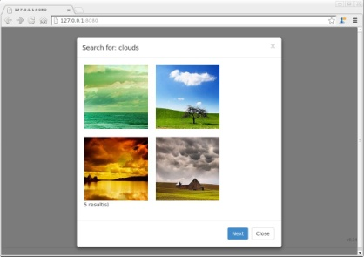
How do the pieces fit together?
Server machine (e.g., EC2 node)
Server
Server code
require('http'); http.createServer (…)
Amazon SimpleDB
Internet
Web page
<html><head> <body>…
DOM accesses
function foo() { $("#id").html("x"); }
Browser
Script on the page
Your VM/laptop/lab machine

Slide 76
How to structure the app
Your web app will have several pieces:
Main application logic
'Routes' for displaying specific pages (/login, /main, ...)
Database model (get/set functions, queries, ...)
Views (HTML or EJS files)
Suggestion: Keep them in different directories
routes/ for the route functions
model/ for the database functions
views/ for the HTML pages and EJS templates
Keep only app.js/package.json/config... in main directory

Slide 77
"Hello world" with Node/Express
var express = require('express');
var bodyParser = require('body-parser');
var morgan = require('morgan'); // logger
var routes = require('./routes/routes.js');
var app = express();
app.use(bodyParser.urlencoded({ extended: true }));
app.use(morgan('combined'))
app.get('/', routes.get_main);
app.post('/results', routes.post_results);
app.listen(8080);
console.log('Server running on port 8080');
var getMain = function(req, res) {
res.render('main.ejs', {});
};
var postResults = function(req, res) {
var x = req.body.myInputField;
res.render('results.ejs', {theInput: x});
};
var routes = {
get_main: getMain,
post_results: postResults
};
module.exports = routes;
app.js
<html><body>
<h1>Dictionary lookup</h1>
<form action="/results" method="post">
<input type="text" name="myInputField">
<input type="submit" value="Search">
</form>
</body></html>
routes/routes.js
{
"name": "HelloWorld",
"description": "Demo",
"version": "0.0.1",
"dependencies": {
"express": "*",
"body-parser": "*",
"morgan": "*",
"ejs": "*"
}
}
views/main.ejs
<html><body>
<h1>Lookup results</h1>
You searched for: <%= theInput %><p>
<a href="/">Back to search</a>
</body></html>
views/results.ejs
package.json

Slide 78
The main application file
var express = require('express');
var bodyParser = require('body-parser');
var morgan = require('morgan'); // logger
var routes = require('./routes/routes.js');
var app = express();
app.use(bodyParser.urlencoded({ extended: true }));
app.use(morgan('combined'))
app.get('/', routes.get_main);
app.post('/results', routes.post_results);
app.listen(8080);
console.log('Server running on port 8080');
Initialization stuff
Includes the code in routes/routes.js
"Routes" URLs to different functions
Starts the server
app.js
What is going on here?
app.js is the "main" file (you run "nodejs app.js" to start)
Does some initialization stuff and starts the server
Key element: URL routing
"If you receive a POST http://localhost/results request, call the function routes.post_results to handle it"
Need one such line for each 'page' our web application has

Slide 79
The request handlers (routes)
var getMain = function(req, res) {
res.render('main.ejs', {});
};
var postResults = function(req, res) {
var x = req.body.myInputField;
res.render('results.ejs', {theInput: x});
};
var routes = {
get_main: getMain,
post_results: postResults
};
module.exports = routes;
Simply displays a page
Extract POSTed form data from request (req)
Display a page with the 'theInput' blank filled in
Makes a 'class' that contains all the request handlers we've defined here
Exports the 'class'
routes/routes.js
Defines a 'request handler' for each page
Has access to the HTTP request (req), e.g., for extracting posted data, and to the response (res) for writing output
The .ejs pages are normal HTML pages but can have 'blanks' in them that we can fill with data at runtime
Need a new page? Just add a new handler!

Slide 80
The page templates
<html><body>
<h1>Dictionary lookup</h1>
<form action="/results" method="post">
<input type="text" name="myInputField">
<input type="submit" value="Search">
</form>
</body></html>
<html><body>
<h1>Lookup results</h1>
You searched for: <%= theInput %><p>
<a href="/">Back to search</a>
</body></html>
views/results.ejs
views/main.ejs
The .ejs files are 'templates' for HTML pages
Don't want to 'println()' the entire page (messy!)
Instead, you can write normal HTML with some 'blanks' that can be filled in by the program at runtime
Syntax for the blanks: <%= someUniqueName %>
Values are given as the second argument of render(), which is basically a mapping from unique names to values
See also http://embeddedjs.com/getting_started.html and http://code.google.com/p/embeddedjavascript/w/list

Slide 81
The package manifest
{
"name": "HelloWorld",
"description": "Demo",
"version": "0.0.1",
"dependencies": {
"express": "*",
"body-parser": "*",
"morgan": "*",
"ejs": "*"
}
}
Dependencies
package.json
Contains some metadata about your web app
Name, description, version number, etc.
... including its dependencies
Names of the Node modules you are using, and the required versions (or '*' to designate 'any version')
Once you have such a file, you can simply use 'npm install' to download all the required modules!
No need to ship node_modules with your app

Slide 82
Let's add some real data!
<!DOCTYPE html>
<html>
<body>
<h1>Lookup results</h1>
You searched for: <%= theInput %><p>
<%if (result != null) { %>
Translation: <%= result %><p>
<% } %>
<%if (message != null) { %>
<font color="red"><%= message %><p>
<% } %>
<a href="/">Back to search</a>
</body>
</html>
Our extra 'blank' for the translation
Conditional (works because of EJS)
views/results.ejs
Let's show translations of the words
Simple add a new 'blank' to the results.ejs page template
But what if no result was found, or an error occurred?
Add conditionals to only show the result and error elements when there is actually something to be shown

Slide 83
Database schema and model
We need a database to store the translations
We'll use SimpleDB for this
Let's store English->German and English->French
What would be a good way to keep this data?
How many tables are needed?
What data will they contain?
Which columns will they have?
This is called a 'schema'
How will your program access the data?
BAD: Hard-code SimpleDB calls everywhere
GOOD: Write a 'model' with wrapper functions, like lookup(term,language), addWord(term,translation,lang), ...
ItemName | German | French
apple | Apfel | pomme
pear | Birne | poire

Slide 84
Accessing the database
var AWS = require('aws-sdk');
AWS.config.loadFromPath('config.json');
var simpledb = new AWS.SimpleDB();
var myDB_lookup = function(term, language, callback){
simpledb.getAttributes({DomainName:'words', ItemName: term}, function (err, data) {
if (err) {
callback(null, "Lookup error: "+err);
} else if (data.Attributes == undefined) {
callback(null, null);
} else {
var results = {};
for (i = 0; i<data.Attributes.length; i++) {
if (data.Attributes[i].Name === language)
results.translation = data.Attributes[i].Value;
}
callback(results, null);
}
});
};
var database = {
lookup: myDB_lookup
};
module.exports = database;
{
"name": "HelloWorld",
"description": "Demo",
"version": "0.0.1",
"dependencies": {
"express": "~3.3.5",
"ejs": "*", "aws-sdk": "*"
}
}
package.json
{
"accessKeyId": "yourAccessKeyIDhere",
"secretAccessKey": "yourSecretKeyhere",
"region": "us-east-1"
}
models/simpleDB.js
config.json

Slide 85
SimpleDB API
createDomain Creates a new domain
deleteDomain Deletes a domain
listDomains Lists all of current user's domains
domainMetadata Returns information about domain
putAttributes Creates or replaces attr. of item
getAttributes Returns attributes of item
deleteAttributes Deletes attributes from item
select Returns attributes matching expr.
batchDeleteAttributes Multiple DeleteAttributes
batchPutAttributes Multiple PutAttributes
See also: http://docs.aws.amazon.com/AWSJavaScriptSDK/latest/frames.html

Slide 86
Doing the actual lookups
var db = require('../models/simpleDB.js');
var getMain = function(req, res) {
res.render('main.ejs', {});
};
var postResults = function(req, res) {
var userInput = req.body.myInputField;
db.lookup(userInput, "german", function(data, err) {
if (err) {
res.render('results.ejs', {theInput: userInput, message: err, result: null});
} else if (data) {
res.render('results.ejs', {theInput: userInput, message: null, result: data.translation});
} else {
res.render('results.ejs', {theInput: userInput, result: null, message: 'We did not find anything'});
}
});
};
var routes = {
get_main: getMain,
post_results: postResults
};
module.exports = routes;
Include the database code
Database lookup, needs a callback that will receive results (or error)
Fill in multiple 'blanks'
routes/routes.js

Slide 87
Loading the data
var AWS = require('aws-sdk');
AWS.config.loadFromPath('./config.json');
var simpledb = new AWS.SimpleDB();
var async = require('async');
var words = [{English:'apple', German:'Apfel', French:'pomme'},
{English:'pear', German:'Birne', French:'poire'}];
simpledb.deleteDomain({DomainName:'words'},
function(err, data) {
if (err) {
console.log("Cannot delete: "+err);
} else {
simpledb.createDomain({DomainName:'words'}, function(err, data) {
if (err) {
console.log("Cannot create: "+err);
} else {
async.forEach(words, function(w, callback) {
simpledb.putAttributes({DomainName:'words', ItemName:w.English,
Attributes: [{Name:'german', Value:w.German},
{Name:'french', Value:w.French}]},
function(err, data) {
if (err)
console.log("Cannot put: "+err);
callback();
});
});
}
});
}
});
loader.js

Slide 88
Parameters in Express
app.param('id', /^\d+$/); app.get('/user/:id', function(req, res) { res.send('user ' + req.params.id); });
Express can automatically parse parameters from a given URL
Syntax: /your/url/here/:paramName
Available to your function as req.params.paramName
Can have more than one, e.g., /user/:uid/photos/:file
Parameters can also be validated
app.param('name', regEx)

Slide 89
Serving static content
app.use('/', express.static("public"));
Where content appears in the URL
Where content lives in the file system on the server
Your web app will probably have static files
Examples: Images, client-side JavaScript, ...
Writing an app.get(...) route every time would be too cumbersome
Solution: express.static

Slide 90
Dynamic content
Web application technologies
Background: CGI
Java Servlets
Node.js / Express / EJS
Express framework
SimpleDB bindings
Example application: Dictionary
Session management and cookies
NEXT

Slide 91
Client-side vs server-side (last time)
What if web app needs to remember information between requests in a session?
Example: Contents of shopping cart, login name of user, ...
Recap from last time: Client-side/server-side
Even if the actual information is kept on the server side, client still needs some kind of identifier (session ID)
Now: Discuss four common approaches
URL rewriting and hidden variables
Cookies
Session object

Slide 92
URL rewriting and hidden variables
Idea: Session ID is part of every URL
Example 1: http://my.server.com/shoppingCart?sid=012345
Example 2: http://my.server.com/012345/shoppingCart
Why is the first one better?
Technique #1: Rewrite all the URLs
Before returning the page to the client, look for hyperlinks and append the session ID
Example: <a href="foo.html"> → <a href="foo.html?sid=012345">
In which cases will this approach not work?
Technique #2: Hidden variables
<input type="hidden" name="sid" value="012345">
Hidden fields are not shown by the browser

Slide 93
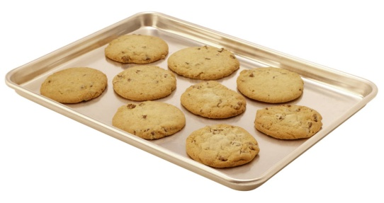
HTTP cookies
GET /index.html HTTP/1.1
HTTP/1.1 200 OK Content-Type: text/html Set-Cookie: sessionid=12345 ... contents of the page ...
Server
Client (browser)
GET /index.html HTTP/1.1 Cookie: sessionid=12345
...
What is a cookie?
A set of key-value pairs that a web site can store in your browser (example: 'sessionid=12345')
Created with a Set-Cookie header in the HTTP response
Browser sends the cookie in all subsequent requests to the same web site until it expires

Slide 94
Node solution: express.session
var cookieParser = require('cookie-parser')
var session = require('express-session')
app.use(cookieParser());
app.use(session({secret: 'thisIsMySecret'});
...
app.get('/test', function(req, res) { if (req.session.lastPage)
req.write('Last page was: '+req.session.lastPage); req.session.lastPage = '/test';
req.send('This is a test.');
}
Abstracts away details of session management
Developer only sees a key-value store
Behind the scenes, cookies are used to implement it
State is stored and retrieved via the 'req.session' object

Slide 95
A few more words on cookies
... Set-Cookie: sessionid=12345; expires=Tue, 02-Nov-2010 23:59:59 GMT; path=/; domain=.mkse.net ...
Each cookie can have several attributes:
An expiration date
If not specified, defaults to end of current session
A domain and a path
Browser only sends the cookies whose path and domain match the requested page
Why this restriction?

Slide 96
What are cookies being used for?
Many useful things:
Convenient session management (compare: URL rewriting)
Remembering user preferences on web sites
Storing contents of shopping carts etc.
Some problematic things:
Storing sensitive information (e.g., passwords)
Tracking users across sessions & across different web sites to gather information about them

Slide 97
The DoubleClick cookie
For the Google Display Network, we serve ads based on the content of the site you view. For example, if you visit a gardening site, ads on that site may be related to gardening. In addition, we may serve ads based on your interests. As you browse websites that have partnered with us or Google sites using the DoubleClick cookie, such as YouTube, Google may place the DoubleClick cookie in your browser to understand the types of pages visited or content that you viewed. Based on this information, Google associates your browser with relevant interest categories and uses these categories to show interest-based ads. For example, if you frequently visit travel websites, Google may show more ads related to travel. Google can also use the types of pages that you have visited or content that you have viewed to infer your gender and the age category you belong to. For example, If the sites that you visit have a majority of female visitors (based on aggregated survey data on site visitation), we may associate your cookie with the female demographic category.
(Source: http://www.google.com/privacy_ads.html)
Used by the Google Display Network
DoubleClick used to be its own company, but was acquired by Google in 2008 (for $3.1 billion)
Tracks users across different visited sites
Associates browser with 'relevant interest categories'

Slide 98
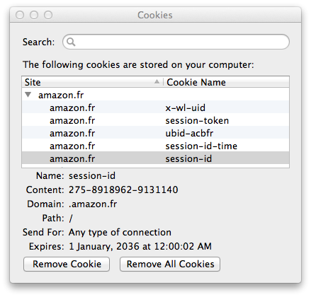
Cookie management in the browser
Firefox: Tools/Options/Privacy/Show Cookies
Chrome: Settings/Privacy/Content settings/All cookies and site data

Slide 99
The Evercookie
Arms race:
Advertisers want to track users
Privacy-conscious users do not want to be tracked
What if users simply delete cookies?
Most browsers offer convenient dialogs and/or plugins
But: Cookies are not the only way to store data in browsers
Recent development: The 'evercookie'
Stores cookie in eight separate ways: HTTP cookies, Flash cookies, force-cached PNGs, web history (!), HTML5 session storage, HTML5 local storage, HTML5 global storage, HTML5 database storage
If any of the eight survives, it recreates the others
http://www.schneier.com/blog/archives/2010/09/evercookies.html

Slide 100
Recap: Session management, cookies
Several ways to manage sessions
URL rewriting, hidden variables, cookies...
HttpSession
Abstract key-value store for session state
Implemented by the servlet container, e.g., with URL rewriting or with cookies
Cookies
Small pieces of data that web sites can store in browsers
Cookies can persist even after the browser is closed
Useful for many things, but also for tracking users

