Slide 1
INGI2145: CLOUD COMPUTING (Fall 2014)
Cloud Networks
12 December 2014
Certain lecture slides adapted judiciously from Duke CPS590 by T. Benson and Cornell CS5413 by H. Weatherspoon

Slide 2
Today
Modern data centers need modern networking!
FatTree-based DC fabric
Software-Defined Networking

Slide 3
Datacenter!
10s to 100s of thousands of servers
Clusters of homogeneous servers
10s of racks with 10s of serves in each rack
Each server: many cores, memory, network interfaces, local storage (HDD and/or SDD)
Individual requests may be served by 10s to even 1000s of serves
Performance based on slowest response
Network congestion affects performance
Overprovisioning large-scale networks is too costly

Slide 4
Networking in Data Centers
Internet
Core Switch (CS)
Bisection bandwidth
Aggregate Switch (AS)
Top of Rack (ToR)

Slide 5
Goals of Data Center Networks
Support diverse application
High throughput/low latency
Utilize multiple paths
Scale to cloud size
Support large number of addresses
5-10 million VMs
Support flexible resource utilization
Support seamless VM mobility

Slide 6
Goals of Data Center Networks
Uniform high capacity:
Maximum rate of server to server traffic flow should be limited only by capacity on network cards
Assigning servers to service should be independent of network topology
Performance isolation:
Traffic of one service should not be affected by traffic of other services
Layer-2 semantics:
Easily assign any server to any service
Configure server with whatever IP address the service expects
VM keeps the same IP address even after migration

Slide 7
Common data center topology
Internet
Data Center
Core
Layer-3 router
Aggregation
Layer-2/3 switch
Access
Layer-2 switch
Servers

Slide 8
Problem with traditional DC topology
Single point of failure
Over subscript of links higher up in the topology
Trade off between cost and provisioning

Slide 9
Problem with traditional DC topology
Oversubscription:
Ratio of the worst-case achievable aggregate bandwidth among the end hosts to the total bisection bandwidth of a particular communication topology
Lower the total cost of the design
Typical designs: factor of 2:5:1 (400 Mbps) to 8:1 (125 Mbps)
Cost:
Edge: $7,000 for each 48-port GigE switch
Aggregation and core: $700,000 for 128-port 10GigE switches
Cabling costs are not considered!

Slide 10
Properties of desired solutions
Backwards compatible with existing infrastructure
No changes in application
Support of layer 2 (Ethernet)
Cost effective
Low power consumption & heat emission
Cheap infrastructure
Allows host communication at line speed

Slide 11
Backwards compatibility tradeoffs
Specialized hardware and communication protocols, such as InfiniBand, Myrinet
Can scale to clusters of 1000s of nodes with high bandwidth
Expensive infrastructure, incompatible with TCP/IP applications
Leverage commodity Ethernet switches and routers to interconnect cluster machines
Backwards compatible with existing infrastructures, low-cost
Aggregate cluster bandwidth scales poorly with cluster size, and achieving the highest levels of bandwidth incurs non-linear cost increase with cluster size

Slide 12
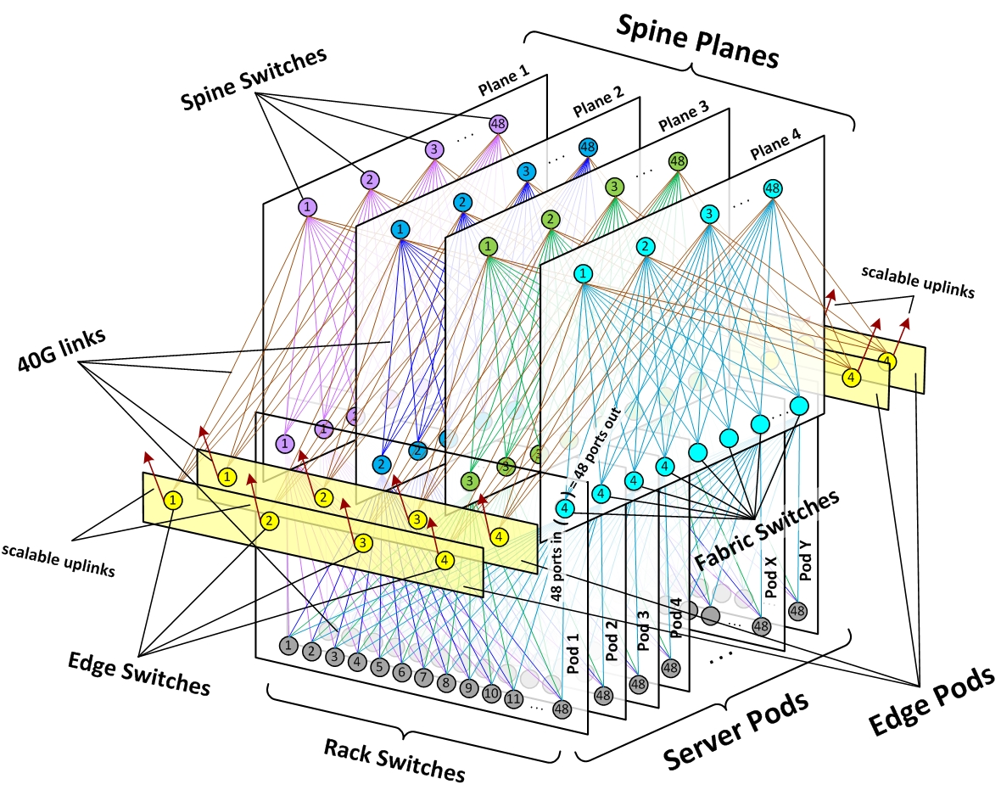
Facebook Example
Introduction to Facebook's data center fabric

Slide 13
Today
Modern data centers need modern networking!
FatTree-based DC fabric
Software-Defined Networking

Slide 14
FatTree based solution
Adopt a special instance of a Clos topology
Similar trends in telephone switches led to designing a topology with high bandwidth by interconnecting smaller commodity switches

Slide 15
FatTree based solution
Connect servers using a fat tree topology
K-ary fat tree: 3-layer topology (edge, aggregation and core)
each pod consists of (k/2)² servers & 2 layers of k/2 k-port switches
each edge switch connects to k/2 servers & k/2 aggr. switches
each aggr. switch connects to k/2 edge & k/2 core switches
(k/2)² core switches: each connects to k pods
Core
Pod
Aggregation
Edge

Slide 16
FatTree based solution
Why Fat Tree?
Fat tree has identical bandwidth at any bisections
Each layer has the same aggregated bandwidth
Built out of cheap devices with uniform capacity
Each port supports same speed as server
All devices can transmit at line speed if packets are distributed uniform along available paths
Great scalability
A k-port fat tree supports k³/4 servers

Slide 17
Problems with a vanilla Fat Tree
Layer 3 will only use one of the existing equal cost paths
Bottlenecks up and down the fat-tree
Packet re-ordering occurs if layer 3 blindly takes advantage of path diversity
Further load may not necessarily be well-balanced
Wiring complexity in large networks
Packing and placement technique

Slide 18
FatTree modified
Enforce a special (IP) addressing scheme in DC
Allows host attached to same switch to route only through switch
Allows inter-pod traffic to stay within pod
unused.PodNumber.switchnumber.Endhost

Slide 19
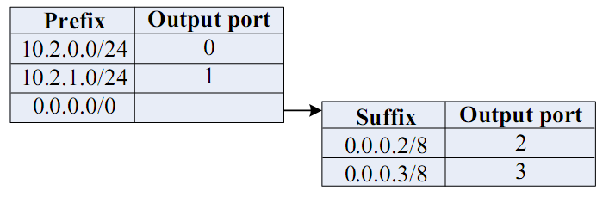
FatTree modified
Use two level look-ups to distribute traffic and maintain packet ordering
First level is prefix lookup
used to route down the topology to servers
Second level is a suffix lookup
used to route up towards core
maintain packet ordering by using same ports for same server
diffuses and spreads out traffic

Slide 20
Optimization: Flow classification
Denote a flow as a sequence of packets
pod switches forward subsequent packets of the same flow to same outgoing port
And periodically reassign a minimal number of output ports
Eliminates local congestion
Assign traffic to ports on a per-flow basis instead of a per-host basis
Ensure fair distribution on flows

Slide 21
Optimization: Flow scheduling
Pay attention to routing large flows, edge switches detect any outgoing flow whose size grows above a predefined threshold, and then send notification to a central scheduler
The central scheduler tries to assign non-conflicting paths for these large flows
Eliminates global congestion
Prevent long lived flows from sharing same links
Assign long lived flows to different links

Slide 22
Fault Tolerance
Each switch in the network maintains a BFD (Bidirectional Forwarding Detection) session with each of its neighbors to determine when a link or neighboring switch fails
Failure between upper layer and core switches
Outgoing inter-pod traffic, local routing table marks the affected link as unavailable and chooses another core switch
Incoming inter-pod traffic, core switch broadcasts a tag to upper switches directly connected signifying its inability to carry traffic to that entire pod, then upper switches avoid that core switch when assigning flows destined to that pod

Slide 23
Fault Tolerance
Failure between lower and upper layer switches
Outgoing inter- and intra pod traffic from lower-layer,
the local flow classifier sets the cost to infinity and does not assign it any new flows, chooses another upper layer switch
Intra-pod traffic using upper layer switch as intermediary
Switch broadcasts a tag notifying all lower level switches, these would check when assigning new flows and avoid it
Inter-pod traffic coming into upper layer switch
Tag to all its core switches signifying its ability to carry traffic, core switches mirror this tag to all upper layer switches, then upper switches avoid affected core switch when assigning new flows

Slide 24
Evaluation
Benchmark suite of communication mappings to evaluate the performance of the 4-port fat-tree using the TwoLevelTable switches, FlowClassifier ans the FlowScheduler and compare to hierarchical tree with 3.6:1 oversubscription ratio

Slide 25
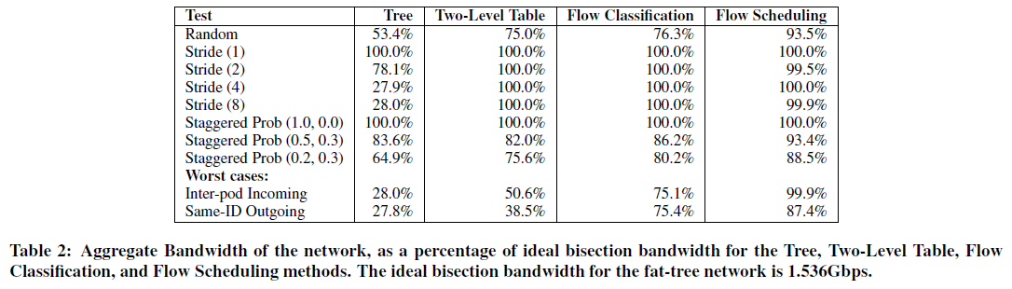
Results: Network Utilization

Slide 26
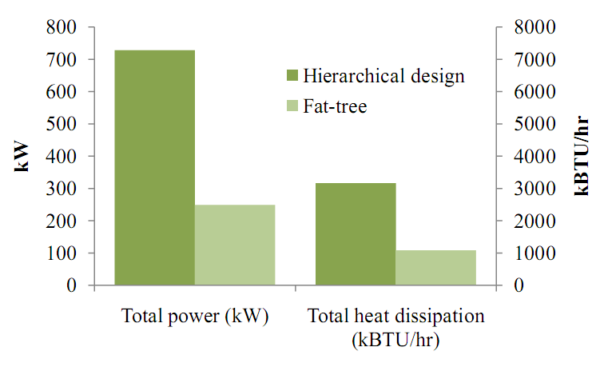
Results: Heat & Power Consumption

Slide 27
Perspective
Bandwidth is the scalability bottleneck in large scale clusters
Existing solutions are expensive and limit cluster size
Fat-tree topology with scalable routing and backward compatibility with TCP/IP and Ethernet
Large number of commodity switches have the potential of displacing high end switches in DC the same way clusters of commodity PCs have displaced supercomputers for high end computing environments

Slide 28
Other Data Center Architectures
A Scalable, Commodity Data Center Network Architecture
a new Fat-tree “inter-connection” structure (topology) to increases “bi-section” bandwidth
needs “new” addressing, forwarding/routing
VL2: A Scalable and Flexible Data Center Network
consolidate layer-2/layer-3 into a “virtual layer 2”
separating “naming” and “addressing”, also deal with dynamic load-balancing issues
Other Approaches:
PortLand: A Scalable Fault-Tolerant Layer 2 Data Center Network Fabric
BCube: A High-Performance, Server-centric Network Architecture for Modular Data Centers

Slide 29
Today
Modern data centers need modern networking!
FatTree-based DC fabric
Software-Defined Networking

Slide 30
Classical network architecture
Distributed control plane
Distributed protocols compute routing state
OSPF, IS-IS, BGP, etc.
Feature
Feature
Specialized Control Plane
Feature
Feature
Specialized Packet Forwarding Hardware
Specialized Control Plane
Feature
Feature
Specialized Packet Forwarding Hardware
Specialized Control Plane
Feature
Feature
Specialized Packet Forwarding Hardware
Specialized Control Plane
Feature
Feature
Specialized Packet Forwarding Hardware
Specialized Control Plane
Specialized Packet Forwarding Hardware

Slide 31




Network Policies
Access control: reachability
Alice can not send packets to Bob
Application classification
Place video traffic in the gold queue

Slide 32




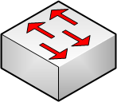


Network Management: Past

Slide 33

Networking Yesterday
Prefix
Port
BGP
OSPF
10.10.2.10
1
IP
VLAN
2.3.4.23
3
MPLS
MPLS Label
Path
23
1
45
Data plane
Determines how to forward a packet
Looks up the forwarding table to determine output port for a packet
Control plane
Determines how to populate the forwarding tables
Translate user commands into hardware
ACLs, MPLS
Runs a bunch of routing protocols
IGPs: OSPF, IS-IS, RIP, & EGPs: BGP
3

Slide 34
Networking Yesterday
Control + Data-plane on each device
Network is a Distributed systems
Built to avoid failure (ArpaNet)
A network is supported by an infinite number of protocols
New protocols developed to support new functionality
Takes time to standardize and to change the hardware
Think: writing a distributed program in Perl
Error prone (Over 50% of errors caused by misconfig)
Time consuming
IT Operators are the most costly portion of IT
Takes up to 6 months for ISPs to roll out services for new costumers
Very difficult to add new functionality into the network
Notes:
Perl analogy → need for a higher level abstraction for doing things

Slide 35
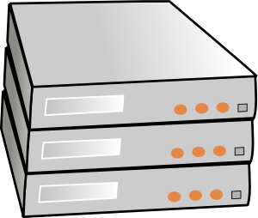
Separation of control and data planes
Feature
Feature
Network OS
Feature
Feature
Specialized Control Plane
Feature
Feature
Specialized Packet Forwarding Hardware
Specialized Control Plane
Feature
Feature
Specialized Packet Forwarding Hardware
Specialized Control Plane
Feature
Feature
Specialized Packet Forwarding Hardware
Specialized Control Plane
Feature
Feature
Specialized Packet Forwarding Hardware
Specialized Control Plane
Specialized Packet Forwarding Hardware

Slide 36
Requirements for SDN
Network Operating
System
Operate without Guarantees
Need abstraction for distributed state
Want to deal with information without worrying about the fact that the state is from a distribution
Logically Centralized
Compute configuration of each device
Need abstraction that simplifies configuration
Want to specify your intent → desired goal; the what
NOT: how to do it.
Operate within given network-level protocol
Need abstraction for forwarding model
Hide details about hardware specifics
No need to worry about he exact hardware
Network Operating
System
OpenFlow Protocol

Slide 37
Enter Software Defined Networking: Separation of concerns
Network operator
Specify behavior on a model
Behavior == network policies
Network runtime
Provides abstract view of the network
Maps abstract view to global view
Function of the types of network policies to be supported
Network Operating System
Maps global view to physical view
Translate abstract commands to device configuration
Device interface: forwarding abstractions

Slide 38
Software Defined Networking (SDN)
Feature
Feature
Constructs a logical map of the network
Global Network View
Network OS
Open vendor-agnostic protocol
Packet
Forwarding
Packet
Forwarding
OpenFlow
Packet
Forwarding
Packet
Forwarding
Simple packet forwarding hardware
Packet
Forwarding

Slide 39
Software Defined Networking (SDN)
Control
Programs
Control
Programs
Control
Programs
Abstract Network View
Network Virtualization
Constructs a logical map of the network
Global Network View
Network OS
Open vendor-agnostic protocol
Packet
Forwarding
Packet
Forwarding
OpenFlow
Packet
Forwarding
Packet
Forwarding
Simple packet forwarding hardware
Packet
Forwarding

Slide 40
Software Defined Networking (SDN)
firewall.c
…
if( pkt->tcp->dport == 22)
dropPacket(pkt);
…
Control
Programs
Control
Programs
Control
Programs
Abstract Network View
Network Virtualization
Global Network View
Network OS
<Match, Action>
<Match, Action>
<Match, Action>
<Match, Action>
<Match, Action>
…
…
<Match, Action>
<Match, Action>
<Match, Action>
<Match, Action>
<Match, Action>
…
…
Packet
Forwarding
<Match, Action>
<Match, Action>
<Match, Action>
<Match, Action>
<Match, Action>
…
…
<Match, Action>
<Match, Action>
<Match, Action>
<Match, Action>
<Match, Action>
…
…
Packet
Forwarding
<Match, Action>
<Match, Action>
<Match, Action>
<Match, Action>
<Match, Action>
…
…
Packet
Forwarding
Packet
Forwarding
Packet
Forwarding

Slide 41
What problem does SDN solve?
Great tool to enable innovation in network control
Platform to help solve longstanding problems in managing networks and deploying new functionality

Slide 42
SDN applications
Network management
Enterprise access, middleboxes waypointing
Monitoring and measurement
Network virtualization
User mobility and VM migration
Server load balancing
Traffic engineering
Energy efficiency, high WAN utilization
Exposing an API to host applications

Slide 43
OpenFlow
is a protocol for remotely controlling the forwarding table of a switch or router
is one element of SDN

Slide 44
OpenFlow Protocol
Message between controller and switches
Synchronous
Stats, Flow-mods
Asynchronous
Packet-in
Abstract hardware details
Allows direct control over forwarding table
Match
Action
10.2.3.4:10.2.3.3
Fwd Port 1
A2:e3:f1:ba:ea:23:*
Drop

Slide 45

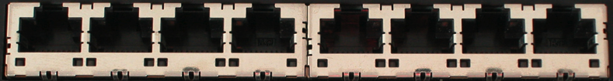
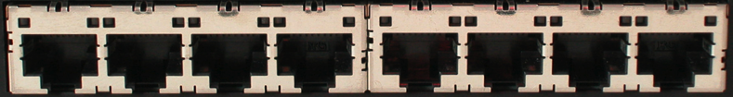
How does OpenFlow work?
Ethernet Switch

Slide 46
OpenFlow Controller
OpenFlow Protocol (SSL/TCP)
OpenFlow Agent
Data Plane (Hardware)

Slide 47


Main components of an OpenFlow switch
OpenFlow Agent
Software
Layer
OpenFlow protocol
Flow Table
Flow Table
…
pipeline
Hardware
Layer
Group Table
Meter Table
Controller
port 1
port 2
port 3
port 4
5.6.7.8
1.2.3.4

Slide 48
Flow Table Entries
Main components of a flow entry in a flow table.
Match fields | To match against packets. These consist of the ingress port and packet headers
Priority | Matching precedence of the flow entry
Counters | e.g. packet and byte counters
Instructions | Determine action set or pipeline processing
Timeouts | Maximum amount of time or idle time before flow is expired by the switch
Cookies | Opaque data value chosen by the controller. Not used when processing packets.
Switch
Port
VLAN
ID
VLAN
pcp
MAC
src
MAC
dst
Eth
type
IP
Src
IP
Dst
IP
ToS
IP
Prot
L4
sport
L4
dport
The match field contains either a specific value or a “wildcard”

Slide 49
Match/action examples
Switching
Switch
Port
MAC
src
MAC
dst
Eth
type
VLAN
ID
IP
Src
IP
Dst
IP
Prot
TCP
sport
TCP
dport
Action
*
*
00:1f:..
*
*
*
*
*
*
*
port6
Flow Switching
Switch
Port
MAC
src
MAC
dst
Eth
type
VLAN
ID
IP
Src
IP
Dst
IP
Prot
TCP
sport
TCP
dport
Action
port3
00:20..
00:1f..
0800
vlan1
1.2.3.4
5.6.7.8
4
17264
80
port6
Firewall
Switch
Port
MAC
src
MAC
dst
Eth
type
VLAN
ID
IP
Src
IP
Dst
IP
Prot
TCP
sport
TCP
dport
Action
*
*
*
*
*
*
*
*
*
22
drop

Slide 50
Examples
Routing
Switch
Port
MAC
src
MAC
dst
Eth
type
VLAN
ID
IP
Src
IP
Dst
IP
Prot
TCP
sport
TCP
dport
Action
*
*
*
*
*
*
5.6.7.8
*
*
*
port6
VLAN Switching
Switch
Port
MAC
src
MAC
dst
Eth
type
VLAN
ID
IP
Src
IP
Dst
IP
Prot
TCP
sport
TCP
dport
Action
port6,
port7,
port9
*
*
00:1f..
*
vlan1
*
*
*
*
*

Slide 51
Headers as a protocol-agnostic collection of bits
Ethernet
DA, SA, etc
IP
DA, SA, etc
TCP
DP, SP, etc
Payload
Collection of bits to plumb flows
(of different granularities)
between end points
Header
User-defined flowspace
Payload

Slide 52
“Flowspace”: A way to think about flows defined by match fields
Single flow
All flows from A
All flows between two subnets
IP DA
A
IP SA

Slide 53
Flowspace: Generalization
Single flow
Set of flows
Field 1
Field 2
Field n

Slide 54
OpenFlow key messages
Message | Direction | Description
Packet-In | Switch->Controller | Transfer the control of a packet to the controller. Packet-in events can be configured to buffer packets
Packet-Out | Controller->Switch | Instruct switch to send a packet out of a specified port. Send in response to Packet-in messages.
Modify-State | Controller->Switch | Add, delete and modify flow/group entries in the flow tables and to set switch port properties
Flow-Removed | Switch->Controller | Inform the controller about the removal of a flow entry from a flow table

Slide 55
Further readings
A Guided Tour Through Datacenter Networking Abts, D., Felderman, B. Communications of the ACM(CACM), 55(6), 2012http://queue.acm.org/detail.cfm?id=2208919
The next-generation Facebook data center network http://bit.ly/1xp8fbi
A scalable, commodity data center network architecture Al-Fares, M., Loukissas, A., & Vahdat, A. SIGCOMM 2008
OpenFlow: Enabling Innovation in Campus Networks McKeown, N., Anderson, … Turner, J. ACM SIGCOMM Computer Communication Review, 38(2), 2008
Software-Defined Networking at the Crossroads S. Shenker https://www.youtube.com/watch?v=WabdXYzCAOU

Slide 56
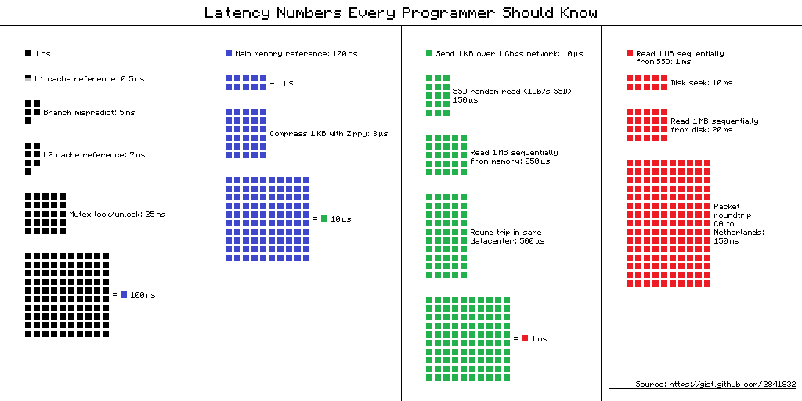
Numbers Everyone Should Know
Source: http://i.imgur.com/k0t1e.png
Numbers by Jeff Dean (Google)

Slide 57
That’s all
Hope you enjoyed INGI2145!
Exam: 17 January 8:30 – BARB 91

