Slide 1
Amazon Storage Services
S3 – DynamoDB – ElastiCache
Waleed F. Reda

Slide 2
Cloud Storage Services - Introduction
Cloud Storage Services are public infrastructure for the storage of objecs
Files / blobs / images / videos / etc.
Stored in Internet (in a public cloud)
Accessible through some API (REST / SDK / etc.)
May have front-end for end-user access
Could operate as a key-value store
Could be free (with limits) or paid (on-demand)

Slide 3
Introduction to Amazon S3
Amazon S3 == Simple Storage Service
On-demand file storage in the AWS cloud
Highly-reliable (99.999999999% durability and 99.99% availability)
Many APIs: RESTful / SOAP / C# / Java / others
Two modes:
Normal – more reliable, more expensive
Reduced redundancy – cheaper, but less reliable
Multiple locations: US, Europe, Asia

Slide 4
Amazon S3 Concepts
Your cloud storage consists of buckets
Objects are stored in the buckets
Object
Object
Object
Bucket
Bucket
Bucket
Tango.mp3
MyHouse.jpeg
PilotEpisode.avi

Slide 5

Introduction to DynamoDB
Fully managed NoSQL database service by Amazon
Database type: Key-value stores
Designed to address the core problems of database management, performance, scalability, and reliability

Slide 6
NoSQL systems
Not every data management/analysis problem
is best solved exclusively using a traditional DBMS
“NoSQL” = “Not Only SQL”
6
Université catholique de Louvain

Slide 7
NoSQL systems
Alternative to traditional relational DBMS
Flexible schema
Quicker/cheaper to set up
Massive scalability
Relaxed consistency → higher performance & availability
No declarative query language → more programming
Relaxed consistency → fewer guarantees
7
Université catholique de Louvain

Slide 8
NoSQL systems
Several incarnations
Document Stores
MapReduce framework
Key-value stores
Graph database systems
8
Université catholique de Louvain

Slide 9
Key-Value Stores
Extremely simple interface
Data model: (key, value) pairs
Operations: Insert(key,value), Fetch(key),
Update(key), Delete(key)
Implementation: efficiency, scalability, fault-tolerance
Records distributed to nodes based on key
Replication
Single-record transactions, “eventual consistency”
9
Université catholique de Louvain

Slide 10
Key-Value Stores
Extremely simple interface
Data model: (key, value) pairs
Operations: Insert(key,value), Fetch(key),
Update(key), Delete(key)
Example systems
Google BigTable, Amazon Dynamo, Cassandra,
Voldemort, HBase, …
Will be covered more thoroughly in upcoming lectures
10
Université catholique de Louvain

Slide 11
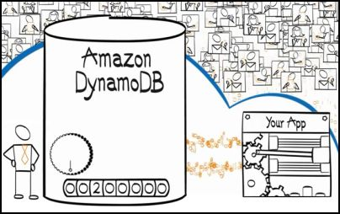
Features
Scalable
Provisioned Throughput
Fully Distributed, Shared Nothing Architecture
Fast Performance
Average service-side latencies < 10 ms
The service runs on Solid State Disks -consistent, fast latencies at any scale
Easy Administration and Cost Effective
a fully managed service by Amazon
Fault-tolerant
Synchronous replication across multiple zones in a region
Notes:
Scalable — DynamoDB is designed for seamless throughput and storage scaling. (live repartitioning)
Cost Effective— You can get started with a free tier that allows more than 40 million database operations per month, and pay low hourly rates only for the resources you consume above that limit. With easy administration and efficient request pricing, DynamoDB can offer significantly lower total cost of ownership (TCO) for your workload compared to operating a relational or non-relational database on your own.

Slide 12
Features
Flexible
Does not have a fixed schema
Efficient Indexing
Every item identified by a primary key
Strong consistency
Implemented with Atomic Counters
Disk-only writes
Notes:
Atomic counters –The service natively supports atomic counters, allowing you to atomically (where each action in done one-at-a-time) increment or decrement numerical attributes with a single API call
Amazon Elastic MapReduce Integration— DynamoDB also integrates with Amazon Elastic MapReduce (Amazon EMR). Amazon EMR allows businesses to perform complex analytics of their large datasets using a hosted pay-as-you-go Hadoop framework on AWS. With the launch of DynamoDB, it is easy for customers to use Amazon EMR to analyze datasets stored in DynamoDB and archive the results in Amazon Simple Storage Service (Amazon S3), while keeping the original dataset in DynamoDB intact. Businesses can also use Amazon EMR to access data in multiple stores (i.e. DynamoDB and Amazon RDS), perform complex analysis over this combined dataset, and store the results of this work in Amazon S3.
Amazon Redshift Integration—You can load data from DynamoDB tables into Amazon Redshift, a fully managed data warehouse service. You can connect to Amazon Redshift with a SQL client or business intelligence tool using standard PostgreSQL JDBC or ODBC drivers, and perform complex SQL queries and business intelligence tasks on your data.

Slide 13
Data model concepts
Tables
Items
Attributes
Except for the primary key, DynamoDB is schema-less
Each item can have any number of attributes
An attribute is a name-value pair
can be single valued or multi-valued set
Database
Notes:
In Amazon DynamoDB, a database is a collection of tables. A table is a collection of items and each item is a collection of attributes.
Individual items in an DynamoDB table can have any number of attributes, although there is a limit of 64 KB on the item size.
The multi-valued attribute is a set; duplicate values are not allowed. Also, DynamoDB does not allow null or empty string attribute values.

Slide 14
Data model concepts
Primary keys
Hash type primary key
Hash and range type primary key
Secondary Indexes
Local secondary index
Global secondary index
DynamoDB data types
Scalar data types
Multivalued data types
Primary or hash key
Composite or range key
Sets of strings or numbers
“ImageID” = “1”
“Date” = “20140401”
“Title” = “flower”
“Tags”’= “flower”, “jasmine” , “white”
Notes:
Hash Type Primary Key—In this case the primary key is made of one attribute, a hash attribute.
Hash and Range Type Primary Key—In this case, the primary key is made of two attributes. The first attribute is the hash attribute and the second one is the range attribute.
Local secondary index — an index that has the same hash key as the table, but a different range key.
Global secondary index — an index with a hash and range key that can be different from those on the table.
Scalar data types—Number, String, and Binary.
Multi-valued types—String Set, Number Set, and Binary Set.

Slide 15
Supported Operations
Table operations
create, update and delete tables
Item operations
add, update and delete items from a table
retrieve a single item (GetItem) or multiple items (BatchGetItem)
Query and Scan
query a table using the hash attribute and an optional range filter.
If the table has a secondary index, you can also Query the index using its key
Scan operation reads every item in the table or secondary index

Slide 16
Supported Operations
Data Read and Consistency considerations
Multiple copies of each item to ensure durability
Eventually Consistent Reads
Strongly Consistent Reads
Conditional updates and concurrency control
updates made by one client don't overwrite updates made by another client
“conditional write” and “atomic counter”
Notes:
Eventually Consistent Reads: When you read data (GetItem, BatchGetItem, Query or Scan operations) , the response might not reflect the results of a recently completed write operation (PutItem, UpdateItem or DeleteItem).
Strongly Consistent Reads: When you issue a strongly consistent read request, DynamoDB returns a response with the most up-to-date data.
DynamoDB supports a "conditional write" feature that lets you specify a condition when updating an item. DynamoDB writes the item only if the specified condition is met; otherwise it returns an error.
DynamoDB also supports an "atomic counter" feature where you can send a request to add or subtract from an existing attribute value without interfering with another simultaneous write request (one-action-at-a-time).

Slide 17
Considerations
Item size is limited to 64KB
Attribute values can not be null or empty
Hash primary key attribute value is limited to 1024 bytes
Range primary key attribute value is limited to 2048 bytes
Up to 5 local as well as global secondary indexes per table

Slide 18
Introduction to Amazon ElastiCache
Memory caching moves repetitive queries to a cache to limit loads on the server.
The information is in the memory, as opposed to on disk, so it serves up very fast.
Works on top of Memcached
A free open source, high-performance, distributed memory object caching system
AWS is taking out the complexity by offering Memecached as a service.

Slide 19
Memcached - Introduction
Very simple
In-memory key-value object cache service
“Hot” data from DB stored in cache
Memory caching tier comprises of a pool of memcached servers each of which is a standalone server that is independent of the other servers in the pool
Memcache 1
App
Memcache 2
Memcache 3
Notes:
Thus in summary memcached as we saw is a simple, in-memory distributed hash table service that caches all the “hot” data from the DB so that client requests can be served with minimum latency.
In practice, the memory caching tier is a pool of such memcached servers, each of which is a standalone server that need not be aware of the other servers in the pool.
Each server is responsible for a shard of the key space. Such sharding is realized by using a hash function to map the keys to the individual servers.
Memcached uses CONSISTENT HASHING and SEPARATE MEMCACHED CLIENTS (different from end user / browser / client) who are aware of the number of servers in the pool are responsible for directing accesses to the appropriate shard.

Slide 20






Memcached – Users and Services
Notes:
Due to its simplicity and the performance improvements it provides memcached is used widely today.
Facebook is supposedly the largest user of memcached and also contributed back to the community. In one of the papers Facebook attributes a 10x performance improvement to the use of a memcached based caching tier
Other users include youtube (google), zynga and Wikipedia, etc.
Amazon Web Services and Google App Engine also offer APIs for memcached services

Slide 21
Memcached – Access Characteristics
Read-mostly workloads
Writes in order to be durable have to be made to the underlying (non-volatile) data store
Other studies have shown that writes constitute mere 3-12% of all accesses in large scale key-value stores
Notes:
The typical workload of memcached is read-mostly as memached can only speed up reads.
Memcached cannot filter writes from the underlying datastore because memory writes are not durable. Because it is important to ensure durability of writes, a write may be deemed to be complete only if the write to the underlying datastore is complete.
However studies show that it is read accesses that are more common that writes in a large scale key value store.
Facebook which is supposedly the largest user of memcached reports that reads are two magnitudes higher than writes . For more details about this you can refer to the scaling memcache at Facebook presentation made in NSDI 2013.
Also some other studies cited in the paper [2,10] report that writes constitute a mere 3-12% of all accesses.

Slide 22
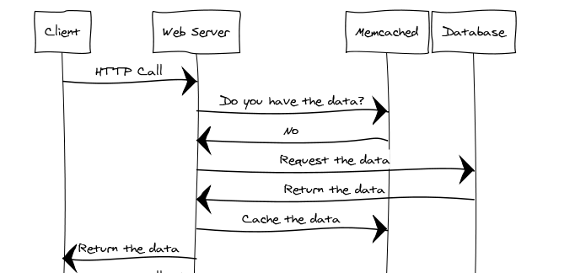


Memcached - Example
Application DB
memcached

Slide 23
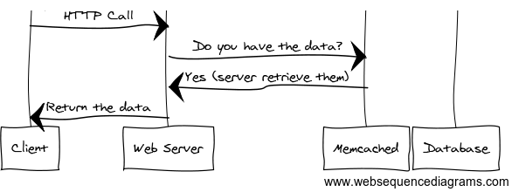
Memcached - Example
Application DB
memcached

Slide 24
Comparative analysis
Property/ Storage Service | Amazon S3 | DynamoDB | ElastiCache
Features | Object storage | Key-value db | Caching of highly utilized data
Limitations | Slower than nosql alternatives | Key/value sizes | Can’t be accessed from outside EC2
Use-cases | Cold data | Hot data | Very hot data
Price model
Refer to Amazon’s price calculator: http://calculator.s3.amazonaws.com/index.html

Slide 25
Tutorial session
Please refer to your handouts
We need to run a total of 3 exercises that spans:
S3
DynamoDB
ElastiCache (Memcached)
You will be asked to write a few line of code for some added functionality

