Slide 1
INGI2145: CLOUD COMPUTING (Fall 2014)
Cloud Storage
13 November 2014
Certain lecture slides adapted from Upenn NETS212 by A. Haeberlen, Z. Ives Reproduced with permission

Slide 2
Non final version
These slides will be updated afterwards with contents from the paper discussed in class

Slide 3
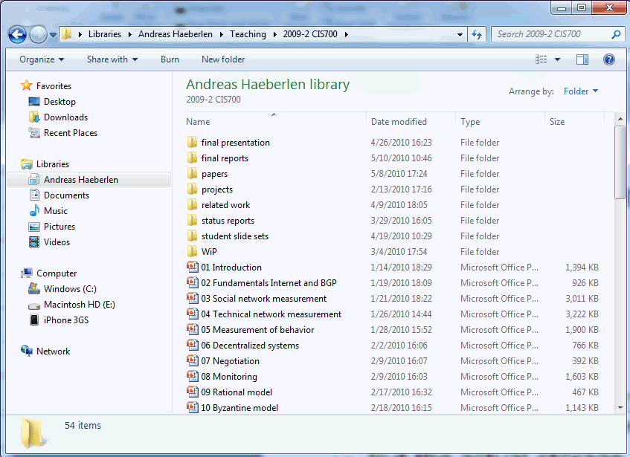



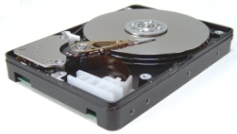
Complex service, simple storage
Variable-size files - read, write, append - move, rename - lock, unlock - ...
Operating system
Fixed-size blocks - read - write
PC users see a rich, powerful interface
Hierarchical namespace (directories); can move, rename, append to, truncate, (de)compress, view, delete files, ...
But the actual storage device is very simple
HDD only knows how to read and write fixed-size data blocks
Translation done by the operating system

Slide 4
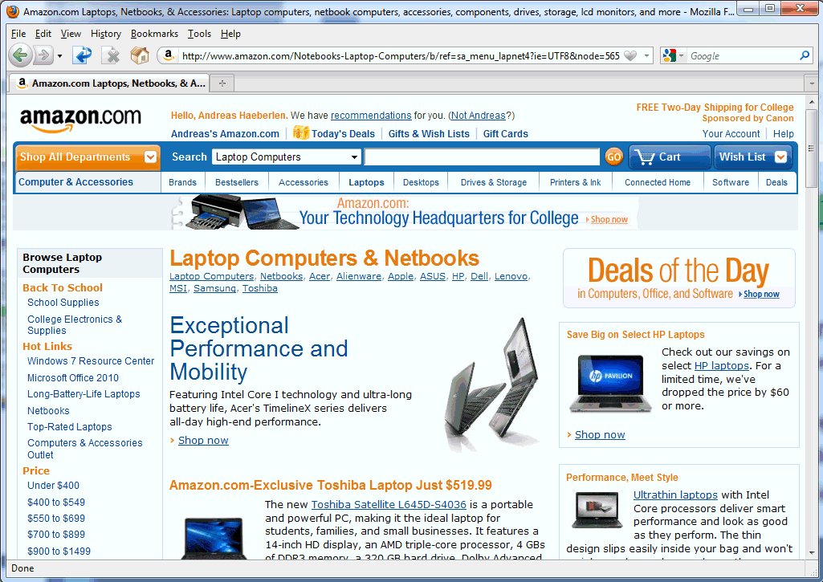


Analogy to cloud storage
Shopping carts Friend lists User accounts Profiles ...
Web service
Key/value store - read, write - delete
Many cloud services have a similar structure
Users see a rich interface (shopping carts, product categories, searchable index, recommendations, ...)
But the actual storage service is very simple
Read/write 'blocks', similar to a giant hard disk
Translation done by the web service

Slide 5
What’s Wrong with Relational DBs?
Most applications interact through a database
Recall RDBMS:
Manage data access, enforce data integrity, control concurrency, support recovery after a failure
Many applications push traditional RDBMS solutions to the limit by demanding:
High scalability
Very large amounts of data
Minimal latency
High availability
Solution is far from ideal

Slide 6
Ideal data stores on the Cloud
Many situations need hosting of large data sets
Examples: Amazon catalog, eBay listings, Facebook pages, …
Ideal: Abstraction of a 'big disk in the clouds', which would have:
Perfect durability – nothing would ever disappear in a crash
100% availability – we could always get to the service
Zero latency from anywhere on earth – no delays!
Minimal bandwidth utilization – we only send across the network what we absolutely need
Isolation under concurrent updates – make sure data stays consistent

Slide 7
The inconveniences of the real world
Why isn't this feasible?
The “cloud” exists over a physical network
Communication takes time, esp. across the globe
Bandwidth is limited, both on the backbone and endpoint
The “cloud” has imperfect hardware
Hard disks crash
Servers crash
Software has bugs
Can you map these to the previous desiderata?

Slide 8
Finding the right tradeoff
In practice, we can't have everything
... but most applications don't really need 'everything'!
Some observations:
Read-only (or read-mostly) data is easiest to support
Replicate it everywhere! No concurrency issues!
But only some kinds of data fit this pattern – examples?
Granularity matters: “Few large-object” tasks generally tolerate longer latencies than “many small-object” tasks
Fewer requests, often more processing at the client
But it’s much more expensive to replicate or to update!
Maybe it makes sense to develop separate solutions for large read-mostly objects vs. small read-write objects!
Different requirements → different technical solutions

Slide 9
Many situations need hosting of large data sets
Examples: Amazon catalog, eBay listings, Facebook pages, …
General trend:
From performance at any cost to …
reliability at the lowest possible cost

Slide 11

Key-value stores
Keys
Values
(bob, bschmitt@foo.com)
(gettysburg, "Four score and seven years ago...")
(29ck2dxa1, 0128ckso1$9#*!!8349e)
(windows, )
The key-value store (KVS) is a simple abstraction for managing persistent state
Data is organized as (key,value) pairs
Only three basic operations:
PUT(key, value)
GET(key) → value
Delete(key)

Slide 12
Examples of KVS
Where have you seen this concept before?
Conventional examples outside the cloud:
In-memory associative arrays and hash tables – limited to a single application, only persistent until program ends
On-disk indices (like BerkeleyDB)
"Inverted indices" behind search engines
Database management systems – multiple KVSs++
Distributed hashtables
Decentralized distributed systems inspired by P2P (see LSINF2345)
Examples: Chord/Pastry

Slide 13
Supporting an Internet service with a KVS
We’ll do this through a central server, e.g., a Web or application server
Two main issues:
There may be multiple concurrent requests from different clients
These might be GETs, PUTs, DELETEs, etc.
These requests may come from different parts of the network, with message propagation delays
It takes a while for a request to make it to the server!
We’ll have to handle requests in the order received (why?)
A
B
S

Slide 14
Managing concurrency in a KVS
What happens if we do multiple GET operations in parallel?
... over different keys?
... over the same key?
What if we do multiple PUT operations in parallel? or a GET and a PUT?
What is the unit of protection (concurrency control) that is necessary here?

Slide 15
Concurrency control
Most systems use locks on individual items
Each requestor asks for the lock
A lock manager processes these requests (typically in FIFO order) as follows:
Lock manager grants the lock to a requestor
Requestor makes modifications
Then releases the lock when it’s done

Slide 16
Limitations of per-key concurrency control
Suppose I want to transfer credits from my WoW account to my friend’s?
… while someone else is doing a GET on my (and her) credit amounts to see if they want to trade?
This is where one needs a database management system (DBMS) or transaction processing manager (app server)
Allows for “locking” at a higher level, across keys and possibly even systems (see LINGI2172 for more details)
Could you implement higher-level locks within the KVS? If so, how?

Slide 17
No longer one-size-fits-all solution

Slide 18
Specialized data stores
Example: Amazon’s solutions
Dynamo [SOSP’07]
Many services only store and retrieve data by primary key
Examples: user preferences, shopping cart, best seller lists
Don’t require querying and management RDBMS functionality
Simple Storage Service (S3)
Need to store large objects that change infrequently
Examples: virtual machines, pictures

Slide 19
Specialized data stores
Example: Google’s solutions
The Google File System [SOSP’03]
Distributed file system for large data-intensive applications
No POSIX API; focus on multi-GB files divided in fixed-size chunks (64 MB); mostly mutated by appending new data
Single master node maintains all file metadata
Bigtable [OSDI’06]
Distributed storage system for structured data
Data model is a sparse multi-dimensional sorted map indexed by row and column keys and a timestamp
Each value in the map is opaque to the storage system

Slide 20
Specialized data stores
Example: Facebook’s solutions
Cassandra [Ladis’09]
A distributed storage system for large sets of structured data
Optimized for very high write throughput; no master nodes
Haystack [OSDI’10]
Object store system optimized for photos
In 2010, over 260 billion images; 20 PB of data; 60 TB/week
Data written once, read often, never modified, rarely deleted
TAO [ATC’13]
A read-optimized graph data store to serve the social graph
Sustains 1 billion reads/s on a changing data set of many PBs
Explicitly favors availability over consistency

Slide 21
Specialized data stores
Example: LinkedIn’s solutions
Kafka [NetDB’11]
A high-throughput distributed messaging system
Pub/sub architecture designed for aggregating log data
Messages are persisted on disk for durability and replicated for fault tolerance; guarantees at-least-once delivery
Voldemort
A distributed key-value store supporting only get/put/delete
Inspired by Amazon’s Dynamo: tunable consistency, highly available

Slide 22
Let’s dive into these 7 systems
We form groups of 3-4, each with an assigned paper
We will break off for ~30 minutes
During that time
For 20 minutes, each of you read/scan the assigned paper looking for answers to one of a set of questions (next slide)
For 10 minutes, discuss within your group what you found
Then we spend time to share with the class our findings about these systems
Short presentation of 5 minutes of the findings of each group and a short Q&A
I will discuss too!

Slide 23
What you should look out for
Not so much the exact details of how it works
Highly technical, and somewhat problem-specific
Rather:
What requirements pushed for a specialized solution?
What principles were used?
How did they make it scale?
Why did they make the design decisions the way they did?
What kinds of problems did they face?
What guarantees do these systems give?
What are the experiences, lessons and practical applications results?

Slide 25
Dynamo

Slide 26
Google File System

Slide 27
Bigtable

Slide 28
Cassandra

Slide 29
Tao

Slide 30
Haystack

Slide 31
Finding a needle in Haystack: Facebook's photo storage Doug Beaver, Sanjeev Kumar, Harry C. Li, Jason Sobel, Peter Vajgel
OSDI 2010

Slide 32
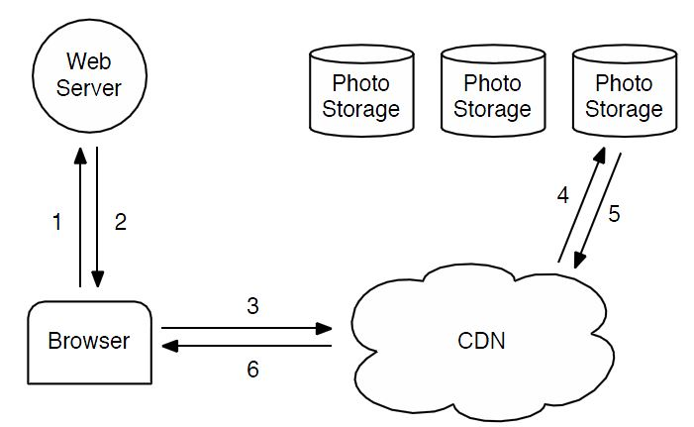
Motivation
Facebook stores a huge number of images
In 2010, over 260 billion (~20PB of data)
One billion (~60TB) new uploads each week
How to serve requests for these images?
Typical approach: Use a CDN (and Facebook does do that)

Slide 33
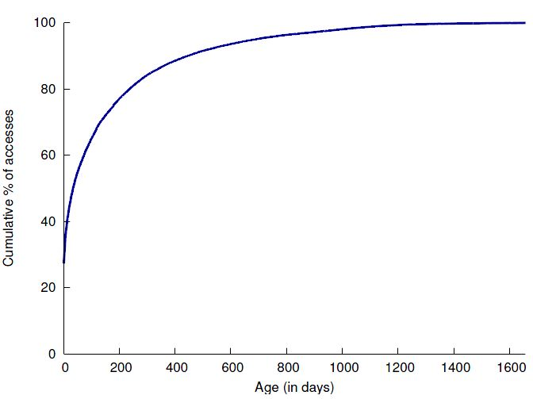
The problem
"Long tail"
When would the CDN approach work well?
If most requests were for a small # of images
But is this the case for Facebook photos?
Problem: "Long tail" of requests for old images!
CDN can help, but can't serve everything!
Facebook's system still needs to handle a lot of requests

Slide 34
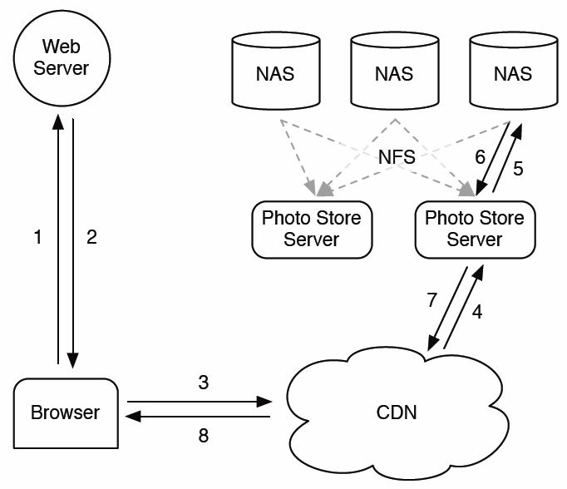
Facebook pre-2010 (1/2)
Images were kept on NAS devices
NAS = network-attached storage
File system can be mounted on servers via NFS
CDN can request images from the servers

Slide 35
Facebook pre-2010 (2/2)
Directories, inodes, block maps, ...
Problem: Accesses to metadata
OS needs to translate file name to inode number, read inode from disk, etc., before it can read the file itself
Often more than 10 disk I/Os - and these are really slow! (Disk head needs to be moved, wait for rotating media, ...)
Hmmm... what happens once they have SSDs?
Result: Disk I/Os for metadata were limiting their read throughput
Could you have guessed that this was going to be the bottleneck?

Slide 36
What could be done?
They considered various ways to fix this...
... including kernel extensions etc.
But in the end they decided to build a special-purpose storage system for images
Goal: Massively reduce size of metadata
When is this a good idea (compared to using an existing storage system)?
Pros and cons - in general?
... and for Facebook specifically?

Slide 37
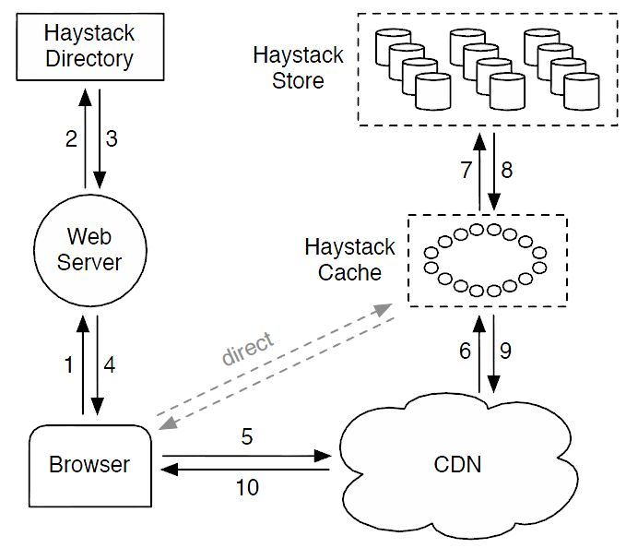
Haystack overview
Three components:
Directory
Cache
Store
Physical volumes
Several of these make up a logical volume
Replication - why?
When the user visits a page:
Web server constructs a URL for each image
http://(CDN)/(Cache)/(MachineID)/(Logical volume, photo)

Slide 38
Reading an image
http://(CDN)/(Cache)/(MachineID)/(Logical volume, photo)
Read path:
CDN tries to find the image first
If not found, strips CDN part off and contacts the Cache
If not found there either, Cache strips off the cache part and contacts the specified Store machine
Store machine finds the volume, and the photo within the volume
All the necessary information comes from the URL!

Slide 39
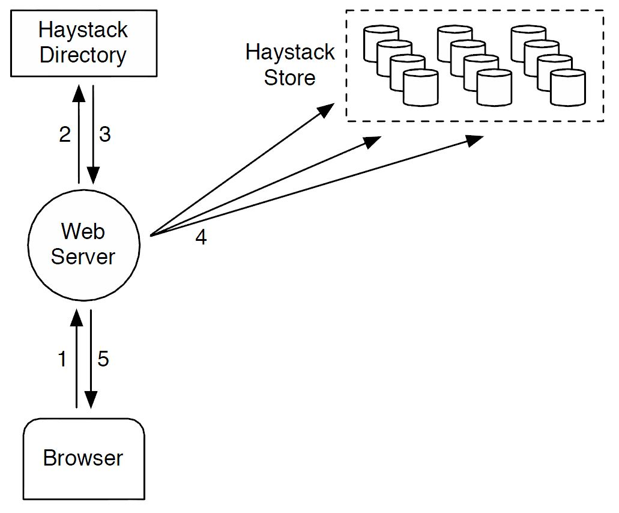
Uploading an image
User uploads image to a web server
Web server requests a write-enabled volume
Volumes become read-only when they are full, or for operational reasons
Web server assigns unique ID and sends image to each of the physical volumes that belong to the chosen logical volume

Slide 40
Haystack: The Directory
Directory serves four functions:
Maps logical to physical volumes
Balances writes across logical volumes, and reads across physical volumes
Determines whether request should be handed by the CDN or by the Cache
Identifies the read-only volumes
How does it do this?
Information stored as usual: replicated database, Memcache to reduce latency

Slide 41
Haystack: The Cache
Organized as a distributed hashtable
Remember the Pastry lecture?
Caches images ONLY if:
1) the request didn't come from the CDN, and
2) the request came from a write-enabled volume
Why?!?
Post-CDN caching not very effective (hence #1)
Photos tend to be most heavily accessed soon after they uploaded (hence #2)
... and file systems tend to perform best when they're either reading or writing (but not both at the same time!)

Slide 42
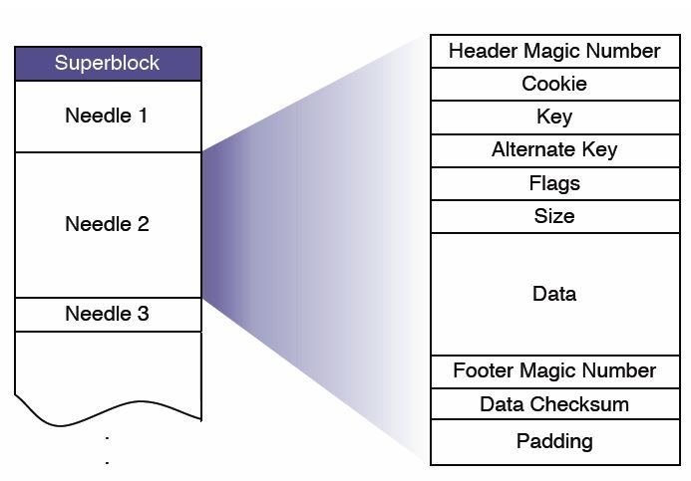
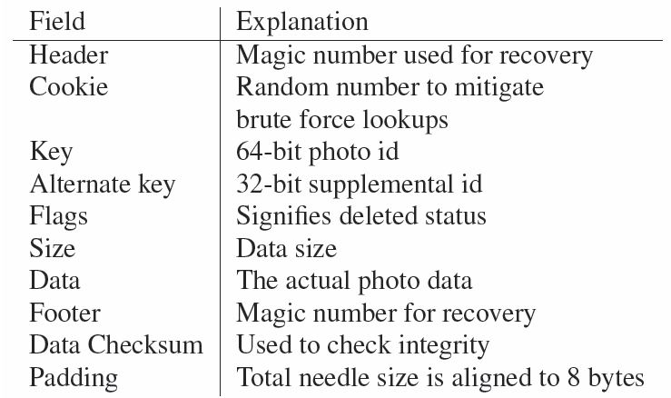
Haystack: The Store (1/2)
Volumes are simply very large files (~100GB)
Few of them needed → In-memory data structures small
Structure of each file:
A header, followed by a number of 'needles' (images)
Cookies included to prevent guessing attacks
Writes simply append to the file; deletes simply set a flag

Slide 43
Haystack: The Store (2/2)
Store machines have an in-memory index
Maps photo IDs to offsets in the large files
What to do when the machine is rebooted?
Option #1: Rebuild from reading the files front-to-back
Is this a good idea?
Option #2: Periodically write the index to disk
What if the index on disk is stale?
File remembers where the last needle was appended
Server can start reading from there
Might still have missed some deletions - but the server can 'lazily' update that when someone requests the deleted img

Slide 44
Recovery from failures
Lots of failures to worry about
Faulty hard disks, defective controllers, bad motherboards...
Pitchfork service scans for faulty machines
Periodically tests connection to each machine
Tries to read some data, etc.
If any of this fails, logical (!) volumes are marked read-only
Admins need to look into, and fix, the underlying cause
Bulk sync service can restore the full state
... by copying it from another replica
Rarely needed

Slide 45
How well does it work?
How much metadata does it use?
Only about 12 bytes per image (in memory)
Comparison: XFS inode alone is 536 bytes!
More performance data in the paper
Cache hit rates: Approx. 80%

Slide 46
Summary
Presence of "long tail" → caching won't help as much
Interesting (and unexpected) bottleneck
To get really good scalability, you need to understand your system at all levels!
In theory, constants don't matter - but in practice, they do!
Shrinking the metadata made a big difference to them, even though it is 'just' a 'constant factor'
Don't (exclusively) think about systems in terms of big-O notations!

Slide 48
Consistent hashing
89
39
On which nodes should objects be stored?
Assumption: Each object has an identifier too ('key')
Idea #1: Hashing
Example: k nodes, object O is stored on node (O mod k)
What happens when nodes join or leave?
Idea #2: Consistent hashing
Object O is stored on node whose ID is closest to O
What happens when nodes join or leave?
If each object has k replicas, where should we put these?
34
42
39
51
39

