Slide 1
INGI2145: CLOUD COMPUTING (Fall 2014)
Design for scale
2 October 2014
Certain lecture slides adapted from Upenn NETS212 by A. Haeberlen, Z. Ives Reproduced with permission

Slide 2
Announcements
VMs in the computer rooms
Please send me a note (via Piazza) if you want to run the VM in the INGI computers

Slide 3
Plan for today
Parallel programming and its challenges
Parallelization and scalability, Amdahl's law
Synchronization, consistency
Architectures: SMP, NUMA, Shared-Nothing
Wide-area network
Latency, packet loss, bottlenecks, and why they matter
Distributed programming and its challenges
Faults, failures, and what we can do about them
Network partitions, CAP theorem, relaxed consistency
NEXT

Slide 4

Plan for today
Parallel programming and its challenges
Parallelization and scalability, Amdahl's law
Synchronization, consistency
Mutual exclusion, locking, issues related to locking
Architectures: SMP, NUMA, Shared-nothing
All about the Internet in 30 minutes
Structure; packet switching; some important protocols
Latency, packet loss, bottlenecks, and why they matter
Distributed programming and its challenges
Faults, failures, and what we can do about them
Network partitions, CAP theorem, relaxed consistency
NEXT

Slide 5
Goal: Building fast, scalable systems
What are the hard problems?
How do they affect what we can do?
How do we write the software? How do we speed it up?

Slide 6
What is scalability?
A system is scalable if it can easily adapt to increased (or reduced) demand
Example: A storage system might start with a capacity of just 10TB but can grow to many PB by adding more nodes
Scalability is usually limited by some sort of bottleneck
Often, scalability also means...
the ability to operate at a very large scale
the ability to grow efficiently
Example: 4x as many nodes → ~4x capacity (not just 2x!)

Slide 7
An obvious way to scale
Throw more hardware at the problem!
go from one processor to many
go from one computer to many
… but what are the challenges?

Slide 8

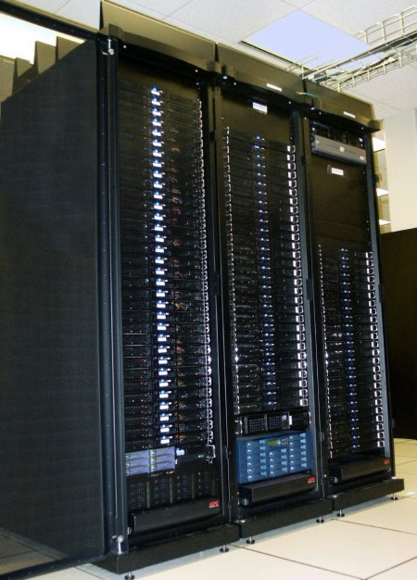

Scale increases complexity
Wide-area network
Single-core machine
Multi-core server
Large-scale distributed system
Cluster
More challenges
Time-sharing
True concurrency
Network
Message passing
More failure modes (faulty nodes, ...)
Wide-area network
Even more failure modes
Incentives, laws, ...

Slide 9
A big challenge of scale
“when a system processes trillions and trillions of requests, events that normally have a low probability of occurrence are now guaranteed to happen and need to be accounted for up front in the design and architecture of the system” – Werner Wogels, Amazon.com
Example:
Single node 99.9% chance of not failing, a cluster of 40 has 96.07% chance of not failing
4% chance that something will fail!

Slide 10

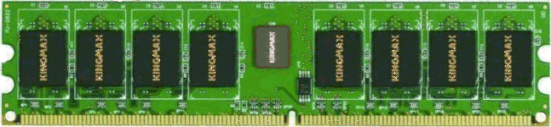
Parallelism in one machine with Symmetric Multiprocessing (SMP)
Cache
Cache
Cache
Cache
Memory bus
For now, assume we have multiple cores that can access the same shared memory
Any core can access any byte; speed is uniform (no byte takes longer to read or write than any other)
Not all machines are like that -- other models discussed later

Slide 11
Parallelization
void bubblesort(int nums[]) {
boolean done = false;
while (!done) {
done = true;
for (int i=1; i<nums.length; i++) {
if (nums[i-1] > nums[i]) {
swap(nums[i-1], nums[i]);
done = false;
}
}
}
}
int[] mergesort(int nums[]) {
int numPieces = 10;
int pieces[][] = split(nums, numPieces);
for (int i=0; i<numPieces; i++)
sort(pieces[i]);
return merge(pieces);
}
Can be done in parallel!
The left algorithm works fine on one core
Can we make it faster on multiple cores?
Difficult – need to find something for the other cores to do
There are other sorting algorithms where this is much easier
Not all algorithms are equally parallelizable
Can you have scalability without parallelism?
Notes:
Yes, depends whether the CPU is the bottleneck. For example, a routing protocol is considered scalable with respect to network size, if the size of the necessary routing table on each node grows as O(log N), where N is the number of nodes in the network.

Slide 12
Scalability
Completion time with one core
Speedup:
Completion time with n cores
Ideal
Numbers sorted per second
Expected
Cores used
If we increase the number of processors, will the speed also increase?
Yes, but (in almost all cases) only up to a point
Why?

Slide 13
Amdahl’s law
....
Parallel part
Core #6
Sequential parts
Core #5
Core #4
Core #3
Core #3
Core #2
Core #2
Core #1
Core #1
Time
Time
Time
Usually, not all parts of the algorithm can be parallelized
Let α be the fraction of the algorithm that is sequential, then the maximum speedup S that can be achieved with N cores is:

Slide 14
Is more parallelism always better?
Ideal
Numbers sorted per second
Sweet spot
Expected
Reality (often)
Cores
Increasing parallelism beyond a certain point can cause performance to decrease! Why?
Time for serial parts can depend on #cores
Example: Need to send a message to each core to tell it what to do

Slide 15
Granularity
How big a task should we assign to each core?
Coarse-grain vs. fine-grain parallelism
Frequent coordination creates overhead
Need to send messages back and forth, wait for other cores...
Result: Cores spend most of their time communicating
Coarse-grain parallelism is usually more efficient
Bad: Ask each core to sort three numbers
Good: Ask each core to sort a million numbers

Slide 16
Dependencies
START
START
Dependencies
...
Individual tasks
DONE
DONE
"Embarrassingly parallel"
With dependencies
What if tasks depend on other tasks?
Example: Need to sort lists before merging them
Limits the degree of parallelism
Minimum completion time (and thus maximum speedup) is determined by the longest path from start to finish
Assumes resources are plentiful; actual speedup may be lower

Slide 17
Heterogeneity
What if...
some tasks are larger than others?
some tasks are harder than others?
some tasks are more urgent than others?
not all cores are equally fast, or have different resources?
Result: Scheduling problem
Can be very difficult

Slide 18
Recap: Parallelization
Parallelization is hard
Not all algorithms are equally parallelizable – need to pick very carefully
Scalability is limited by many things
Amdahl’s law
Communication and coordination overheads
Dependencies between tasks
Heterogeneity
...

Slide 19
Plan for today
Parallel programming and its challenges
Parallelization and scalability, Amdahl's law
Synchronization, consistency
Architectures: SMP, NUMA, Shared-Nothing
Wide-area network
Latency, packet loss, bottlenecks, and why they matter
Distributed programming and its challenges
Faults, failures, and what we can do about them
Network partitions, CAP theorem, relaxed consistency
NEXT

Slide 20


Why do we need synchronization?
void transferMoney(customer A, customer B, int amount) {
showMessage("Transferring "+amount+" to "+B);
int balanceA = getBalance(A);
int balanceB = getBalance(B);
setBalance(B, balanceB + amount);
setBalance(A, balanceA - amount);
showMessage("Your new balance: "+(balanceA-amount));
}
Simple example: Accounting system in a bank
Maintains the current balance of each customer’s account
Customers can transfer money to other customers

Slide 21


Why do we need synchronization?
$100
Alice
$500
Bob
1) B=Balance(Bob)
2) A=Balance(Alice)
3) SetBalance(Bob,B+100)
4) SetBalance(Alice,A-100)
1) A=Balance(Alice)
2) B=Balance(Bob)
3) SetBalance(Alice,A+500)
4) SetBalance(Bob,B-500)
What can happen if this code runs concurrently?
1
2
3
4
Time
1
2
3
4
Alice's balance: Bob's balance:
$200
$800
$200
$900
$700
$900
$700
$300
$100
$300

Slide 22
Problem
: Race condition
void transferMoney(customer A, customer B, int amount) {
showMessage("Transferring "+amount+" to "+B);
int balanceA = getBalance(A);
int balanceB = getBalance(B);
setBalance(B, balanceB + amount);
setBalance(A, balanceA - amount);
showMessage("Your new balance: "+(balanceA-amount));
}
Alice's and Bob's threads of execution
What happened?
Race condition: Result of the computation depends on the exact timing of the two threads of execution, i.e., the order in which the instructions are executed
Reason: Concurrent updates to the same state
Can you get a race condition when all the threads are reading the data, and none of them are updating it?

Slide 23
Goal
: Consistency
What should have happened?
Intuition: It shouldn't make a difference whether the requests are executed concurrently or not
How can we formalize this?
Need a consistency model that specifies how the system should behave in the presence of concurrency

Slide 24
Sequential consistency
Core #1:
T2
T4
T5
Actual execution
Core #2:
T1
T3
T6
Time
Hypothetical execution
Single core:
T1
T2
T3
T6
T4
T5
Same start state
Time
Same result
Sequential consistency:
The result of any execution is the same as if the operations of all the cores had been executed in some sequential order, and the operations of each individual processor appear in this sequence in the order specified by the program

Slide 25
Other consistency models
Strong consistency
After update completes, all subsequent accesses will return the updated value
Weak consistency
After update completes, accesses do not necessarily return the updated value; some condition must be safisfied first
Example: Update needs to reach all the replicas of the object
Eventual consistency
Specific form of weak consistency: If no more updates are made to an object, then eventually all reads will return the latest value
Variants: Causal consistency, read-your-writes, monotonic writes, ...
How do we build systems that achieve this?

Slide 26
Plan for today
Parallel programming and its challenges
Parallelization and scalability, Amdahl's law
Synchronization, consistency
Architectures: SMP, NUMA, Shared-Nothing
Wide-area network
Latency, packet loss, bottlenecks, and why they matter
Distributed programming and its challenges
Faults, failures, and what we can do about them
Network partitions, CAP theorem, relaxed consistency
NEXT

Slide 27
Other architectures
Earlier assumptions:
All cores can access the same memory
Access latencies are uniform
Why is this problematic?
Processor speeds in GHz, speed of light is 299 792 458 m/s → Processor can do 1 addition while signal travels 30cm → Putting memory very far away is not a good idea
Let's talk about other ways to organize cores and memory!
SMP, NUMA, Shared-nothing
?

Slide 28
Symmetric Multiprocessing (SMP)
Cache
Cache
Cache
Cache
Memory bus
All processors share the same memory
Any CPU can access any byte; latency is always the same
Pros: Simplicity, easy load balancing
Cons: Limited scalability (~12 processors), expensive
Pros:
Cons:

Slide 29
Non-Uniform Memory Architecture (NUMA)
Cache
Cache
Cache
Cache
Consistent cache interconnect
Memory is local to a specific processor
Each CPU can still access any byte, but accesses to 'local' memory are considerably faster (2-3x)
Pros: Better scalability
Cons: Complicates programming a bit, scalability still limited
Pros:
Cons:

Slide 30
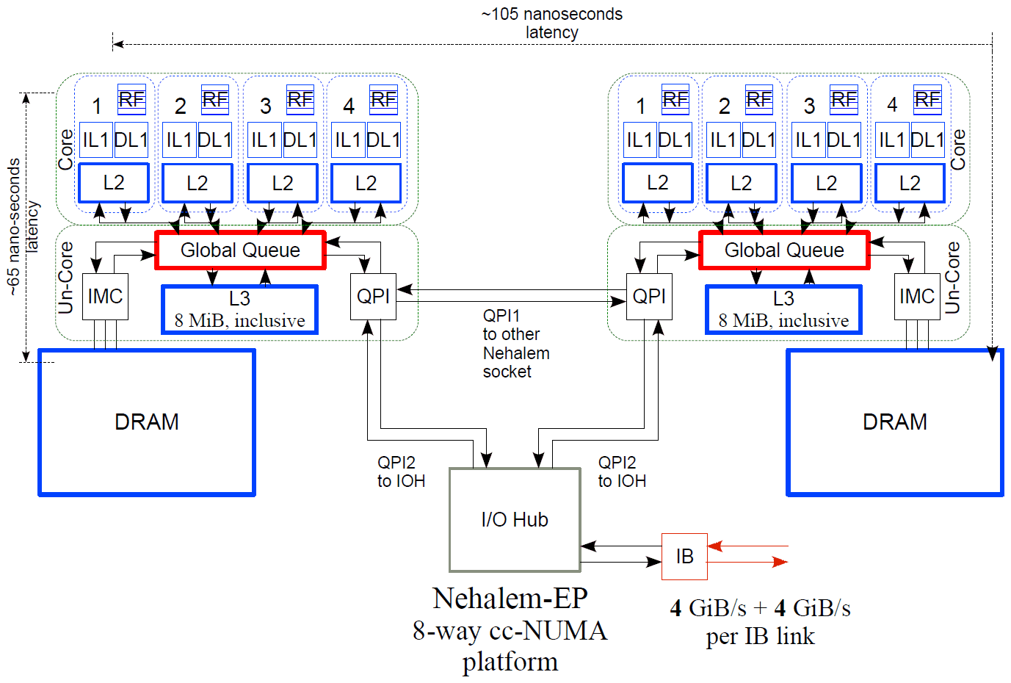
Example: Intel Nehalem
Source: The Architecture of the Nehalem Microprocessor and Nehalem-EP SMP Platforms, M. Thomadakis, Texas A&M
Access to remote memory is slower
In this case, 105ns vs 65ns

Slide 31
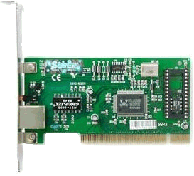
Shared-Nothing
Cache
Cache
Cache
Cache
Network
Independent machines connected by network
Each CPU can only access its local memory; if it needs data from a remote machine, it must send a message there
Pros: Much better scalability
Cons: Requires a different programming model
Pros:
Cons:

Slide 32
Plan for the next two lectures
Parallel programming and its challenges
Parallelization and scalability, Amdahl's law
Synchronization, consistency
Architectures: SMP, NUMA, Shared-nothing
Wide-area network
Latency, packet loss, bottlenecks, and why they matter
Distributed programming and its challenges
Faults, failures, and what we can do about them
Network partitions, CAP theorem, relaxed consistency
NEXT

Slide 33




The life and times of a web request
"Please give me the web page"
Server in California
What happens when I open the web page 'www.google.com' in my browser?
First approximation: My computer contacts another computer in California and requests the web page from there

Slide 34
HTTP and HTML
"Please give me the web page"
GET / HTTP/1.1
Server in California
HTTP/1.1 200 OK
<html> <head><title>Google</title></head> <body>...</body> </html>
There are standardized protocols:
Hypertext Transfer Protocol (HTTP): Describes how web pages are requested
Hypertext Markup Language (HTML): The language the actual web page is written in
How does the request make it to California?

Slide 35
Path properties: Bottleneck capacity
Server
Client
Bottleneck
How fast can we send data on our path?
Limited by the bottleneck capacity
What else does the available capacity depend on?
Which links are usually the bottleneck links?

Slide 36
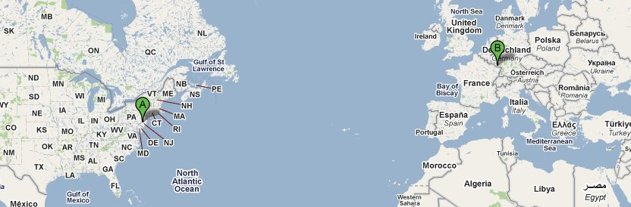
Path properties: Propagation delay
~6,270km (one way)
[ahae@ds01 ~]$ traceroute www.mpi-sws.org
traceroute to www.mpi-sws.org (139.19.1.156), 30 hops max, 60 byte packets
1 SUBNET-46-ROUTER.seas.UPENN.EDU (158.130.46.1) 1.744 ms 2.134 ms 2.487 ms
2 158.130.21.34 (158.130.21.34) 5.327 ms 5.395 ms 5.649 ms
3 isc-uplink-2.seas.upenn.edu (158.130.128.2) 5.671 ms 5.825 ms 6.175 ms
4 external3-core1.dccs.UPENN.EDU (128.91.9.2) 6.007 ms 6.283 ms 6.362 ms
5 external-core2.dccs.upenn.edu (128.91.10.1) 6.830 ms 6.990 ms 7.080 ms
6 local.upenn.magpi.net (216.27.100.73) 7.250 ms 3.429 ms 3.533 ms
7 remote.internet2.magpi.net (216.27.100.54) 4.487 ms 3.002 ms 2.925 ms
8 198.32.11.51 (198.32.11.51) 90.557 ms 90.806 ms 91.028 ms
9 so-6-2-0.rt1.fra.de.geant2.net (62.40.112.57) 97.403 ms 97.473 ms 97.766 ms
10 dfn-gw.rt1.fra.de.geant2.net (62.40.124.34) 98.834 ms 98.890 ms 99.043 ms
11 xr-fzk1-te2-3.x-win.dfn.de (188.1.145.50) 100.627 ms 101.034 ms 101.387 ms
12 xr-kai1-te1-1.x-win.dfn.de (188.1.145.102) 103.985 ms 104.383 ms 104.528 ms
13 xr-saa1-te1-1.x-win.dfn.de (188.1.145.97) 103.636 ms 103.903 ms 104.139 ms
14 kr-0unisb.x-win.dfn.de (188.1.234.38) 103.983 ms 103.746 ms 103.853 ms
15 mpi2rz-hsrp2.net.uni-saarland.de (134.96.6.28) 104.469 ms 104.355 ms 104.491 ms
[ahae@ds01 ~]$
Round-trip time
Speed of light: 299 792 458 m/s
Latency matters!

Slide 37
Path properties:
, loss
Queueing delay
What if we send packets too quickly?
Router stores the packets in a queue until it can send them
Consequence : End-to-end delay increases
Where does this matter?
What if the router runs out of queue space?
Packets are dropped and lost
Other reasons why packets might be dropped?

Slide 38

TCP
TCP
TCP
Data packets
IP
1
2
3
4
1
4
2
IP
Sender
ACK 1
Acknowledgments
ACK 2
Receiver
Transmission Control Protocol (TCP) provides abstraction of a reliable stream of bytes
Ensures packets are delivered to application in correct order
Retransmits lost packets
Tracks available capacity and prevents packets from being sent too fast (congestion control)
Prevents sender from overwhelming the receiver (flow control)

Slide 39
TCP congestion control
packet loss
Congestion window (cwnd)
ssthresh
-50%
-50%
-50%
"Slow start" phase (actually fast!)
Time
How fast should the sender send?
Problem: Available capacity not known (and can vary)
Solution: Congestion control
Maintain a congestion window of max #packets in flight
Slow start: Exponential increase until threshold
Increase cwnd by one packet for each incoming ACK
Congestion avoidance: Additive increase, multiplicative decrease (AIMD)

Slide 40
Another reason why latency matters
Sender
Receiver
Sender
Receiver
1-1460
1-1460
ACK 1460
1461-2920
ACK 1460
1461-2920
2921-4380
ACK 2920
ACK 4380
...
The higher the RTT, the slower the process

Slide 41
Recap: Wide-area network
How does the network matter to applications?
Propagation delay → Good to be physically close to customer
Bottlenecks → Transfer speed is limited
Queueing delays, loss, reordering → Delay can vary
Some of these can be taken care of by TCP

Slide 42
Plan for today
Parallel programming and its challenges
Parallelization and scalability, Amdahl's law
Synchronization, consistency
Architectures: SMP, NUMA, Shared-nothing
Wide-area network
Latency, packet loss, bottlenecks, and why they matter
Distributed programming and its challenges
Faults, failures, and what we can do about them
Network partitions, CAP theorem, relaxed consistency
NEXT

Slide 43
Complications in wide-area networks
Communication is slower, less reliable
Latencies are higher, more variable
Bottleneck capacity is lower
Packet loss, reordering, queueing delays
Faults are more common
Broken or malfunctioning nodes
Network partitions

Slide 44
Faults and failures
What is X?
X=5
X=5
Correct
X=5
X=5
What is X?
Set X:=5
X=5
Fault (masked)
X=5
X=5
What is X?
Faults causing failure
X=3
X=3
Terminology:
Fault: Some component is not working correctly
Failure: System as a whole is not working correctly

Slide 45
Faults in distributed systems
What could possibly go wrong?
Node loses power
Hard disk fails
Administrator accidentally erases data
Administrator configures node incorrectly
Software bug triggers
Network overloaded, drops lots of packets
Hacker breaks into some of the nodes
Disgruntled employee manipulates node
Fire breaks out in data center where node resides
Police confiscates node because of illegal activity
…

Slide 46
Common misconceptions about faults
"Faults are rare exceptions"
NO! At scale, faults are occurring all the time
Stopping the system while handling the fault is NOT an option – system needs to continue despite the fault
"Faulty machines always stop/crash"
NO! There are many types of faults with different effects
If your system is designed to handle only crash faults and another type of fault occurs, things can become very bad

Slide 47

Types of faults
Crash faults
Node simply stops
Examples: OS crash, power loss
Rational behavior
Owner manipulates node to increase profit
Example: Traffic attraction attack (see next slide)
Byzantine faults
Arbitrary - faulty node could do anything (stop, tamper with data, tell lies, attack other nodes, send spam, spy on user...)
Example: Node compromised by a hacker, data corruption, hardware defect...

Slide 48




Rational fault example
I have a good route
$$$$
$$$$$$$
$$$$
Who knows how to get to YouTube?
I need connectivity!
I have an okay route
$$$
$$$
Alice
Alice's provider can choose between several routes to the same destination
System + control are distributed
Traffic attraction: see Goldberg et al., "Rationality and Traffic Attraction: Incentives for honestly announcing paths in BGP", SIGCOMM 2010

Slide 49
Rational fault example
$$$$
I wish my route had been chosen
I have a GREAT route to YouTube
$$$
Alice
Networks have an incentive to make their routes appear better than they are

Slide 50
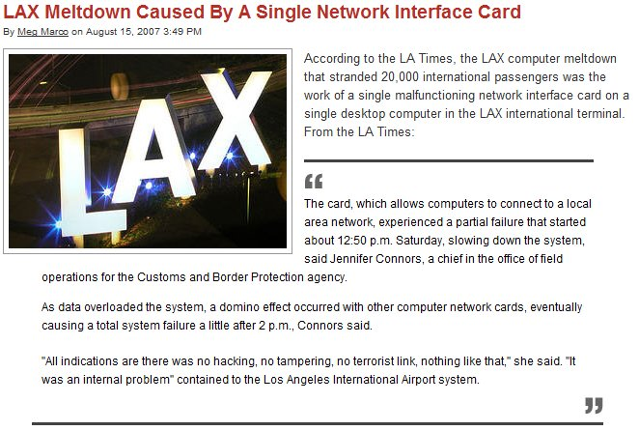
Some examples of Byzantine faults
http://consumerist.com/2007/08/lax-meltdown-caused-by-a-single-network-interface-card.html

Slide 51
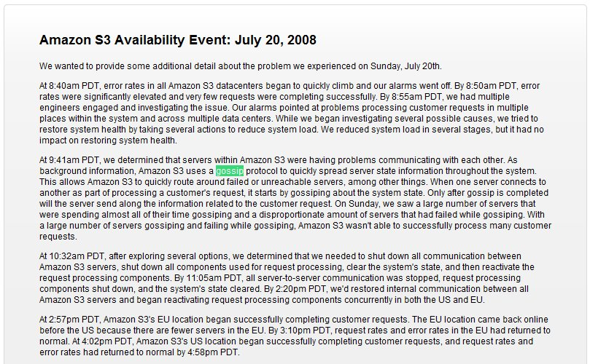
Some examples of Byzantine faults
http://status.aws.amazon.com/s3-20080720.html

Slide 52
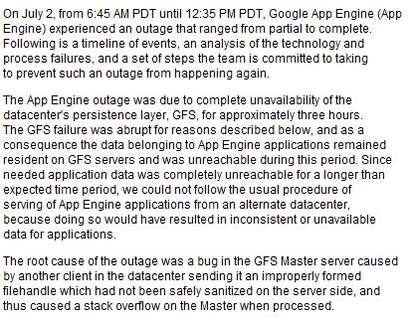
Some examples of Byzantine faults
http://groups.google.com/group/google-appengine/msg/ba95ded980c8c179

Slide 53
Correlated faults
A single problem can cause many faults
Example: Overloaded machine crashes, increases load on other machines → domino effect
Example: Bug is triggered in a program that is used on lots of machines
Example: Hacker manages to break into many computers due to a shared vulnerability
Example: Machines may be connected to the same power grid, cooled by the same A/C, managed by the same admin
...
Why is this problematic?

Slide 54
Recap: Faults and failures
Faults happen all the time
Hardware malfunction, software bug, manipulation, hacker break-ins, misconfiguration, ...
NOT a rare occurrence at scale – must design system to handle them
All faults are NOT independent crash faults
Faults can be correlated
Rational and Byzantine faults are real
Three common fault models:
Crash fault model: Faulty machines simply stop
Rational model: Machines manipulated by selfish owners
Byzantine fault model: Faulty machines could do anything

Slide 55
What can we do?
Prevention and avoidance
Example: Prevent crashes with software verification
See formal methods at AWS: http://research.microsoft.com/en-us/um/people/lamport/tla/formal-methods-amazon.pdf
Example: Provide incentives for participation
Detection
Example: Cross-check network's route announcements with other information to see whether it is lying, and hold it accountable if it is (e.g., sue for breach of contract)
Masking
Example: Store replicas of the data on multiple nodes; if data is lost or corrupted on one of them, we still have the other copies
Mitigation

Slide 56

Masking faults with replication
Server A
Bob
Alice
Server B
Alice can store her data on both servers
Bob can get the data from either server
A single crash fault on a server does not lead to a failure
Availability is maintained
What about other types of faults, or multiple faults?

Slide 57
Problem: Maintaining consistency
Server A
Bob
X:=5
X:=7
X:=7
X:=5
Alice
Server B
What if multiple clients are accessing the same set of replicas?
Requests may be ordered differently by different replicas
Result: Inconsistency! (remember race conditions?)
For what types of requests can this happen?
What do we need to do to maintain consistency?

Slide 58
Types of consistency
Strong consistency
After an update completes, any subsequent access will return the updated value
Weak consistency
Updated value not guaranteed to be returned immediately, only after some conditions are met (inconsistency window)
Eventual consistency
A specific type of weak consistency
If no new updates are made to the object, eventually all accesses will return the last updated value

Slide 59
Eventual consistency variations
Causal consistency
If client A has communicated to client B that it has updated a data item, a subsequent access by B will return the updated value, and a write is guaranteed to supersede the earlier write. Client C that has no causal relationship to client A is subject to the normal eventual consistency rules
Read-your-writes consistency
Client A, after it has updated a data item, always accesses the updated value and will never see an older value
Session consistency
Like previous case but in the context of a session, for as long as the sessions remains alive

Slide 60
Eventual consistency variations
Monotonic read consistency
If client A has has seen a particular value for the object, any subsequent accesses will never return any previous values
Monotonic write consistency
In this case the system guarantees to serialize the writes by the same process
Systems that do not guarantee this level of consistency are notoriously hard to program
Few consistency properties can be combined
monotonic reads + read-your-writes most desirable for eventual consistency. Why?

Slide 61
Example: Storage system
Replica
Scenario: Replicated storage
We have N nodes that can store data
Data contains a monotonically increasing timestamp
To write a value:
Pick W replicas and write the value to each, using a fresh timestamp (say, the current wallclock time)
To read a value:
Pick R replicas and read the value from each
Return the value with the highest timestamp
If any replicas had a lower timestamp, send them the newer value
X=3 v1
X=3 v1
X=5 v2
X=2 v4
X=3 v1
X=5 v2

Slide 62
How to set N, R, and W
Write set
For strong consistency?
What happens otherwise?
Will the data ever become consistent again?
To avoid conflicting writes?
To make reads fast? Writes?
To minimize the risk of data loss?
Let's do some examples!
N=2, W=2, R=1
N=2, W=1, R=1
Read set

Slide 63
Strong consistency: Quorum principle
Majority quorum
Always write to and read from a majority of nodes
At least one node knows the most recent value
Pro: tolerate up to ⌈N/2⌉ - 1 crashes
Con: have to read/write ⌊N/2⌋ + 1 values
Read/write quorums
Read R nodes, write W nodes, s.t. R + W > N
Pro: adjust performance of reads/writes
Con: availability can suffer
Read set
Write set

Slide 64
Consensus
Replicas need to agree on a single order in which to execute client requests
How can we do this?
Does the specific order matter?
Problem: What if some replicas are faulty?
Crash fault: Replica does not respond; no progress (bad)
Byzantine fault: Replica might tell lies, corrupt order (worse)
Solution: Consensus protocol
Paxos (for crash faults), PBFT (for Byzantine faults)
Works as long as no more than a certain fraction of the replicas are faulty (PBFT: one third)

Slide 65

How do consensus protocols work?
Idea: Correct replicas 'outvote' faulty ones
Clients send requests to each of the replicas
Replicas coordinate and each return a result
Client chooses one of the results, e.g., the one that is returned by the largest number of replicas
If a small fraction of the replicas returns the wrong result, or no result at all, they are 'outvoted' by the other replicas

Slide 66
Plan for today
Parallel programming and its challenges
Parallelization and scalability, Amdahl's law
Synchronization, consistency
Architectures: SMP, NUMA, Shared-nothing
Wide-area network
Latency, packet loss, bottlenecks, and why they matter
Distributed programming and its challenges
Faults, failures, and what we can do about them
Network partitions, CAP theorem, relaxed consistency
NEXT

Slide 67
Network partitions
What if this link breaks?
Server A
Bob
Alice
Server B
Network can partition
Hardware fault, router misconfigured, undersea cable cut, ...
Result: Gobal connectivity is lost
What does this mean for the properties of our system?

Slide 68
The CAP theorem
What we want from a web system:
Consistency: All clients single up-to-data copy of the data, even in the presence of concurrent updates
Availability: Every request (including updates) received by a non-failing node in the system must result in a response, even when faults occur
Partition-tolerance: Consistency and availability hold even when the network partitions
Can we get all three?
CAP theorem: We can get at most two out of the three
Which ones should we choose for a given system?
Conjecture by Brewer; proven by Gilbert and Lynch

Slide 69
Visual CAP
A
Availability: Each client can always read and write despite node failures
C&A
A&P
Pick Two
C
P
C&P
Consistency: All clients always have the same view of the data at the same time
Partition-tolerance: The system continues to operate despite arbitrary message loss

Slide 70
Common CAP choices
Example #1: Consistency & Partition tolerance
Many replicas + consensus protocol
Do not accept new write requests during partitions
Certain functions may become unavailable
Example #2: Availability & Partition tolerance
Many replicas + relaxed consistency
Continue accepting write requests
Clients may see inconsistent state during partitions

Slide 71
“2 of 3” view is misleading
Meaning of C&A over P is unclear
If a partition occurs, the choice must be reverted to C or A
No reason to forfeit C or A when system is not partitioned
Choice of C and A can occur many times within the same system at fine granularity
Three properties are more of a continuous
Availability is 0 to 100
Many levels of consistency
Disagreement within the system whether a partition exists
The modern CAP goal should be to maximize application-specific combinations of C and A

Slide 72
Dealing with partitions
Detect partition
Enter an explicit partition mode that can limit some operations
Initiate partition recovery when communication is restored
Restore consistency and compensate for mistakes made while the system was partitioned
State: S
State: S1
State: S’
Partition recovery
Operations on S
State: S2
Time
Partition mode

Slide 73
Which operations should proceed?
Depends primarily on the invariants that the system intends to maintain
If an operation is allowed and turns out to violate an invariant, the system must restore the invariant during recovery
Example: 2 objects are added with the same (unique) key; to restore, we check for duplicate keys and merge objects
If invariant cannot be violated, system must prohibit or modify the operation (e.g. record the intent and execute it after)
Example: delay charging the credit card; user does not see system is not available

Slide 74


Eventual consistency
Server A
Server B
Alice
Idea: Optimistically allow updates
Don't coordinate with ALL replicas before returning response
But ensure that updates reach all replicas eventually
What do we do if conflicting updates were made to different replicas?
Good: Decouples replicas. Better performance, availability under partitions
(Potentially) bad: Clients can see inconsistent state

Slide 75
Partition recovery
State on both sides must become consistent
Compensation for mistakes during partition
Start from state at the time of the partition and roll forward both sets of operations in some way, maintaining consistency
The system must also merge conflicts
constraint certain operations during partition mode so that conflicts can always be merged automatically
detect conflicts and report them to a human
use commutative operations as a general framework for automatic state convergence
commutative replicated data types (CRDTs)

Slide 76
Compensate for mistakes
Tracking and limitation of partition-mode operations ensures the knowledge of which invariants could have been violated
trivial ways such as “last writer wins”, smarter approaches that merge operations, and human escalation
For externalized mistakes typically requires some history about externalized outputs
System could execute orders twice
If the system can distinguish two intentional orders from two duplicate orders, it can cancel one of the duplicates
If externalized, send an e-mail explaining the order was accidentally executed twice but that the mistake has been fixed and to attach a coupon for a discount

Slide 77
Relaxed consistency: ACID vs. BASE
Classical database systems: ACID semantics
Atomicity
Consistency
Isolation
Durability
Modern Internet systems: BASE semantics
Basically Available
Soft-state
Eventually consistent

Slide 78
Recap: Consistency and partitions
Use replication to mask limited # of faults
Can achieve strong consistency by having replicas agree on a common request ordering
Even non-crash faults can be handled, as long as there are not too many of them (typical limit: 1/3)
Partition tolerance, availability, consistency?
Can't have all three (CAP theorem)
Typically trade-off between C and A
If service works with weaker consistency guarantees, such as eventual consistency, can get a compromise (BASE)

Slide 79
Plan for today
Parallel programming and its challenges
Parallelization and scalability, Amdahl's law
Synchronization, consistency
Architectures: SMP, NUMA, Shared-nothing
Wide-area network
Latency, packet loss, bottlenecks, and why they matter
Distributed programming and its challenges
Faults, failures, and what we can do about them
Network partitions, CAP theorem, relaxed consistency

Slide 80

Stay tuned
Next time you will learn about: Cloud basics
Assigned reading: “BASE: An ACID Alternative” by Dan Pritchett, http://queue.acm.org/detail.cfm?id=1394128

